Slide 1



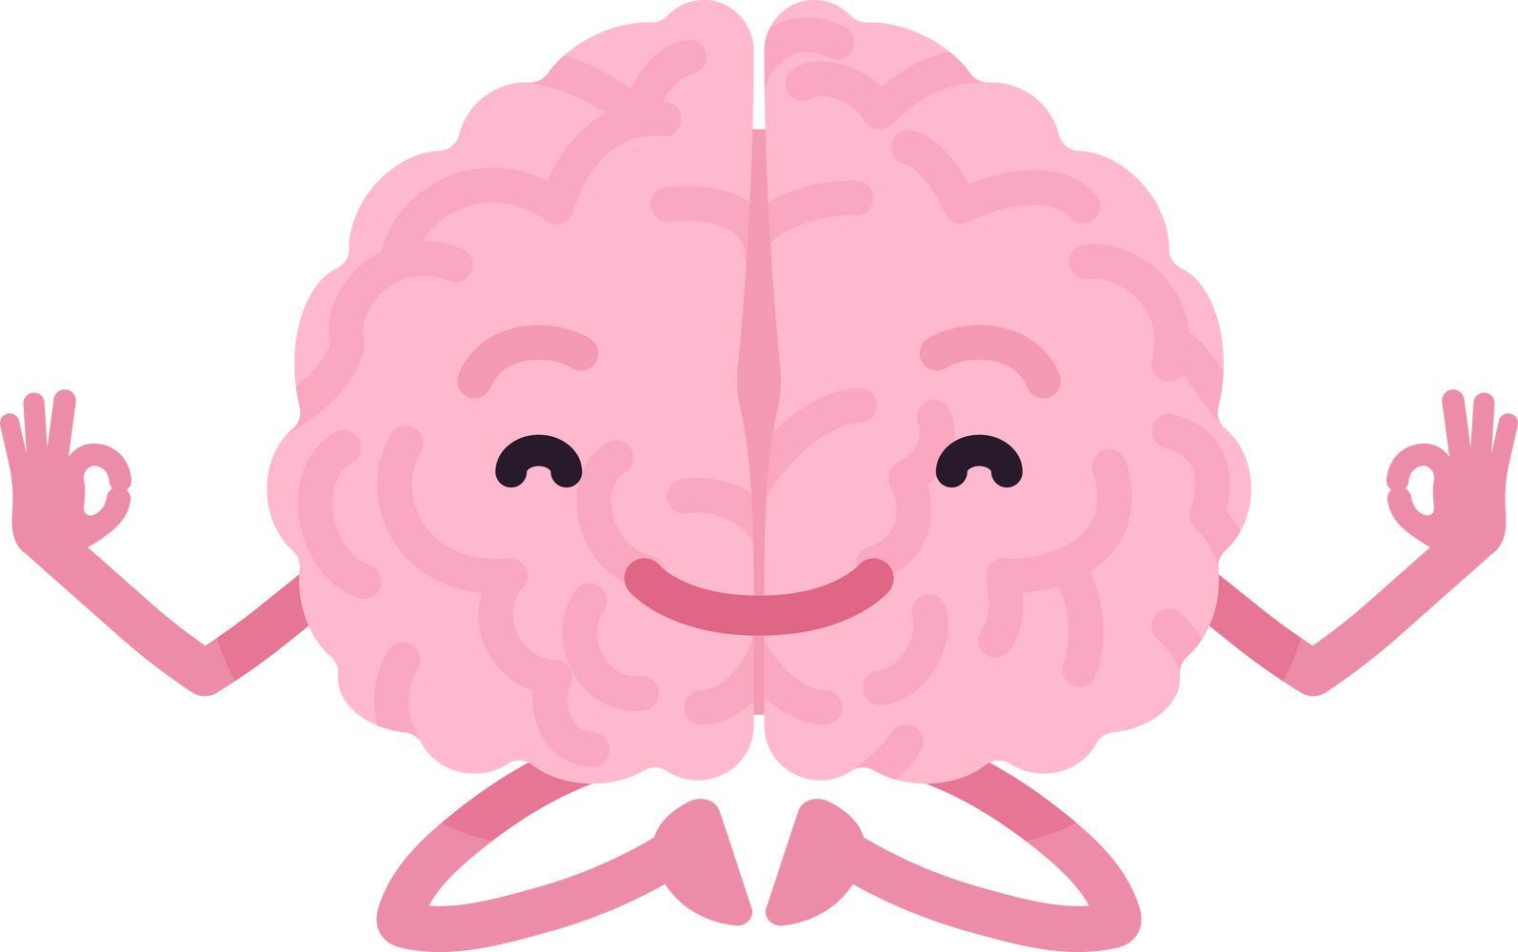
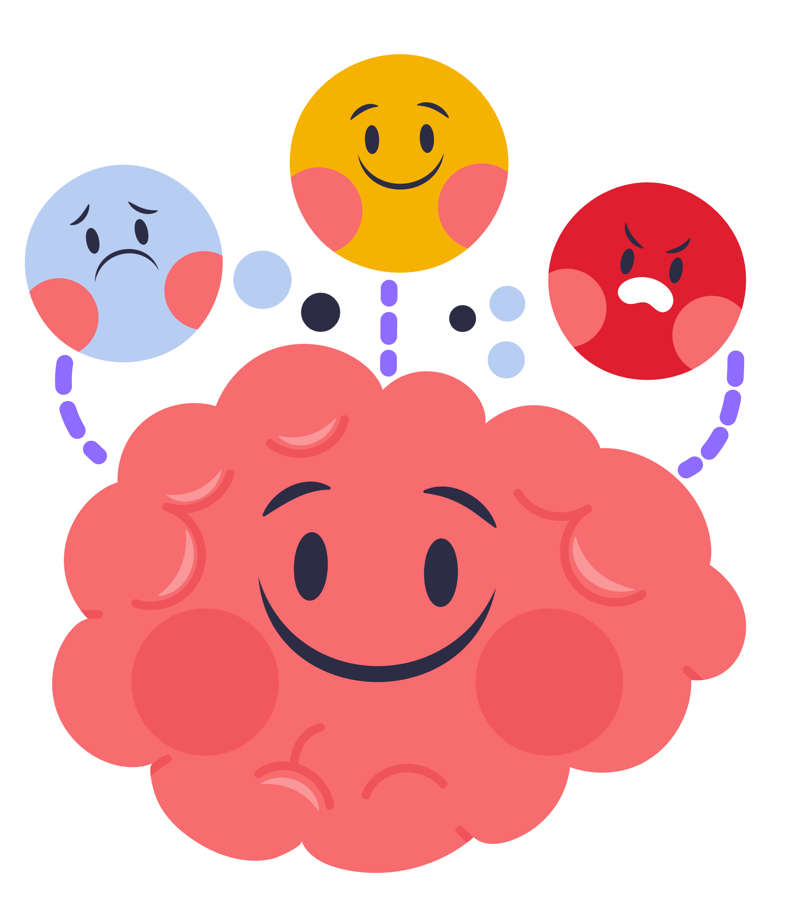

Mental Health Awareness Week
Your Voice Matters

Slide 2
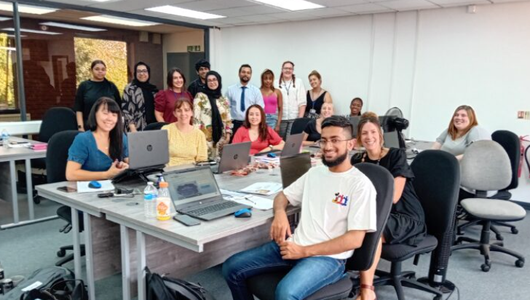




Who Are We?
We are Compass
  We support children with their mental health, such as low mood, anxiety and challenging behaviour
  We will work with your school to see how we can work on positive mental health
  We will work with children & parents to see how we can help with your mental health difficulties

Slide 3


What is Mental Health?

Slide 4

Lets watch a short video...

Slide 5
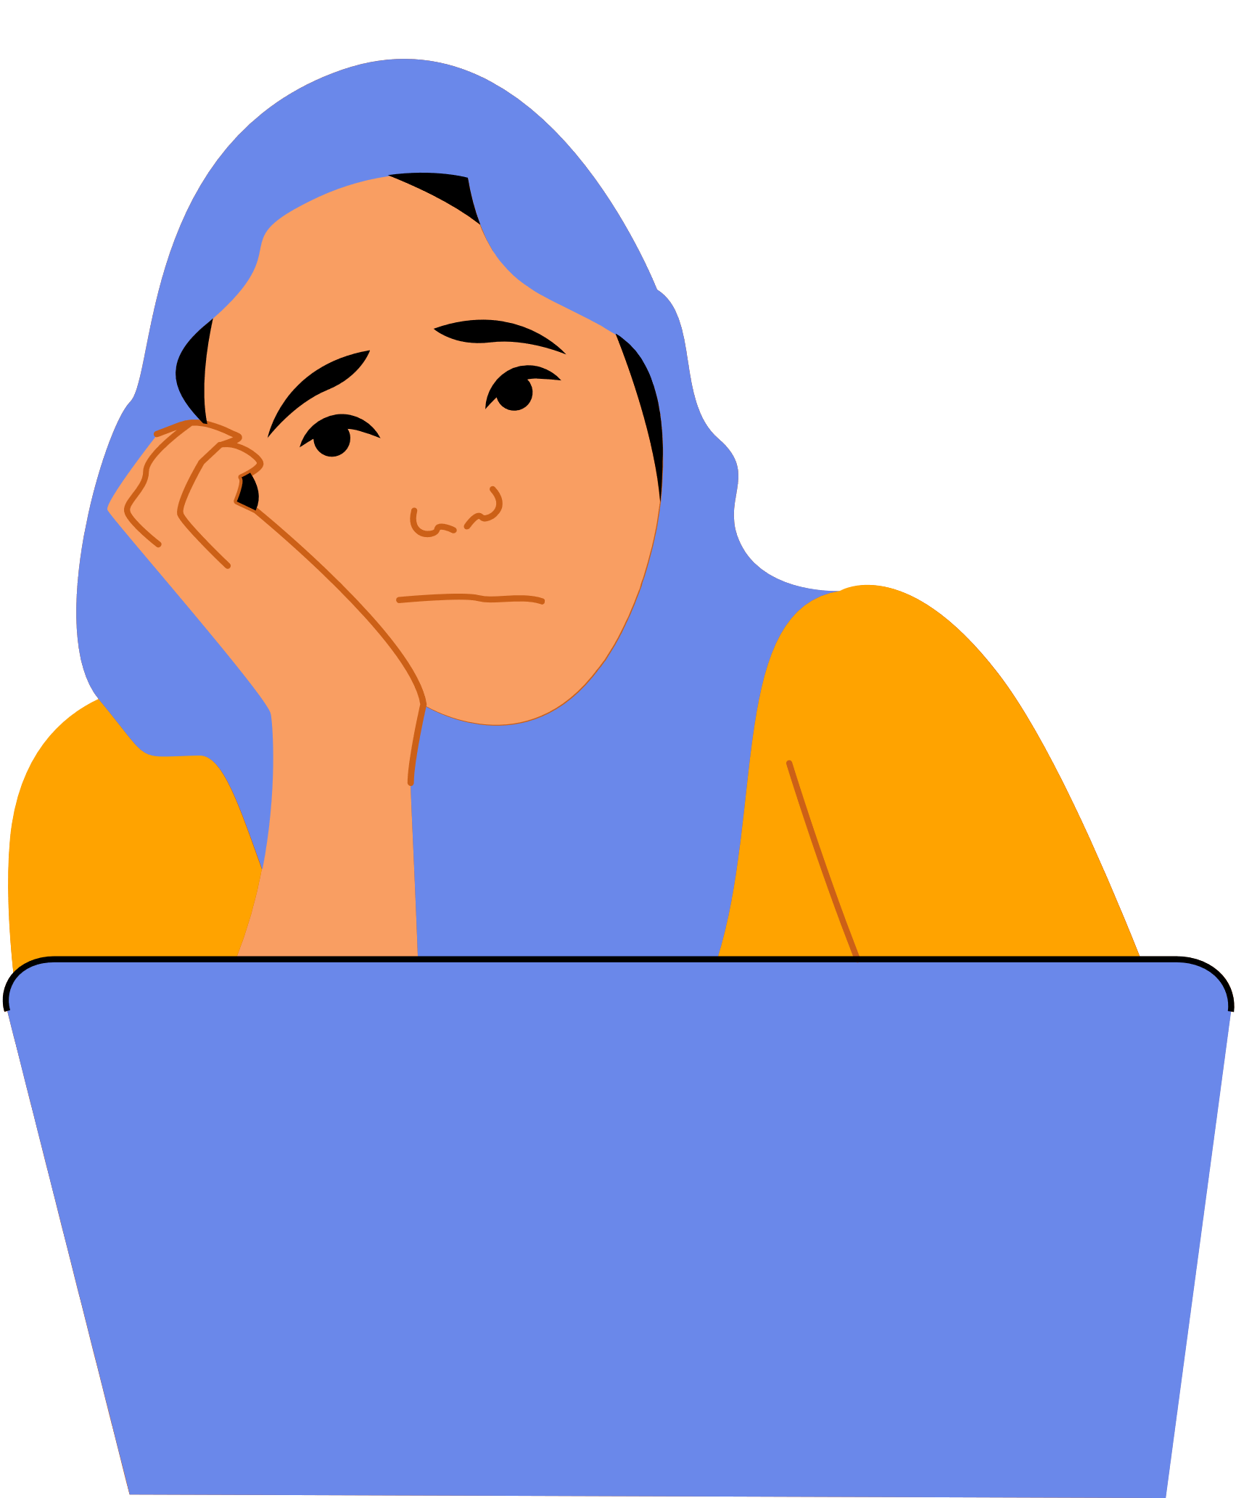

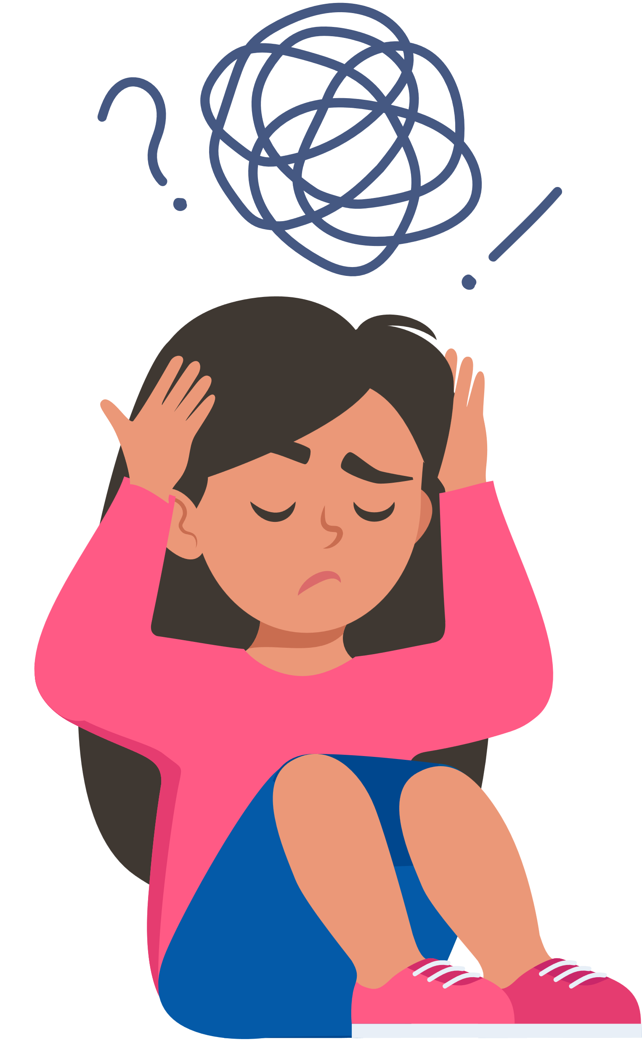
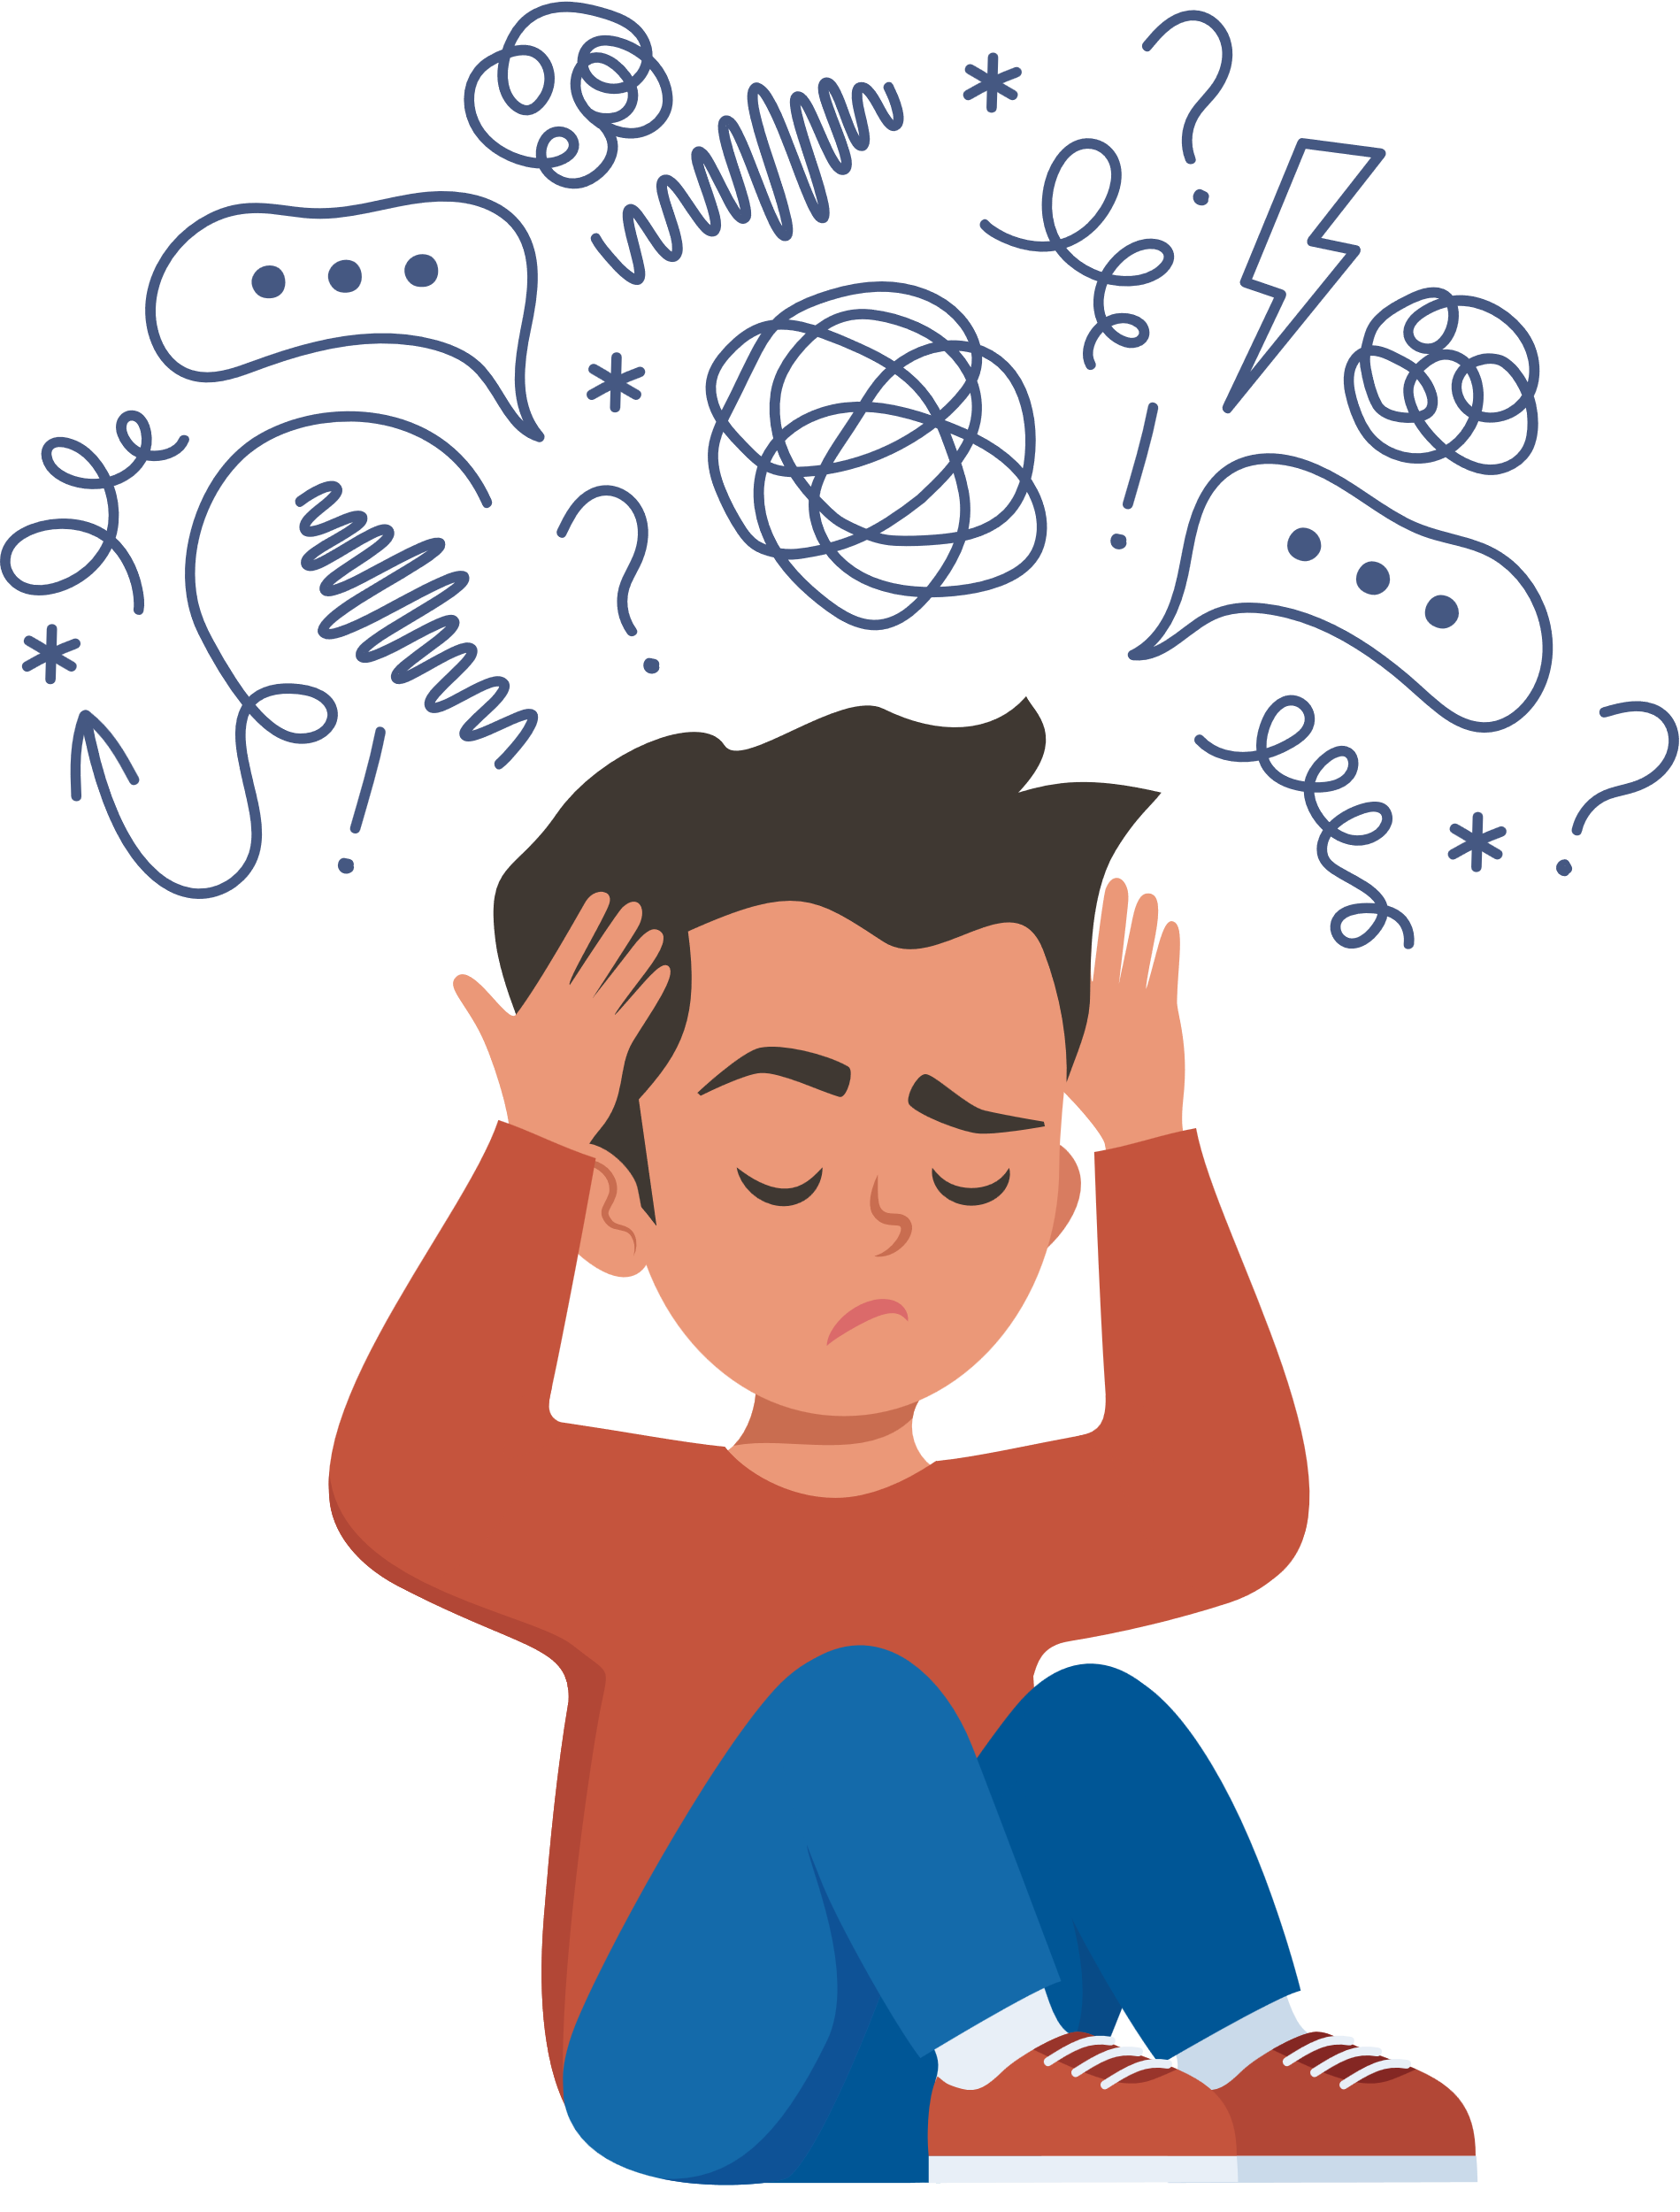
What anxiety Might Look Like
Sweating
Worried
“No one likes me”
Shaking
“What if something bad happens”
Heavy breathing
Stop playing with friends
Scared
Feeling sick
Butterflies
Fast heartbeat
Overwhelmed

Slide 6
What low mood Might Look Like
Crying
Sad
“I can’t be bothered”
Unmotivated
“There’s no point anymore”
Headache
Stop playing with friends
Irritated
Feeling sick
Not sleeping
Angry
Not engaging in activities

Slide 7





Mental Health awareness theme
Your Voice Matters
You have the right to express your views, thoughts and feelings
Make your voice heard!
This can improve your confidence, health and well-being
Say and believe
MY VOICE MATTERS
You have the right for your views to be considered and taken seroiusly
Being empowered and working together can create positive changes for ourselves and others

Slide 8



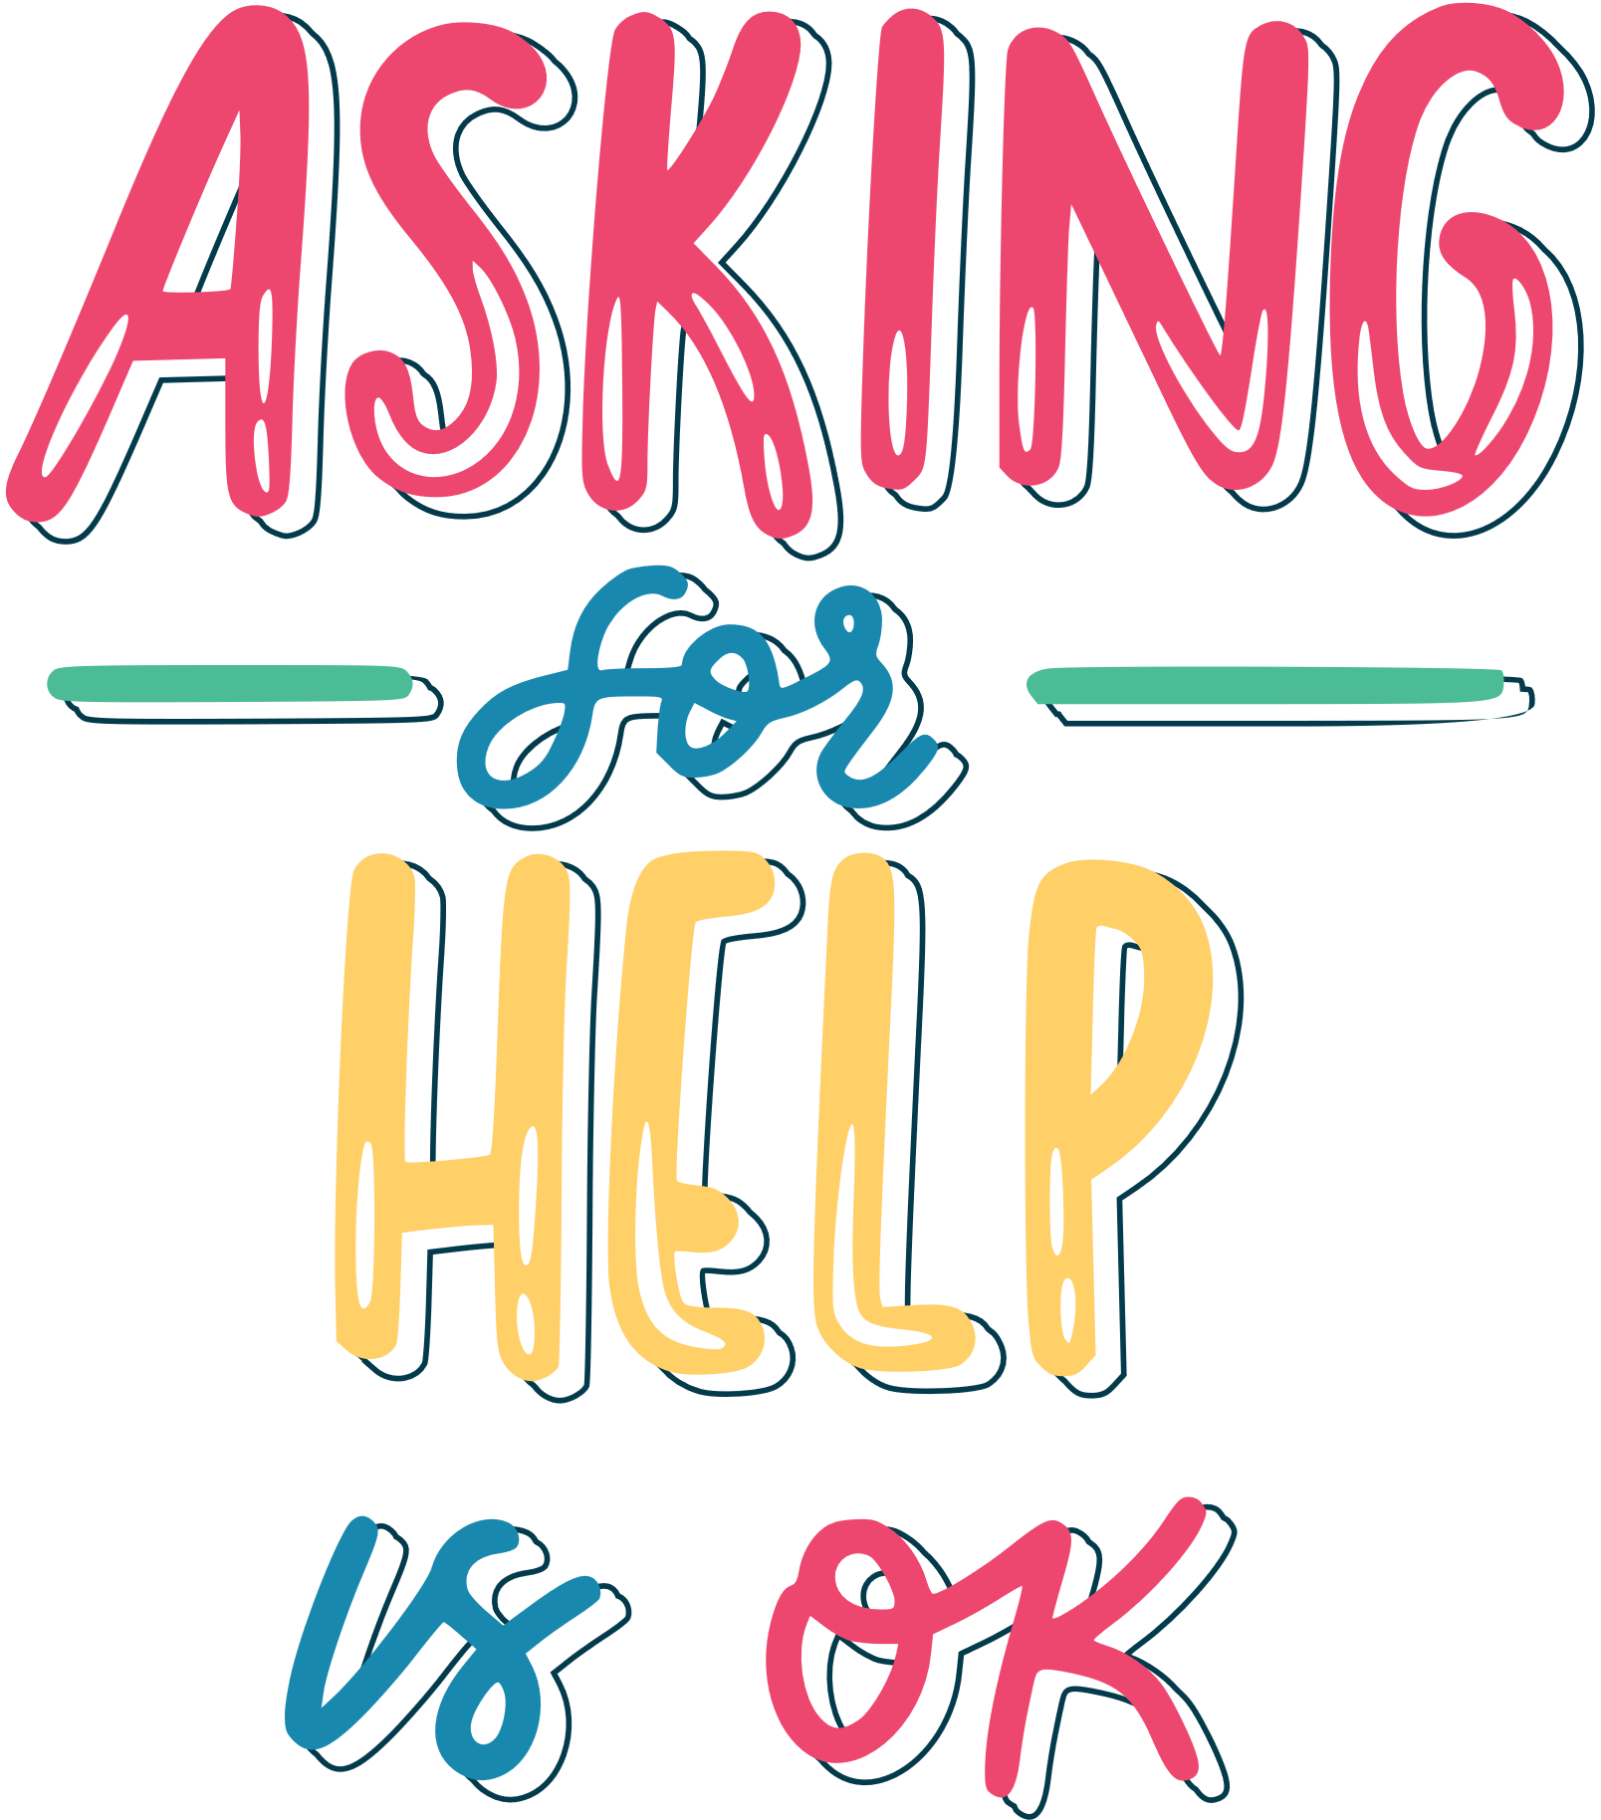
Who Can Help Me?
Talk to a trusted adult
Asking for help with your mental health can be hard, but you are not alone
Parent/carer
School staff member
Family member
It is important to speak to the person/people that you feel most confident to tell how you feel! Whoever you tell can help you access the right support!
Teacher

Slide 9

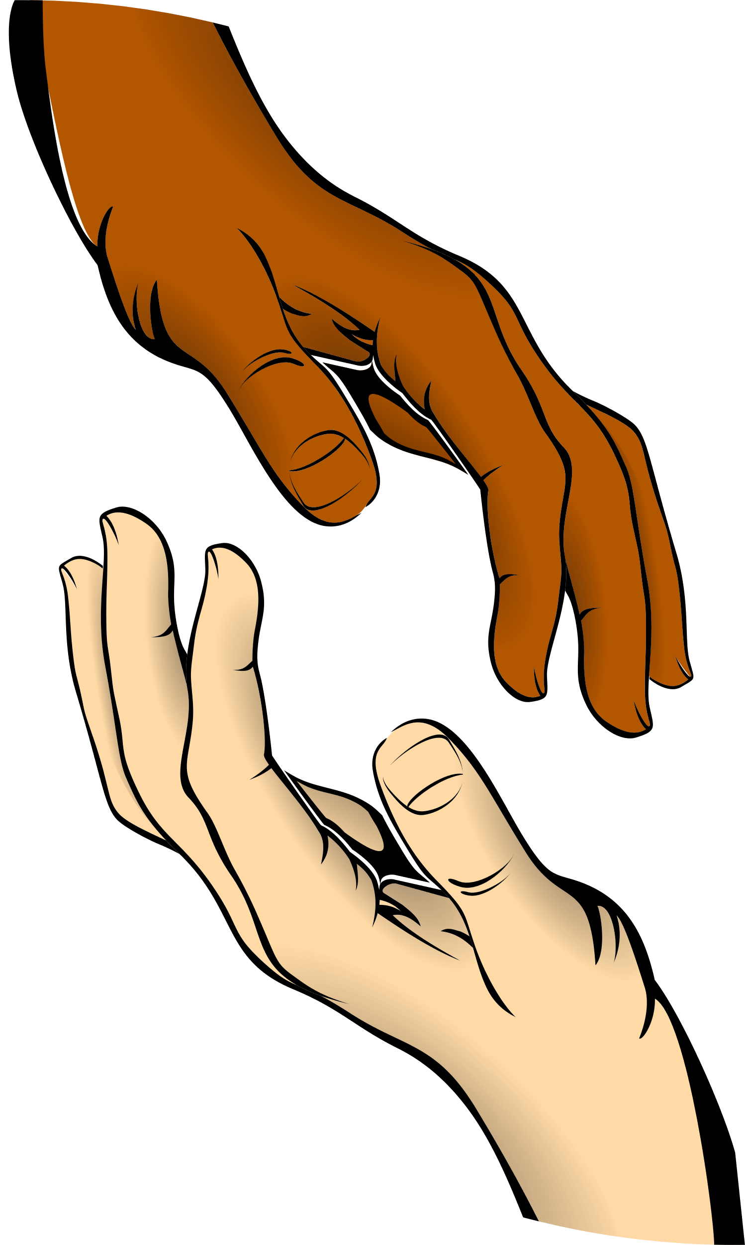



54321 GAME
This game is called a grounding technique. If you ever have difficult feelings and struggle to use your voice to ask for help, this can help you calm so that you can use your voice!
5
Things you can see
4
Things you can touch
3
Things you can hear
2
Things you can smell
1
Thing you can taste

Slide 10


Thank you!

