Slide 1





Welcome to Reception at
Ward End Primary School

Slide 2
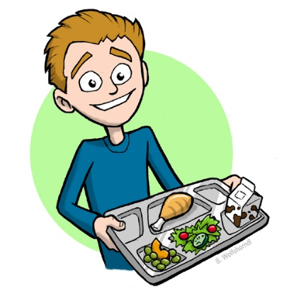
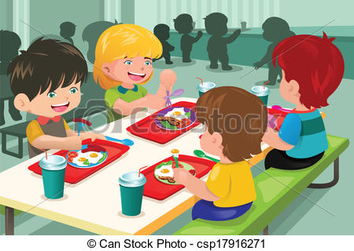

Free School Meals
Every child in Reception to Year 2 is entitled to a free school meal. You will need to fill in a pupil premium form in September.
You can see a copy of our menus showing the range of food your children will be eating on our website.
It is very important, for your child to practise eating independently with cutlery if they don’t already. ☺

Slide 3




Money in School
Snack is 70p a week, payable on a Monday morning for Reception children.
It must be in a labelled envelope with child’s name, class and amount.
It must be handed to the adults in the classroom and not to the front office

Slide 4




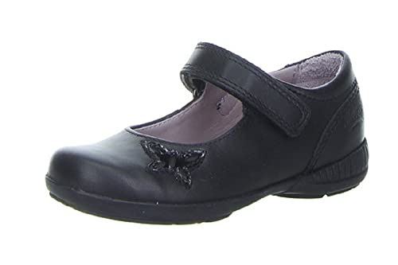
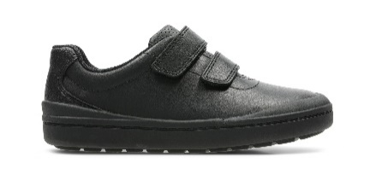
Our Uniform
Our uniform is:
Black or grey jumper/ cardigan/ sweatshirt
Black or grey trousers/ skirt/ pinafore dress or shalwar kamiz
White or yellow polo shirt or
White shirt/ blouse
Yellow and white summer dress.
Please ensure that your child’s name is in all items of clothing.
P.E kit must be kept in school. It can be taken home half termly to be washed.
Stud earrings are allowed, but should be removed for P.E. No other jewellery is allowed.
Shoes – Velcro fastening or slip on only.
NO shoelaces please.
Uniform can be purchased from mapac www.mapac.com/education please see the leaflet in your pack.

Slide 5

Attendance
Please help your child in their first year of school by
Making sure they come into school every day.
Making sure they are on time every day.
We aim for attendance of 95% and above.
Research shows that poor attendance and punctuality has a negative impact on children. Children with good attendance make better progress with their education and are more settled and happy in school.

Slide 6

Attendance
It is very important that your child arrives on time to school, and that they come every day. Each week we have class of the week. The winning class will get a certificate. The results will be on the website and on the classroom door.

Slide 7

Helping Your Child Start School
Information regarding our stay and play sessions are in the packs you will be given today. It is really important that your child attends these sessions, as they can meet their teacher and see their classroom ready for September.
In September we will have 1 week of part time to (morning or afternoon session) to help your child settle in. After the first week they will then be full time (8.30-3.30 Monday-Thursday and 8.30- 12.15 on Friday). All of this information will be given out during the stay and play sessions.

Slide 8

What is the Early Years Foundation Stage?
The Early Years Foundation Stage (E.Y.F.S.) is the stage of education for children from birth to the end of the Reception year.
It is based on the recognition that children learn best through play and active learning.

Slide 9
Your child will be learning skills, acquiring new knowledge and demonstrating their understanding through 7 areas of learning and development.
The 3 prime areas of learning are:
1. Personal, social and emotional development
2. Communication and language
3. Physical development
As children grow, the prime areas will help them to develop skills in 4 specific areas. These are:
1. Literacy;
2. Mathematics;
3. Understanding the world
4. Expressive arts and design

Slide 10




Personal, Social and Emotional Development
The children will be learning to:
become self-confident.
have awareness of their own feelings and feelings of others, including self regulation.
take an interest in things.
become independent.
tell the difference between right and wrong.
work well as part of a team.
understand about their rights as a child as part of our UNICEF work.

Slide 11



Communication and Language
The children will be learning to:
talk confidently and clearly
show awareness of listener
enjoy listening to stories, songs and poems, showing good attention
follow instructions
ask and answer questions

Slide 12



Physical Development
The children will be learning to:
move confidently
control their body
handle equipment
manage their own basic hygiene and personal needs including dressing independently, oral health and using the toilet.
understand healthy practices and how to stay safe

Slide 13

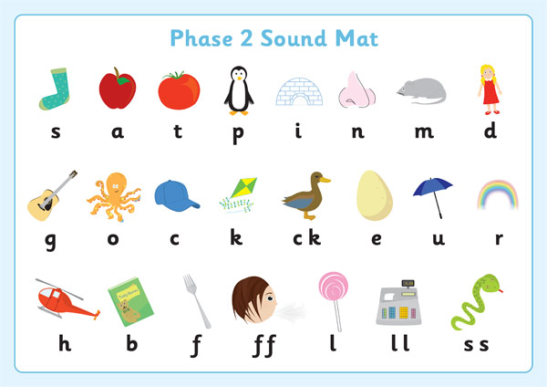
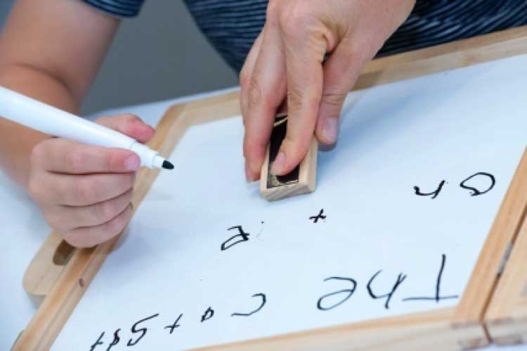
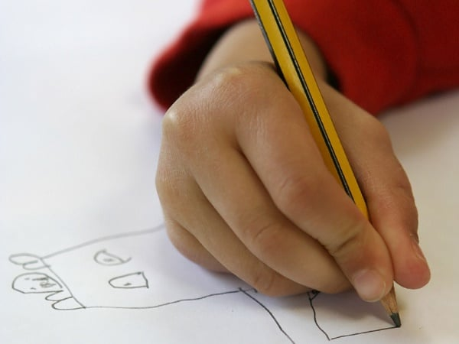
Literacy
The children will be learning to:
hear and say sounds, and link them to the alphabet and recognise digraphs.
read and write familiar words and
sentences
learn to use a pencil effectively
You can help your child practise writing their name at home. It’s important to model writing correctly.
Musa not MUSA

Slide 14


Reading at Home
Children will be given a library book for you to read to your child. These will be given out once a week. They will also have a reading book, once they have started to blend some sounds.
Each child will be given a word wall and a ‘Tricky Word’ wall. It is important to help your child to read these key words regularly.

Slide 15
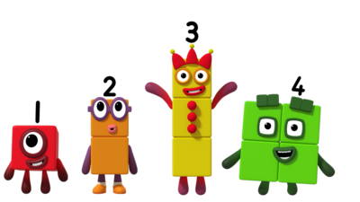
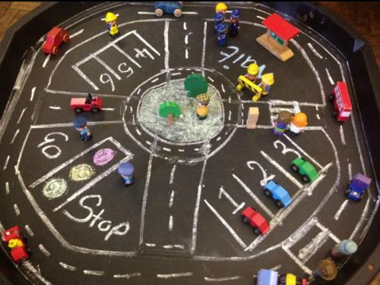
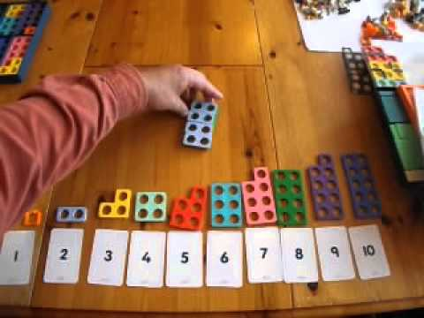
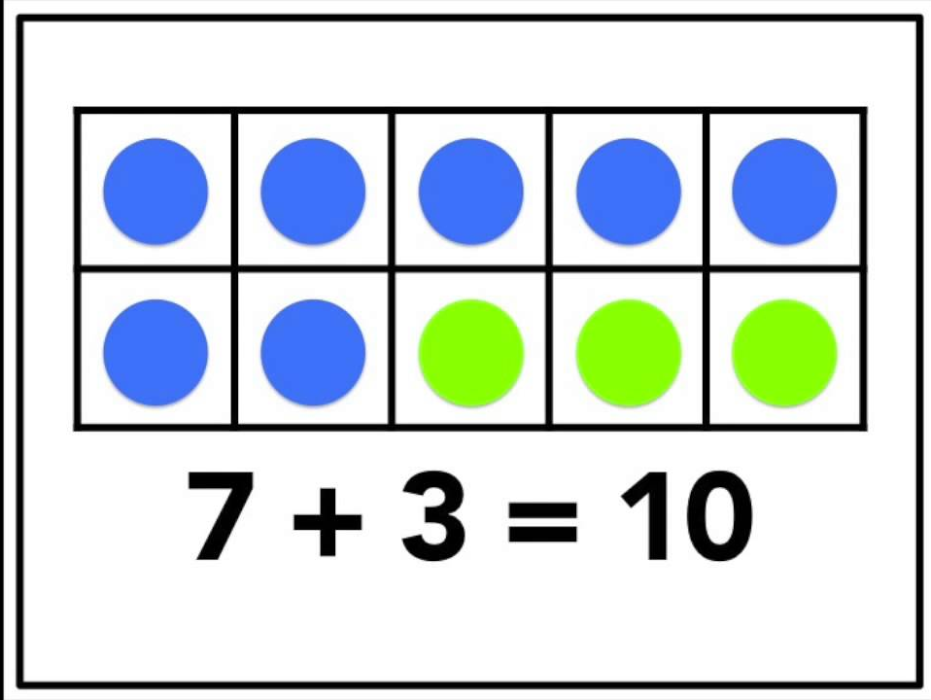
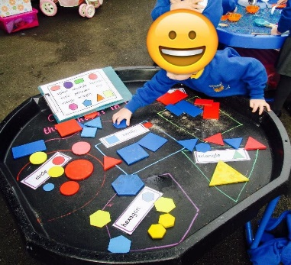

Mathematics
The children will be learning to:
develop an understanding of maths through stories, songs games and imaginative play using a mastery approach.
become confident with
counting and understanding numbers 1-10, including number bonds
be aware of shapes and measures.

Slide 16



Understanding the World
The children will be learning to:
explore and find out about the world around them, asking questions about it.
build with different materials, know about everyday technology and learn what it is used for.
find out about past events in their
lives and their families' lives.
find out about different cultures
and beliefs.

Slide 17
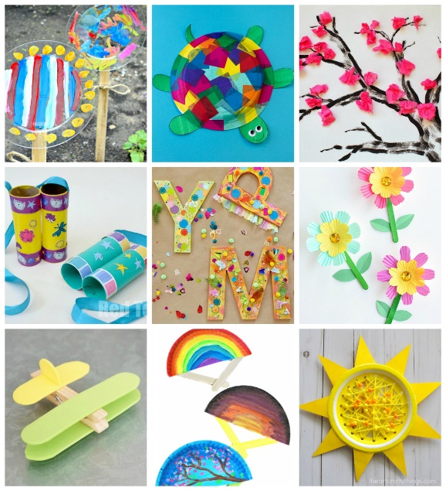
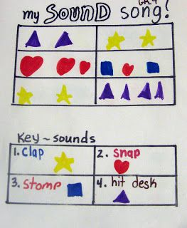

Expressive Arts and Design
The children will explore:
colours and shapes
painting, collaging and constructing
role play
making music and singing songs

Slide 18
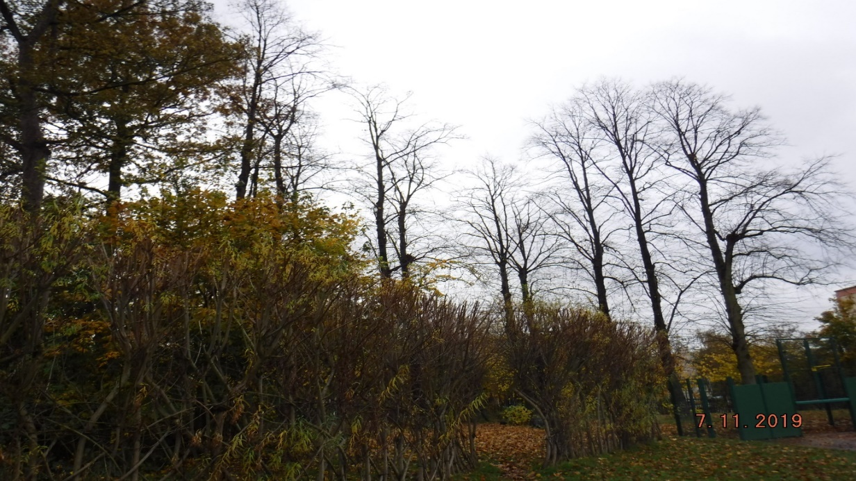
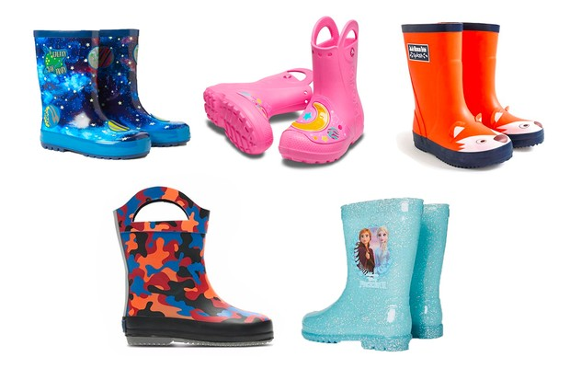
Outdoors
We use the woodland area in the school grounds to do lots of fun activities. Please ensure your child has a pair of wellington boots in school with their name inside them.

Slide 19
Monitoring Progress
Each of the 7 areas of learning has its own set of Early Learning Goals’ which determine what most children are expected to achieve by the end of Reception Class.
We use Development matters to identify the developing knowledge, skills, understanding and attitudes that children will need if they are to achieve the early learning goals by the end of the EYFS. These statements will be updated regularly throughout the year to show your child’s development and areas where they need further support.

Slide 20
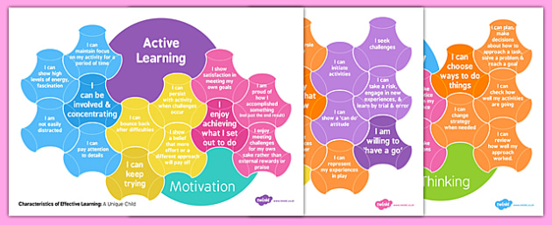
Characteristics of effective learning
We will be looking at how your child plays and learns
How your child engages with other people and their environment (playing, finding out and exploring)
How they focus on certain activities and enjoy challenging themselves (active learning)
How they make links between ideas and how they solve problems. (creating and thinking critically)

Slide 21

Baseline Assessments
When children enter Reception a baseline assessment will be completed within six weeks.
This will be used to indicate the level of progress when a child leaves in school in year 6.

Slide 22

Wellcomm
Wellcomm is a speech, language and understanding screening tool.
All children will be screened as part of our baseline assessment.
Individual targets will be discussed with you.

Slide 23

It is important that parents and staff work together. We want you to feel comfortable about sharing information with us and discussing things that will benefit your child. You can speak to your child’s “key person” regularly.
This is the person who:
Is your main point of contact within the setting.
Helps your child to become settled, happy and safe.
Is responsible for your child’s care, development and learning.
Takes a careful note of your child’s progress, sharing this with you and giving you ideas as to how to help your child at home.
Working Together

Slide 24


Parent Partnerships
Your child will have;
Home reading book and reading record
SCARF compliment sheets
Parent workshops
Holiday homework
Tapestry
Together we will continually praise and encourage your child to try their best.

Slide 25
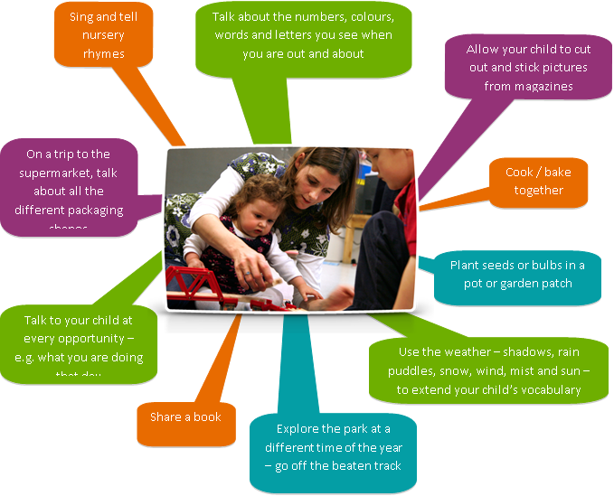
Working Together
All the activities that you do with your child at home are important in supporting their learning and development, and have a really long lasting effect on your child's learning as they progress towards and through school.

Slide 26


School Trips
We normally arrange two educational visits for reception
The first will be in January to the fire station (free of charge).
The second will be in May 2024 to Twycross Zoo. The cost will be around £17.

Slide 27

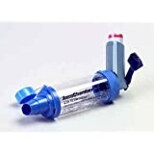
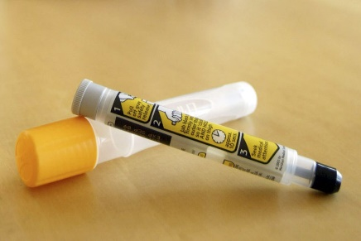

Medication
If your child requires any form of medication this needs to be in school before or on their first day.
This includes;
Asthma blue inhaler and spacer
Epi-pen
Eczema cream

Slide 28
Pupil Information
Finally it would be really helpful if you please let your class teacher know your child’s preferred name and the spelling of it as soon as possible. For example if their birth certificate says;
Mohammed Ayaan and they are known as Ayaan.
Thank you ☺

