Slide 1
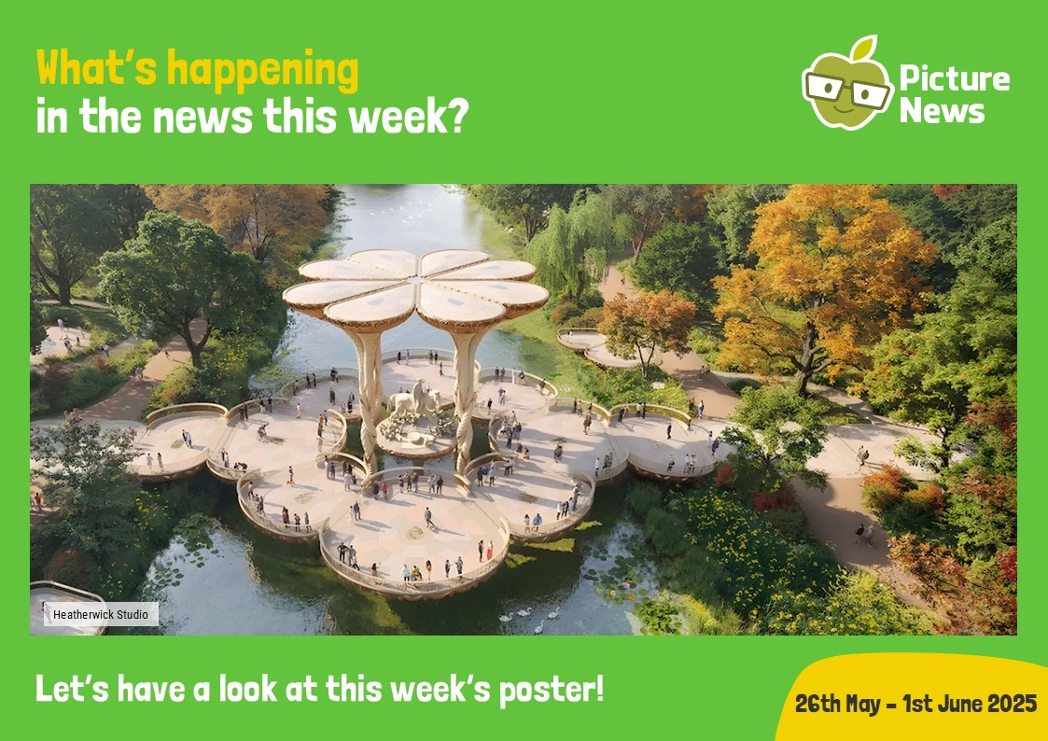


Slide 2


Slide 3


Slide 4

https://www.youtube.com/watch?v=4UOG7jNmIUY

Slide 5
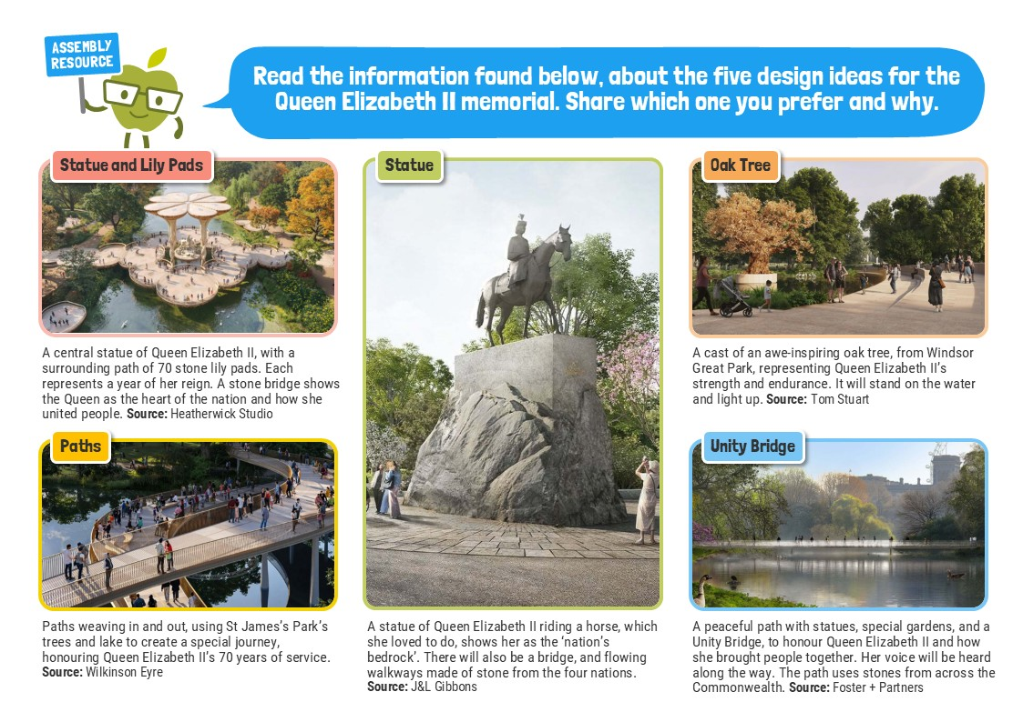

Slide 6
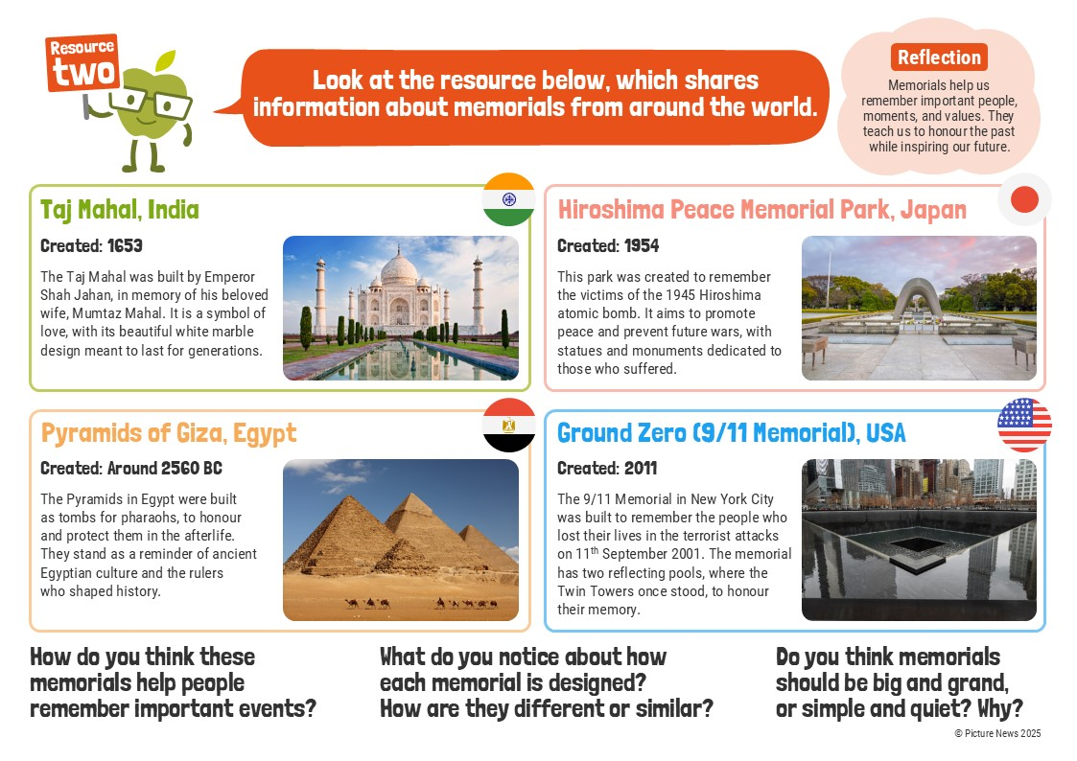

Slide 7


Slide 8


Slide 9


Slide 10


