Slide 1


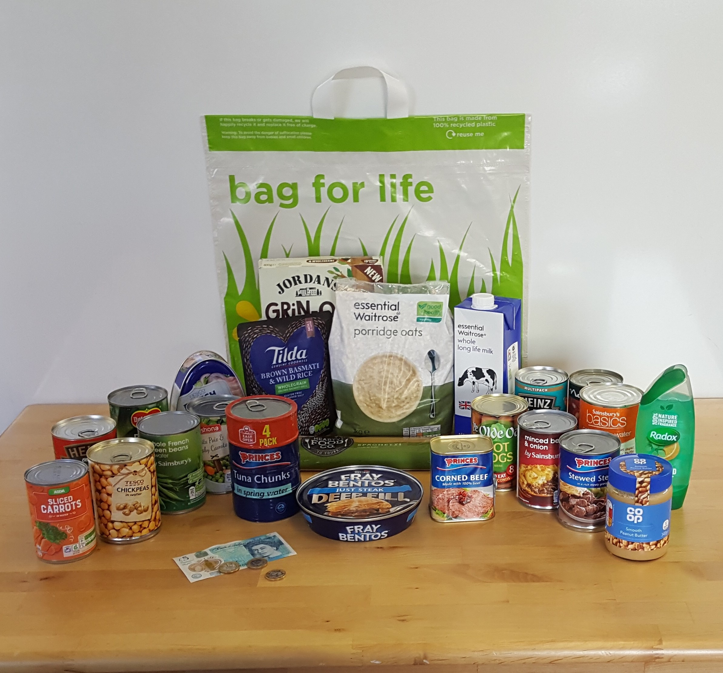
Attendance assembly 20th October 2025

Slide 2

95% and above Attendance weekly Reward.
Gain a star for each week your class achieves 95%+ How did your class do?

Slide 3

15 classes over 95%
One class has 100%
6 stars to have a class celebration!! One more week to go
Do your very best to be in school every day.

Slide 4

Ward End weekly attendance
YEAR | Wb 3rd Sept | Wb 8th Sept | Wb 15th Sept | Wb 22nd Sept | ^{Wb 29th Sept} | ^{Wb 6th Oct} | ^{W b 13th Oct}
6.1 | 87% | 87% | 95% | 92% | 99% | 92% | 99%
6.2 | 90% | 91% | 93% | 97% | 95% | 93% | 96%
6.3 | 92% | 89% | 95% | 93% | 91% | 92% | 93%
6.4 | 91% | 90% | 89% | 92% | 89% | 94% | 92%
5.1 | 93% | 98% | 96% | 90% | 92% | 99% | 97%
5.2 | 98% | 97% | 92% | 89% | 94% | 93% | 90%
5.3 | 91% | 91% | 88% | 93% | 91% | 92% | 98%
5.4 | 86% | 97% | 91% | 92% | 98% | 93% | 96%

Slide 5

Ward End weekly attendance
 | Wb 3rd Sept | Wb 8th Sept | Week 15th Sept | Wb 22nd Sept | ^{Wb 29th Sept} | ^{Wb 6th October} | ^{Wb 13th Oct}
4.1 | 89% | 90% | 88% | 88% | 92% | 91% | 91%
4.2 | 92% | 97% | 96% | 93% | 93% | 97% | 95%
4.3 | 96% | 94% | 90% | 92% | 93% | 89% | 87%
4.4 | 91% | 95% | 89% | 96% | 96% | 98% | 94%
3.1 | 95% | 95% | 94% | 95% | 91% | 94% | 94%
3.2 | 95% | 97% | 96% | 97% | 94% | 89% | 92%
3.3 | 89% | 92% | 95% | 88% | 93% | 94% | 93%
3.4 | 94% | 99% | 97% | 94% | 93% | 98% | 97%

Slide 6

Ward End weekly attendance
YEAR | Wb 3rd Sept | Wb 8th Sept | Wb 15th Sept | Wb 22nd Sept | ^{Wb 29th Sept} | ^{Wb 6th October} | ^{Wb 13th Oct}
2.1 | 87% | 90% | 90% | 93% | 94% | 90% | 85%
2.2 | 88% | 93% | 97% | 94% | 92% | 95% | 94%
2.3 | 97% | 98% | 97% | 95% | 92% | 92% | 92%
2.4 | 90% | 98% | 98% | 95% | 95% | 96% | 91%
1.1 | 94% | 94% | 95% | 94% | 93% | 97% | 100%
1.2 | 96% | 98% | 99% | 98% | 97% | 97% | 95%
1.3 | 96% | 98% | 96% | 96% | 96% | 95% | 89%
1.4 | 96% | 97% | 98% | 91% | 95% | 93% | 96%

Slide 7

Ward End weekly attendance- for next week
YEAR | Wb 8th Sept | Wb 8th Sept | Wb 15th Sept | Wb 22nd Sept | Wb 29th Sept | Wb 6th Oct | Wb 13th Oct
Rabbits |  |  | 98% | 97% | 94% | 95% | 99%
Squirrels |  |  | 97% | 90% | 77% | 93% | 95%
Foxes |  |  | 90% | 91% | 92% | 82% | 83%
Hedgehogs |  |  | 91% | 96% | 90% | 94% | 95%
Owls |  | 99% | 94% | 90% | 88% | 98% | 98%
Doves |  | 93% | 91% | 92% | 82% | 92% | 92%
Swans |  | 96% | 96% | 92% | 96% | 92% | 96%

Slide 8
Story telling-
Diwali
This is our Assembly Theme this week.
Value: Respect, courage.
Use Presentation talk and presenting skills.
Can you tell the Diwali story to a group?
Look at the orange and pink sections on the next slide;
Physical- How you stand and speak
Linguistic- What you say. Vary your voice tone for different parts of the story, make a plan and try it out.
Practise in class presenting your thoughts, to a group od children.

Slide 9

Check presentation skills on this chart.

Slide 10

Happy Diwali to anyone celebrating, we can all wear our cultural clothes all day this Thursday.
School closed on Friday for one week.

Slide 11
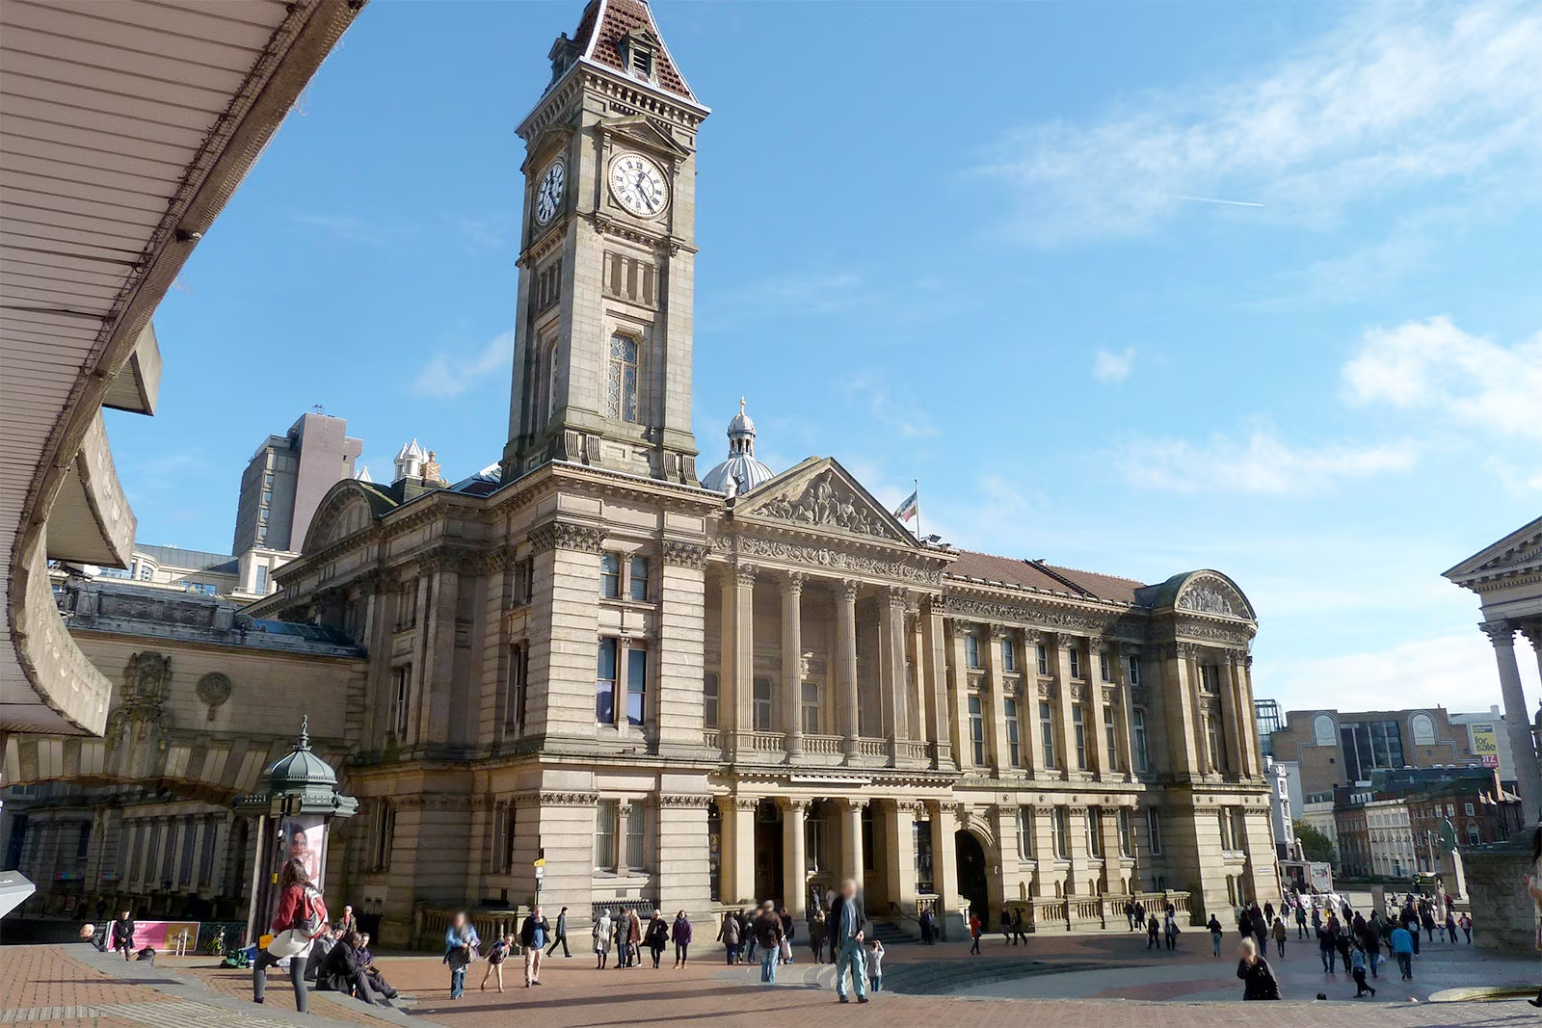
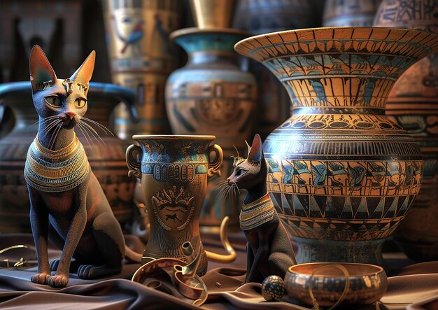

What’s happening at Ward End this week?
Year 3 are visiting the Museum and Art Gallery in Birmingham to study The Egyptians.

Slide 12
This week please bring a harvest donation to school, we will, send it to local food banks.
Only closed packets or tins please.

Slide 13


Slide 14


Slide 15


Slide 16


Slide 17


Get your book ready for half term…
This is what I am reading over half term.

Slide 18
Ward End Welcome’s!
Thank you for wishing staff on the doors a ‘good morning’
Remember, don’t just walk past please- return the greeting please.
Value: Respect
Please WALK SENSIBLY from the top gate, don’t run down the path into school.
Your class teacher will check that all pupils have all the correct uniform daily- this is part of being a World Class School, with high standards. Important black shoes ( no trainers) and
fitted headscarves please.

Slide 19

More 6 books in 6 week winners…
Last week we showed the Key stage two winners.
Here are the Key stage one pupils who read 6 books across the summer- well done!
1.4 -Shahroz
2.1- Sophie
2.2- Zoya
2.3-Khadijah
2.4 –Hoorain

Slide 20

Happy Half term
See you all On Monday 3rd November.

