Slide 1
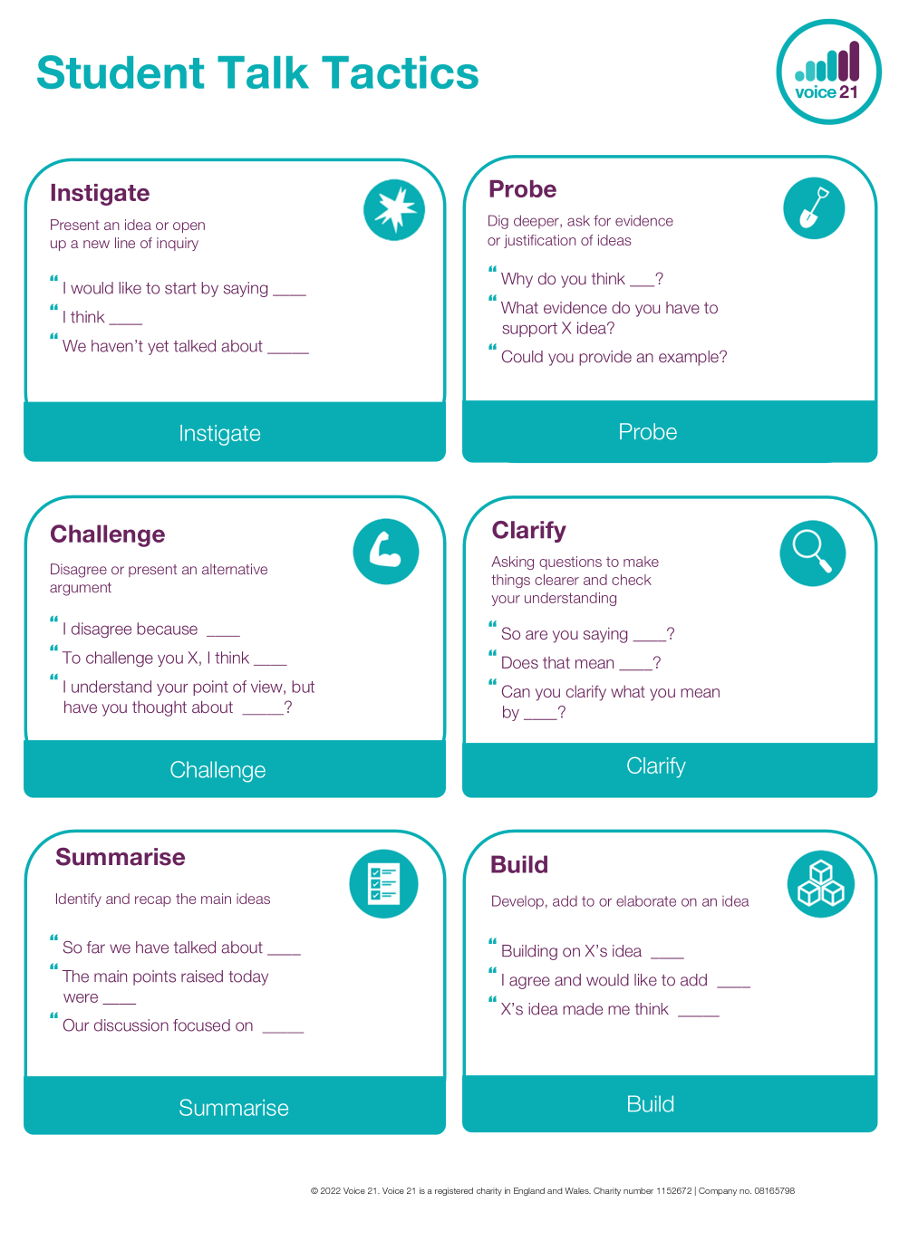

Attendance assembly 3rd November 2025

Slide 2

95% and above Attendance weekly Reward.
Gain a star for each week your class achieves 95%+ How did your class do?

Slide 3

11 classes over 95%
6 stars to have a class celebration!
One class has over 95% EVERY week this term.
One other class has over 95% for 7/8 weeks
WELL DONE.

Slide 4
There are individual, attendance prizes this Tuesday (tomorrow)
- for children who have over 95% this term.

Slide 5

Ward End weekly attendance- Autumn 1
YEAR | Wb 3rd Sept | Wb 8th Sept | Wb 15th Sept | Wb 22nd Sept | ^{Wb 29th Sept} | ^{Wb 6th Oct} | ^{W b 13th Oct} | ^{Wb 20th Oct}
6.1 | 87% | 87% | 95% | 92% | 99% | 92% | 99% | 98%
6.2 | 90% | 91% | 93% | 97% | 95% | 93% | 96% | 97%
6.3 | 92% | 89% | 95% | 93% | 91% | 92% | 93% | 93%
6.4 | 91% | 90% | 89% | 92% | 89% | 94% | 92% | 94%
5.1 | 93% | 98% | 96% | 90% | 92% | 99% | 97% | 90%
5.2 | 98% | 97% | 92% | 89% | 94% | 93% | 90% | 87%
5.3 | 91% | 91% | 88% | 93% | 91% | 92% | 98% | 93%
5.4 | 86% | 97% | 91% | 92% | 98% | 93% | 96% | 97%

Slide 6

Ward End weekly attendance Autumn 1
 | Wb 3rd Sept | Wb 8th Sept | Week 15th Sept | Wb 22nd Sept | ^{Wb 29th Sept} | ^{Wb 6th October} | ^{Wb 13th Oct} | ^{Wb 20th Oct}
4.1 | 89% | 90% | 88% | 88% | 92% | 91% | 91% | 89%
4.2 | 92% | 97% | 96% | 93% | 93% | 97% | 95% | 94%
4.3 | 96% | 94% | 90% | 92% | 93% | 89% | 87% | 83%
4.4 | 91% | 95% | 89% | 96% | 96% | 98% | 94% | 96%
3.1 | 95% | 95% | 94% | 95% | 91% | 94% | 94% | 95%
3.2 | 95% | 97% | 96% | 97% | 94% | 89% | 92% | 90%
3.3 | 89% | 92% | 95% | 88% | 93% | 94% | 93% | 81%
3.4 | 94% | 99% | 97% | 94% | 93% | 98% | 97% | 95%

Slide 7

Ward End weekly attendance Autumn 1
YEAR | Wb 3rd Sept | Wb 8th Sept | Wb 15th Sept | Wb 22nd Sept | ^{Wb 29th Sept} | ^{Wb 6th October} | ^{Wb 13th Oct}
2.1 | 87% | 90% | 90% | 93% | 94% | 90% | 85% | 70%
2.2 | 88% | 93% | 97% | 94% | 92% | 95% | 94% | 94%
2.3 | 97% | 98% | 97% | 95% | 92% | 92% | 92% | 90%
2.4 | 90% | 98% | 98% | 95% | 95% | 96% | 91% | 90%
1.1 | 94% | 94% | 95% | 94% | 93% | 97% | 100% | 90%
1.2 | 96% | 98% | 99% | 98% | 97% | 97% | 95% | 96%
1.3 | 96% | 98% | 96% | 96% | 96% | 95% | 89% | 97%
1.4 | 96% | 97% | 98% | 91% | 95% | 93% | 96% | 86%

Slide 8

Ward End weekly attendance Autumn 1
YEAR | Wb 8th Sept | Wb 8th Sept | Wb 15th Sept | Wb 22nd Sept | Wb 29th Sept | Wb 6th Oct | Wb 13th Oct | Wb 20th Oct
Rabbits |  |  | 98% | 97% | 94% | 95% | 99% | 98%
Squirrels |  |  | 97% | 90% | 77% | 93% | 95% | 88%
Foxes |  |  | 90% | 91% | 92% | 82% | 83% | 93%
Hedgehogs |  |  | 91% | 96% | 90% | 94% | 95% | 77%
Owls |  | 99% | 94% | 90% | 88% | 98% | 98% | 97%
Doves |  | 93% | 91% | 92% | 82% | 92% | 92% | 85%
Swans |  | 96% | 96% | 92% | 96% | 92% | 96% | 95%

Slide 9
Firework safety and darker nights safety.
This is our Assembly Theme this week.
Value: Courage, resilience.
Use Explain & debate types of talk.
Prepare in advance- note how we can…
Stay safe on darker nights
Stay safe around fireworks.
Look at the GREEN sections on the next slide;
Working with others- debate listening and responding.
Warm- up activity – If I ruled the world, children would…………..
on Firework nights
I couldn’t disagree more, If I ruled the world on darker- nights we would………

Slide 10

Check presentation skills on this chart.

Slide 11
Parents afternoon this week
Join your teacher and tell your parents how we use our types of talk and Oracy framework to develop better speech.
Practise what you are going to say before your appointment
Try it out on a friend- how does it sound.
What are your next targets?

Slide 13


Slide 14


This is what I have been reading over half term.
Explain to a friend what you enjoyed reading and why it was great?

Slide 15
Ward End Welcome’s!
Thank you for wishing staff on the doors a ‘good morning’
Remember, don’t just walk past please- return the greeting please.
Value: Respect
Please WALK SENSIBLY from the top gate, don’t run down the path into school.
Your class teacher will check that all pupils have all the correct uniform daily- this is part of being a World Class School, with high standards. Important black shoes ( no trainers) and
fitted headscarves please.

