Slide 1
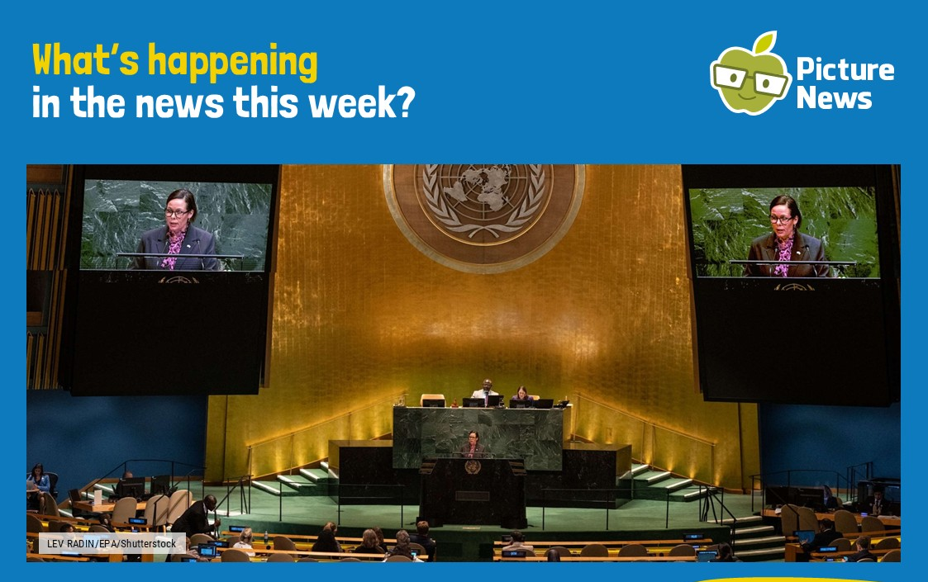


Slide 2
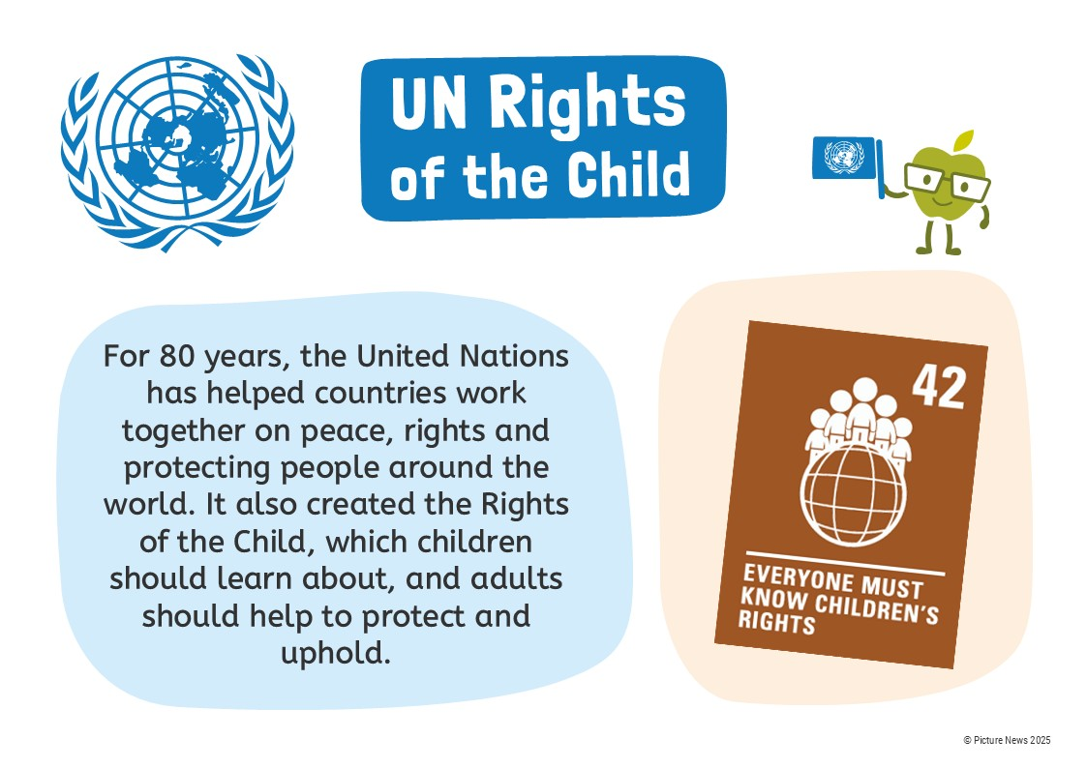

Slide 3


Slide 4
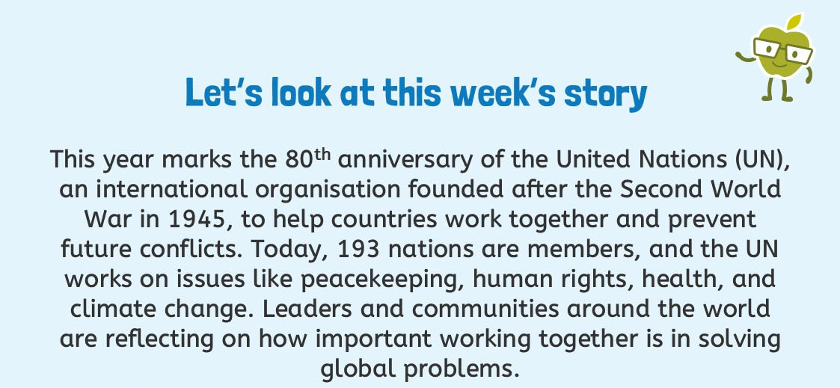
What is the United Nations? | United Nations

Slide 5
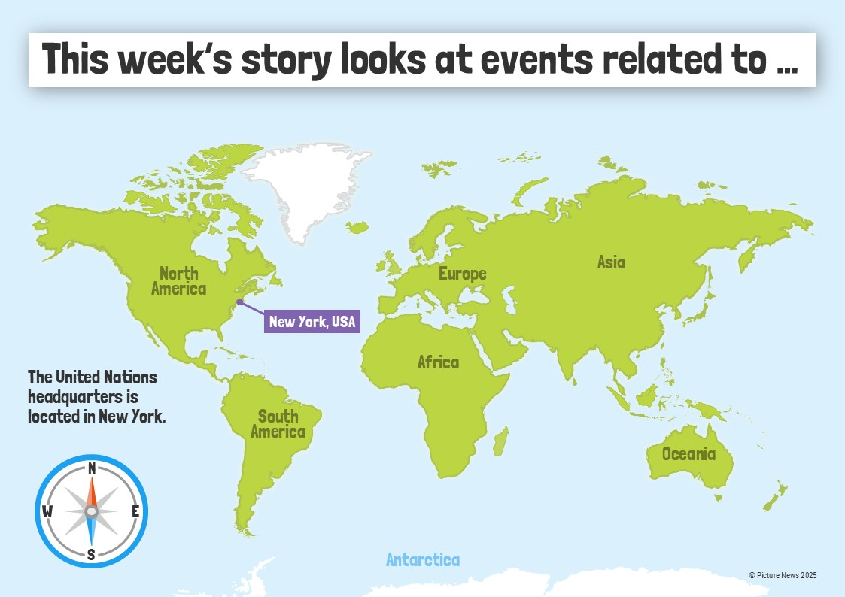

Slide 6
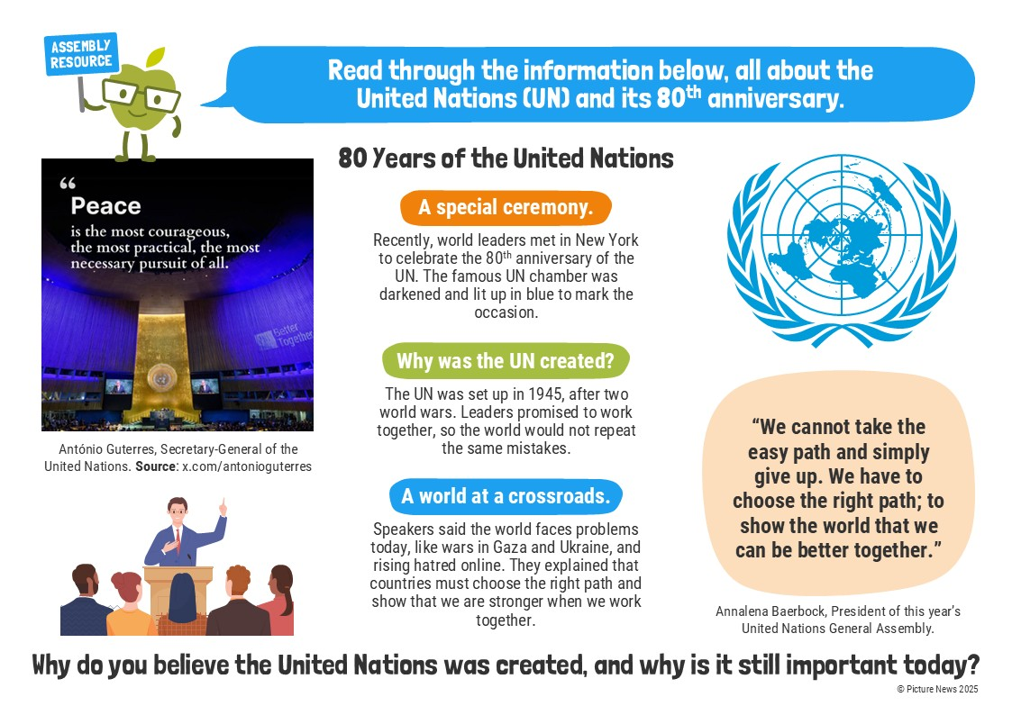

Slide 7
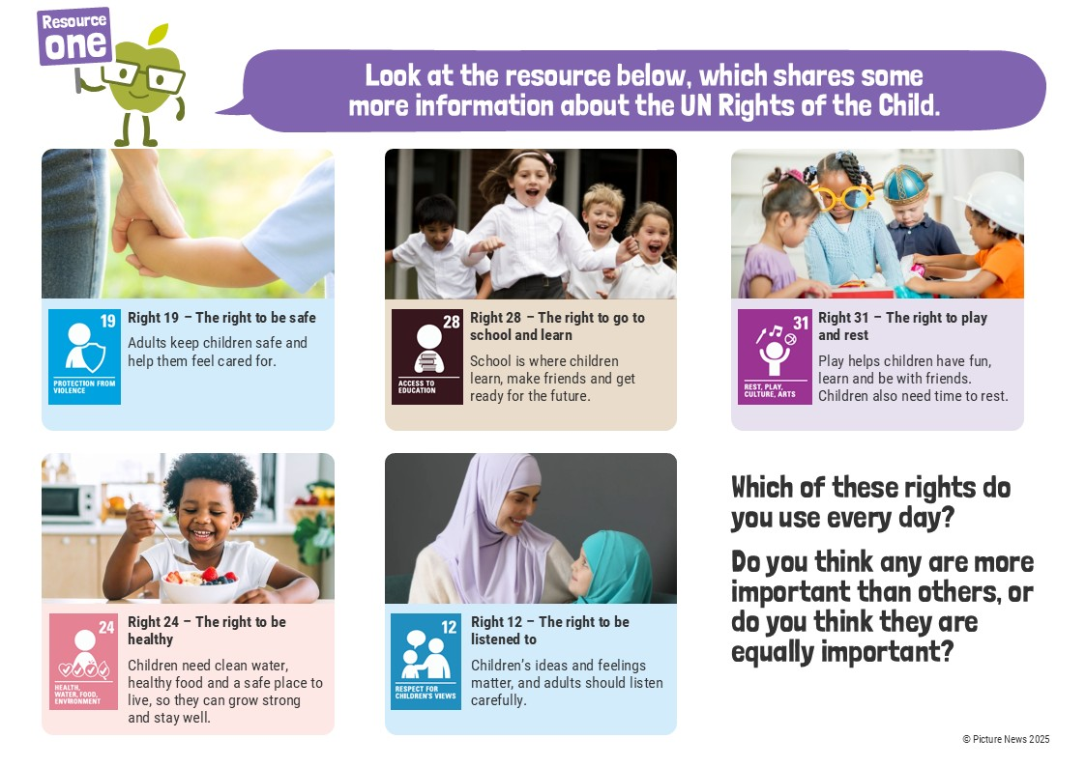

Slide 8
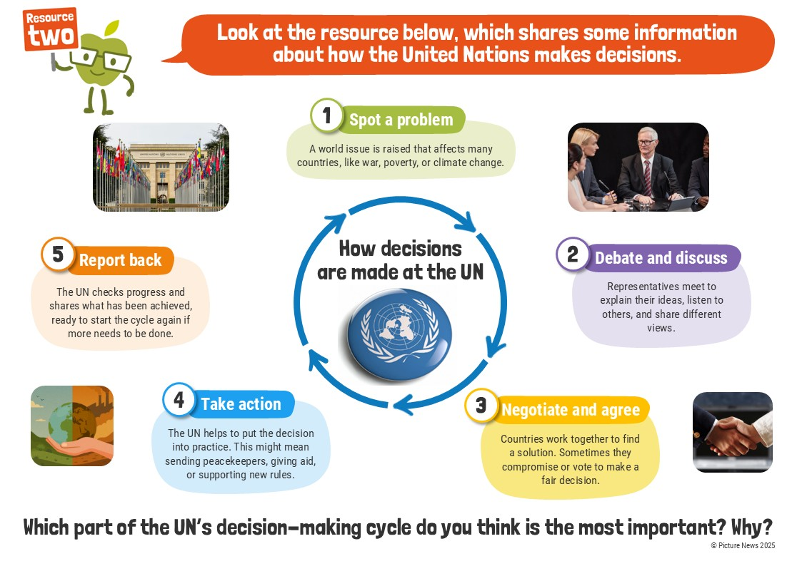

Slide 9
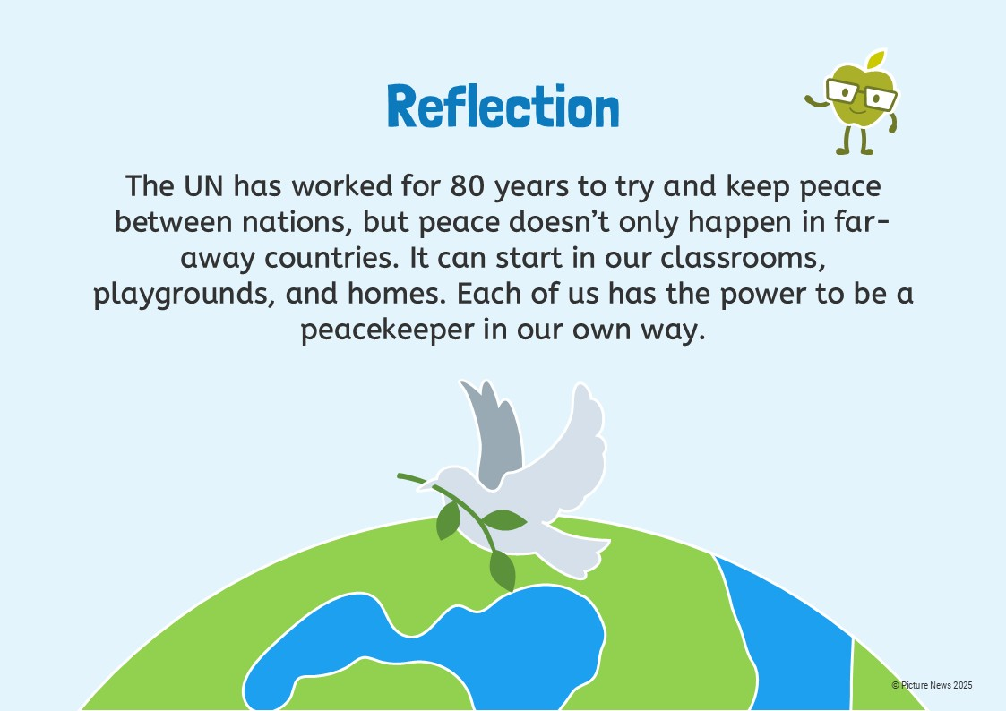

Slide 10

Wk beg. 24.11.25 Article 42-everyone must know children’s rights

Slide 11
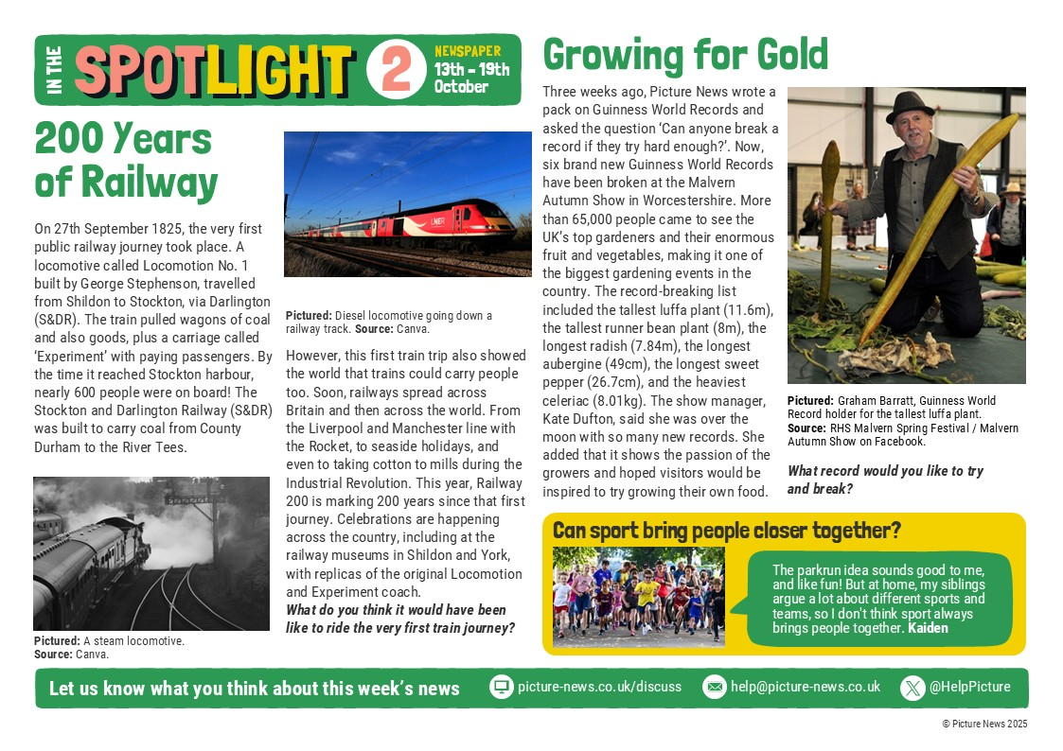
Wk beg. 24.11.25 Article 42-everyone must know children’s rights

