Slide 1

Language, Learning and Strategic Support Team (LLSS)

Slide 2
Language, Learning and Strategic Support Team (LLSS)
Previously Pupil and School Support (PSS)

Slide 3

Brainteasers are a type of memory game that can be used to improve brain function and problem-solving skills.

Slide 4





Slide 5




Slide 6


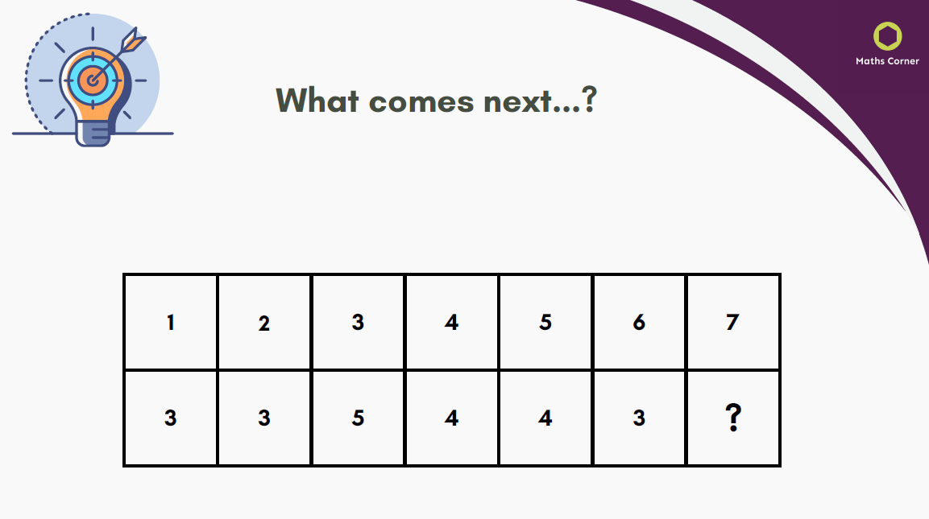


Slide 7





Slide 8
Why?
Increase focus –train your brain to concentrate which is key for remembering details effectively.
Strengthen logic – many teasers involve reasoning and deduction.
Keep your brain active.

Slide 9
Language, Learning and Strategic Support Team (LLSS)
Annie Pitt

Slide 10
Language, Learning and Strategic Support Team (LLSS)
One of the advisory teams in Birmingham that supports children with SEND needs.
LLSS specialises in supporting children with cognition, learning and language difficulties.

Slide 11
Language, Learning and Strategic Support Team (LLSS)
All previous SENCOs and most past SLT members.
Develop the knowledge of SENCOs in schools, ensuring they can:
  Lead whole school improvement
  Help school staff to support pupils with SEN
  Promote inclusive practice
  Set aspirational targets
  Raise attainment
  Support identification of need and evidence-informed interventions.

Slide 12
Language, Learning and Strategic Support Team (LLSS)

Slide 13
Language, Learning and Strategic Support Team (LLSS)
We support children with language needs.
Language is how children understand the world around them, communicate with others, and express their thoughts.
Language is the foundation of learning so if a child struggles to understand or use language, it can affect academic learning, social skills and behaviour.

Slide 14

To help us to explore this theme further…

Slide 15

Say It Without Saying It- Taboo
🧩 How to Play:
Split into small groups .
One person is the describer, everyone else is a guesser.
The describer picks a card with a target word and must get the group to guess it without using the “taboo” words listed.
Set a timer (1 minute per round).
Rotate role.

Slide 16
Say It Without Saying It- Taboo
💬
How did it feel trying to describe without key words?
What strategies helped?
How might this relate to a child with language needs in class?

Slide 17
Say It Without Saying It- Taboo
Experience what it's like for a child with language needs in the classroom.
This might have helped you to understand how it can affect learning and behaviour.

Slide 18
Language Difficulties
Understanding Lessons: Children may find it harder to follow instructions or understand new words and ideas, which can make learning more difficult.
Expressing Themselves: They might struggle to explain what they know or ask for help, which can affect their confidence and progress.
Making Friends: Language is key to social interaction. Difficulties can lead to frustration or feeling left out.
Feeling Confident: When children can’t communicate easily, they may feel anxious or lose interest in school.

Slide 19
Language Difficulties
Around 1.9 million children in the UK are behind in talking or understanding words- that’s 1 in 5 school-aged children.
Speech, language and communication needs (SLCN) are the most common special educational need in schools.
Over 80% of children with mental health difficulties also have speech or language challenges.

Slide 20
Language Difficulties
When we do support children with language development they can thrive both academically and socially.
Are you concerned about your child’s communication or language needs?

Slide 21
Language, Learning and Strategic Support Team (LLSS)

Slide 22
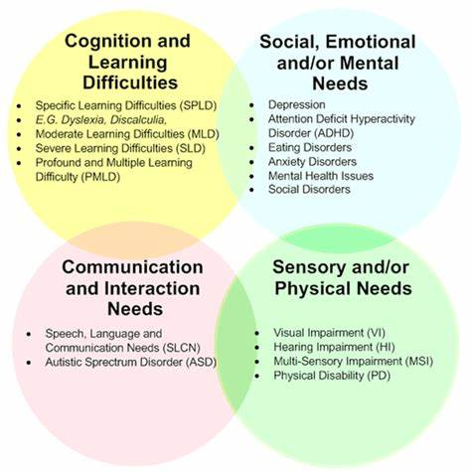
Another group of children LLSS support is those with Cognition and Learning (C&L) needs.
C&L is 1 of the 4 broad areas of need identified in the SEN Code of Practice.
Cognition and learning difficulties generally means that attainment levels are low in one or more area.

Slide 23
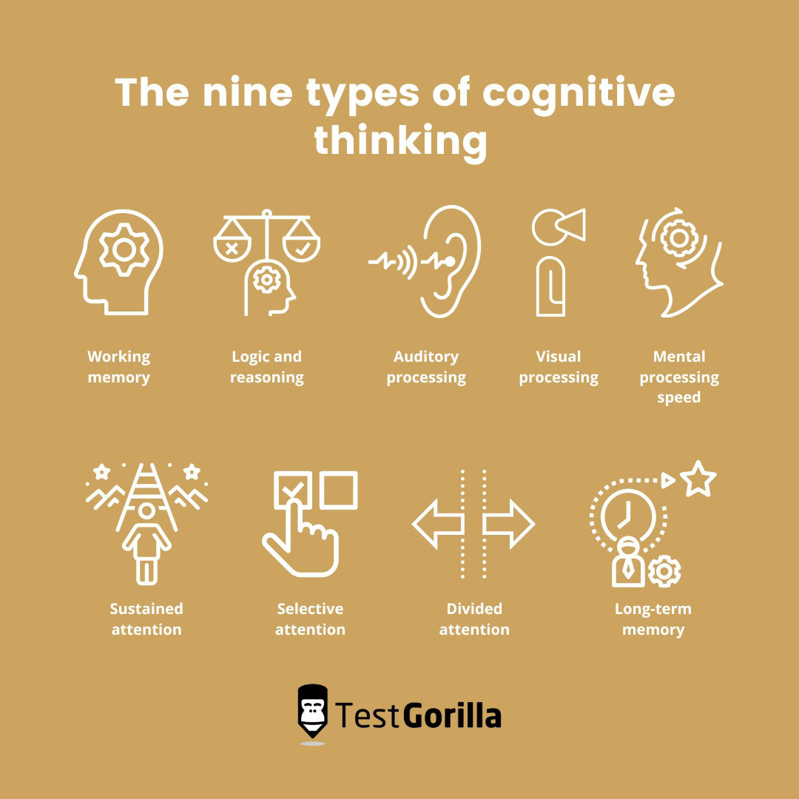
Cognitive skills refer to the mental processes that allow us to acquire knowledge, manipulate information, reason and solve problems.
They encompass a range of abilities, including memory, attention, perception and critical thinking.
These skills are fundamental for learning and interacting with the world around us.

Slide 24
Cognition and learning difficulties in the curriculum include:
Literacy: reading, writing and spelling
Numeracy
Processing difficulties such as sequencing, inference, coherence and elaboration
Working memory
Short term verbal memory
Executive function difficulties

Slide 25
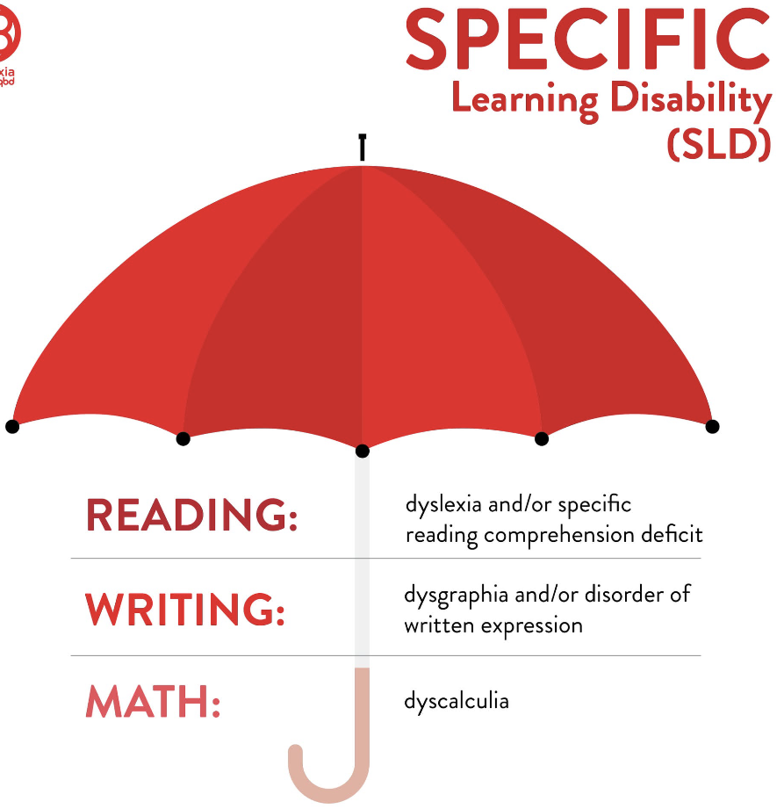
LLSS support children with Specific- Learning Difficulties (SpLDs) such as dyslexia, dyscalculia and dysgraphia.
These difficulties are ‘severe’ and ‘persistent’.
They do not improve over time.

Slide 26
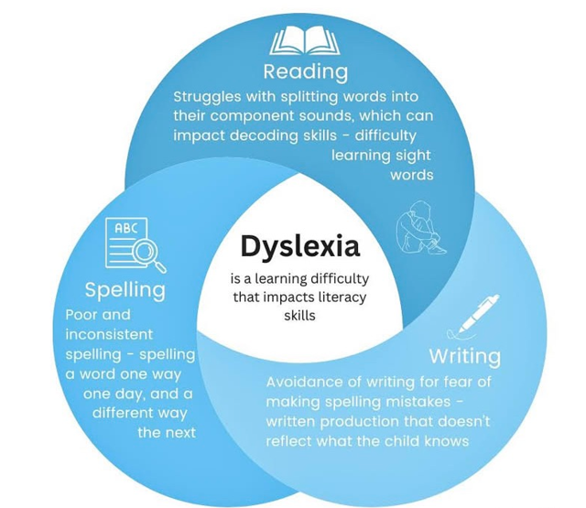
Dyslexia
Dyslexia is a specific learning difficulty that affects the way that someone processes letters, so reading is very slow, hesitant and very hard work.
Dyslexia affects how the brain processes written and spoken language.

Slide 27
Dyslexia
It can make reading, spelling and writing more difficult, even when intelligence is average or above average.
It also affects organisational skills and memory.

Slide 28
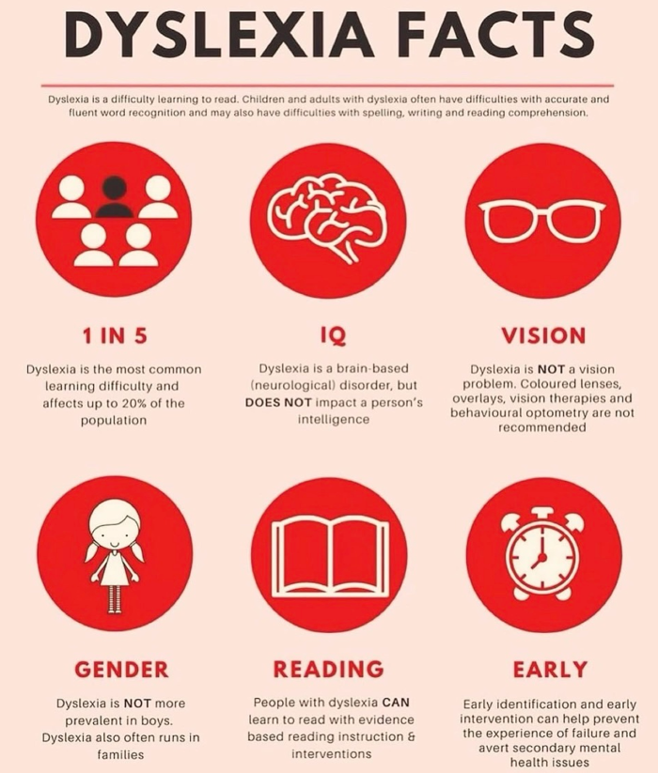
Around 20% of people have dyslexia — about 3 children in every classroom.
Up to 80% of children with dyslexia may leave school undiagnosed.
Without support, children may lose confidence or fall behind — but with early help, they can achieve great success.

Slide 29

What is neurodiversity?
Neurodivergent refers to individuals whose brain functions in ways that differ from what is considered ‘typical’ or ‘neurotypical’ by society.
What is neurodiversity? #autism #adhd #neurodiversity #neurodivergent #mentalhealth #psychology

Slide 30
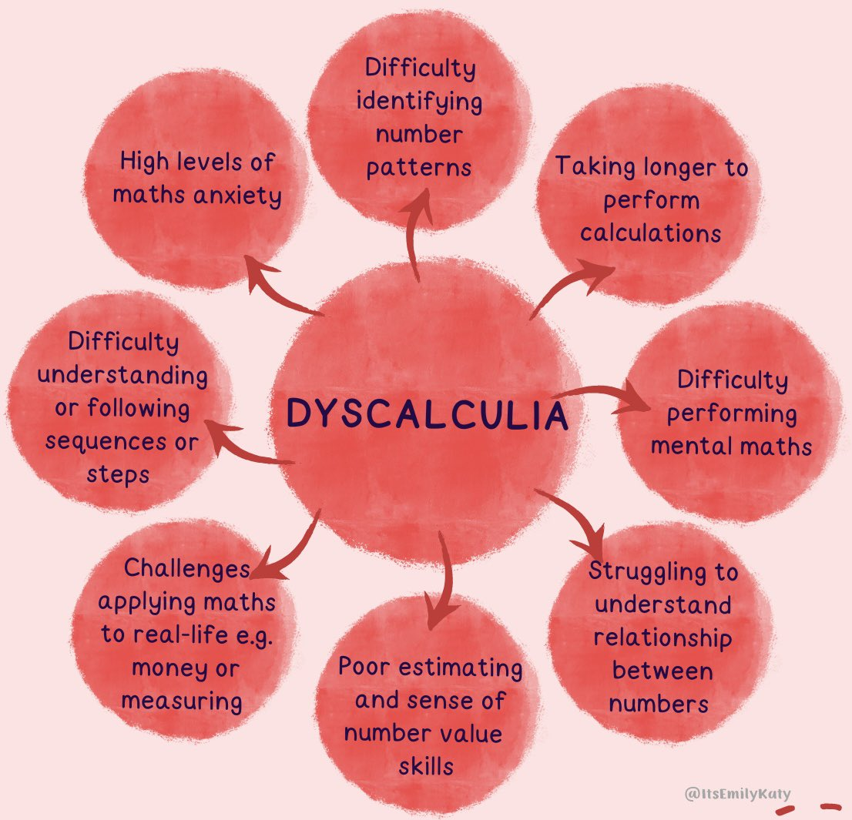
Dyscalculia
Dyscalculia is a term used to describe persistent difficulty in understanding numbers which leads to a range of problems with mathematics.

Slide 31

Flavour of Assessments
1:1 basis
Quiet learning area
Consent and background information must have been completed

Slide 32

Chinn
4 assessments

Slide 33
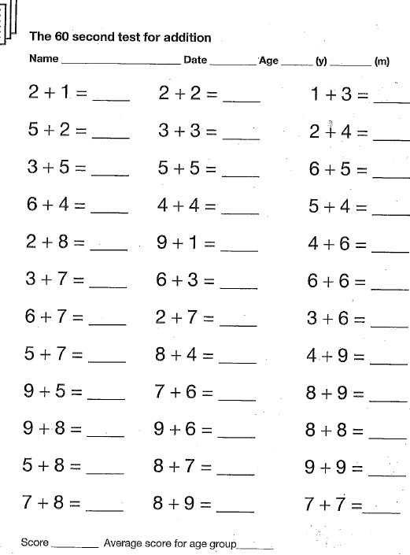

Slide 34
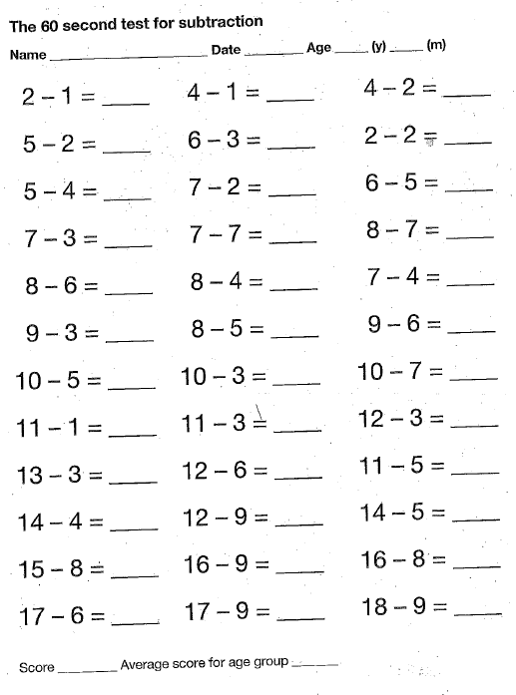

Slide 35
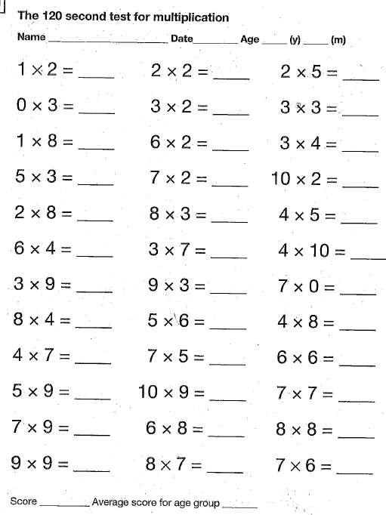

Slide 36
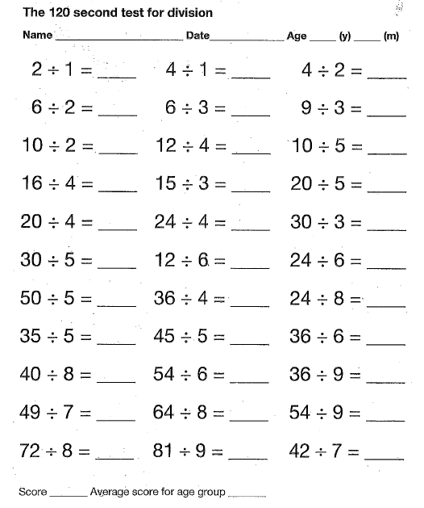

Slide 37
How did you feel?
Assessment results…

Slide 38

Memory Magic
3 assessments

Slide 39
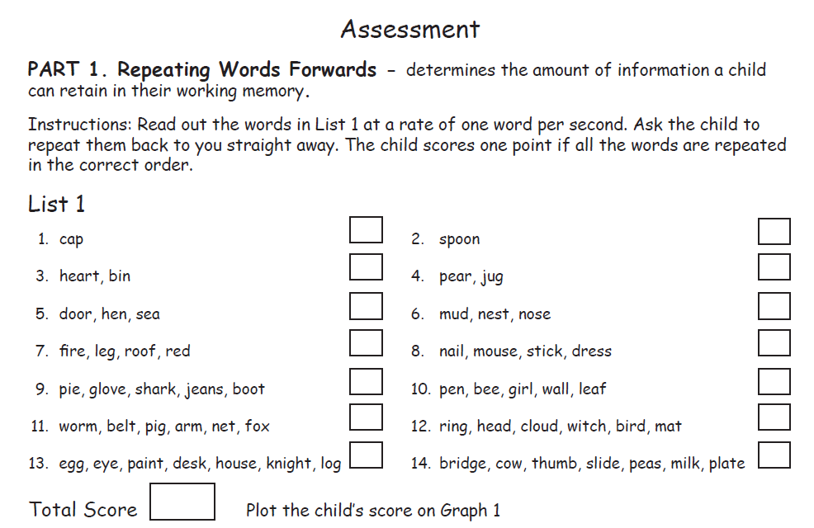

Slide 41
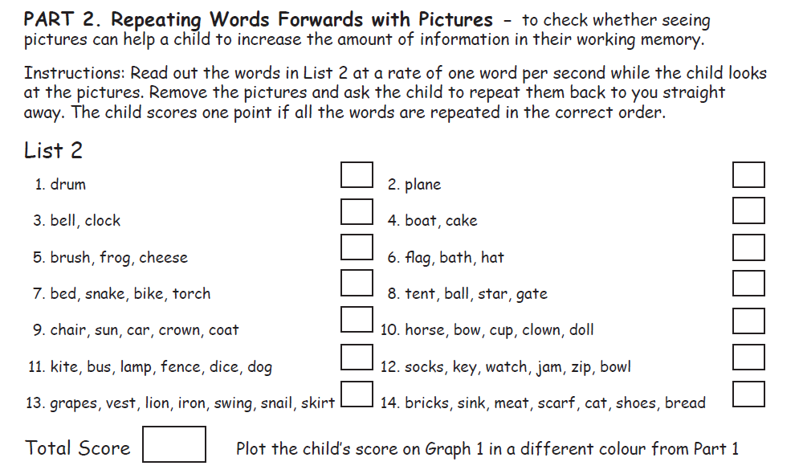

Slide 42


Slide 44


Slide 46


Slide 48


Slide 50


Slide 52
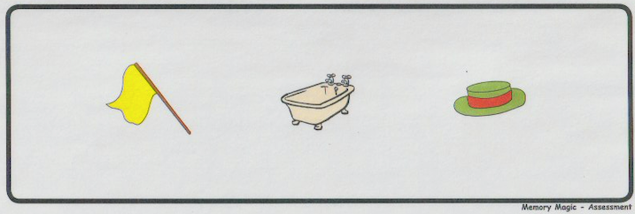

Slide 54
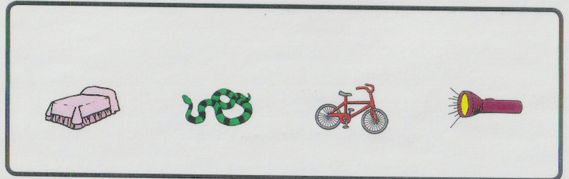

Slide 56
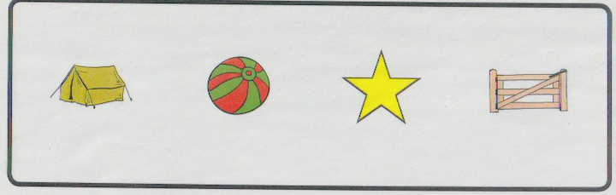

Slide 58
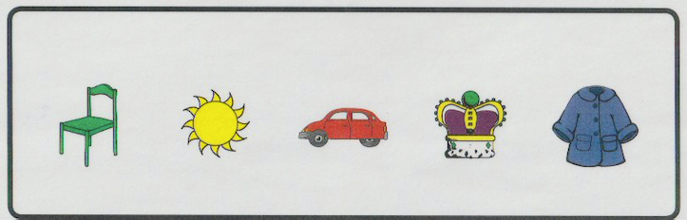

Slide 60
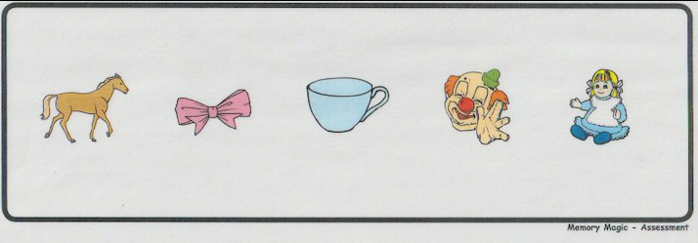

Slide 62
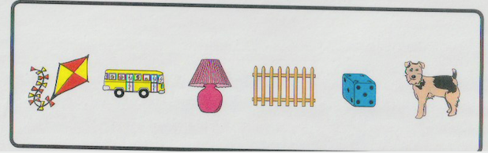

Slide 64
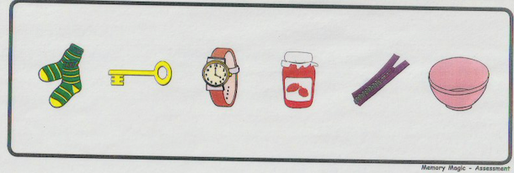

Slide 66


Slide 68
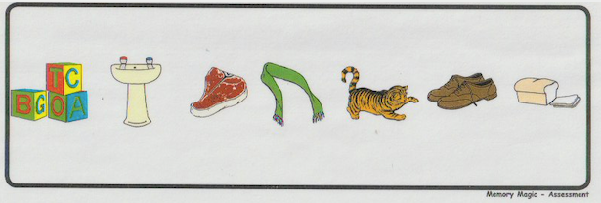

Slide 70
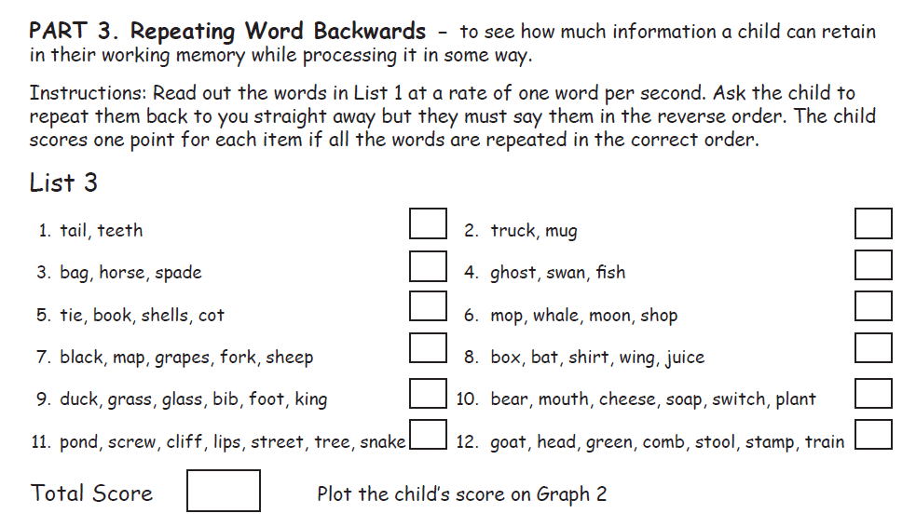

Slide 71
What did it tell you?

Slide 73

Annemarie Pitt
Please contact the school’s SENCO who can then liaise with me regarding a phone call, meeting or assessment.

