Slide 1
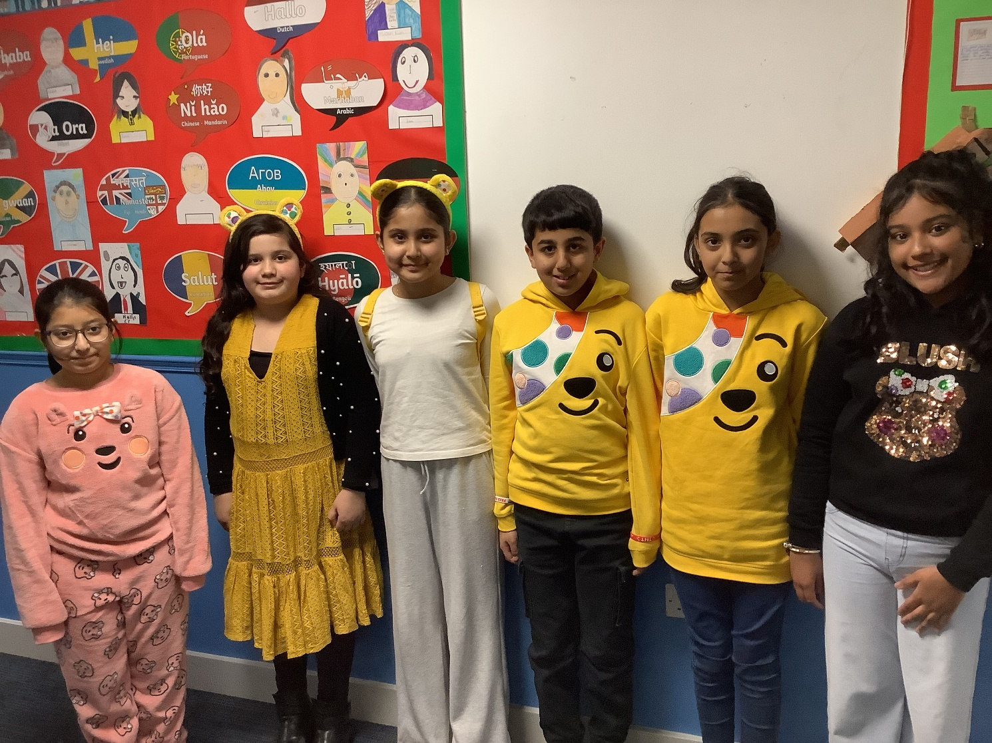

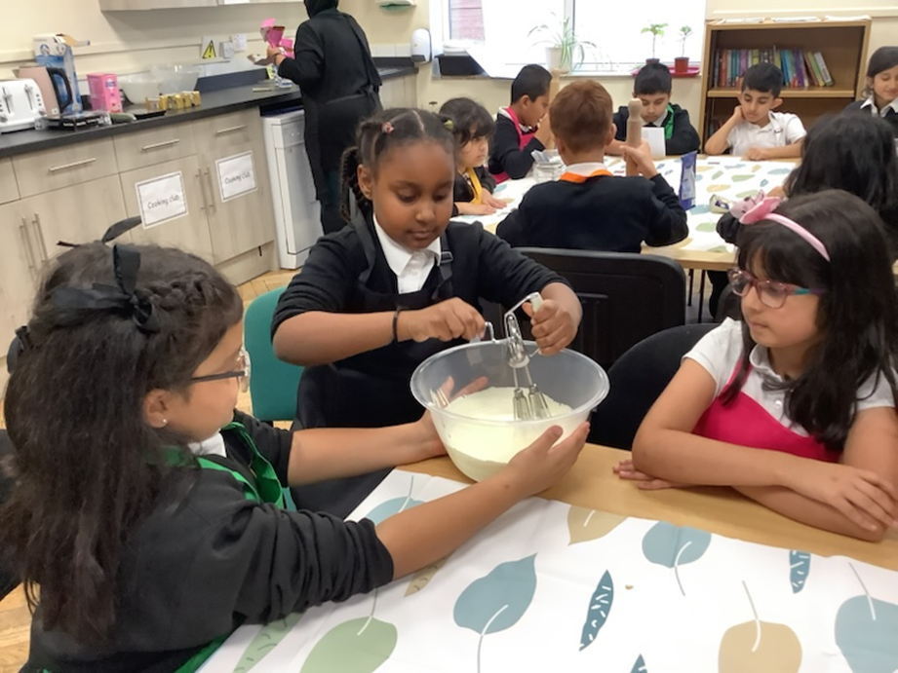
Attendance assembly 17th November 2025

Slide 2

95% and above Attendance weekly Reward.
Gain a star for each week your class achieves 95%+ How did your class do?

Slide 3

16 of our 31 classes have over 95% attendance this week
One class with 99%
Well done!

Slide 4

Ward End weekly attendance- Autumn 1
YEAR | Wb 3rd Nov | Wb 10th Nov | Wb | Wb | ^{Wb} | ^{Wb} | ^{W b}
6.1 | 98% | 95%
6.2 | 93% | 91%
6.3 | 95% | 98%
6.4 | 96% | 95%
5.1 | 93% | 98%
5.2 | 93% | 89%
5.3 | 94% | 96%
5.4 | 96% | 95%

Slide 5

Ward End weekly attendance Autumn 1
 | Wb 3rd Nov | Wb 10th Nov | Week | Wb | ^{Wb} | ^{Wb} | ^{Wb}
4.1 | 90% | 90%
4.2 | 90% | 90%
4.3 | 91% | 95%
4.4 | 92% | 99%
3.1 | 92% | 97%
3.2 | 96% | 93%
3.3 | 87% | 90%
3.4 | 96% | 93%

Slide 6

Ward End weekly attendance Autumn 1
YEAR | Wb 3rd Nov | Wb 10th Nov | Wb | Wb | ^{Wb} | ^{Wb} | ^{Wb}
2.1 | 95% | 93%
2.2 | 95% | 95%
2.3 | 85% | 94%
2.4 | 94% | 95%
1.1 | 91% | 91%
1.2 | 96% | 95%
1.3 | 95% | 98%
1.4 | 94% | 97%

Slide 7

Ward End weekly attendance Autumn 1
YEAR | Wb 3rd Nov | Wb 10th Nov | Wb | Wb | Wb | Wb | Wb
Rabbits | 95% | 93%
Squirrels | 91% | 84%
Foxes | 75% | 94%
Hedgehogs | 90% | 82%
Owls | 96% | 98%
Doves | 92% | 98%
Swans | 100% | 82%

Slide 8
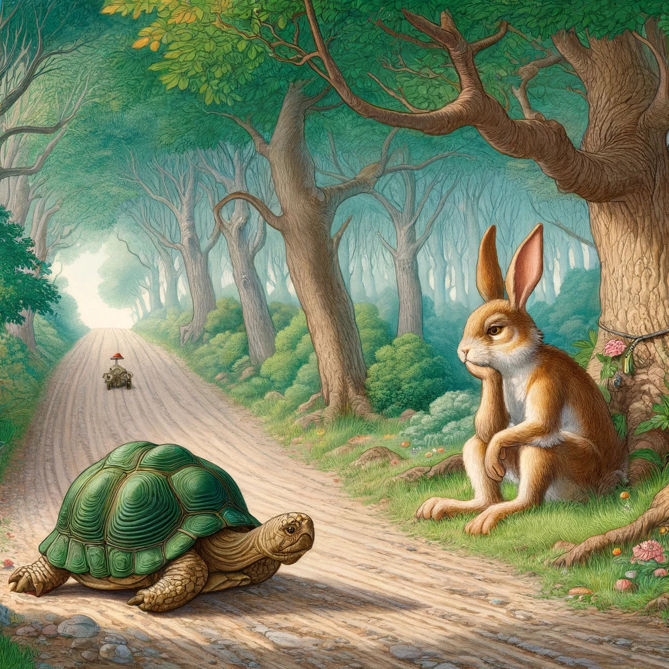
Stories of perseverance?
This is our Assembly Theme this week.
Value: Perseverance
Use the language of Comparison.
What stories do you know that show perseverance. Perhaps have a think during the week. Do YOU have a story about perseverance?
The Hare and the Tortoise – Aesop’s fable.
The Enormous Turnip
The little Red Hen.

Slide 9

Check presentation skills on this chart.

Slide 10
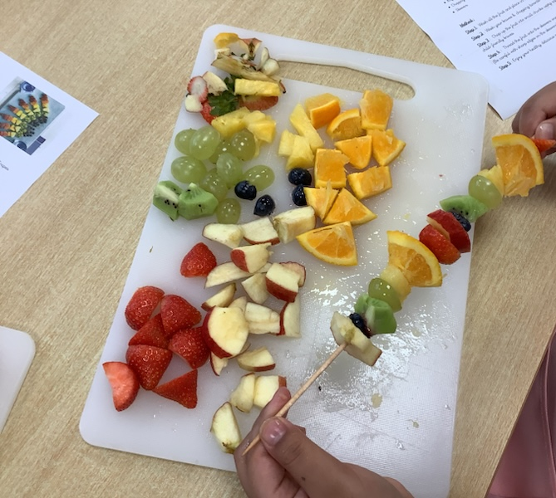
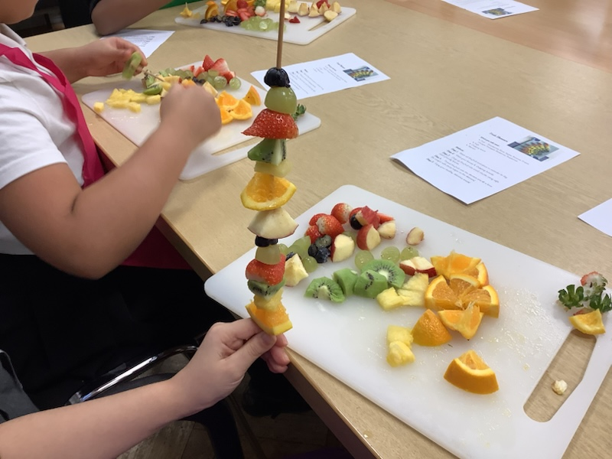
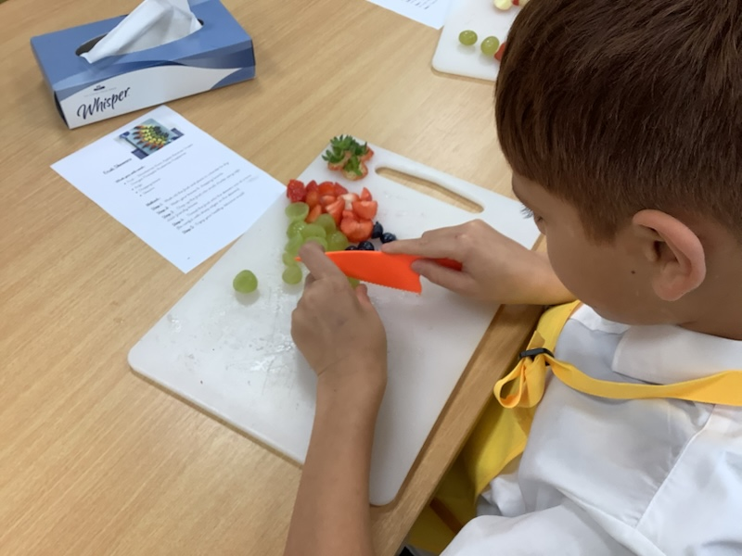
What’s happening at Ward End?
Cooking club has begun for years 4 and 2. Year 2 made fruit kebabs, washing and cutting carefully and enjoying eating them at home. They look great!

Slide 11
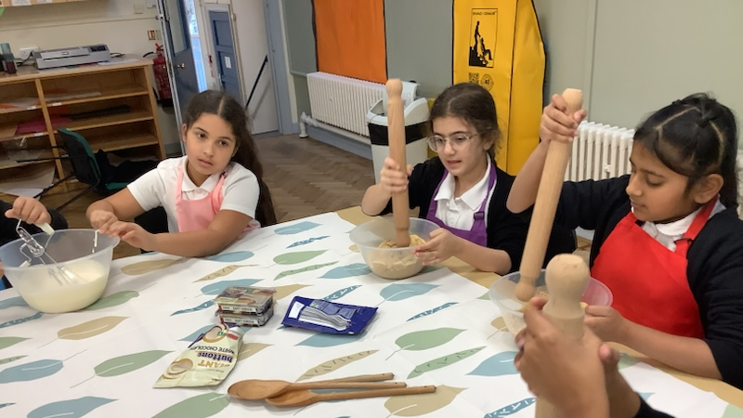
Cheesecake making- what is happening here?

Slide 12
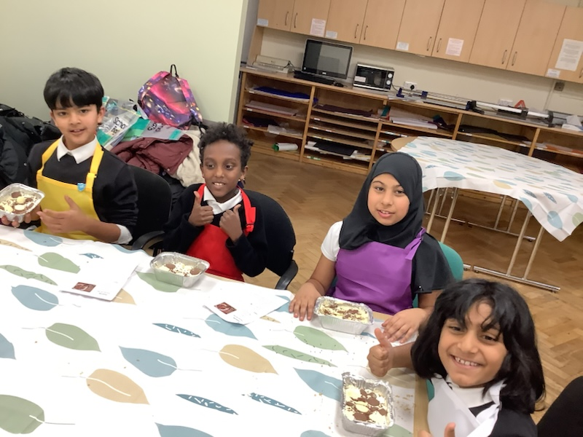

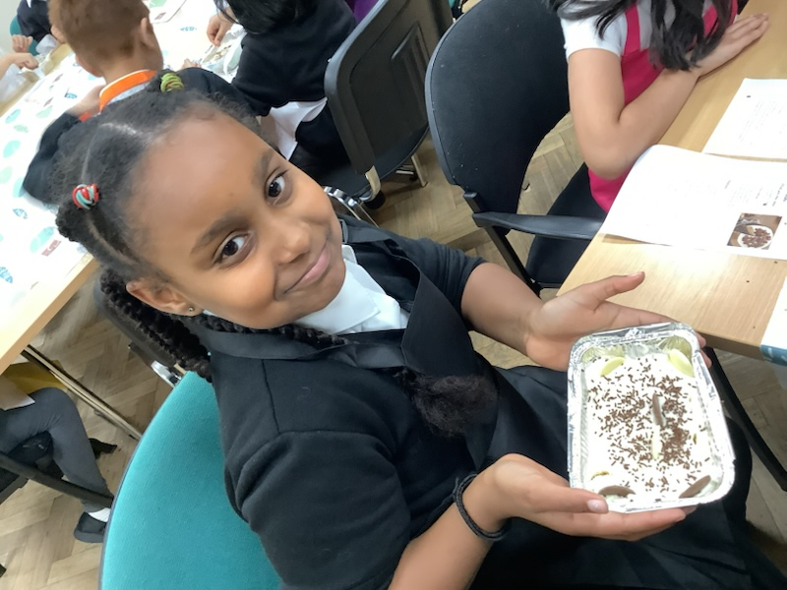
Year 4 cookers!

Slide 13
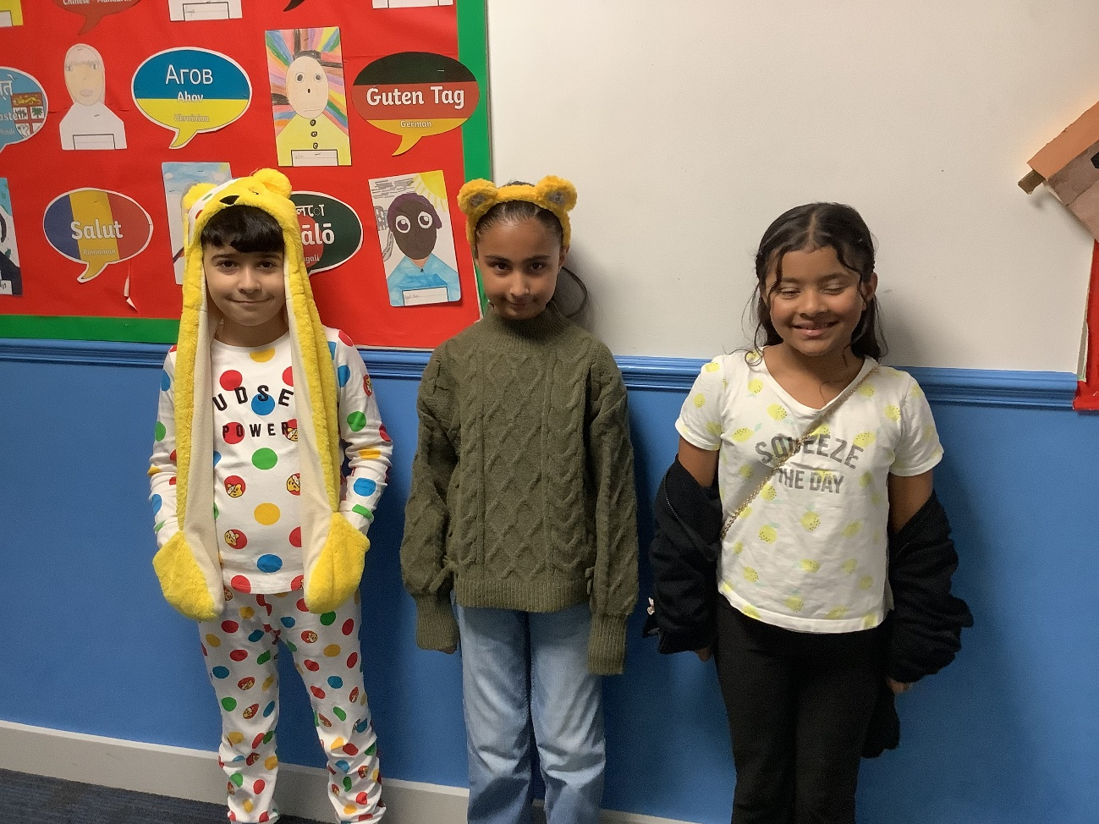
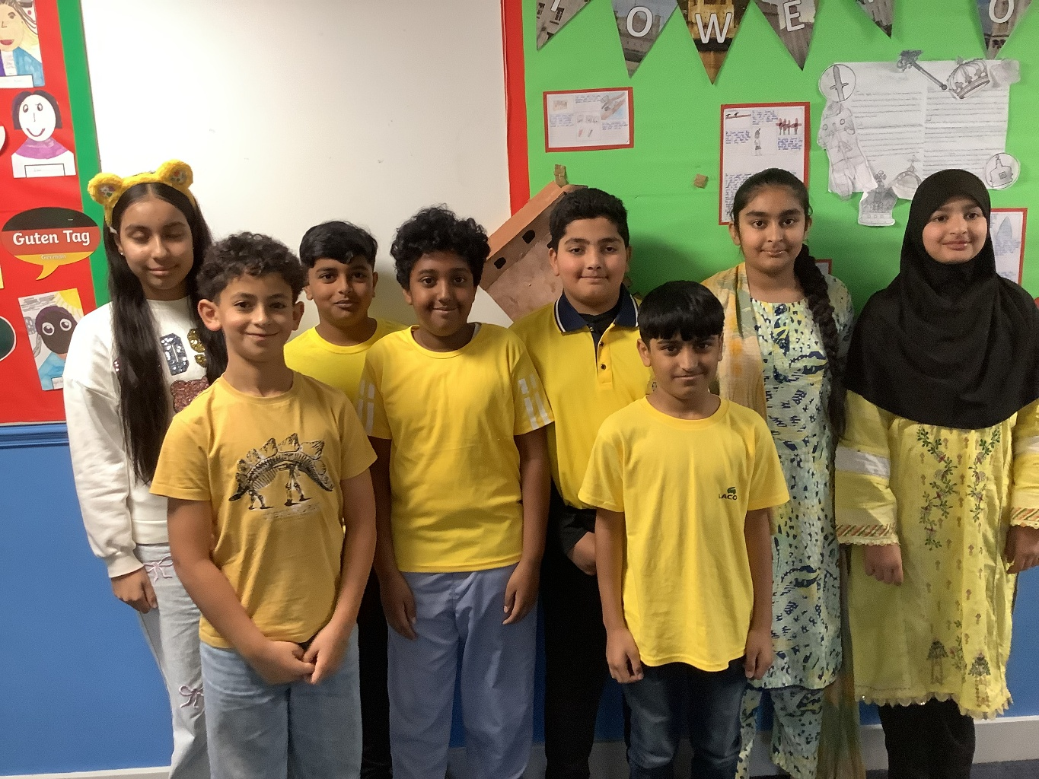
Thank you everyone for joining in with
Children in Need day 2025- you can still donate £1

Slide 14

Friday 14th November,
Children in Need day 2025
Wear something Spotty and donate £1- links have been sent to your adults to make the donation on line

Slide 15


Just finished reading Midnight Treasure-
A 3 word, review
A terrifying fantasy quest!

Slide 16


My next read!

Slide 17
Ward End Welcome’s!
Did everyone complete the half term Homework Challenge?
Share some across the year group please.
Reminder Wednesday and Thursday this week- photograph day.

Slide 18

The book fair is coming to Ward End!
From the 1st December to 5th December
- Books are half price -
You don’t want to miss it.
Make sure to bring your parents and come see us !

Slide 19
Join us for our Book Fair!
📍 Location: School canteen
📅 Dates: 1st–5th December
🕒 Times: 3:30 PM daily (Friday starts at 3:00 PM)
💸 Books are HALF PRICE!
We’re going mostly cashless this year, but cash is still welcome!
To keep things safe and organized, each year group has its own day:
Monday: Year 1 & 2
Tuesday: Year 3 & 4
Wednesday: Year 5 & 6
Thursday: Reception & Nursery
Friday: Open to everyone
We can’t wait to see you there!

