Slide 1
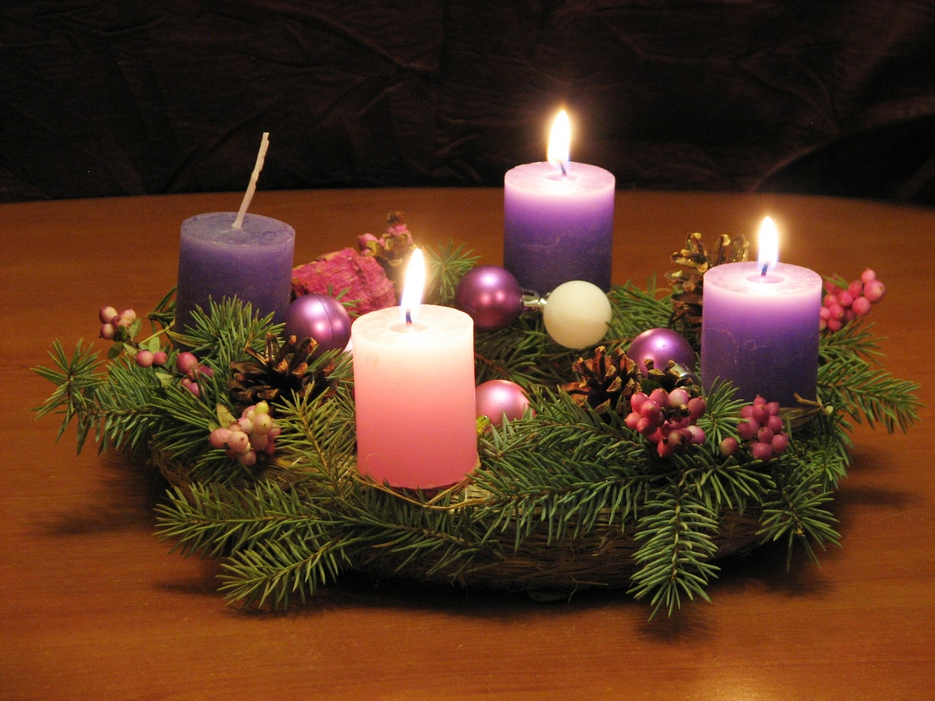
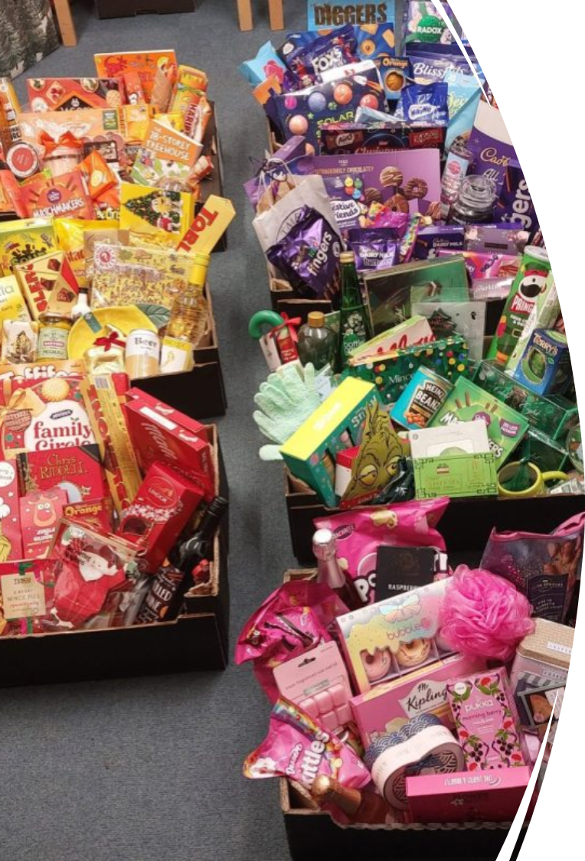


Attendance assembly 8th December 2025

Slide 2

95% and above Attendance weekly Reward.
Gain a star for each week your class achieves 95%+ How did your class do?

Slide 3

11 of our 31 classes have over 95% attendance this week
Highest score was 97% this week
We need to be in school EVERY DAY to be successful.

Slide 4

Ward End weekly attendance- Autumn 1
YEAR | Wb 3rd Nov | Wb 10th Nov | Wb 17th Nov | Wb 24th Nov | ^{Wb 1st Dec} | ^{Wb 8th Dec} | ^{W b}
6.1 | 98% | 95% | 95% | 96% | 94% | 93%
6.2 | 93% | 91% | 95% | 94% | 92% | 93%
6.3 | 95% | 98% | 98% | 96% | 95% | 88%
6.4 | 96% | 95% | 99% | 95% | 97% | 91%
5.1 | 93% | 98% | 95% | 95% | 96% | 96%
5.2 | 93% | 89% | 89% | 91% | 96% | 95%
5.3 | 94% | 96% | 96% | 88% | 82% | 92%
5.4 | 96% | 95% | 94% | 85% | 91% | 95%

Slide 5

Ward End weekly attendance Autumn 1
 | Wb 3rd Nov | Wb 10th Nov | Week 17th Nov | Wb 24th Nov | ^{Wb 1st Dec} | ^{Wb 8th Dec} | ^{Wb}
4.1 | 90% | 90% | 95% | 93% | 87% | 88%
4.2 | 90% | 90% | 95% | 95% | 87% | 83%
4.3 | 91% | 95% | 91% | 98% | 98% | 97%
4.4 | 92% | 99% | 95% | 94% | 92% | 88%
3.1 | 92% | 97% | 99% | 99% | 97% | 97%
3.2 | 96% | 93% | 91% | 95% | 94% | 86%
3.3 | 87% | 90% | 95% | 93% | 96% | 95%
3.4 | 96% | 93% | 97% | 96% | 86% | 97%

Slide 6

Ward End weekly attendance Autumn 1
YEAR | Wb 3rd Nov | Wb 10th Nov | Wb 17th Nov | Wb 24th Nov | ^{Wb 1st Dec} | ^{Wb 8th Dec} | ^{Wb}
2.1 | 95% | 93% | 93% | 94% | 92% | 94%
2.2 | 95% | 95% | 93% | 96% | 93% | 94%
2.3 | 85% | 94% | 94% | 85% | 91% | 95%
2.4 | 94% | 95% | 98% | 94% | 95% | 92%
1.1 | 91% | 91% | 98% | 98% | 88% | 87%
1.2 | 96% | 95% | 95% | 95% | 96% | 90%
1.3 | 95% | 98% | 91% | 93% | 94% | 95%
1.4 | 94% | 97% | 96% | 96% | 91% | 94%

Slide 7


Ward End weekly attendance Autumn 1
YEAR | Wb 3rd Nov | Wb 10th Nov | Wb 17th Nov | Wb 24th Nov | Wb 1st Dec | Wb 8th Dec | Wb
Rabbits | 95% | 93% | 88% | 93% | 91% | 86%
Squirrels | 91% | 84% | 84% | 84% | 90% | 87%
Foxes | 75% | 94% | 95% | 77% | 86% | 88%
Hedgehogs | 90% | 82% | 80% | 90% | 88% | 94%
Owls | 96% | 98% | 90% | 93% | 95% | 95%
Doves | 92% | 98% | 95% | 98% | 95% | 78%
Swans | 100% | 82% | 95% | 100% | 97% | 95%

Slide 8
Advent: Joy
This is our Assembly Theme this week.
Value: Aspiration, Respect.
Use the language of Comparison to ask some questions about Advent.
Advent is a Christian season of preparation for Christmas. It begins on the 4th Sunday before Christmas.
Traditions include Advent calendars, lighting Advent wreaths with candles, and reflection and charity involvement.
In Churches a wreath with candles is lit on each Sunday-The 4 candles themes are; Hope, Peace, Joy and Love.

Slide 9

Joy- the pink candle
The pink candle in the advent wreath symbolises ‘Joy’- the anticipation of the festival to come.
The last candle means Love.
Can you talk about similar themes in other religions as well? Like Rama and Sita story at Diwali.
(Hope, Peace, Joy and Love)

Slide 10

Check presentation skills on this chart.

Slide 11
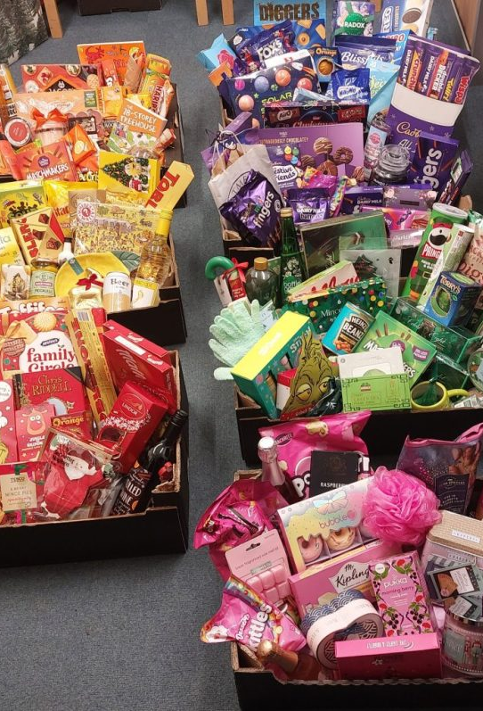
What’s happening at Ward End this week?
A fabulous Winter Craft fair
Thank you everyone
You can still buy tickets for the Rainbow raffle £1 a strip. Raffle is drawn on Wednesday 17th December.

Slide 12
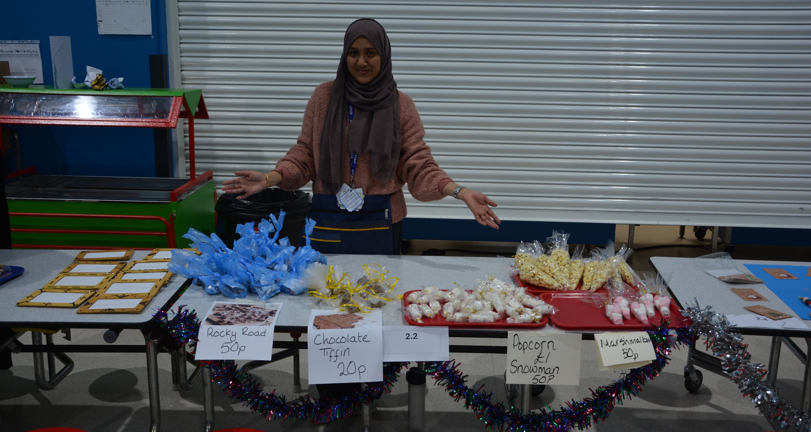
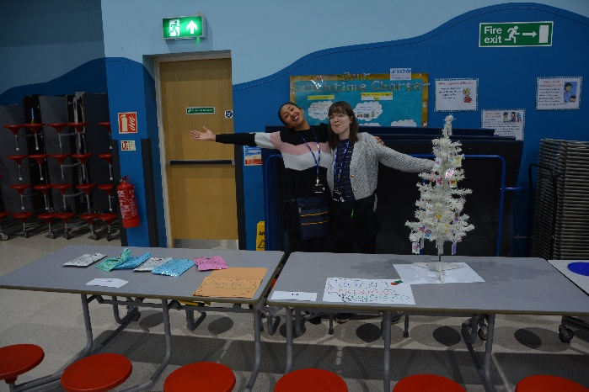
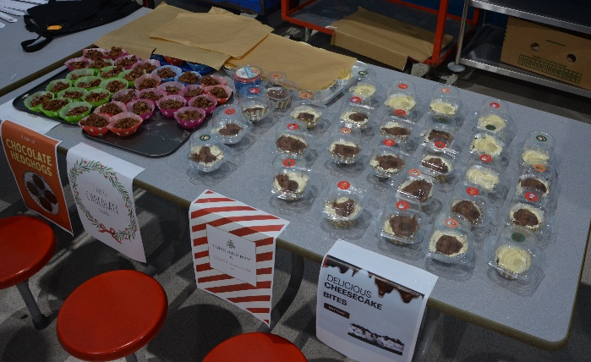
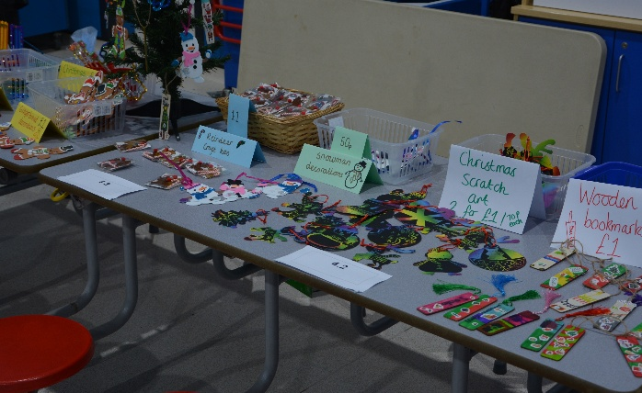
What a great day!

Slide 13
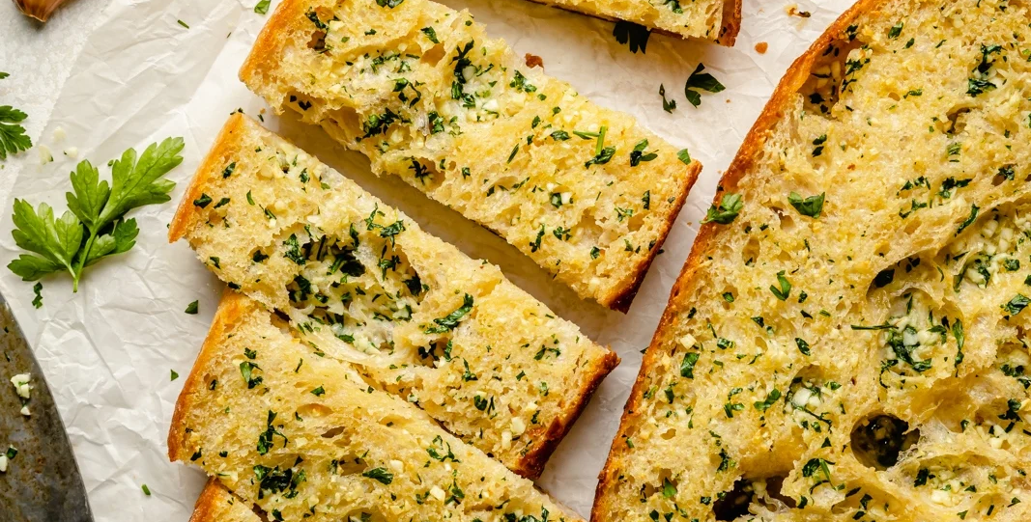
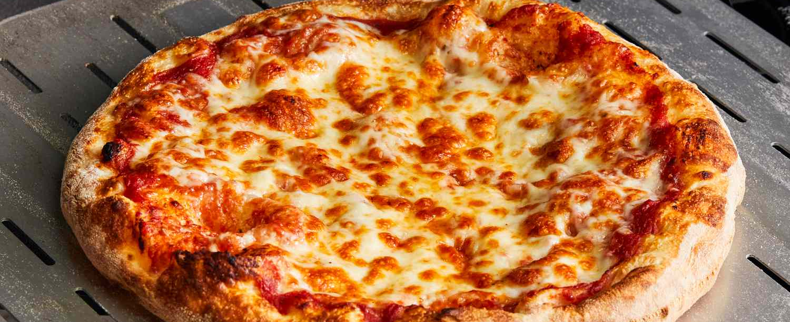
If you presently do not have school dinners, but would like to join –in. You Can!
You can choose 1, 2,3 or 4 days each week to have a school dinner.
Stick to them same days each week.
You could join for Pizza Friday’s?
The new menus have been published on dojo, so you can discuss it at home and decide.
Parents E mail the school office when you have decided.

Slide 14


My next read. I am Rebel.
Check you have your log- in for MyOn ready to take home over the holidays.
I hope you enjoy the books.

Slide 15

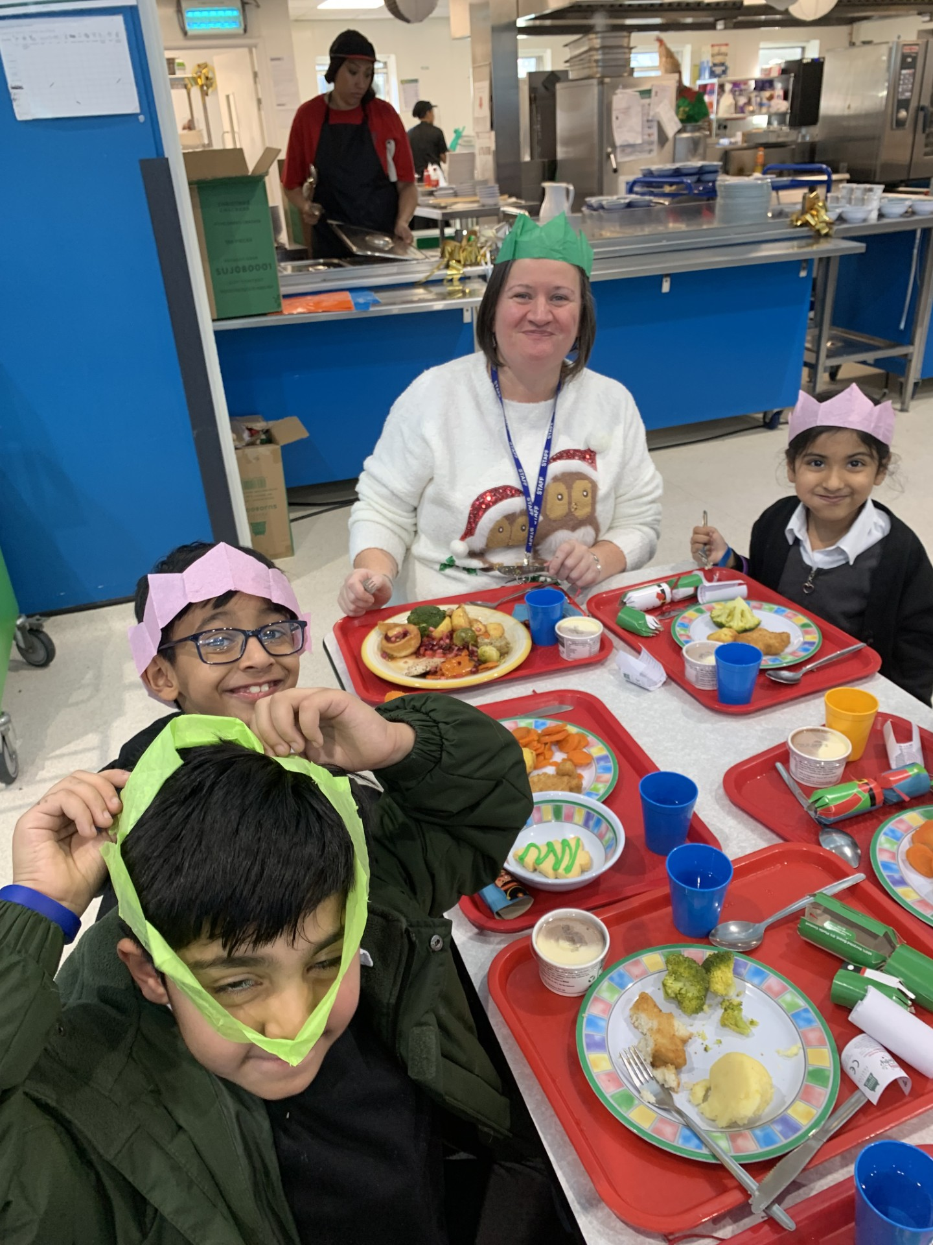
Christmas Jumper day this Friday
Please donate £1 for Save the Children
You have to do it on-line.
The link is on Dojo and BromCom ,
-already sent to your parents.

Slide 16

Winter holiday homework – Oracy challenge, discuss with your teacher.

Slide 17

Have a lovely 2 week holiday. See you all on Tuesday 6th January 2026

