Slide 1
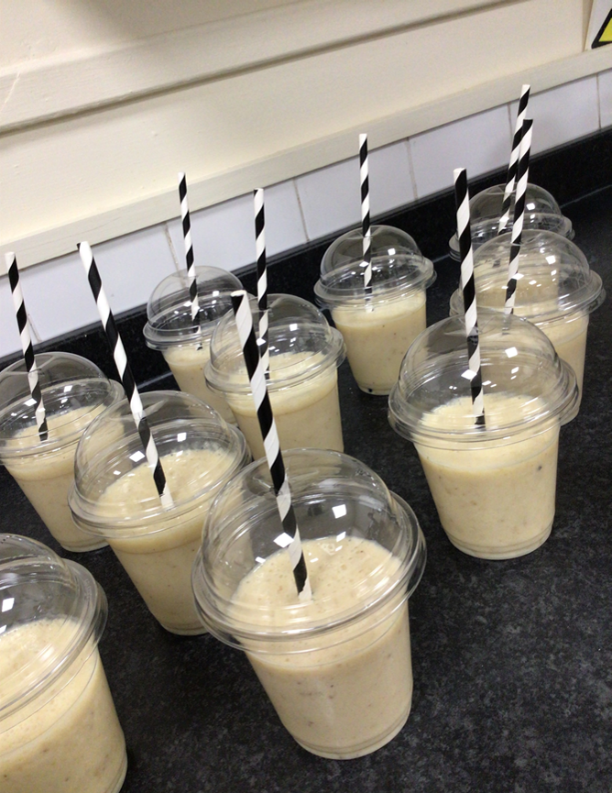
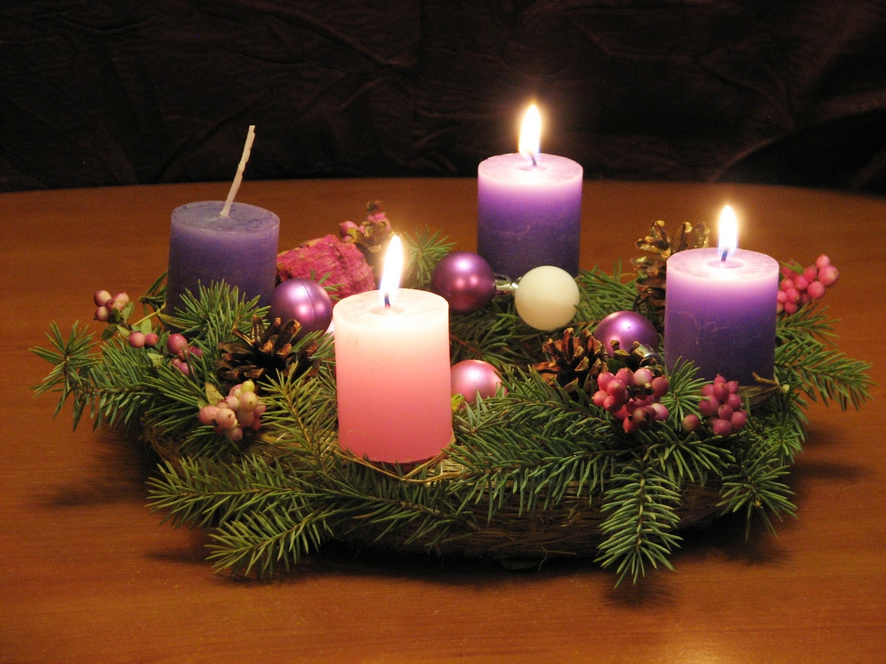

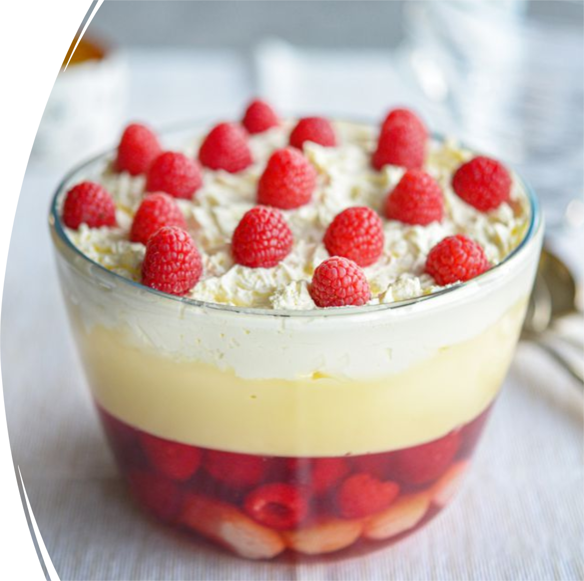
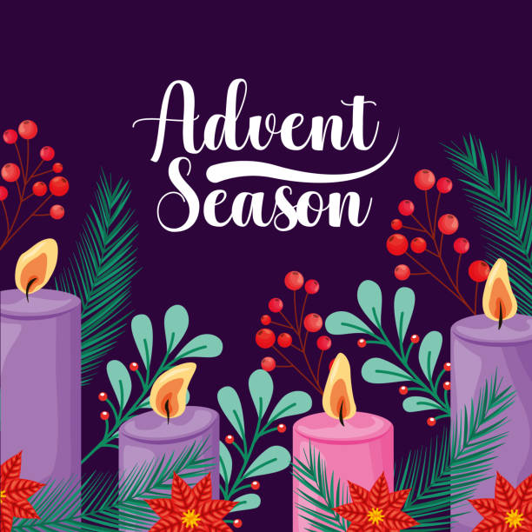
Attendance assembly 8th December 2025

Slide 2

95% and above Attendance weekly Reward.
Gain a star for each week your class achieves 95%+ How did your class do?

Slide 3

12 of our 31 classes have over 95% attendance this week
Highest score was 98% this week
We need to be in school EVERY DAY to be successful.

Slide 4

Ward End weekly attendance- Autumn 1
YEAR | Wb 3rd Nov | Wb 10th Nov | Wb 17th Nov | Wb 24th Nov | ^{Wb 1st Dec} | ^{Wb} | ^{W b}
6.1 | 98% | 95% | 95% | 96% | 94%
6.2 | 93% | 91% | 95% | 94% | 92%
6.3 | 95% | 98% | 98% | 96% | 95%
6.4 | 96% | 95% | 99% | 95% | 97%
5.1 | 93% | 98% | 95% | 95% | 96%
5.2 | 93% | 89% | 89% | 91% | 96%
5.3 | 94% | 96% | 96% | 88% | 82%
5.4 | 96% | 95% | 94% | 85% | 91%

Slide 5

Ward End weekly attendance Autumn 1
 | Wb 3rd Nov | Wb 10th Nov | Week 17th Nov | Wb 24th Nov | ^{Wb 1st Dec} | ^{Wb} | ^{Wb}
4.1 | 90% | 90% | 95% | 93% | 87%
4.2 | 90% | 90% | 95% | 95% | 87%
4.3 | 91% | 95% | 91% | 98% | 98%
4.4 | 92% | 99% | 95% | 94% | 92%
3.1 | 92% | 97% | 99% | 99% | 97%
3.2 | 96% | 93% | 91% | 95% | 94%
3.3 | 87% | 90% | 95% | 93% | 96%
3.4 | 96% | 93% | 97% | 96% | 86%

Slide 6

Ward End weekly attendance Autumn 1
YEAR | Wb 3rd Nov | Wb 10th Nov | Wb 17th Nov | Wb 24th Nov | ^{Wb 1st Dec} | ^{Wb} | ^{Wb}
2.1 | 95% | 93% | 93% | 94% | 92%
2.2 | 95% | 95% | 93% | 96% | 93%
2.3 | 85% | 94% | 94% | 85% | 91%
2.4 | 94% | 95% | 98% | 94% | 95%
1.1 | 91% | 91% | 98% | 98% | 88%
1.2 | 96% | 95% | 95% | 95% | 96%
1.3 | 95% | 98% | 91% | 93% | 94%
1.4 | 94% | 97% | 96% | 96% | 91%

Slide 7


Ward End weekly attendance Autumn 1
YEAR | Wb 3rd Nov | Wb 10th Nov | Wb 17th Nov | Wb 24th Nov | Wb 1st Dec | Wb | Wb
Rabbits | 95% | 93% | 88% | 93% | 91%
Squirrels | 91% | 84% | 84% | 84% | 90%
Foxes | 75% | 94% | 95% | 77% | 86%
Hedgehogs | 90% | 82% | 80% | 90% | 88%
Owls | 96% | 98% | 90% | 93% | 95%
Doves | 92% | 98% | 95% | 98% | 95%
Swans | 100% | 82% | 95% | 100% | 97%

Slide 8
Advent: Peace
This is our Assembly Theme this week.
Value: Courage, Respect.
Use the language of Comparison to ask some questions about Advent.
Advent is a Christian season of preparation for Christmas. It begins on the 4th Sunday before Christmas.
Traditions include Advent calendars, lighting Advent wreaths with candles, and reflection and charity involvement.
In Churches a wreath with candles is lit on each Sunday-The 4 candles themes are; Hope, Peace, Joy and Love.

Slide 9
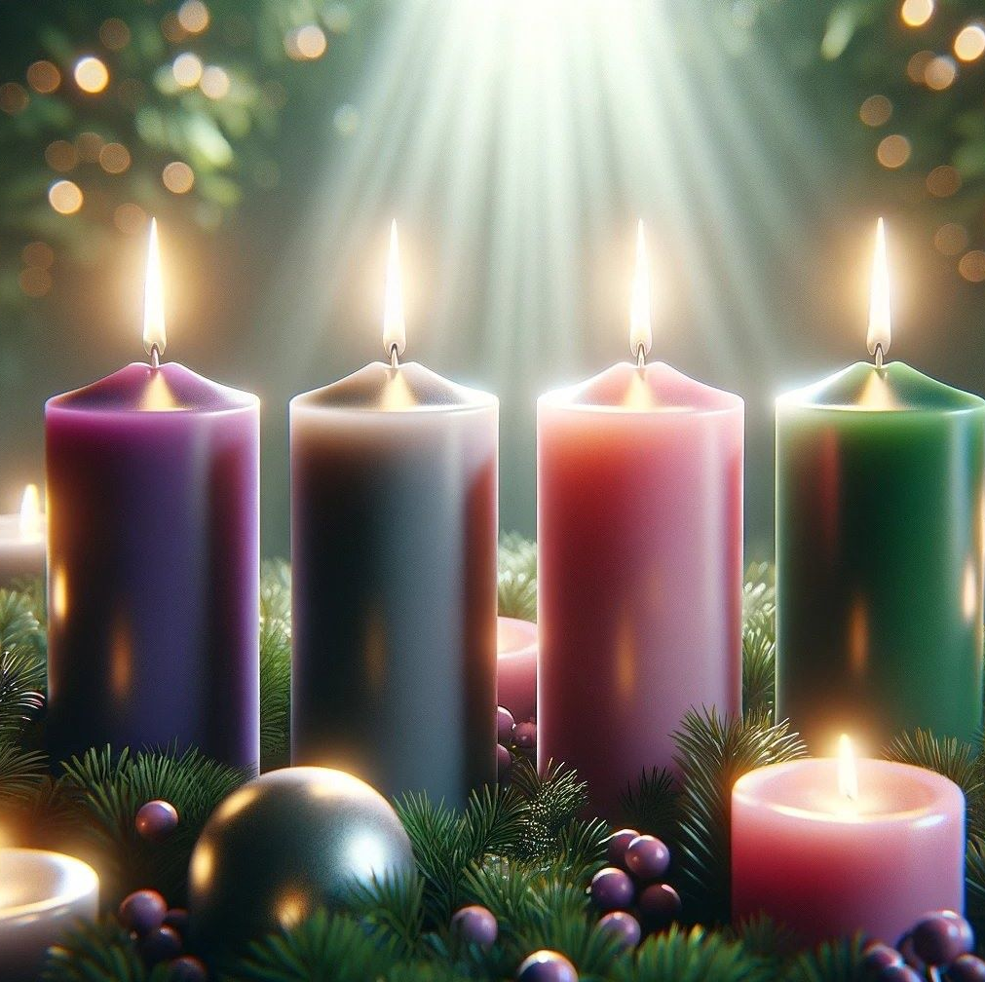
Peace & Forgiveness
Challenge question:
Religious stories often focus on obtaining Peace -through Forgiveness
That’s a really long word…..
What do you think it means?
And how does Peace follow forgiveness?

Slide 10
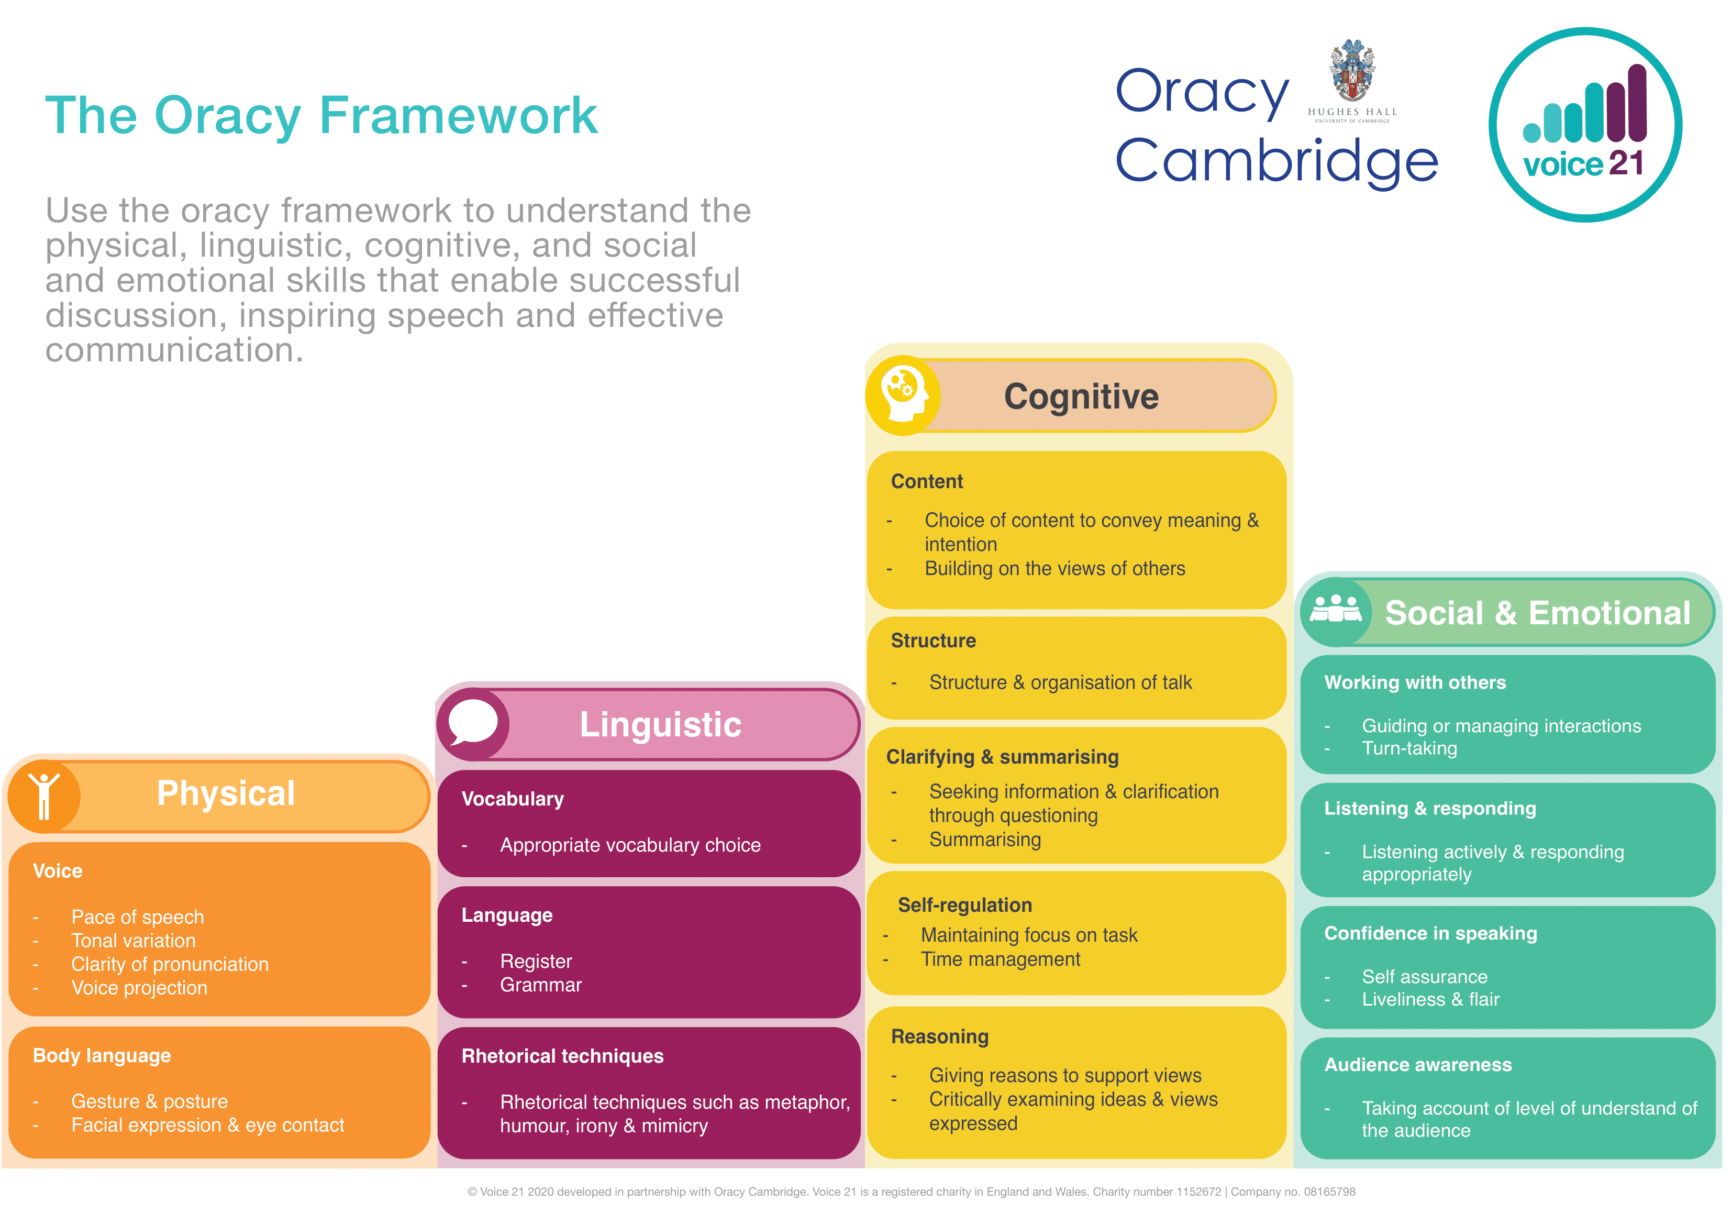
Check presentation skills on this chart.

Slide 11
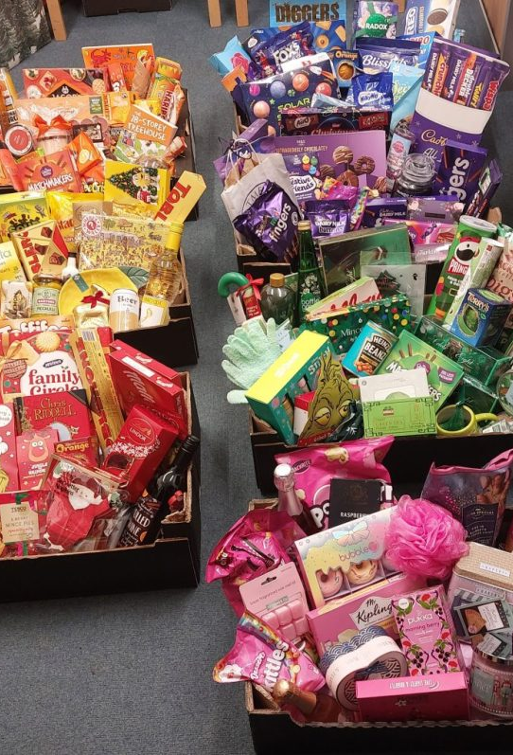
What’s happening at Ward End this week?
Wednesday 10th- School Christmas Dinner
Friday 12th- Winter Craft Fair. You can sell the crafts you have made to others and buy from other classes stalls.
Money raised goes towards school fund- we are saving to replace the school climbing frame.
You can also buy tickets for the Rainbow raffle £1 a strip. Raffle is drawn on Wednesday 17th December.

Slide 12
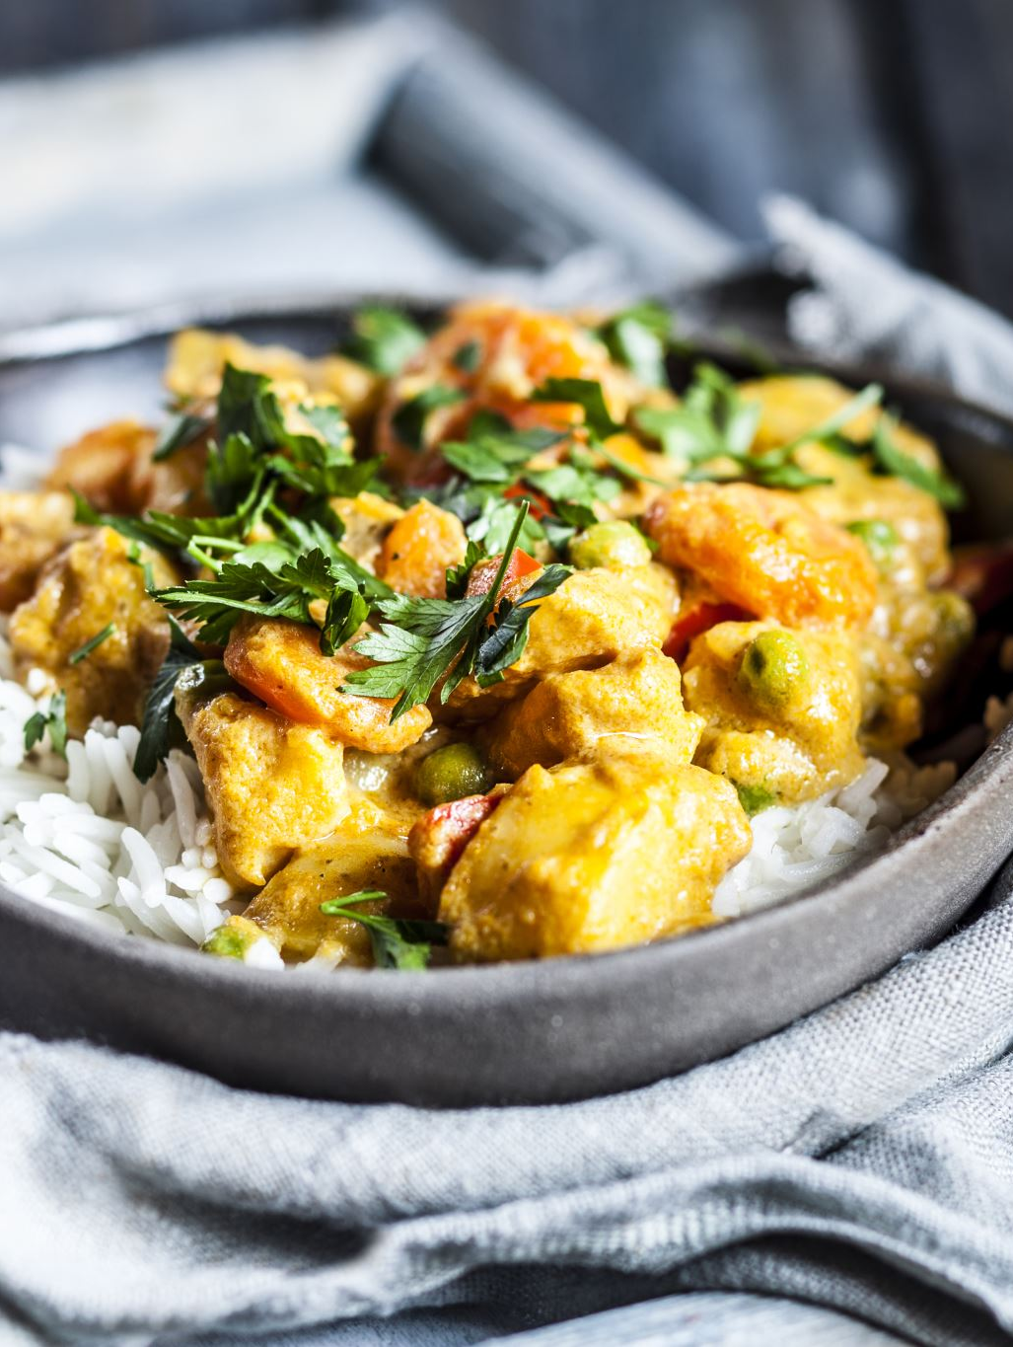
School Council have reviewed the new school dinner menus.
NEW DISHES coming soon…
Chicken Curry
Chicken and chickpea curry
Taco Tuesdays
Chicken and vegetable pie
Chicken meatballs in a tomato sauce.
Macaroni cheese
Pizza baguette
We will trail them and see what people think.

Slide 13
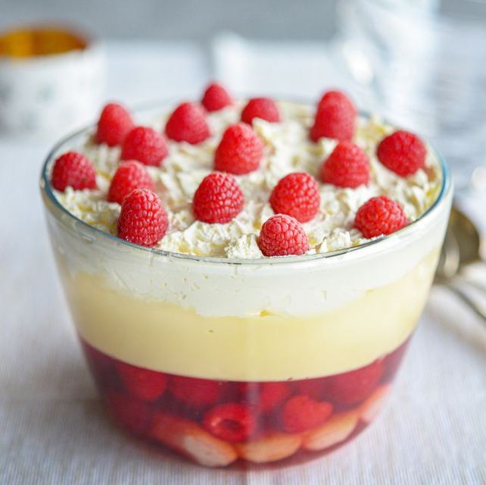
School Council have reviewed the new school dessert menus.
NEW DESSERTS coming soon
Different coloured jellies which are less runny and some with fruit inside.
Maybe trifle too.
Ice creams that are mostly chocolate flavour!
Brownies
Some days have milk or orange juice to drink as well as the water

Slide 14
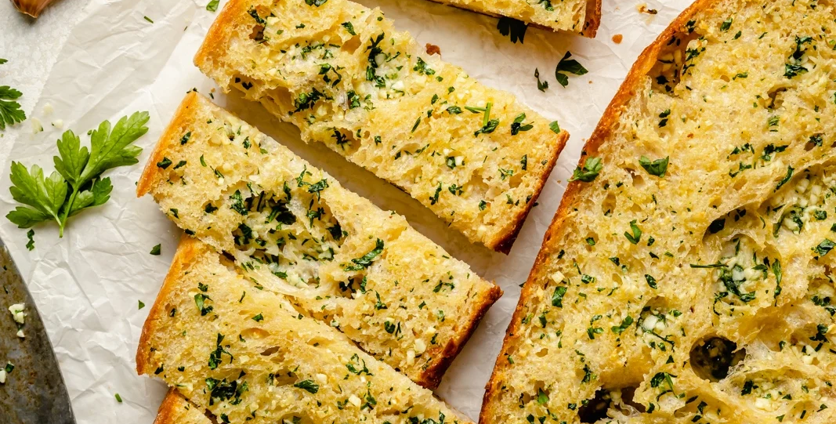
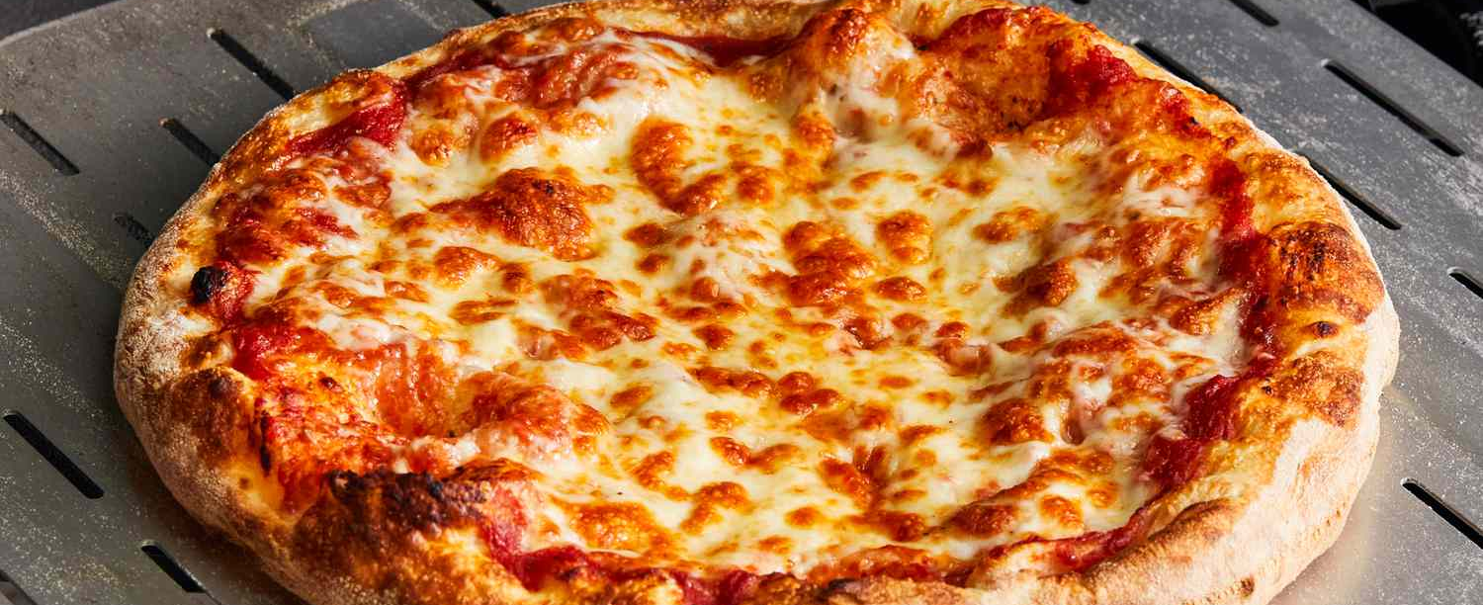
If you presently do not have school dinners, but would like to join –in. You Can!
You can choose 1, 2,3 or 4 days each week to have a school dinner.
Stick to them same days each week.
You could join for Pizza Friday’s?
The new menus will be published soon so you can discuss it at home and decide.
Parents E mail the school office when you have decided.

Slide 15


My next read. I am Rebel.
Check you have your log- in for MyOn ready to take home over the holidays.
Thank you to everyone who visited the book Fair last week.
I hope you enjoy the books.

Slide 16
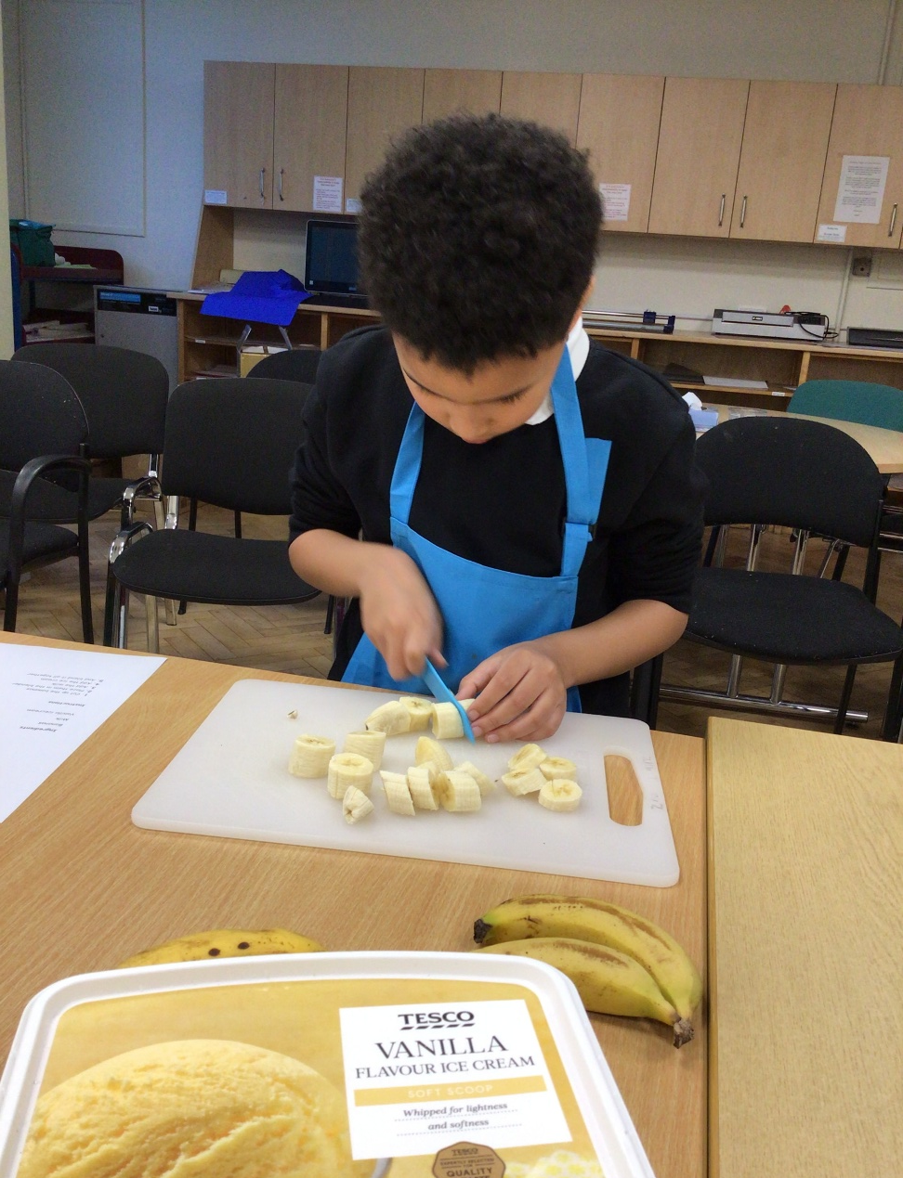
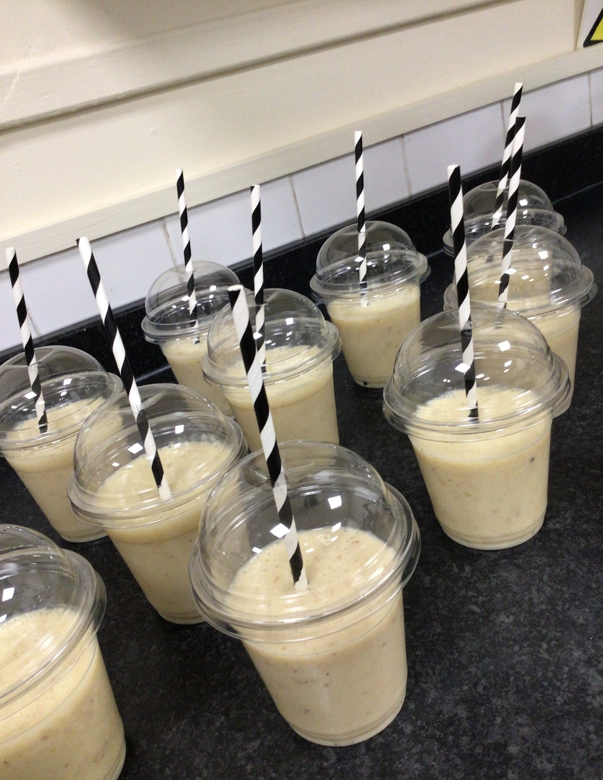
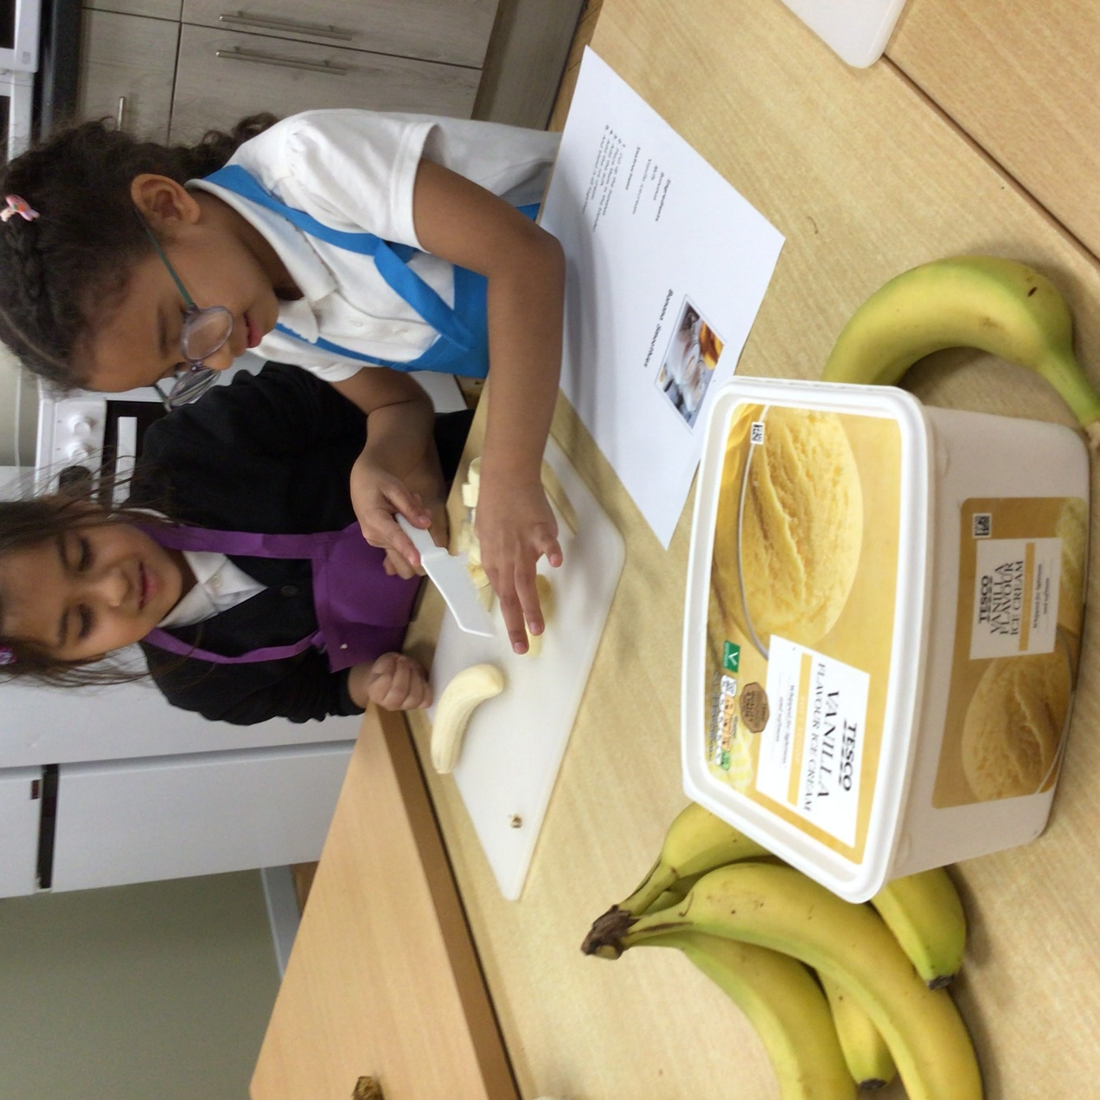
More cooking club news
Banana smoothies.

