Slide 1
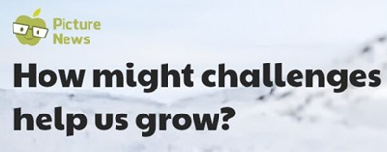


Slide 2


Slide 3


Slide 4
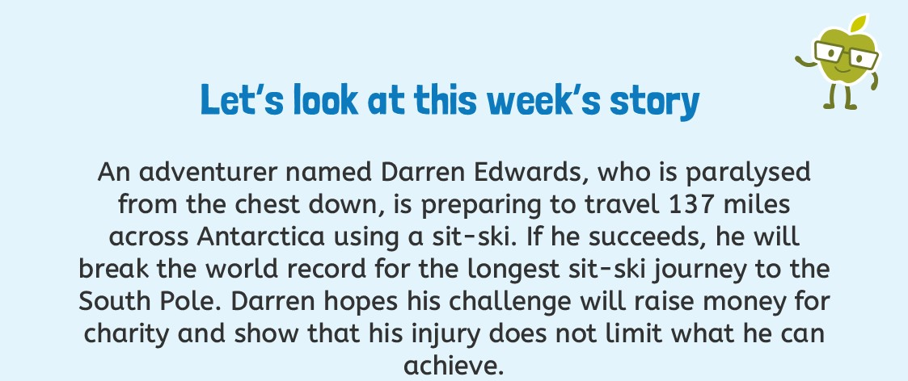
How might challenges help us grow? | Discussion Board

Slide 5
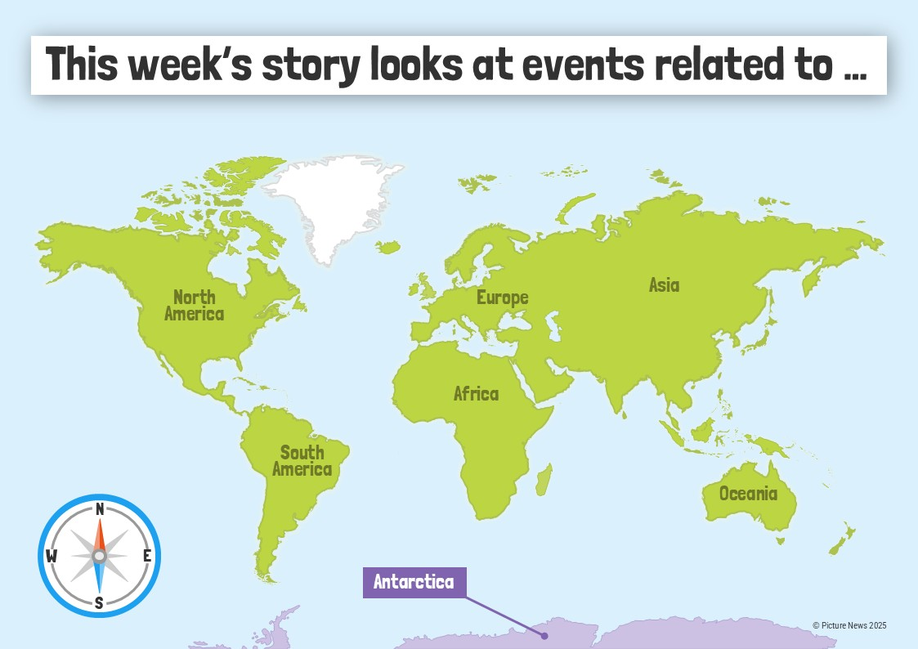

Slide 6
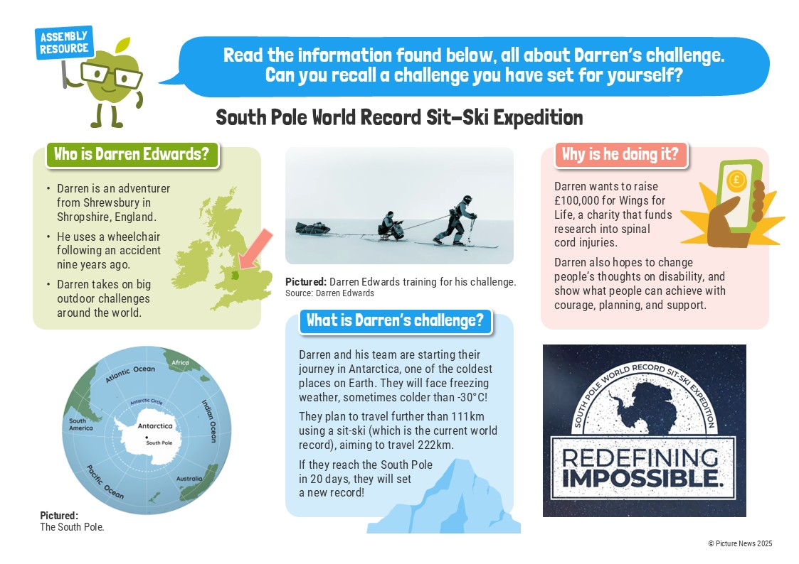

Slide 7
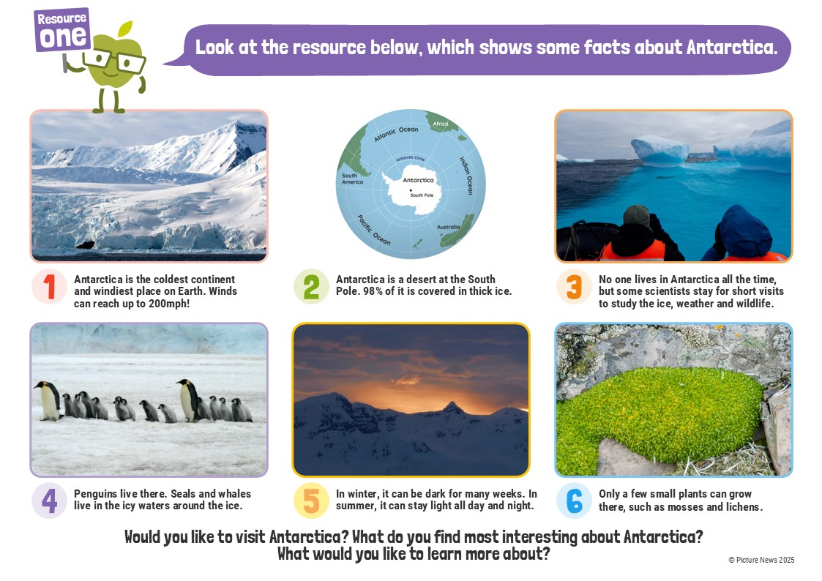

Slide 8
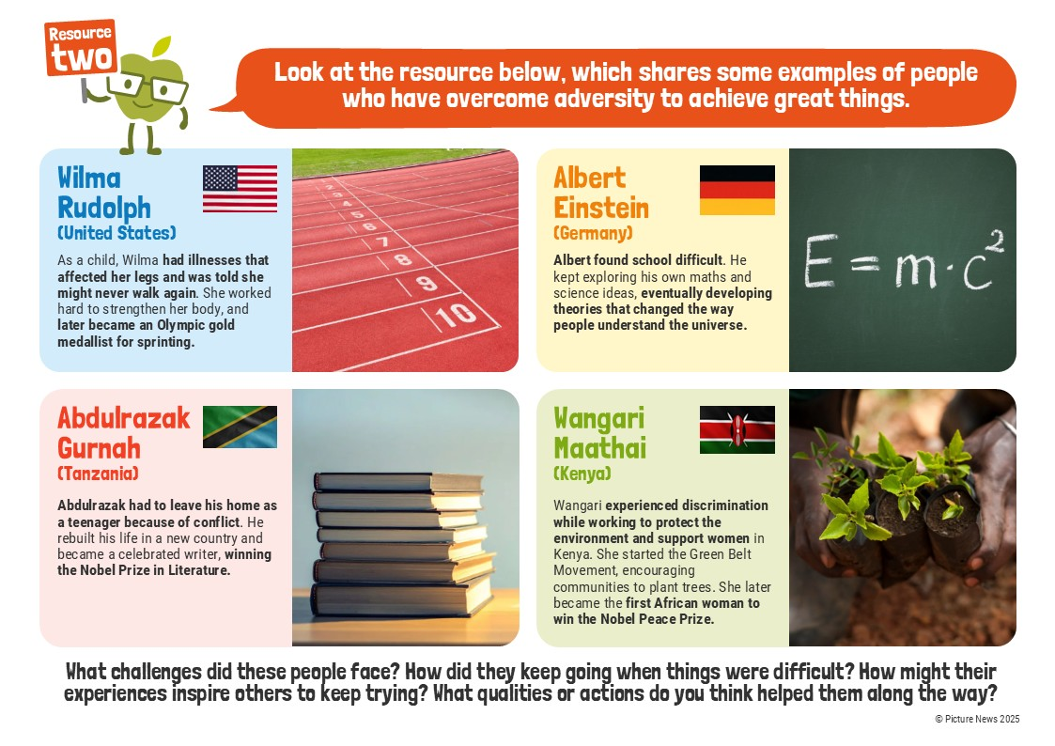

Slide 9
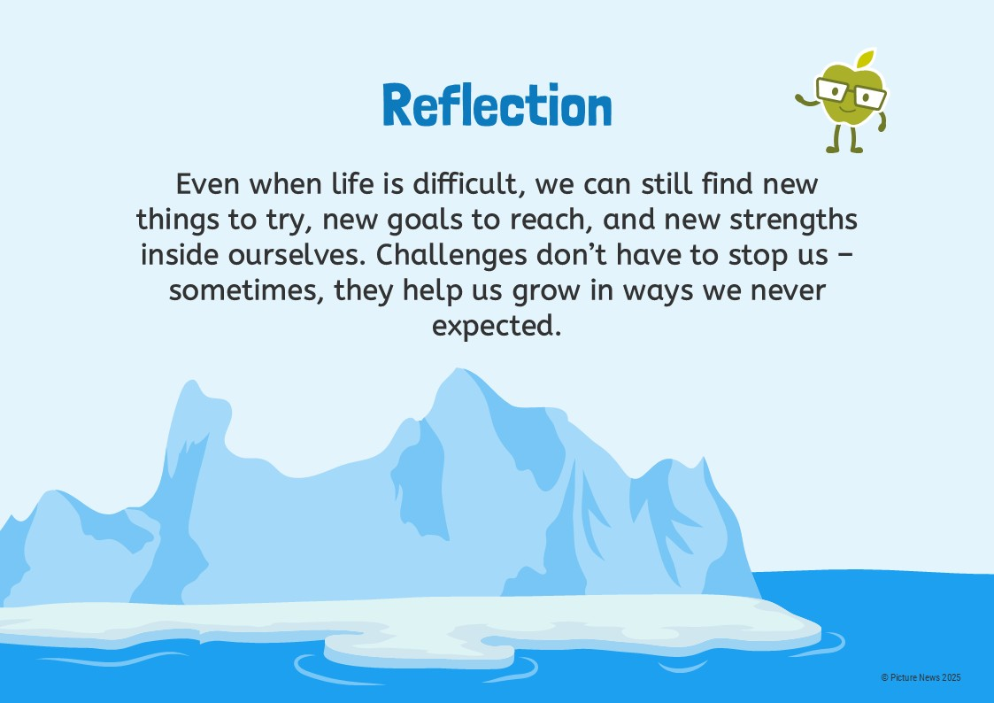

Slide 10

Wk beg. 12.01.26 Article 6-life, survival & development

Slide 11

Wk beg. 12.01.26 Article 6-life, survival & development

