Slide 1



Slide 2


Slide 3


Slide 4
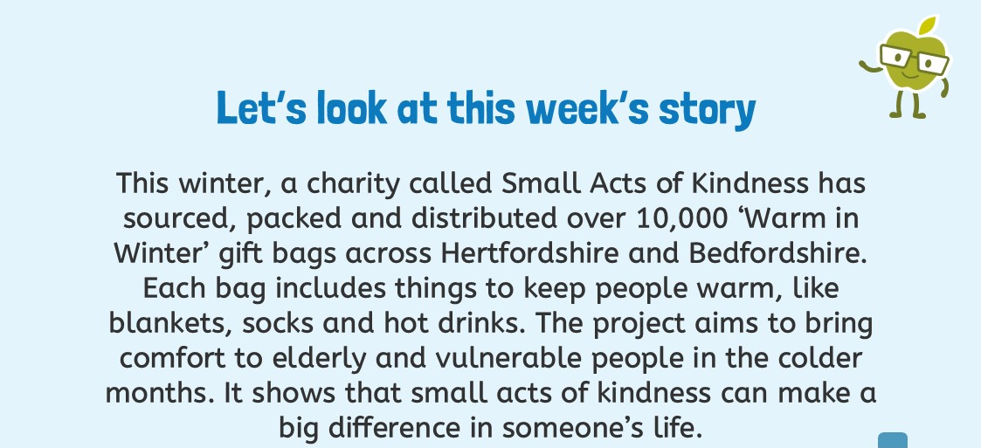
'A SMALL ACT'

Slide 5
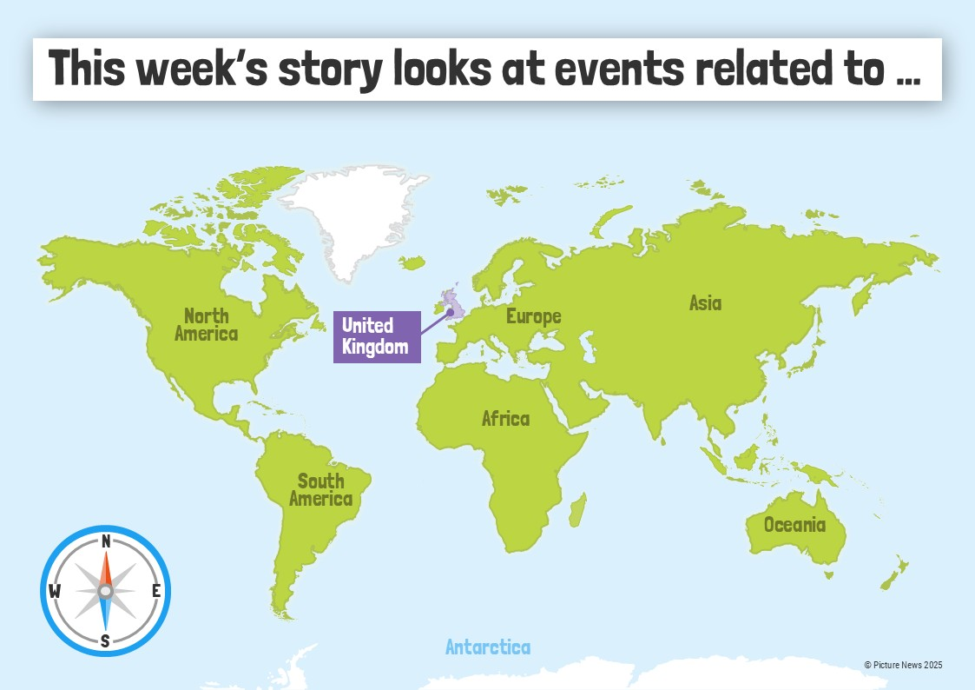

Slide 6
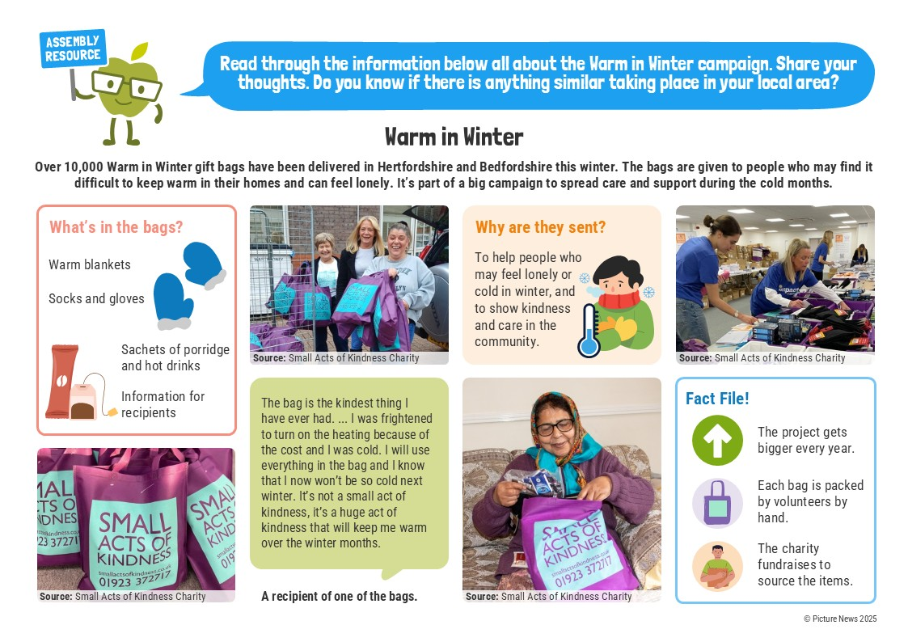

Slide 7


Slide 8
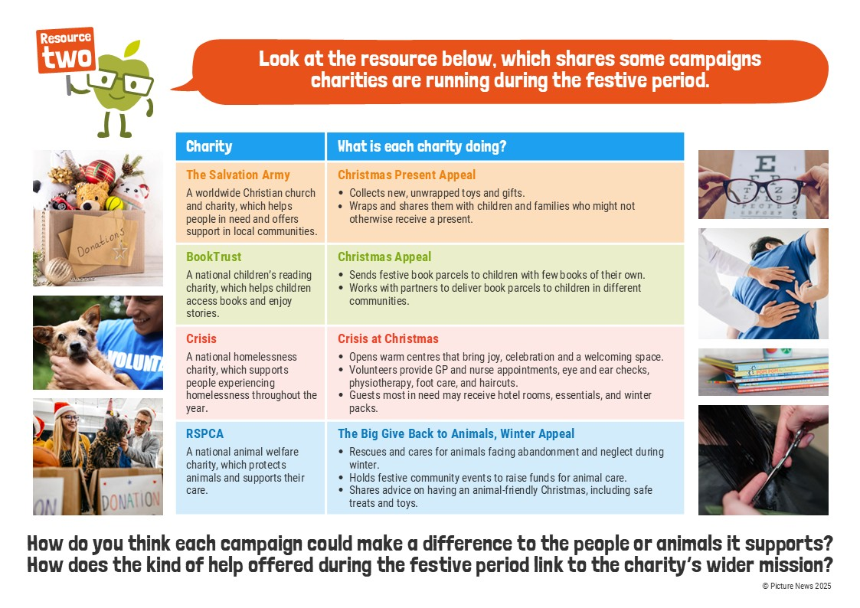

Slide 9


Slide 10
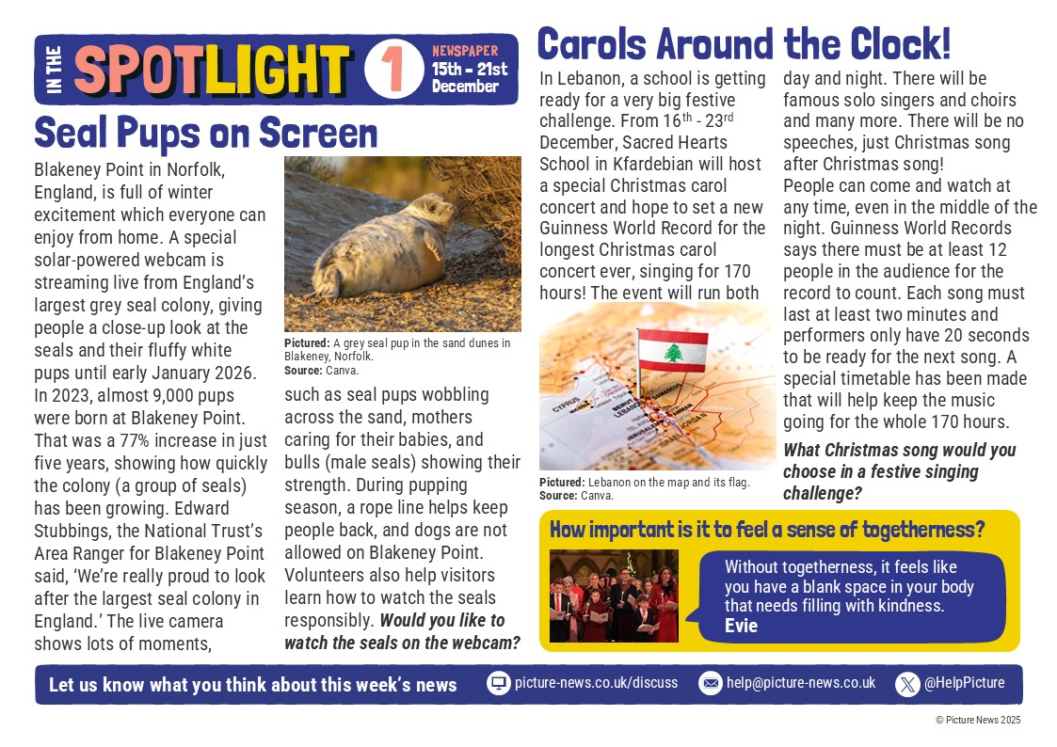
Wk beg. 19.01.26 Article 31-food, clothing & a safe home

Slide 11
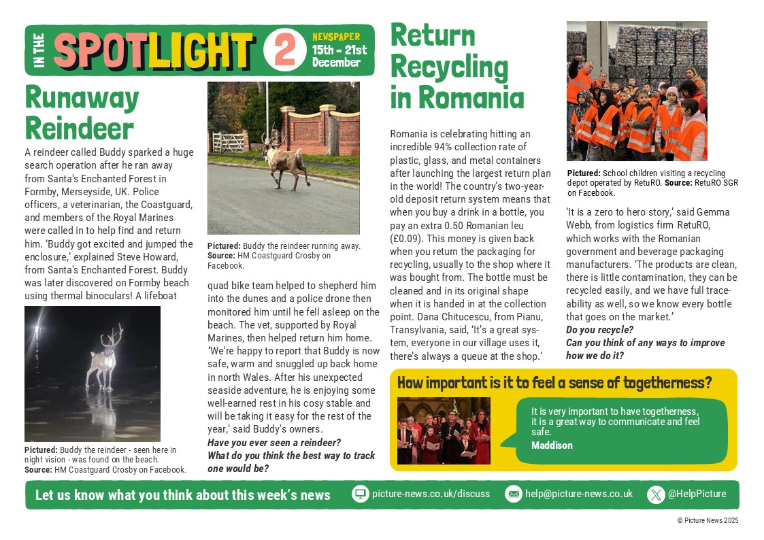
Wk beg. 19.01.26 Article 31-food, clothing & a safe home

