Slide 1
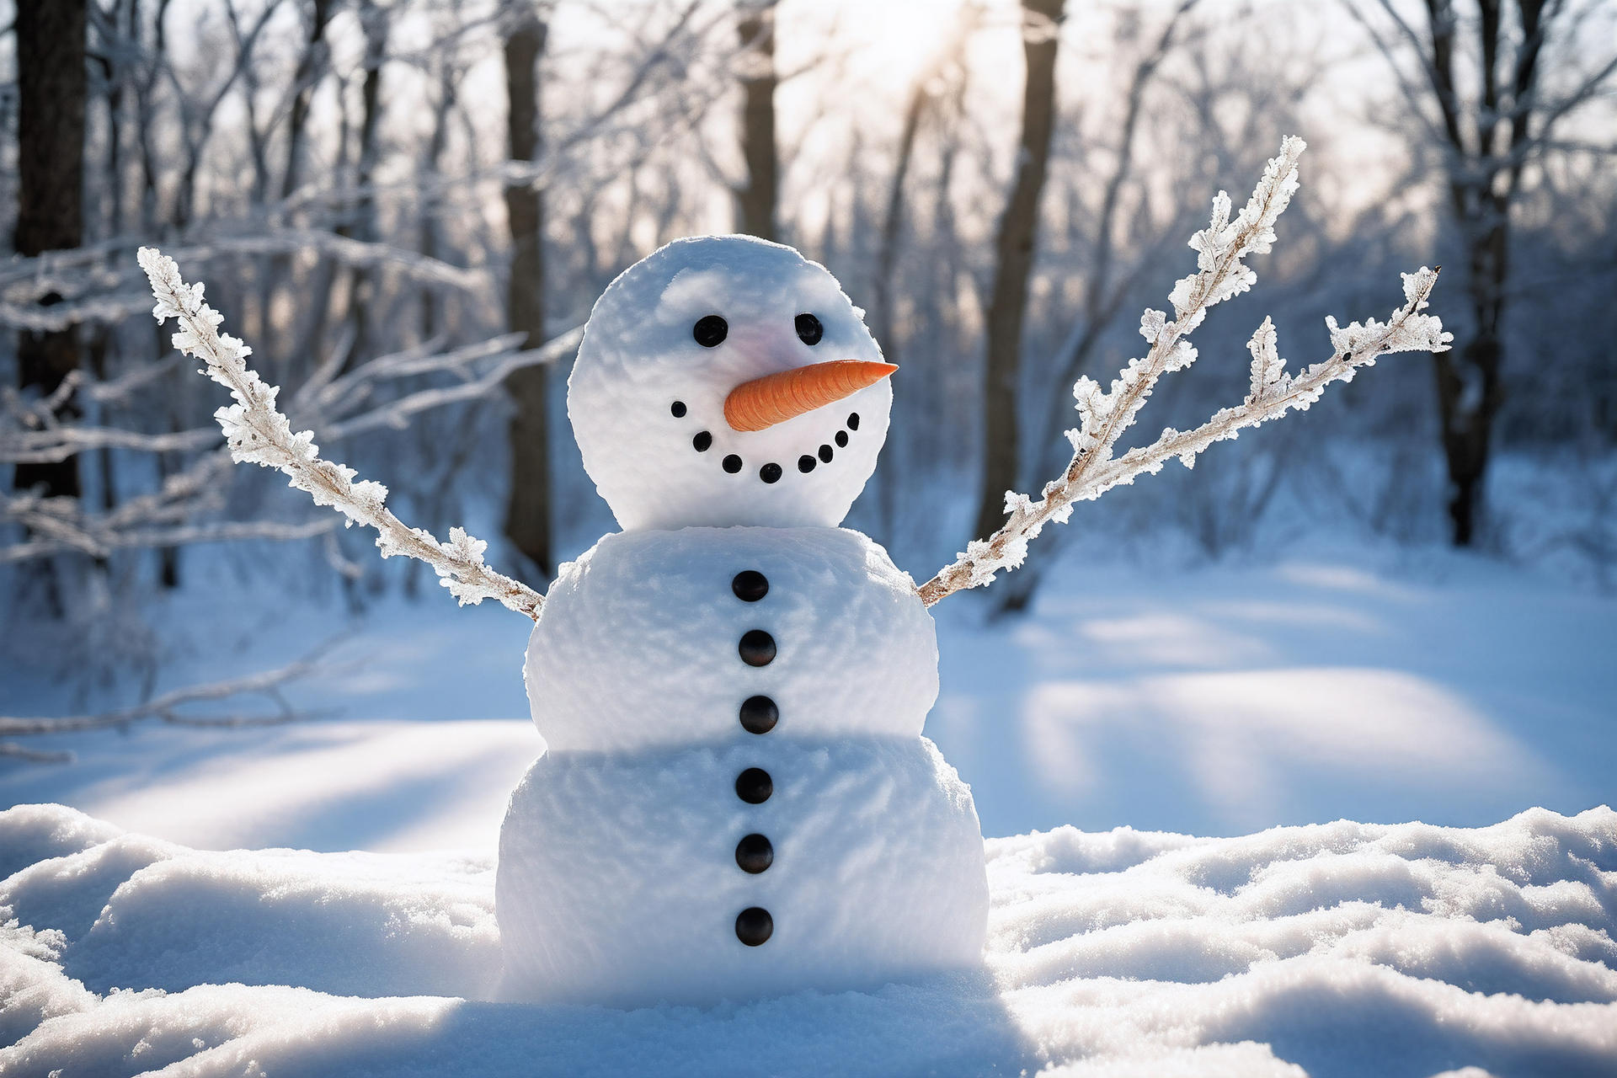
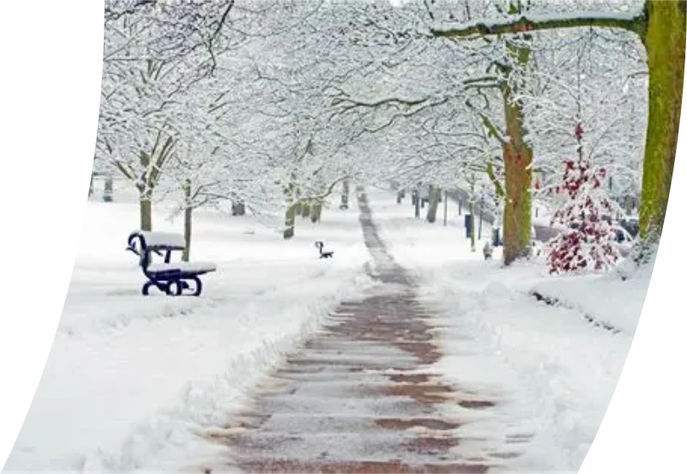


Attendance assembly 12th January 2025

Slide 2
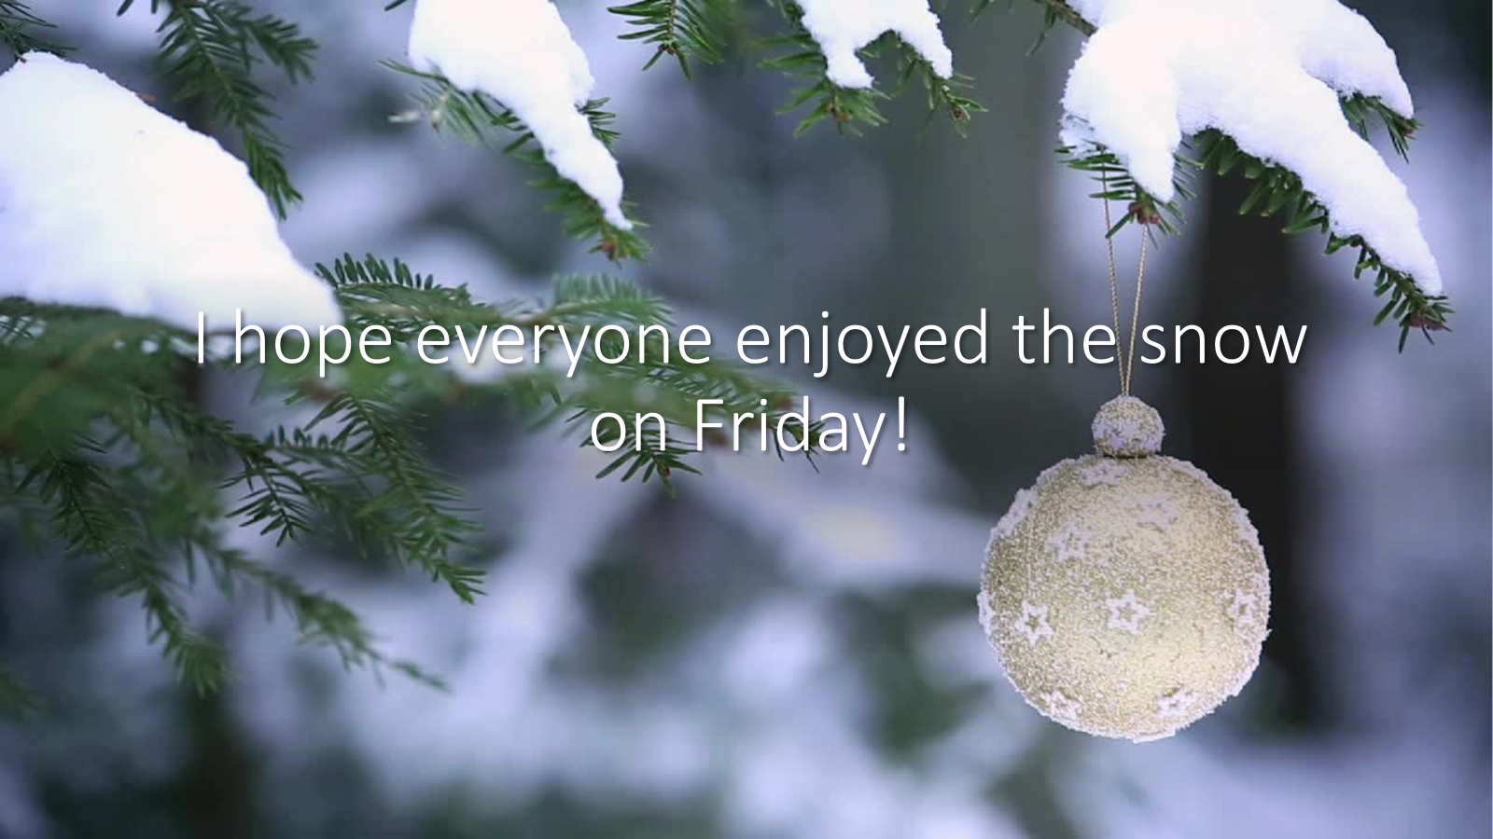

Slide 3

What will the new year bring for you?
Last week we discussed
New Years resolutions- a promise to yourself about how to do something a little better.
Sentence stems
' I would like to be able to....
Try yours out on a friend.
What help would you like from the class – to achieve your New Years Resolution?
Values: Resilience, Perseverance, Aspiration

Slide 4
Please have a look at our attendance newsletter
How is your class doing?
What ways can you think of to make sure everyone comes to school every day?
Can you say WHY this is important? Use the language of discussion.

Slide 5


Slide 6

95% and above Attendance weekly Reward.
Gain a star for each week your class achieves 95%+ How did your class do?

Slide 7

Let's look at attendance in the first week of January
We were in school for 3 days Tuesday- Thursday.
Keep working hard to be over 95% every week.

Slide 8

Ward End weekly attendance
YEAR | Wb 6th January | Wb 12th Jan | Wb 19th Jan | Wb 26th Jan | Wb 2nd Feb | Wb 9th Feb
6.1 | 94%
6.2 | 88%
6.3 | 92%
6.4 | 91%
5.1 | 94%
5.2 | 92%
5.3 | 96%
5.4 | 94%

Slide 9

Ward End weekly attendance
 | Wb 6th Jan | Wb 12th Jan | Week 19th Jan | Wb 26th Jan | Wb 2nd Feb | Wb 9Th Feb
4.1 | 91%
4.2 | 91%
4.3 | 96%
4.4 | 91%
3.1 | 95%
3.2 | 81%
3.3 | 94%
3.4 | 88%

Slide 10

Ward End weekly attendance
YEAR | Wb 6th Jan | Wb 12th Jan | Wb 19th Jan | Wb 26th Jan | Wb 2nd Feb | Wb 9th Feb
2.1 | 87%
2.2 | 93%
2.3 | 87%
2.4 | 91%
1.1 | 88%
1.2 | 91%
1.3 | 87%
1.4 | 91%

Slide 11

Ward End weekly attendance
YEAR | Wb 6th Jan | Wb 12th Jan | Wb 19th Jan | Wb 26th Jan | Wb 2nd Feb | Wb 9th Feb
Rabbits | 92%
Squirrels | 92%
Foxes | 82%
Hedgehogs | 92%
Owls | 95%
Doves | 89%
Swans | 100%

Slide 12

Well done Swans 100% attendance!

Slide 13


Slide 14
Walk to School Initiative
We are starting a Wak to School initiative next week
Less cars outside school makes it safer for everyone.
There will be lots to discuss, and points and badges to be earned.
Pupils who live too far away to walk- can park away from school and join the walking initiative too.
More news to follow – we’ll need everyone’s help.

Slide 15
What are you reading?
Cold weather is a great time to curl up with a good book.
Look on MyOn and choose something great!
Recommend one to your class.

Slide 16
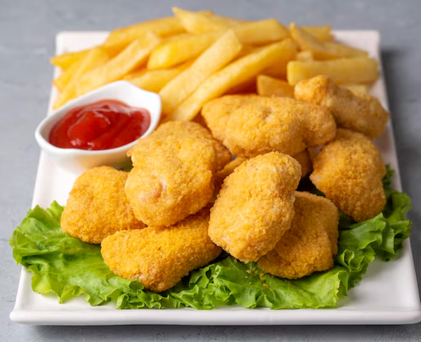

What’s happening this week?
Favourite lunch day 15th January
Voted for by pupils – enjoy!!

