Slide 1
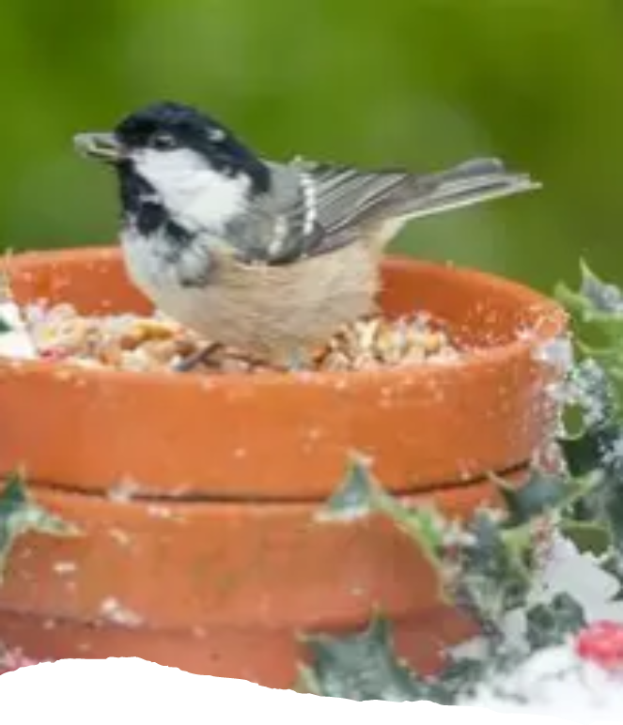
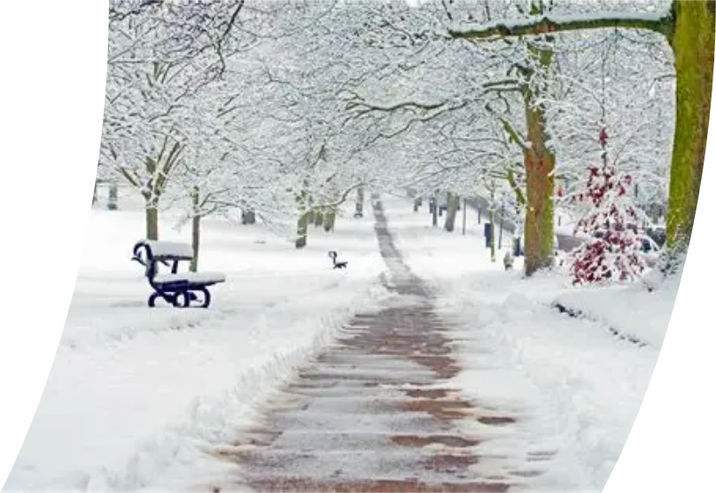


Attendance assembly 19th January 2025
Looking after our wildlife in Winter, and Walk To School Challenge.

Slide 2
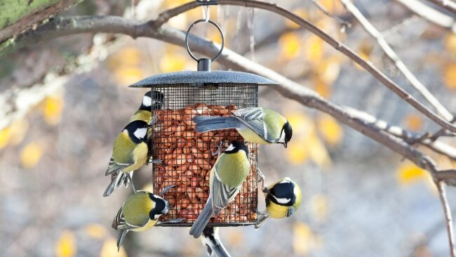
Think about animals who live outside over the winter, can we help them to stay alive in the cold? Value: Respect

Slide 3
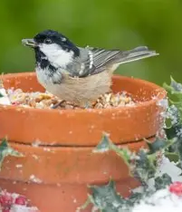
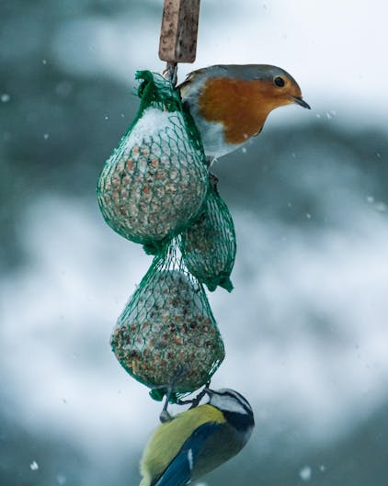
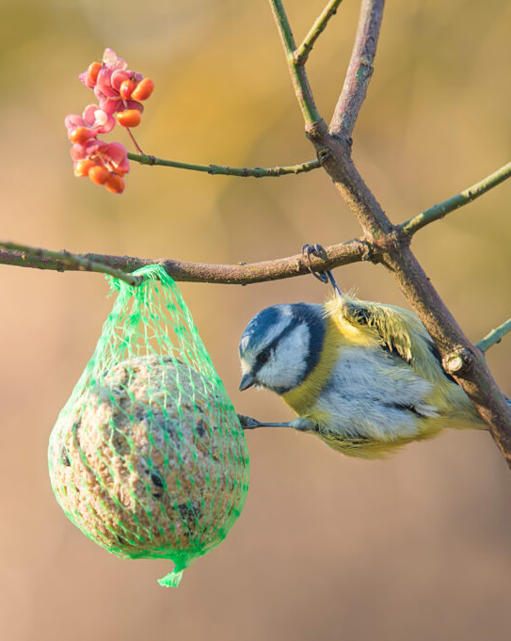
We can make bird cakes full of seed. Look up these garden birds, do you know what they are called?
FamilyID=Office_ArchiveTorn

Slide 4
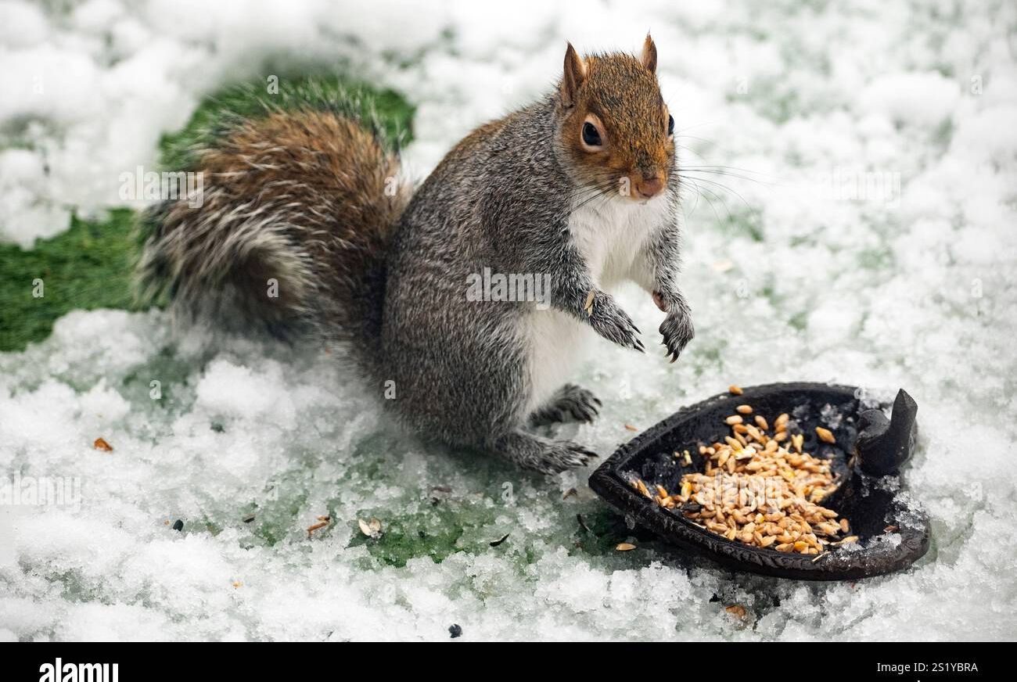
Squirrels need water, seeds and nuts, carrots and fresh green vegetable leaves – but no other human food- avoid bread too.

Slide 5

95% and above Attendance weekly Reward.
Gain a star for each week your class achieves 95%+ How did your class do?

Slide 6

12 classes over 95%
One class 100% two weeks running.

Slide 7

Ward End weekly attendance
YEAR | Wb 6th January | Wb 12th Jan | Wb 19th Jan | Wb 26th Jan | Wb 2nd Feb | Wb 9th Feb
6.1 | 94% | 96%
6.2 | 88% | 97%
6.3 | 92% | 96%
6.4 | 91% | 96%
5.1 | 94% | 98%
5.2 | 92% | 94%
5.3 | 96% | 90%
5.4 | 94% | 94%

Slide 8

Ward End weekly attendance
 | Wb 6th Jan | Wb 12th Jan | Week 19th Jan | Wb 26th Jan | Wb 2nd Feb | Wb 9Th Feb
4.1 | 91% | 93%
4.2 | 91% | 94%
4.3 | 96% | 97%
4.4 | 91% | 92%
3.1 | 95% | 95%
3.2 | 81% | 93%
3.3 | 94% | 92%
3.4 | 88% | 91%

Slide 9

Ward End weekly attendance
YEAR | Wb 6th Jan | Wb 12th Jan | Wb 19th Jan | Wb 26th Jan | Wb 2nd Feb | Wb 9th Feb
2.1 | 87% | 92%
2.2 | 93% | 91%
2.3 | 87% | 92%
2.4 | 91% | 93%
1.1 | 88% | 92%
1.2 | 91% | 93%
1.3 | 87% | 97%
1.4 | 91% | 98%

Slide 10


Ward End weekly attendance
YEAR | Wb 6th Jan | Wb 12th Jan | Wb 19th Jan | Wb 26th Jan | Wb 2nd Feb | Wb 9th Feb
Rabbits | 92% | 99%
Squirrels | 92% | 90%
Foxes | 82% | 87%
Hedgehogs | 92% | 92%
Owls | 95% | 98%
Doves | 89% | 93%
Swans | 100% | 100%

Slide 11
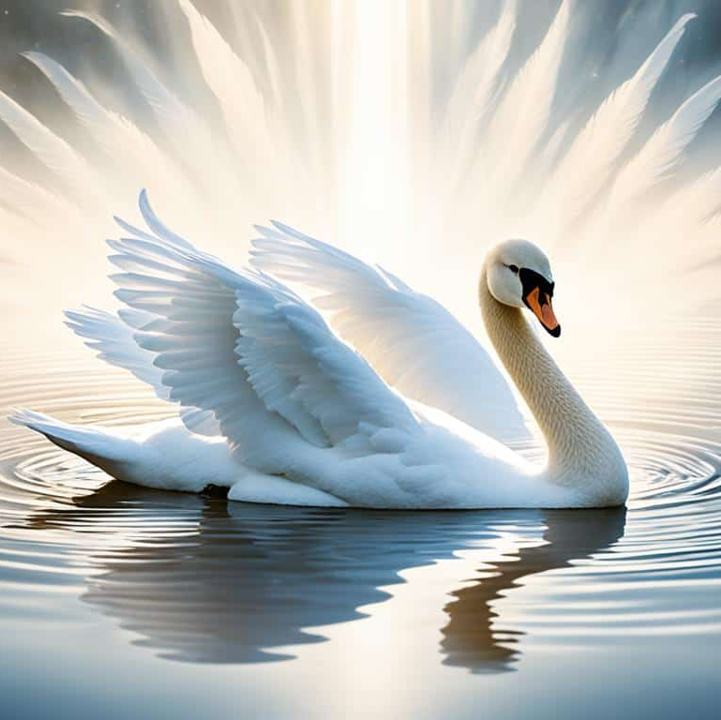
Well done Swans 100% attendance!

Slide 12
Look at your class attendance over the last 2 weeks.
Could your class gain 100% as well?
How is your class doing?
What ways can you think of to make sure everyone comes to school every day?
Can you say WHY this is important? Use the language of discussion.

Slide 13


Slide 14


Slide 15
Walk to School Initiative
We are starting a Walk to School initiative this week and every week.
Less cars outside school makes it safer for everyone.
There will be lots to discuss, and points and badges to be earned.
Pupils who live too far away to walk- can park away from school and join the walking initiative too. Park and stride. Park 5 minutes walk away and walk the extra distance.
Log your journey to school every day- to earn badges each month.
How did you travel to school?
Value: perseverance

Slide 16
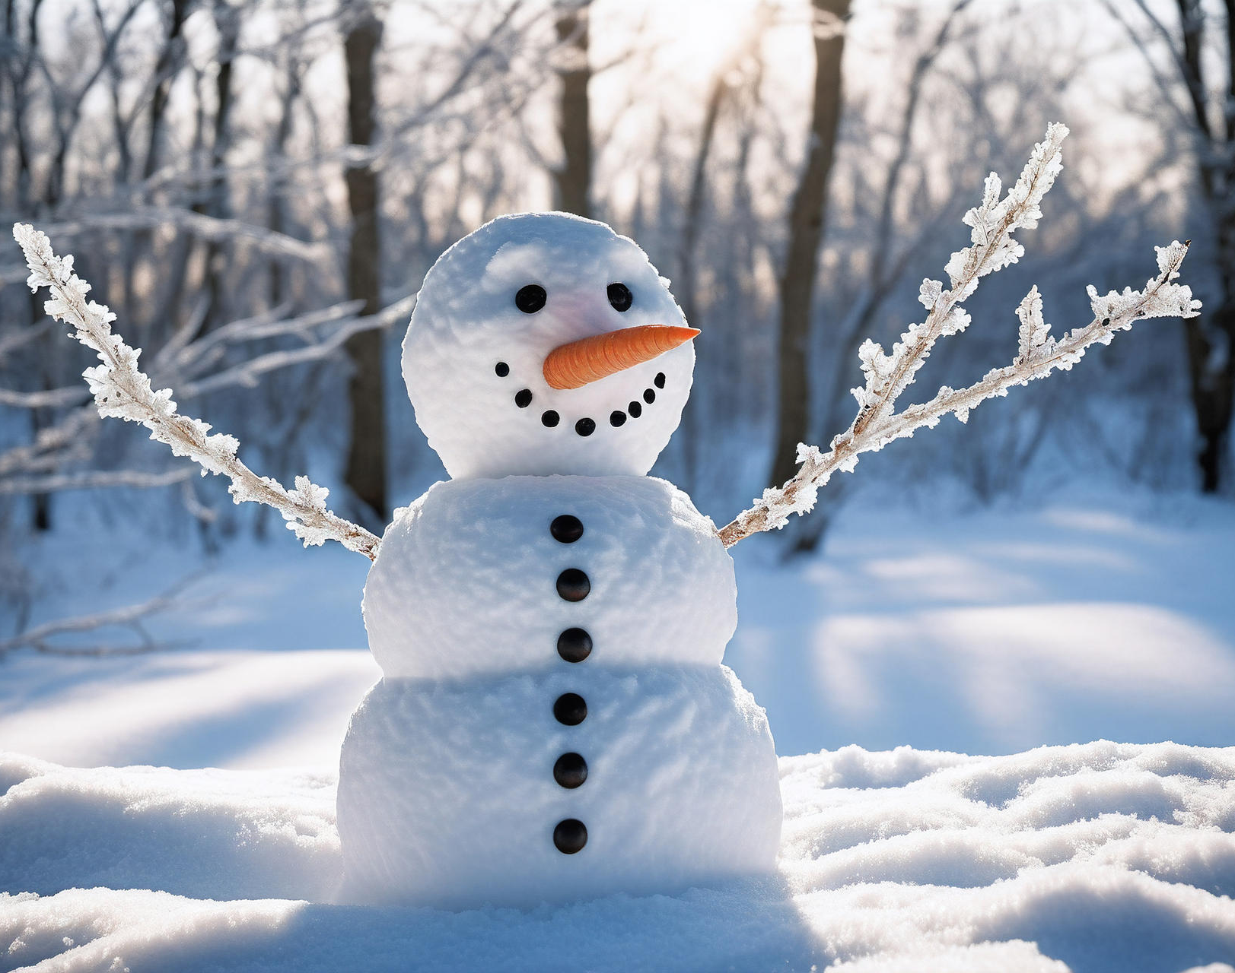
Autumn term 2 attendance rewards.
Certificates will be given out this week- for last terms attendance. Your teacher will share these with you.
Attendance rewards for pupils with over 95% last term, take place this week. Wait and see! It’s a surprise.

Slide 17


What are you Reading? This is my new book.

Slide 18

My next read
Eleven-year-old Zubair is a seventh son. This means a LOT of big brothers. But when Zubair’s granny arrives from Pakistan and gives him a mysterious amulet, he discovers it means something else, too: he has inherited a gift. The seventh sons in his family has the ability to time-travel.
With his dad a shadow of his former self since his car accident, and his mum always tired and angry, Zubair has a genius idea. He’ll use time-travel to fix things.
But each trip comes at a cost. If he changes something small in the past, it can have a huge effect on his future. And if he gets it wrong, the results could be devastating…

Slide 19

What will the new year bring for you?
Last week we discussed New Years resolutions- a promise to yourself about how to do something a little better.
What support do you need from your friends to help with your New Years Resolutions?
Values: Resilience, Perseverance, Aspiration

