Slide 1
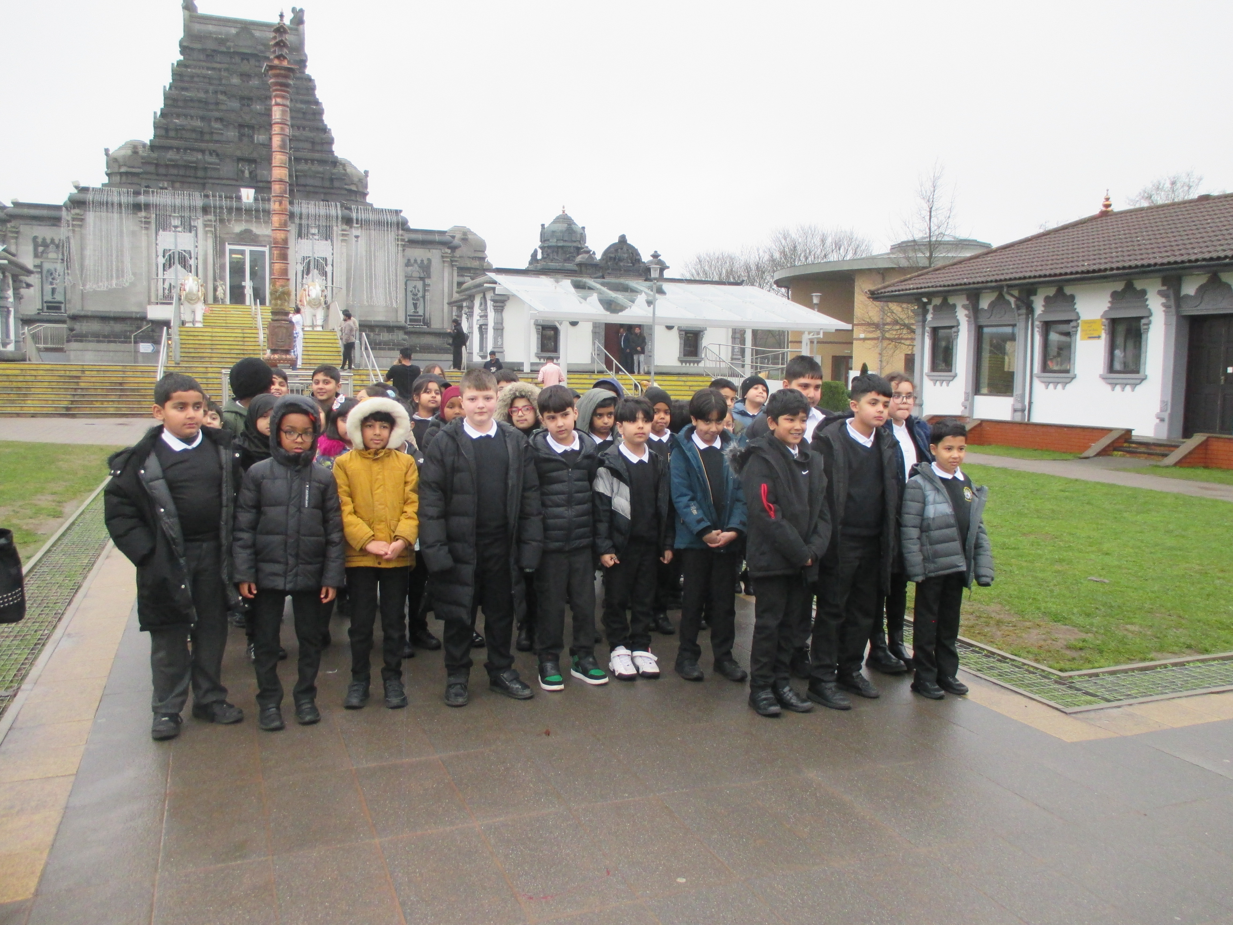



Attendance assembly 26th January 2025

Slide 2

95% and above Attendance weekly Reward.
Gain a star for each week your class achieves 95%+ How did your class do?

Slide 3

16 classes over 95%
One year group has every class over 95%
Well done!

Slide 4

Ward End weekly attendance
YEAR | Wb 6th January | Wb 12th Jan | Wb 19th Jan | Wb 26th Jan | Wb 2nd Feb | Wb 9th Feb
6.1 | 94% | 96% | 93%
6.2 | 88% | 97% | 99%
6.3 | 92% | 96% | 96%
6.4 | 91% | 96% | 96%
5.1 | 94% | 98% | 97%
5.2 | 92% | 94% | 94%
5.3 | 96% | 90% | 93%
5.4 | 94% | 94% | 95%

Slide 5

Ward End weekly attendance
 | Wb 6th Jan | Wb 12th Jan | Week 19th Jan | Wb 26th Jan | Wb 2nd Feb | Wb 9Th Feb
4.1 | 91% | 93% | 92%
4.2 | 91% | 94% | 92%
4.3 | 96% | 97% | 97%
4.4 | 91% | 92% | 95%
3.1 | 95% | 95% | 92%
3.2 | 81% | 93% | 94%
3.3 | 94% | 92% | 95%
3.4 | 88% | 91% | 92%

Slide 6

Ward End weekly attendance
YEAR | Wb 6th Jan | Wb 12th Jan | Wb 19th Jan | Wb 26th Jan | Wb 2nd Feb | Wb 9th Feb
2.1 | 87% | 92% | 92%
2.2 | 93% | 91% | 94%
2.3 | 87% | 92% | 93%
2.4 | 91% | 93% | 95%
1.1 | 88% | 92% | 97%
1.2 | 91% | 93% | 95%
1.3 | 87% | 97% | 95%
1.4 | 91% | 98% | 97%

Slide 7


Ward End weekly attendance
YEAR | Wb 6th Jan | Wb 12th Jan | Wb 19th Jan | Wb 26th Jan | Wb 2nd Feb | Wb 9th Feb
Rabbits | 92% | 99% | 97%
Squirrels | 92% | 90% | 90%
Foxes | 82% | 87% | 93%
Hedgehogs | 92% | 92% | 88%
Owls | 95% | 98% | 95%
Doves | 89% | 93% | 90%
Swans | 100% | 100% | 95%

Slide 8


Well done Year 1! All classes over 95%

Slide 9

Fabulous attendance celebration
We enjoyed the silent disco!
Be in school every day to achieve the next attendance surprise.
Any ideas for our next attendance reward at the end of February????
Value: Curiosity, perseverance

Slide 10
Year 3 visited the Hindu Temple last week

Slide 11
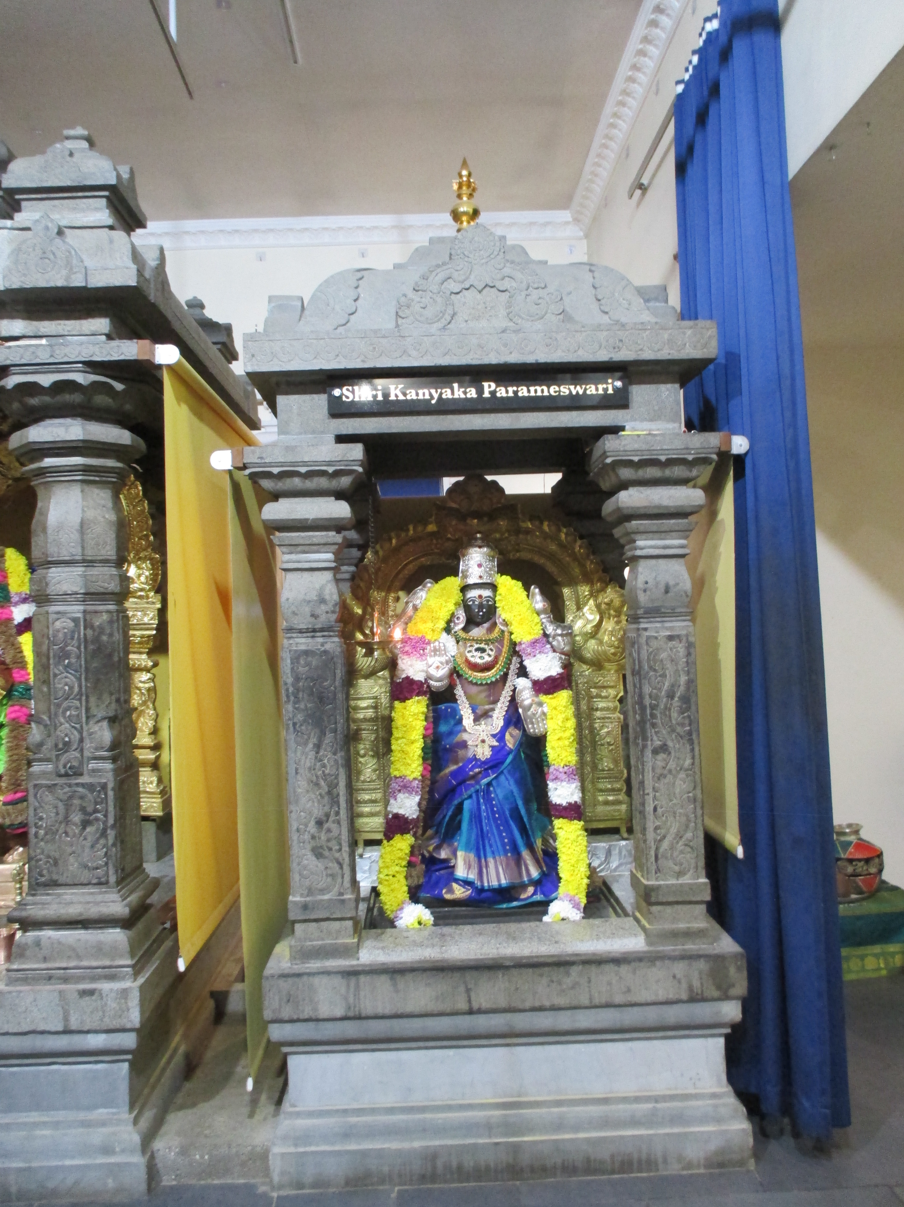
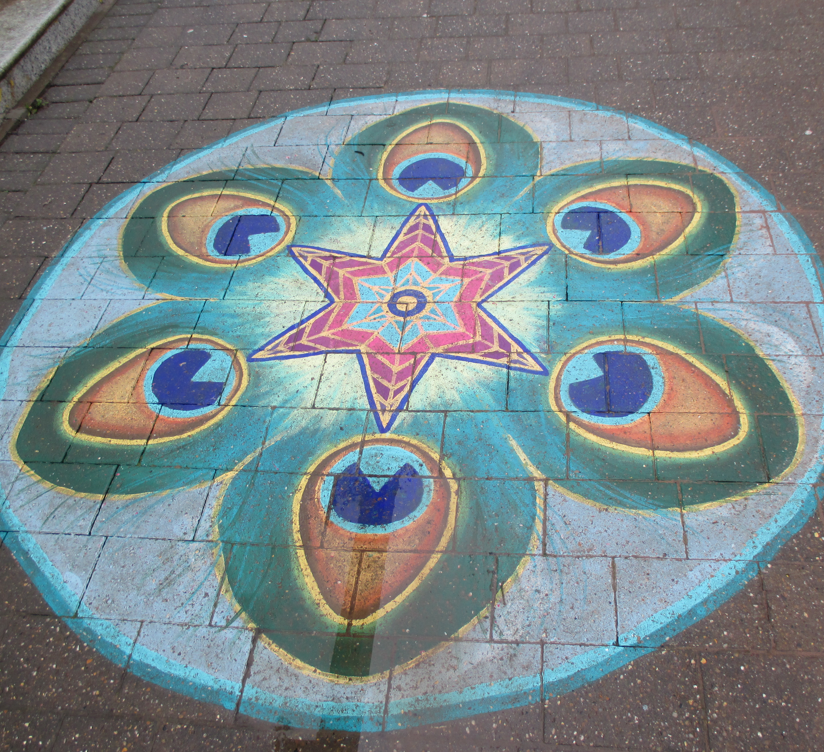
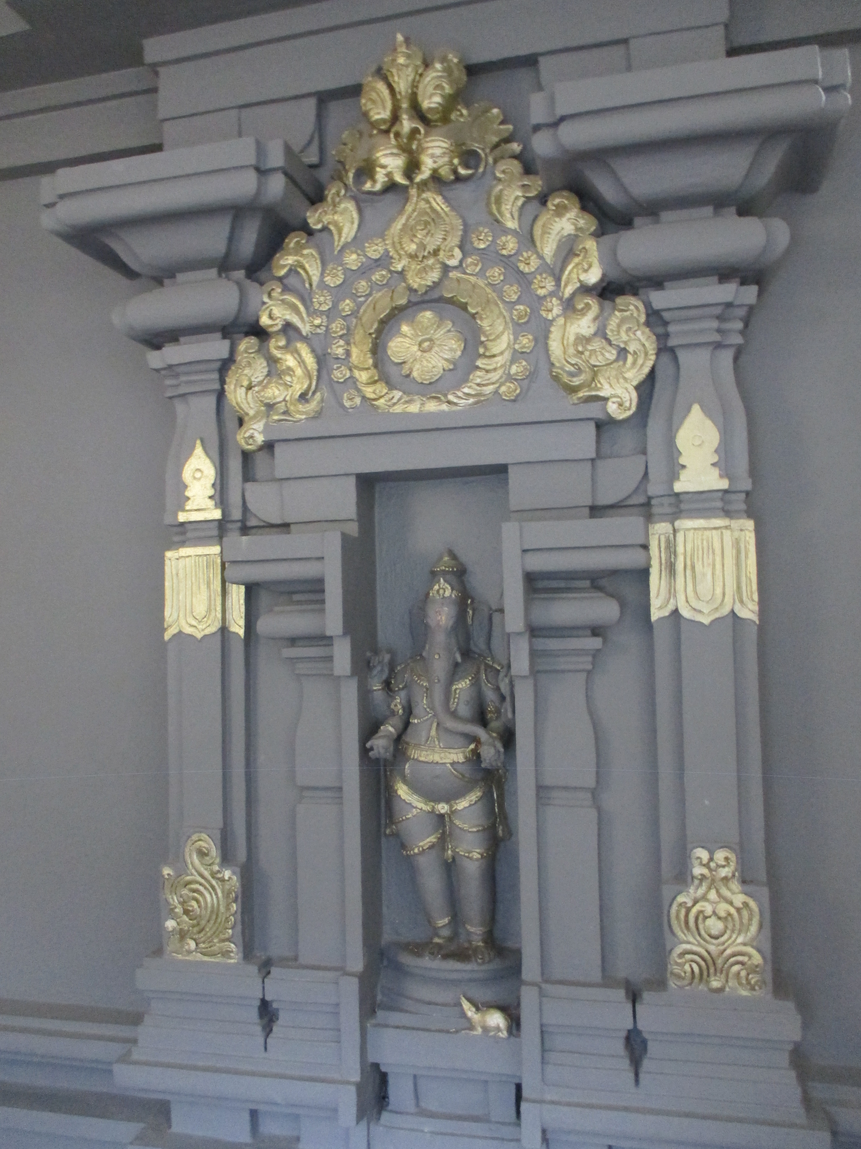
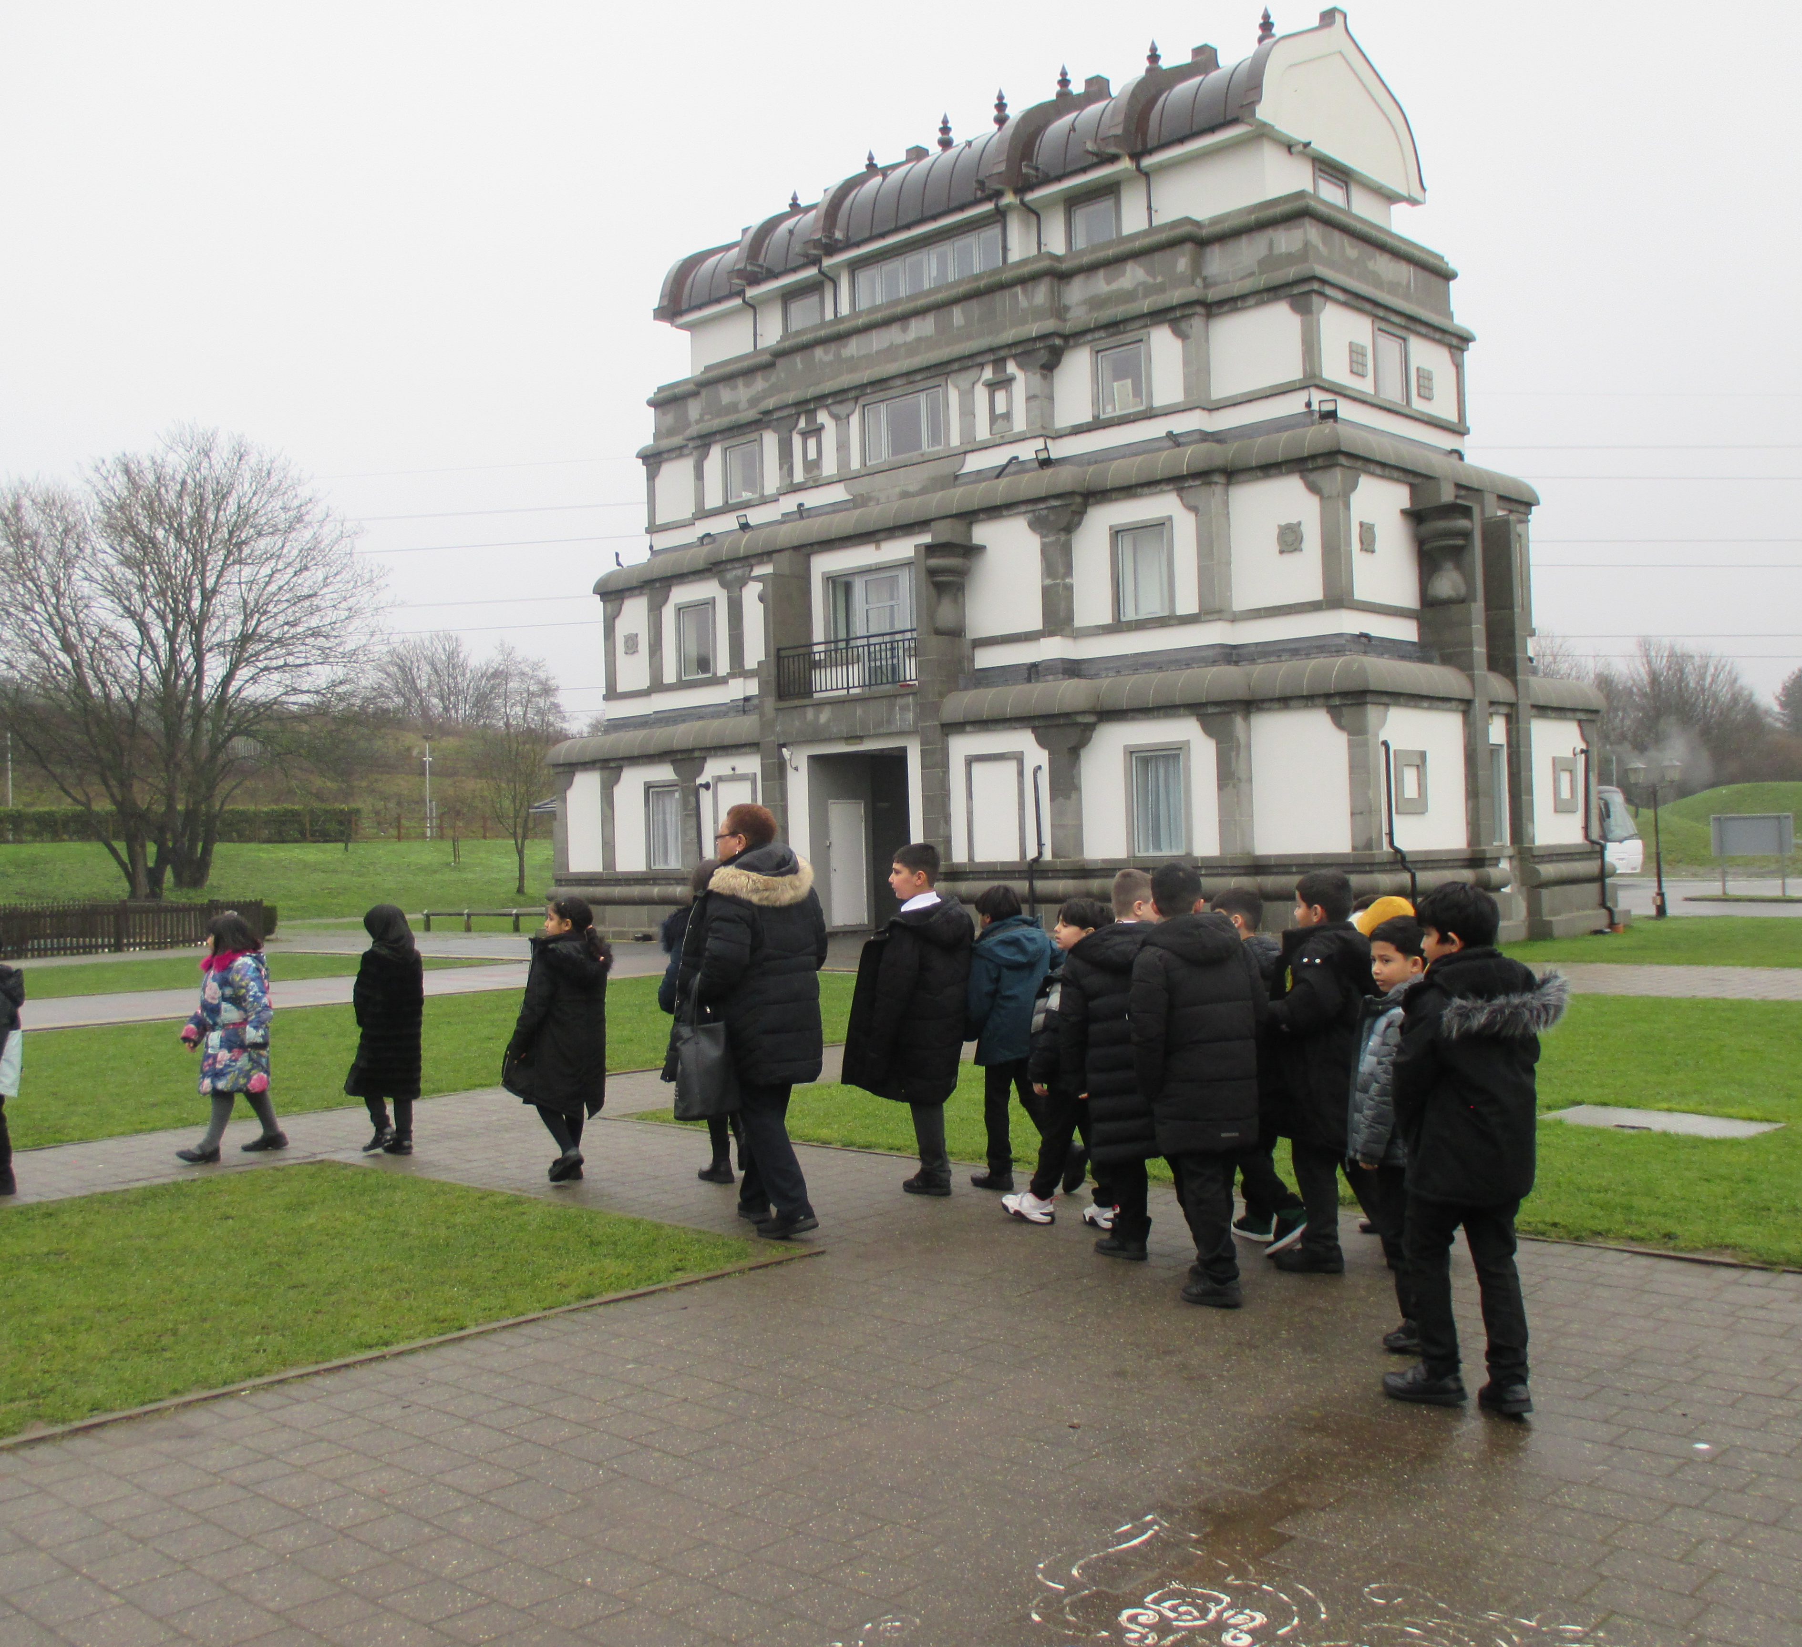
Value
Respect, Curiosity,
Some photos from the visit

Slide 12
Ward End School News

Slide 13

The following posters support our behaviour policy ( next 2 slides)
Have a read and discuss where they should be displayed.
How are they going to be useful.
Hopw could you use them to help others?

Slide 14


Slide 15


Slide 16


Slide 17
Walk to School Initiative
PARK and STRIDE – can you do it? Ask your parents to read the letter sent by class dojo
Pupils who live too far away to walk- can park away from school and join the walking initiative too. Park and stride. Park 5 minutes walk away and walk the extra distance.
Log your journey to school every day- to earn badges each month.
How did you travel to school?
Value: perseverance

Slide 18


What are you Reading? This is my new book.

Slide 19


Slide 20
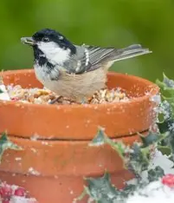
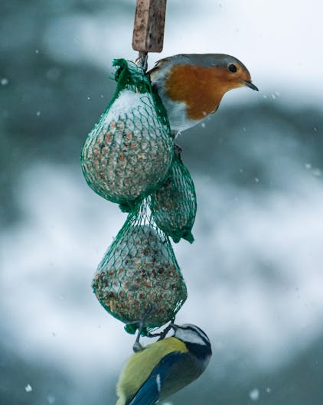
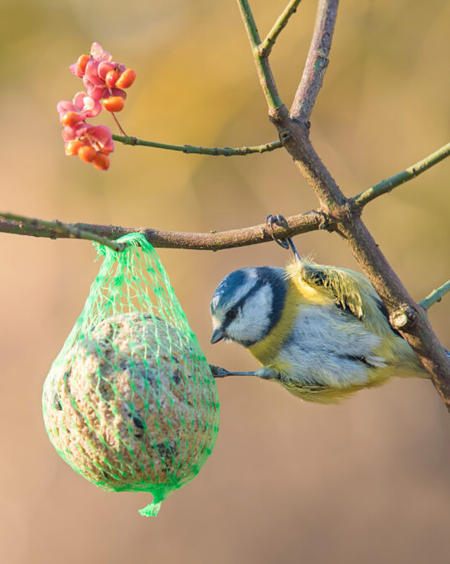
We can make bird cakes full of seed. Look up these garden birds, do you know what they are called? Answer 1.Pied Wagtail 2. Robin 3. Blue-tit
FamilyID=Office_ArchiveTorn

Slide 21
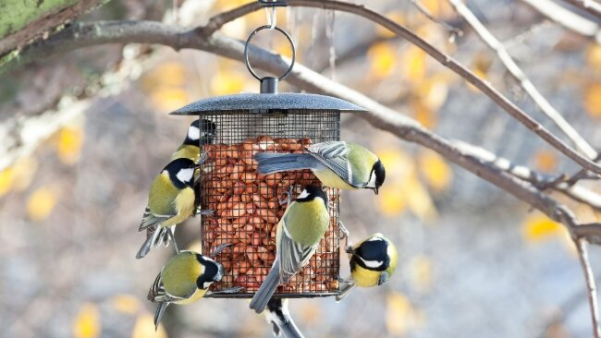
Think about animals who live outside over the winter, can we help them to stay alive in the cold? Value: Respect

