Slide 1


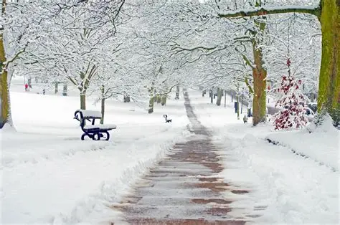
Attendance assembly 6th January 2026

Slide 2

I hope everyone had a lovely 2 weeks holiday.

Slide 3


Slide 4

95% and above Attendance weekly Reward.
Gain a star for each week your class achieves 95%+ How did your class do?

Slide 5

Only 4 of our 31 classes have over 95% attendance for the last week of December 2025
Highest score was 98% Rabbits class Reception.
Well done Rabbits - SUPER STARS
We need to be in school EVERY DAY to be successful.

Slide 6


Slide 7

Ward End weekly attendance- Autumn 1
YEAR | Wb 3rd Nov | Wb 10th Nov | Wb 17th Nov | Wb 24th Nov | ^{Wb 1st Dec} | ^{Wb 8th Dec} | ^{W b 15th Dec}
6.1 | 98% | 95% | 95% | 96% | 94% | 93% | 95%
6.2 | 93% | 91% | 95% | 94% | 92% | 93% | 95%
6.3 | 95% | 98% | 98% | 96% | 95% | 88% | 84%
6.4 | 96% | 95% | 99% | 95% | 97% | 91% | 90%
5.1 | 93% | 98% | 95% | 95% | 96% | 96% | 94%
5.2 | 93% | 89% | 89% | 91% | 96% | 95% | 88%
5.3 | 94% | 96% | 96% | 88% | 82% | 92% | 89%
5.4 | 96% | 95% | 94% | 85% | 91% | 95% | 94%

Slide 8

Ward End weekly attendance Autumn 1
 | Wb 3rd Nov | Wb 10th Nov | Week 17th Nov | Wb 24th Nov | ^{Wb 1st Dec} | ^{Wb 8th Dec} | ^{Wb 15th Dec}
4.1 | 90% | 90% | 95% | 93% | 87% | 88% | 85%
4.2 | 90% | 90% | 95% | 95% | 87% | 83% | 78%
4.3 | 91% | 95% | 91% | 98% | 98% | 97% | 93%
4.4 | 92% | 99% | 95% | 94% | 92% | 88% | 85%
3.1 | 92% | 97% | 99% | 99% | 97% | 97% | 92%
3.2 | 96% | 93% | 91% | 95% | 94% | 86% | 84%
3.3 | 87% | 90% | 95% | 93% | 96% | 95% | 90%
3.4 | 96% | 93% | 97% | 96% | 86% | 97% | 94%

Slide 9

Ward End weekly attendance Autumn 1
YEAR | Wb 3rd Nov | Wb 10th Nov | Wb 17th Nov | Wb 24th Nov | ^{Wb 1st Dec} | ^{Wb 8th Dec} | ^{Wb 15th Dec}
2.1 | 95% | 93% | 93% | 94% | 92% | 94% | 89%
2.2 | 95% | 95% | 93% | 96% | 93% | 94% | 91%
2.3 | 85% | 94% | 94% | 85% | 91% | 95% | 89%
2.4 | 94% | 95% | 98% | 94% | 95% | 92% | 88%
1.1 | 91% | 91% | 98% | 98% | 88% | 87% | 86%
1.2 | 96% | 95% | 95% | 95% | 96% | 90% | 94%
1.3 | 95% | 98% | 91% | 93% | 94% | 95% | 85%
1.4 | 94% | 97% | 96% | 96% | 91% | 94% | 95%

Slide 10


Ward End weekly attendance Autumn 1
YEAR | Wb 3rd Nov | Wb 10th Nov | Wb 17th Nov | Wb 24th Nov | Wb 1st Dec | Wb 8th Dec | Wb 15th Dec
Rabbits | 95% | 93% | 88% | 93% | 91% | 86% | 98%
Squirrels | 91% | 84% | 84% | 84% | 90% | 87% | 88%
Foxes | 75% | 94% | 95% | 77% | 86% | 88% | 88%
Hedgehogs | 90% | 82% | 80% | 90% | 88% | 94% | 92%
Owls | 96% | 98% | 90% | 93% | 95% | 95% | 90%
Doves | 92% | 98% | 95% | 98% | 95% | 78% | 75%
Swans | 100% | 82% | 95% | 100% | 97% | 95% | 85%

Slide 11
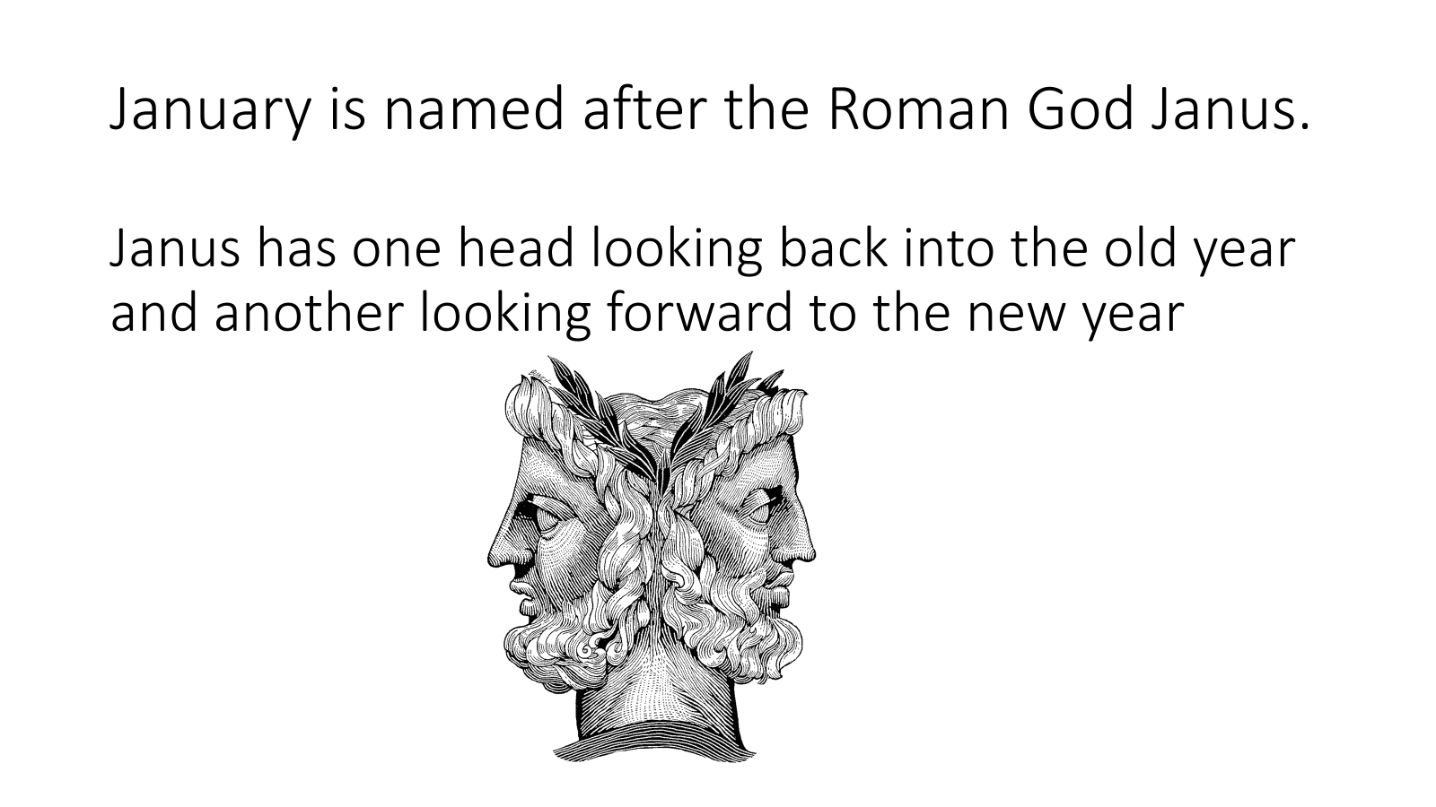

Slide 12


Slide 13
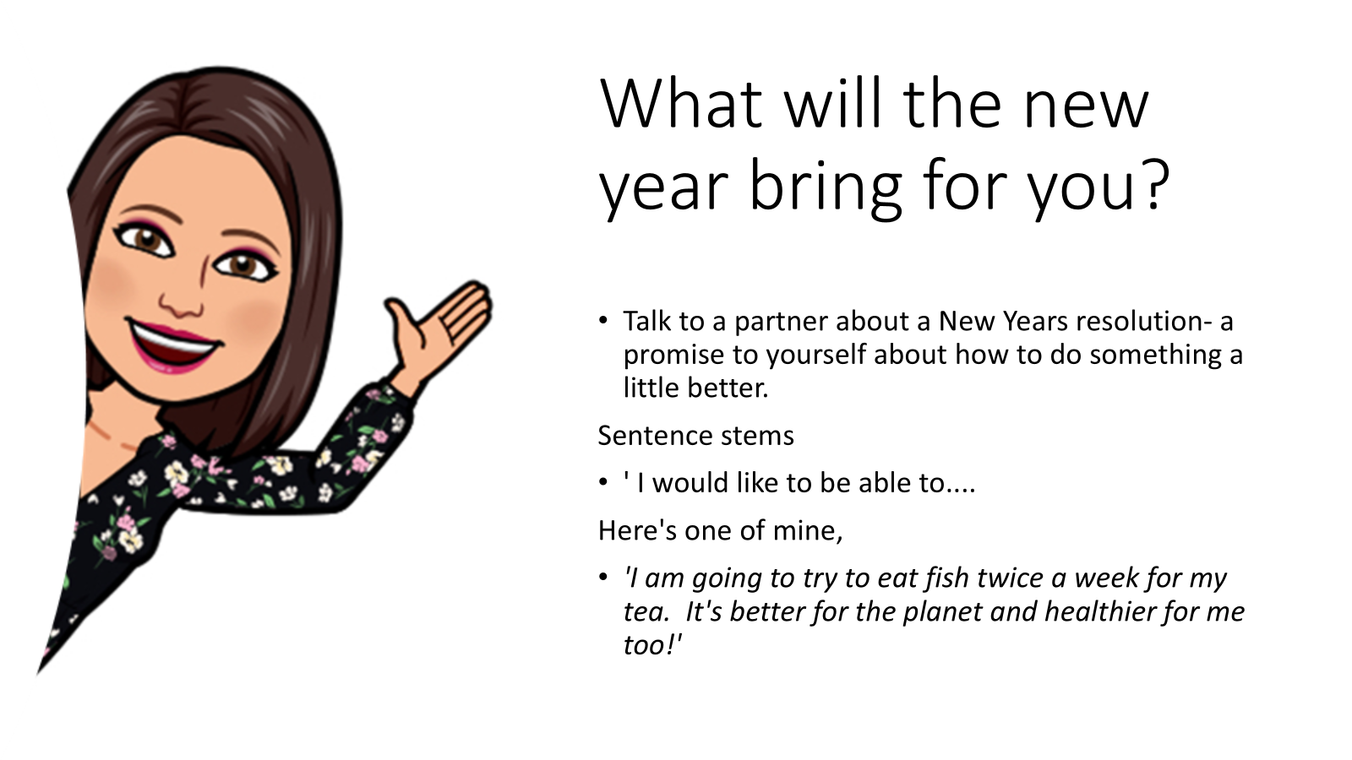

Slide 14

Check presentation skills on this chart.

Slide 15

A very cold week is forecast.
Please name all coats/ hats/ scarves.
As it's rather nippy, if your school shoes are slippery- and you have something more grippy... please wear them.
( carry on the poem if you like)
Requirements for school shoes are relaxed this week.
Choose appropriate foot wear for the weather, to wear with your usual uniform.

Slide 16
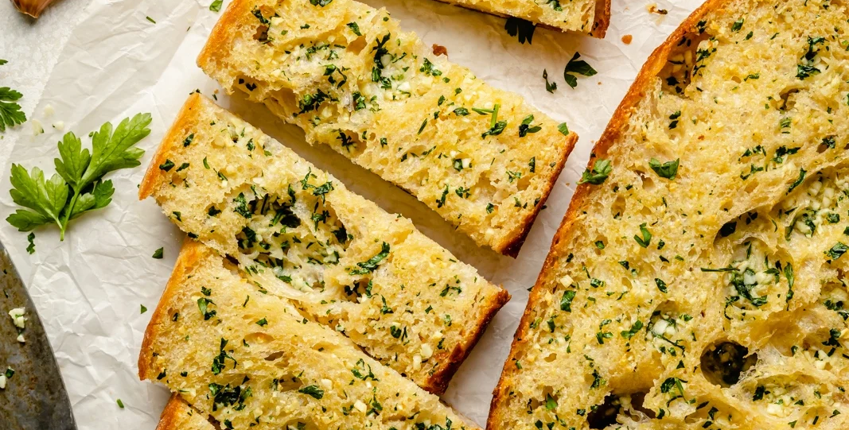
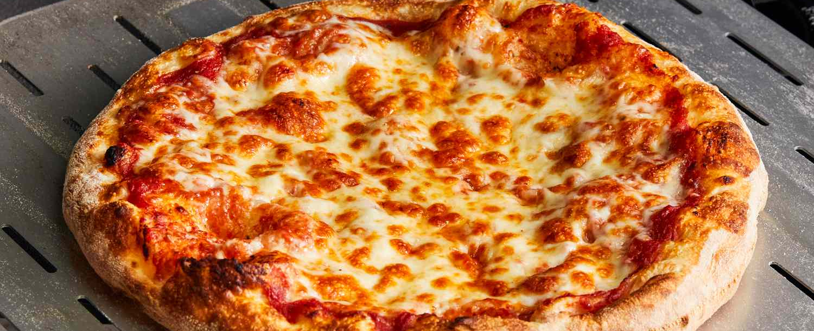
If you presently do not have school dinners, but would like to join –in. You Can!
You can choose 1, 2,3 or 4 days each week to have a school dinner.
Stick to them same days each week.
You could join for Pizza Friday’s?
The new menus have been published on dojo, so you can discuss it at home and decide.
Parents E mail the school office when you have decided.

Slide 17


What did you read over the holidays?
Can you review your book in 3 words?
I am Rebel…Loyalty & friendship in the face of a challenge!

