Slide 1


Attendance assembly 23rd February 2026

Slide 2

95% and above Attendance weekly Reward.
Gain a star for each week your class achieves 95%+ How did your class do?

Slide 3

7 classes over 95%
One class 100%
Well done!

Slide 4

Ward End weekly attendance
YEAR | Wb 6th January | Wb 12th Jan | Wb 19th Jan | Wb 26th Jan | Wb 2nd Feb | Wb 9th Feb
6.1 | 94% | 96% | 93% | 94% | 97% | 94%
6.2 | 88% | 97% | 99% | 97% | 96% | 96%
6.3 | 92% | 96% | 96% | 89% | 98% | 94%
6.4 | 91% | 96% | 96% | 98% | 93% | 92%
5.1 | 94% | 98% | 97% | 95% | 96% | 93%
5.2 | 92% | 94% | 94% | 94% | 91% | 94%
5.3 | 96% | 90% | 93% | 94% | 92% | 92%
5.4 | 94% | 94% | 95% | 95% | 96% | 96%

Slide 5

Ward End weekly attendance
 | Wb 6th Jan | Wb 12th Jan | Week 19th Jan | Wb 26th Jan | Wb 2nd Feb | Wb 9Th Feb
4.1 | 91% | 93% | 92% | 89% | 88% | 92%
4.2 | 91% | 94% | 92% | 95% | 93% | 94%
4.3 | 96% | 97% | 97% | 95% | 98% | 90%
4.4 | 91% | 92% | 95% | 95% | 92% | 94%
3.1 | 95% | 95% | 92% | 91% | 91% | 97%
3.2 | 81% | 93% | 94% | 94% | 94% | 94%
3.3 | 94% | 92% | 95% | 96% | 94% | 95%
3.4 | 88% | 91% | 92% | 92% | 96% | 93%

Slide 6

Ward End weekly attendance
YEAR | Wb 6th Jan | Wb 12th Jan | Wb 19th Jan | Wb 26th Jan | Wb 2nd Feb | Wb 9th Feb
2.1 | 87% | 92% | 92% | 94% | 94% | 94%
2.2 | 93% | 91% | 94% | 89% | 91% | 93%
2.3 | 87% | 92% | 93% | 91% | 97% | 100%
2.4 | 91% | 93% | 95% | 95% | 97% | 97%
1.1 | 88% | 92% | 97% | 96% | 93% | 94%
1.2 | 91% | 93% | 95% | 93% | 96% | 90%
1.3 | 87% | 97% | 95% | 93% | 94% | 92%
1.4 | 91% | 98% | 97% | 95% | 94% | 91%

Slide 7


Ward End weekly attendance
YEAR | Wb 6th Jan | Wb 12th Jan | Wb 19th Jan | Wb 26th Jan | Wb 2nd Feb | Wb 9th Feb
Rabbits | 92% | 99% | 97% | 94% | 93% | 92%
Squirrels | 92% | 90% | 90% | 94% | 91% | 92%
Foxes | 82% | 87% | 93% | 91% | 92% | 87%
Hedgehogs | 92% | 92% | 88% | 91% | 92% | 94%
Owls | 95% | 98% | 95% | 100% | 98% | 82%
Doves | 89% | 93% | 90% | 78% | 87% | 86%
Swans | 100% | 100% | 95% | 95% | 95% | 95%

Slide 8

Well done 2.3

Slide 9
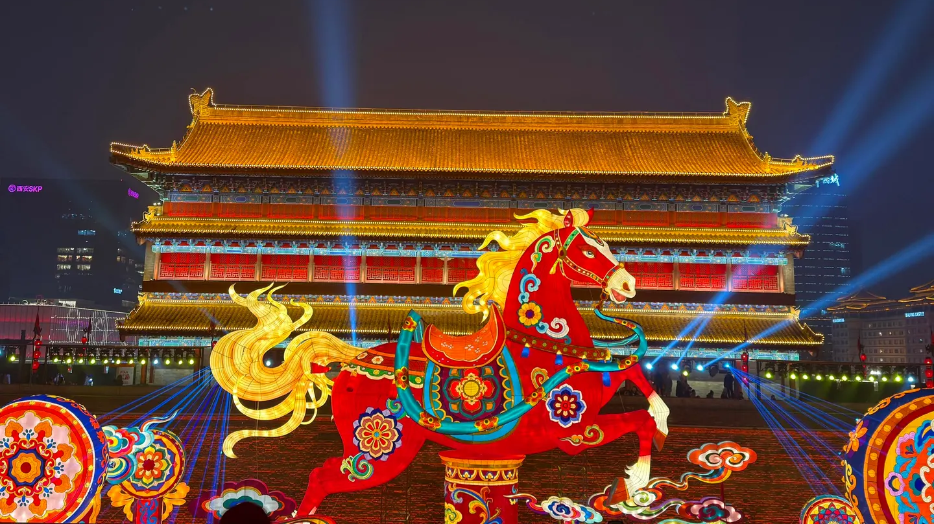
Chinese New Year 17th February- The Year of the Fire Horse

Slide 10
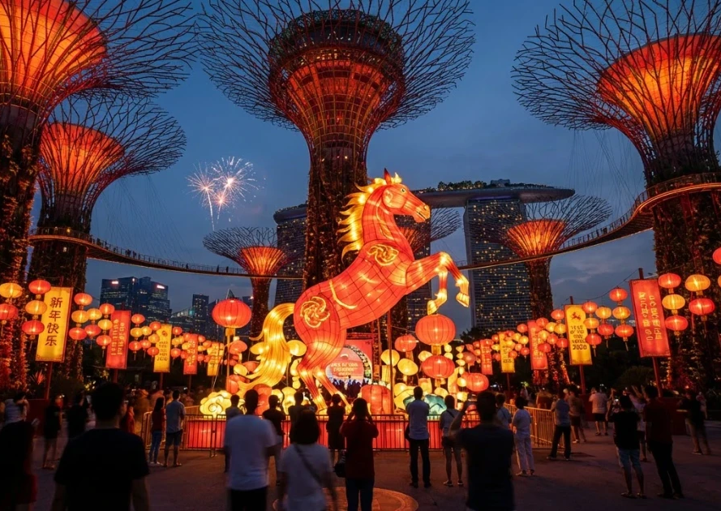
A fire horse year only happens once in 60 years
If you were born during a Fire Horse year you may be;
Independent
Bold, fearless, and action-oriented
A leader
Highly creative and expressive
Other years of the horse 1990 (Metal horse)
2002 (water horse) 2014 (wood horse)

Slide 11
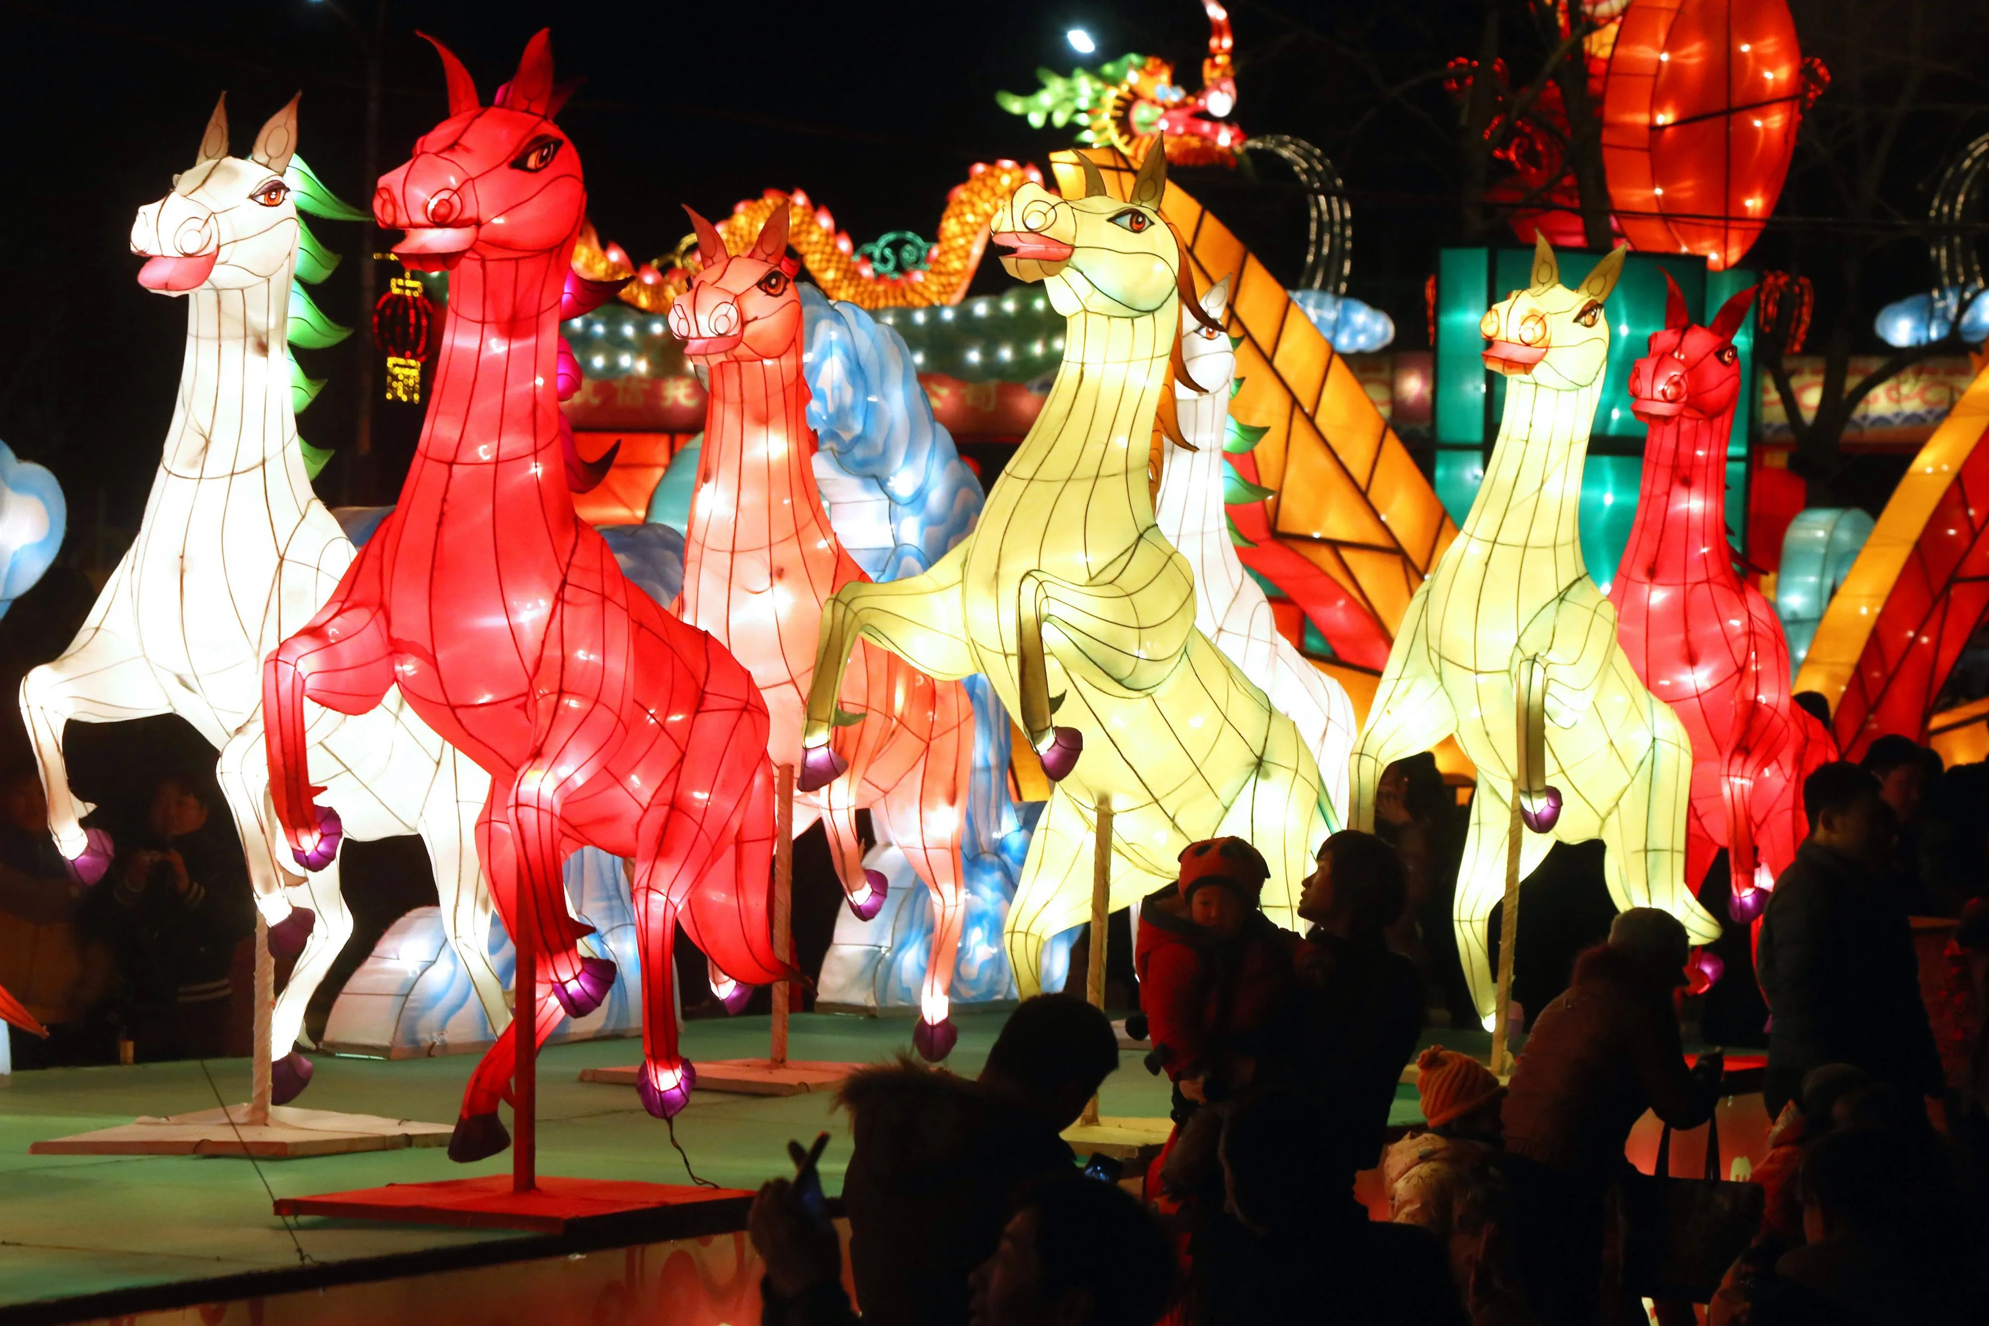
Find out what Chinese New Year you were born under and what your character is said to be

Slide 12

Ward End School News.
The Swimming Pool is here!
Year 3 and Year 4
Monday 23rd February – Friday 17th April
Year 1, Year 2 and Resource Base
Monday 20th April – Friday 22nd May
Year 5 and Year 6
Monday 1st June – Friday 17th July

Slide 13

Save the Date!
Ward End celebrates World Book Day with a week of live author visits and a book fair
On
Monday 2nd – Friday 6th March.
Your teacher has booked a LIVE author visit
you’ll learn secrets, ask questions, and get inspired!”

Slide 14


Which live author do YOU want to meet?
Book on now !

Slide 15

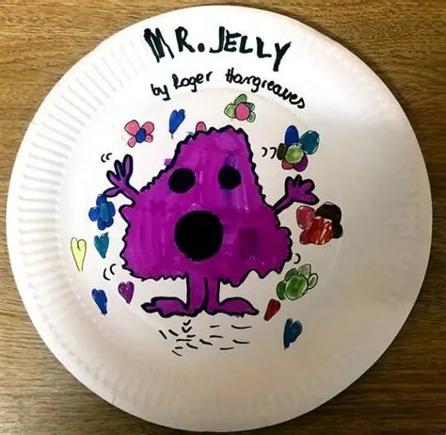
World Book Day 5th March
Have you had a go at designing your plate to represent a book you love? There is still time to complete your art-work and bring it into school (holiday homework)

Slide 16


Fabulous attendance celebration
Our next attendance celebration is planned for next week.
Certificates next week too.
If you gained 95% + attendance in January and February you will be able to attend.
Value: Curiosity, perseverance

Slide 17

A Charter for playtime/lunchtime.
Please work with your class to come up with 4 positive rules for play time and lunchtime.
We want to avoid pupils having accidents by improving the way we play.
What do you think we should plan to do?
Send you 4 ideas to your UNICEF reps at the end of this week please?
Think about our school aims and rules (see next few slides to remind yourself)

Slide 18


Slide 19


Slide 20


Slide 21

WEPS school aims
Ward End Primary is a Reading School.
We are Global Citizens within a World Class School.
We have high standards of attendance and punctuality.
Family, community and character education are at the heart of all we do.
Our pupils are well prepared for Key Stage 3 and beyond

Slide 22
WEPS Values
Respect, Resilience
Courage, Curiosity
Aspiration, Pereverance

Slide 23

Walk to School Initiative
PARK and STRIDE – can you do it? Ask your parents to read the letter sent by class dojo
Pupils who live too far away to walk- can park away from school and join the walking initiative too. Park and stride. Park 5 minutes walk away and walk the extra distance.
Log your journey to school every day- to earn badges each month.
How did you travel to school?
Value: perseverance

