Slide 1




Attendance assembly 2nd February 2026

Slide 2

95% and above Attendance weekly Reward.
Gain a star for each week your class achieves 95%+ How did your class do?

Slide 3

12 classes over 95%
One class gained 100%
Well done!

Slide 4

Ward End weekly attendance
YEAR | Wb 6th January | Wb 12th Jan | Wb 19th Jan | Wb 26th Jan | Wb 2nd Feb | Wb 9th Feb
6.1 | 94% | 96% | 93% | 94%
6.2 | 88% | 97% | 99% | 97%
6.3 | 92% | 96% | 96% | 89%
6.4 | 91% | 96% | 96% | 98%
5.1 | 94% | 98% | 97% | 95%
5.2 | 92% | 94% | 94% | 94%
5.3 | 96% | 90% | 93% | 94%
5.4 | 94% | 94% | 95% | 95%

Slide 5

Ward End weekly attendance
 | Wb 6th Jan | Wb 12th Jan | Week 19th Jan | Wb 26th Jan | Wb 2nd Feb | Wb 9Th Feb
4.1 | 91% | 93% | 92% | 89%
4.2 | 91% | 94% | 92% | 95%
4.3 | 96% | 97% | 97% | 95%
4.4 | 91% | 92% | 95% | 95%
3.1 | 95% | 95% | 92% | 91%
3.2 | 81% | 93% | 94% | 94%
3.3 | 94% | 92% | 95% | 96%
3.4 | 88% | 91% | 92% | 92%

Slide 6

Ward End weekly attendance
YEAR | Wb 6th Jan | Wb 12th Jan | Wb 19th Jan | Wb 26th Jan | Wb 2nd Feb | Wb 9th Feb
2.1 | 87% | 92% | 92% | 94%
2.2 | 93% | 91% | 94% | 89%
2.3 | 87% | 92% | 93% | 91%
2.4 | 91% | 93% | 95% | 95%
1.1 | 88% | 92% | 97% | 96%
1.2 | 91% | 93% | 95% | 93%
1.3 | 87% | 97% | 95% | 93%
1.4 | 91% | 98% | 97% | 95%

Slide 7


Ward End weekly attendance
YEAR | Wb 6th Jan | Wb 12th Jan | Wb 19th Jan | Wb 26th Jan | Wb 2nd Feb | Wb 9th Feb
Rabbits | 92% | 99% | 97% | 94%
Squirrels | 92% | 90% | 90% | 94%
Foxes | 82% | 87% | 93% | 91%
Hedgehogs | 92% | 92% | 88% | 91%
Owls | 95% | 98% | 95% | 100%
Doves | 89% | 93% | 90% | 78%
Swans | 100% | 100% | 95% | 95%

Slide 8
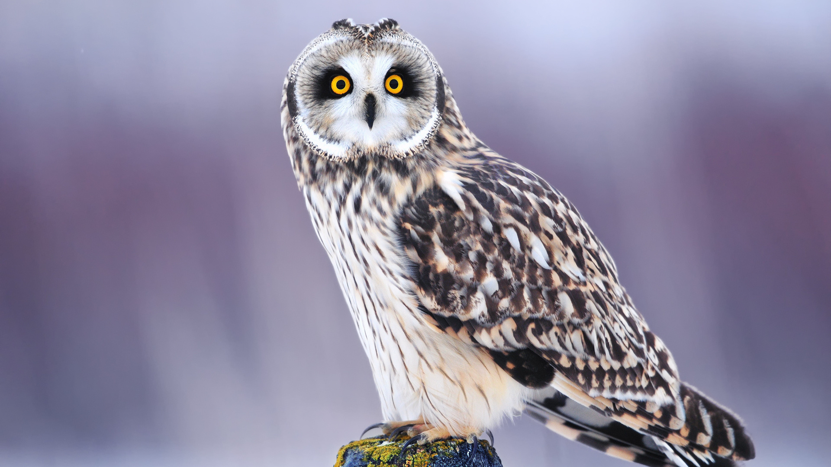
Well done Owls 100%

Slide 9


Slide 10


Slide 11
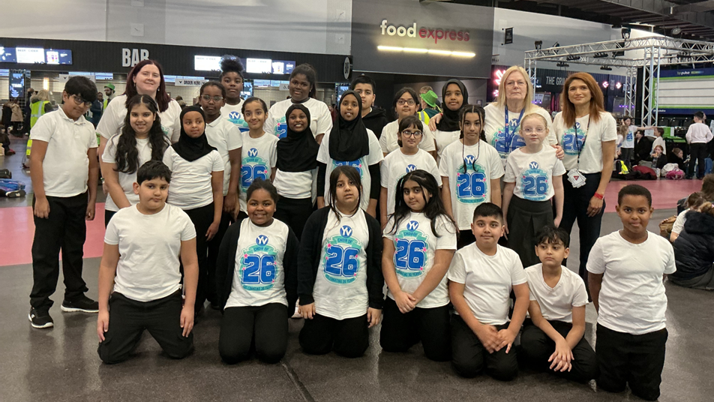
Rehersals at the BP pulse arena

Slide 12
A big ‘Thank you’ to Miss Millward for organizing!

Slide 13
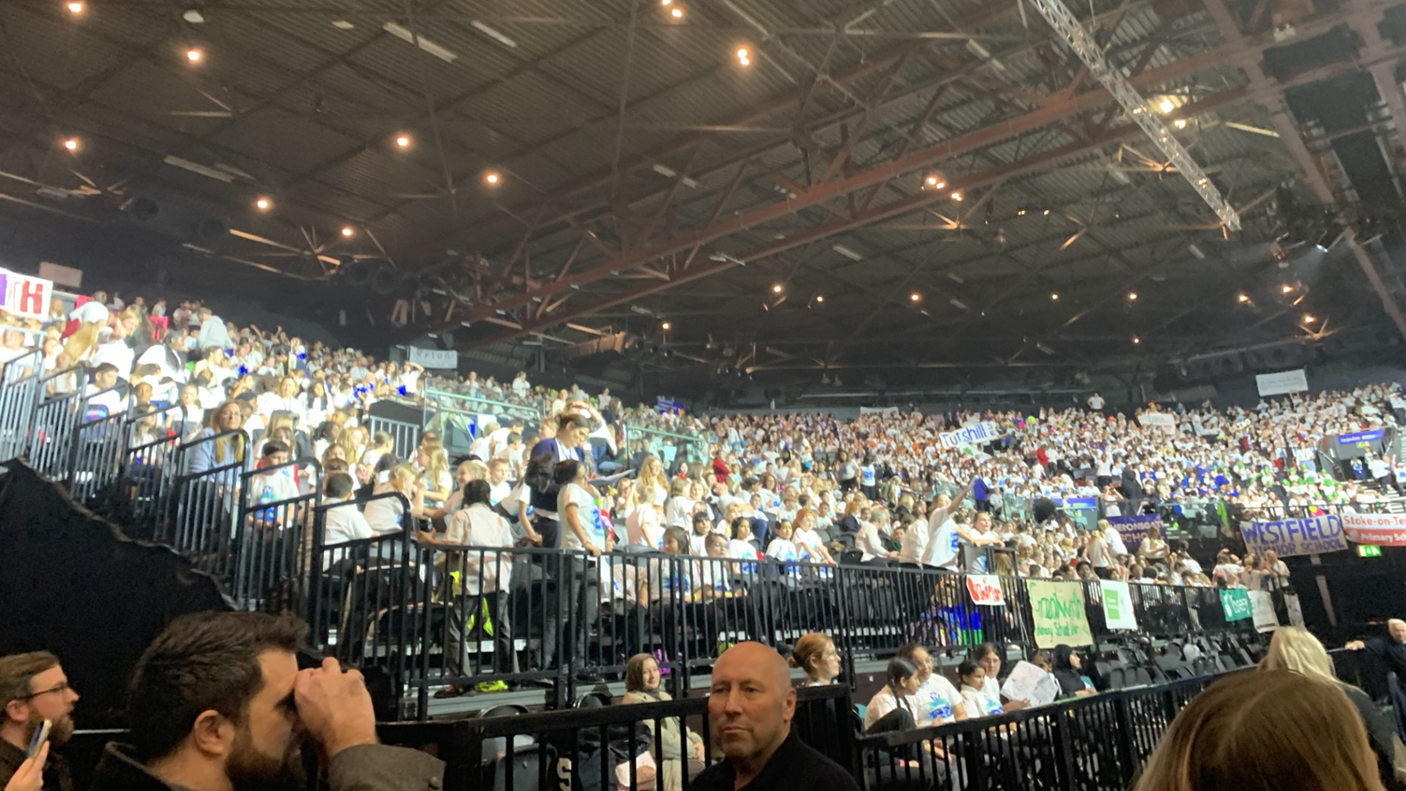

Photo’s from the show- a great night!

Slide 14
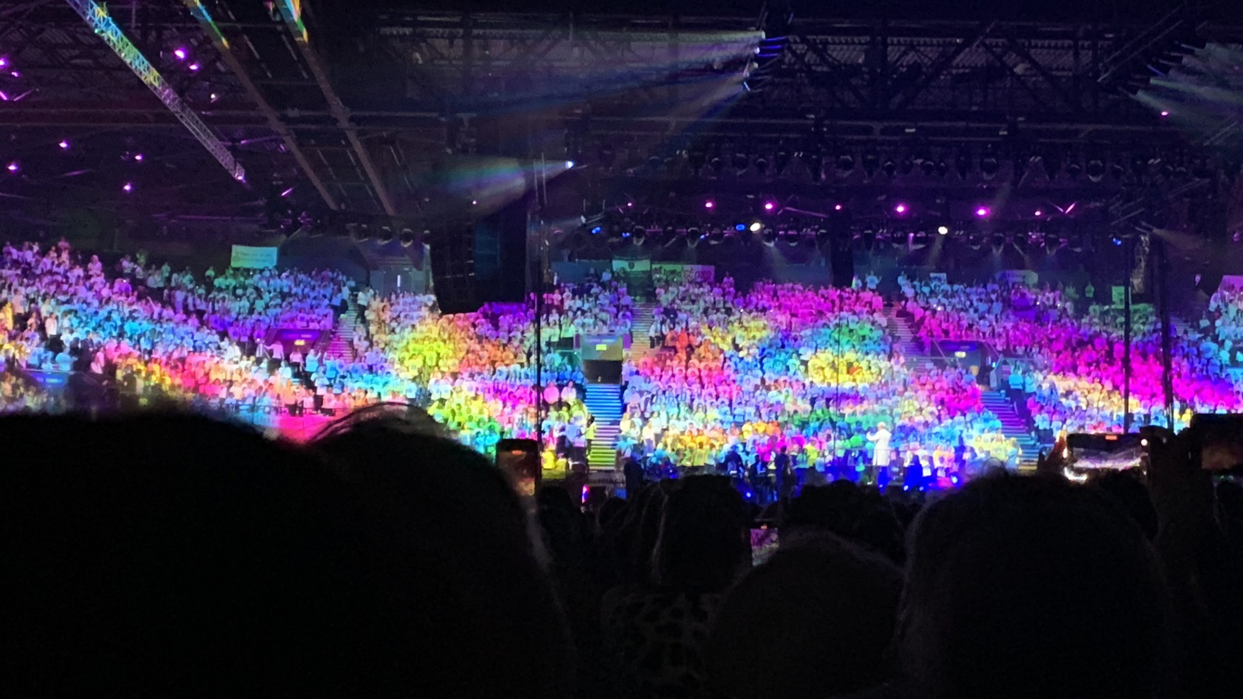

Slide 15
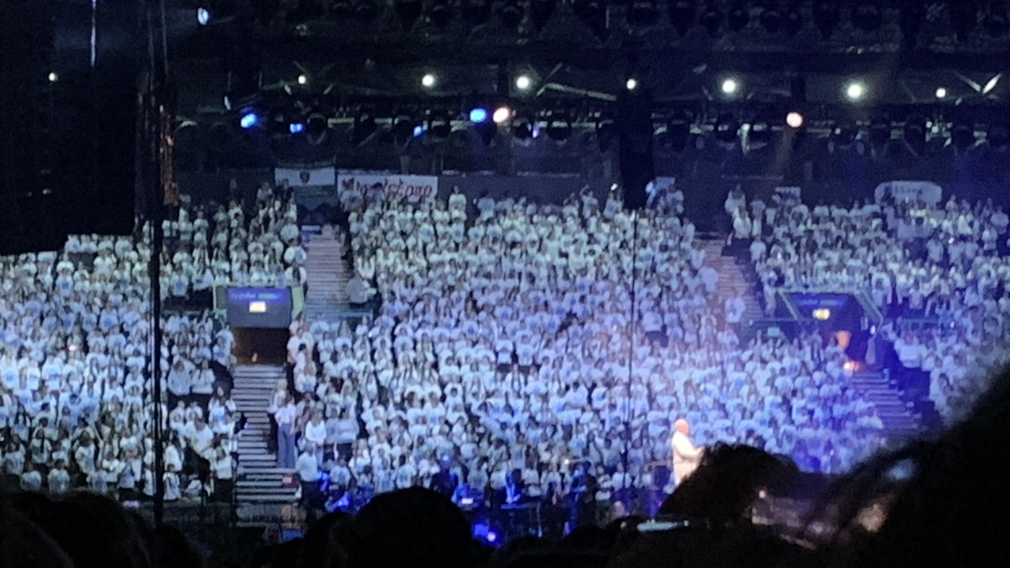

Slide 16
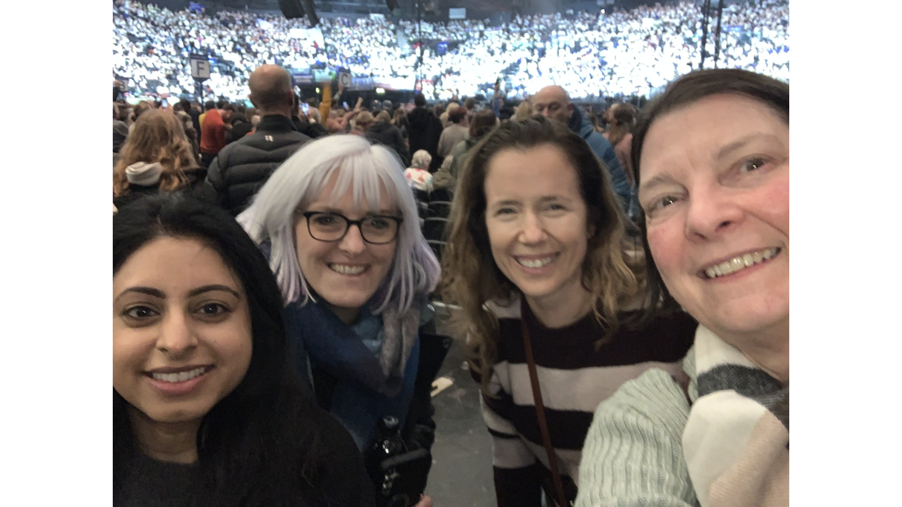
Maybe you would like to be part of next years choir?

Slide 17
Ward End School News

Slide 18

Fabulous attendance celebration
We enjoyed the silent disco!
Be in school every day to achieve the next attendance surprise.
Any ideas for our next attendance reward at the end of February????
Value: Curiosity, perseverance

Slide 19

The following posters support our behaviour policy ( next 2 slides)
Have a read and discuss where they should be displayed.
How are they going to be useful.
How could you use them to help others?

Slide 20


Slide 21


Slide 22

Walk to School Initiative
PARK and STRIDE – can you do it? Ask your parents to read the letter sent by class dojo
Pupils who live too far away to walk- can park away from school and join the walking initiative too. Park and stride. Park 5 minutes walk away and walk the extra distance.
Log your journey to school every day- to earn badges each month.
How did you travel to school?
Value: perseverance

Slide 23

Let’s talk about Safer Internet Day 10th February.
How can we practice being safer on-line?
What do we need to know? Make a list of questions to research. Use clarify talk tactic
Value Resilience

Slide 24


