Slide 1





Attendance assembly 9th February 2026

Slide 2

95% and above Attendance weekly Reward.
Gain a star for each week your class achieves 95%+ How did your class do?

Slide 3

12 classes over 95%
Three classes have had over 95% every week this half term so far
Well done!

Slide 4

Ward End weekly attendance
YEAR | Wb 6th January | Wb 12th Jan | Wb 19th Jan | Wb 26th Jan | Wb 2nd Feb | Wb 9th Feb
6.1 | 94% | 96% | 93% | 94% | 97%
6.2 | 88% | 97% | 99% | 97% | 96%
6.3 | 92% | 96% | 96% | 89% | 98%
6.4 | 91% | 96% | 96% | 98% | 93%
5.1 | 94% | 98% | 97% | 95% | 96%
5.2 | 92% | 94% | 94% | 94% | 91%
5.3 | 96% | 90% | 93% | 94% | 92%
5.4 | 94% | 94% | 95% | 95% | 96%

Slide 5

Ward End weekly attendance
 | Wb 6th Jan | Wb 12th Jan | Week 19th Jan | Wb 26th Jan | Wb 2nd Feb | Wb 9Th Feb
4.1 | 91% | 93% | 92% | 89% | 88%
4.2 | 91% | 94% | 92% | 95% | 93%
4.3 | 96% | 97% | 97% | 95% | 98%
4.4 | 91% | 92% | 95% | 95% | 92%
3.1 | 95% | 95% | 92% | 91% | 91%
3.2 | 81% | 93% | 94% | 94% | 94%
3.3 | 94% | 92% | 95% | 96% | 94%
3.4 | 88% | 91% | 92% | 92% | 96%

Slide 6

Ward End weekly attendance
YEAR | Wb 6th Jan | Wb 12th Jan | Wb 19th Jan | Wb 26th Jan | Wb 2nd Feb | Wb 9th Feb
2.1 | 87% | 92% | 92% | 94% | 94%
2.2 | 93% | 91% | 94% | 89% | 91%
2.3 | 87% | 92% | 93% | 91% | 97%
2.4 | 91% | 93% | 95% | 95% | 97%
1.1 | 88% | 92% | 97% | 96% | 93%
1.2 | 91% | 93% | 95% | 93% | 96%
1.3 | 87% | 97% | 95% | 93% | 94%
1.4 | 91% | 98% | 97% | 95% | 94%

Slide 7


Ward End weekly attendance
YEAR | Wb 6th Jan | Wb 12th Jan | Wb 19th Jan | Wb 26th Jan | Wb 2nd Feb | Wb 9th Feb
Rabbits | 92% | 99% | 97% | 94% | 93%
Squirrels | 92% | 90% | 90% | 94% | 91%
Foxes | 82% | 87% | 93% | 91% | 92%
Hedgehogs | 92% | 92% | 88% | 91% | 92%
Owls | 95% | 98% | 95% | 100% | 98%
Doves | 89% | 93% | 90% | 78% | 87%
Swans | 100% | 100% | 95% | 95% | 95%

Slide 8

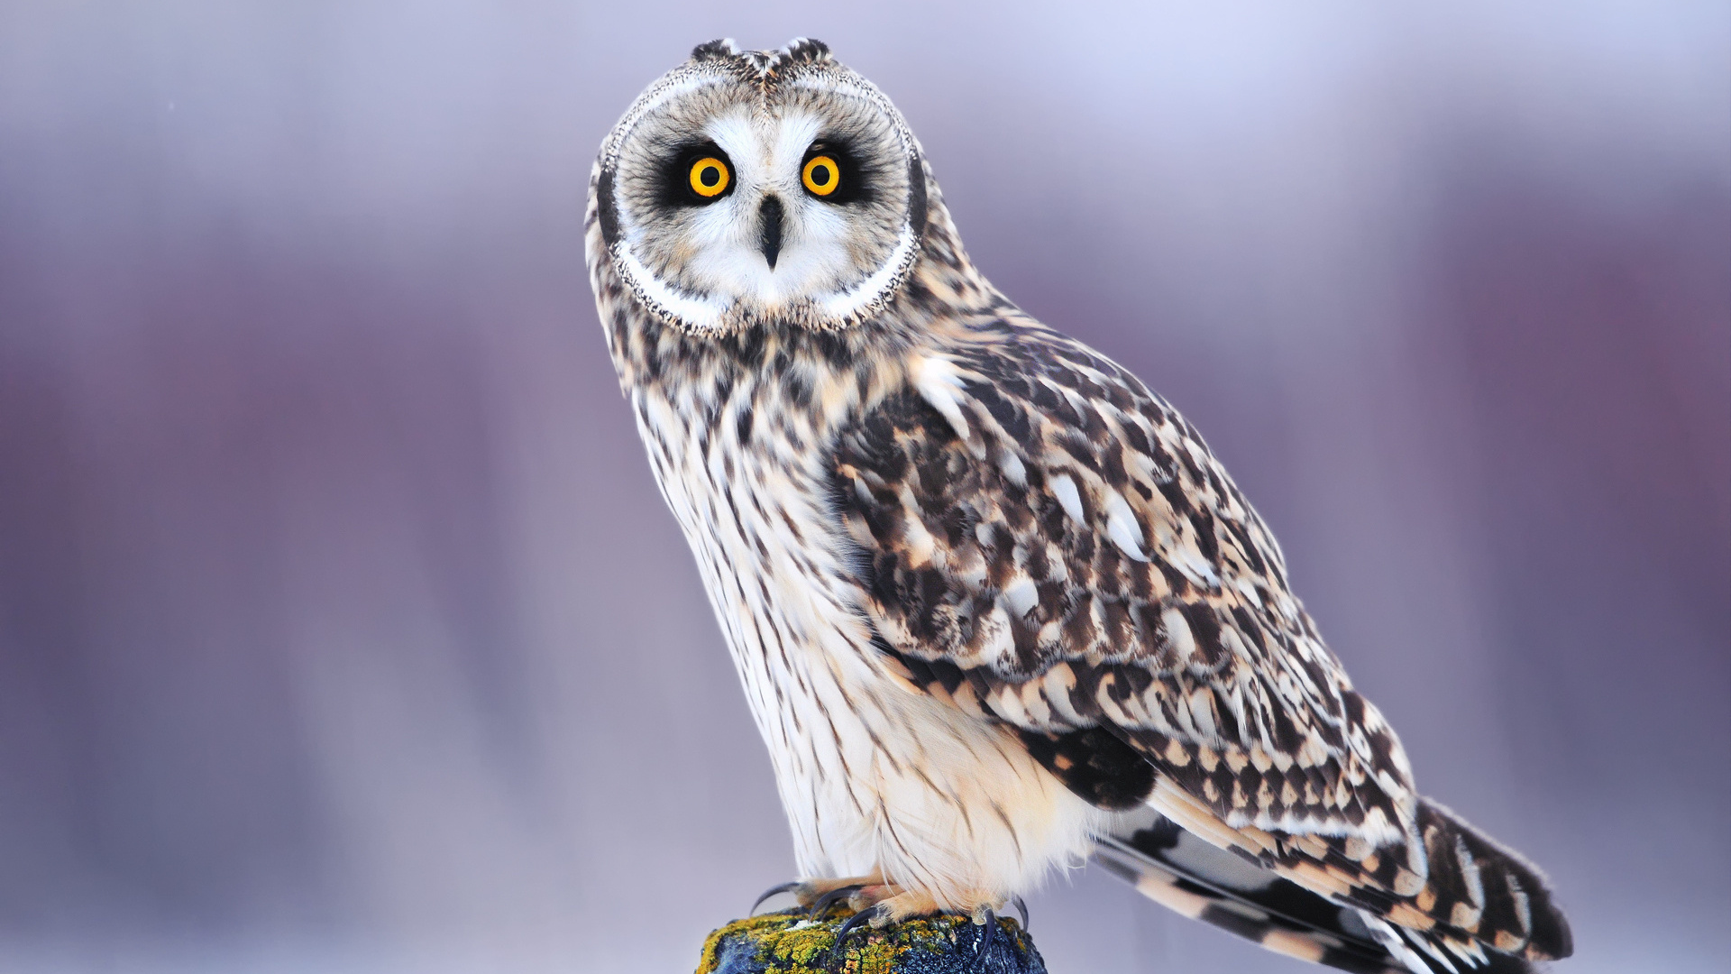

Well done Owls, Swans and 4.3 over 95% every week so far this term.

Slide 9

Ward End School News

Slide 10

Fabulous attendance celebration
Be in school every day to achieve the next attendance surprise.
Any ideas for our next attendance reward at the end of February????
Value: Curiosity, perseverance

Slide 11

Let’s talk about Safer Internet Day 10th February.
How can we practice being safer on-line and when using AI?
What do we need to know? Make a list of questions to research. Use clarify talk tactic
Value Resilience

Slide 12

A Charter for playtime/lunchtime.
Please work with your class to come up with 4 positive rules for play time and lunchtime.
We want to avoid pupils having accidents by improving the way we play.
What do you think we should plan to do?
Send you 4 ideas to your UNICEF reps at the end of this week please?
Think about our school aims and rules (see next few slides to remind yourself)

Slide 13


Slide 14


Slide 15

WEPS school aims
Ward End Primary is a Reading School.
We are Global Citizens within a World Class School.
We have high standards of attendance and punctuality.
Family, community and character education are at the heart of all we do.
Our pupils are well prepared for Key Stage 3 and beyond

Slide 16
WEPS Values
Respect, Resilience
Courage, Curiosity
Aspiration, Pereverance

Slide 17


Slide 18
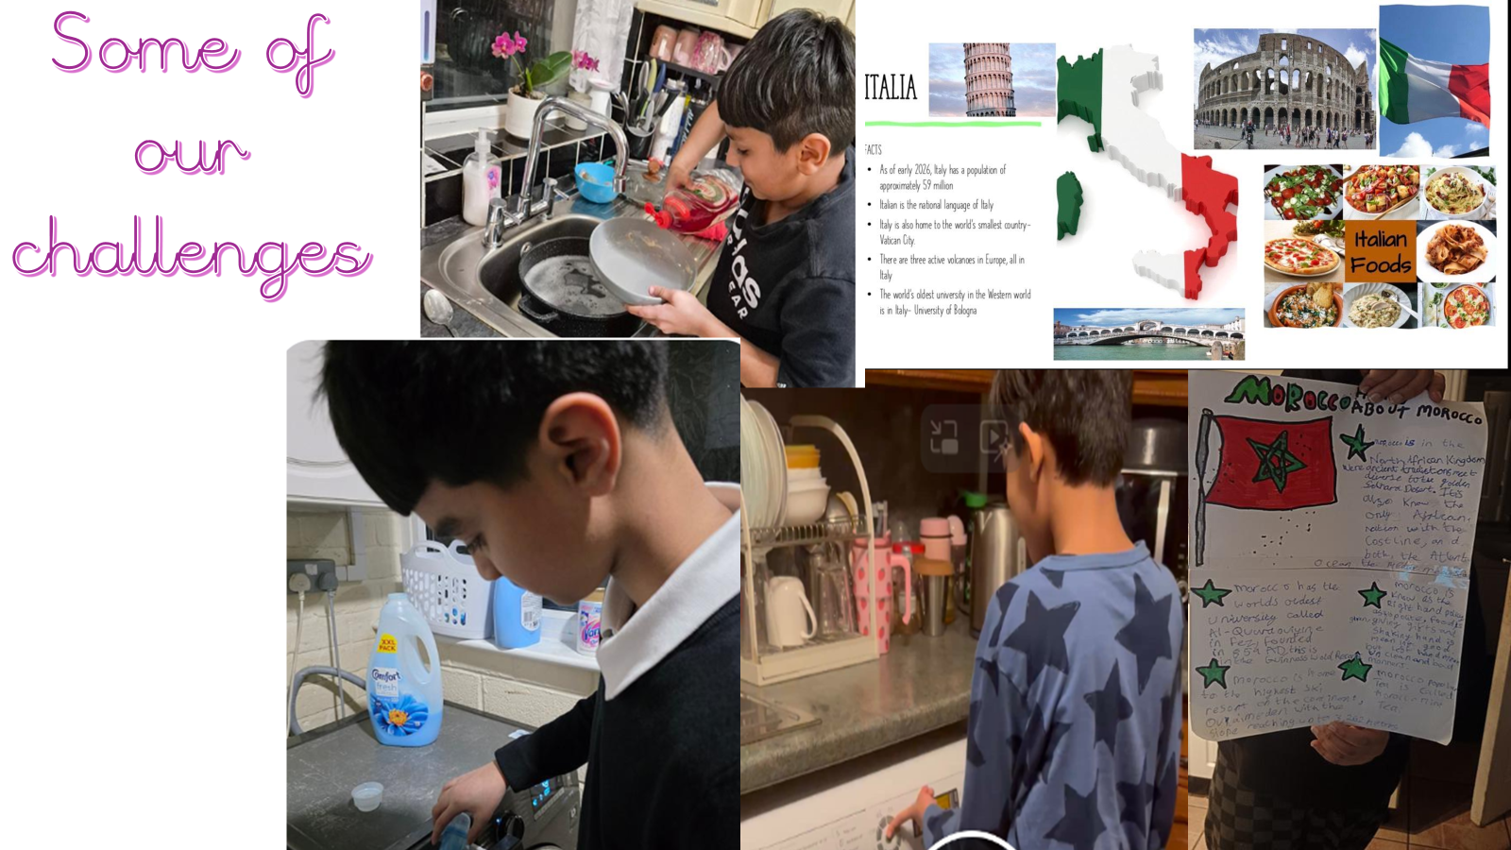

Slide 19
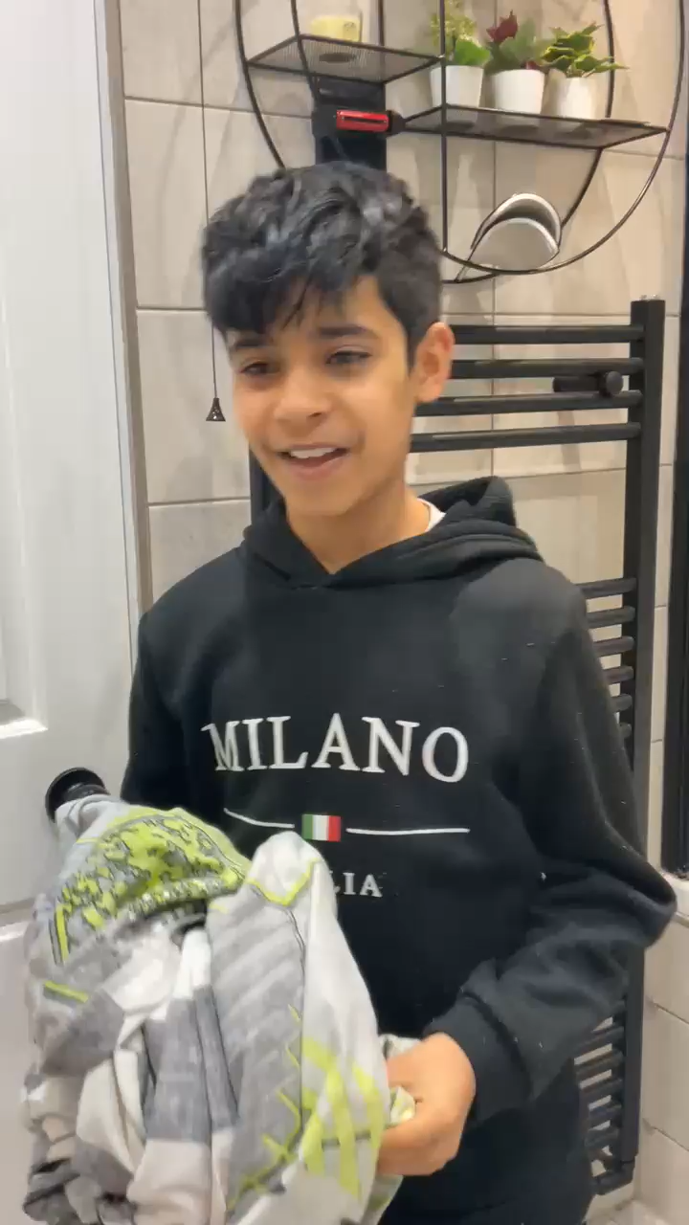
Kasim 6.1
Value ??

Slide 20

Walk to School Initiative
PARK and STRIDE – can you do it? Ask your parents to read the letter sent by class dojo
Pupils who live too far away to walk- can park away from school and join the walking initiative too. Park and stride. Park 5 minutes walk away and walk the extra distance.
Log your journey to school every day- to earn badges each month.
How did you travel to school?
Value: perseverance

Slide 21


