Slide 1

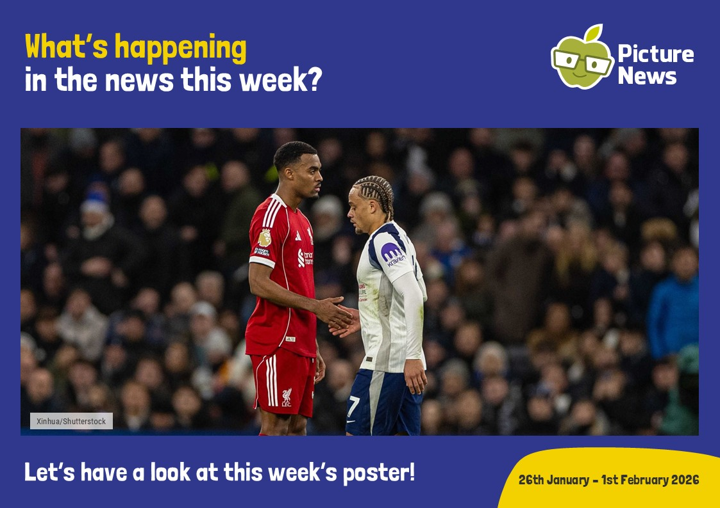

Slide 2


Slide 3


Slide 4

FA Respect - Good behaviour makes for a great game

Slide 5


Slide 6
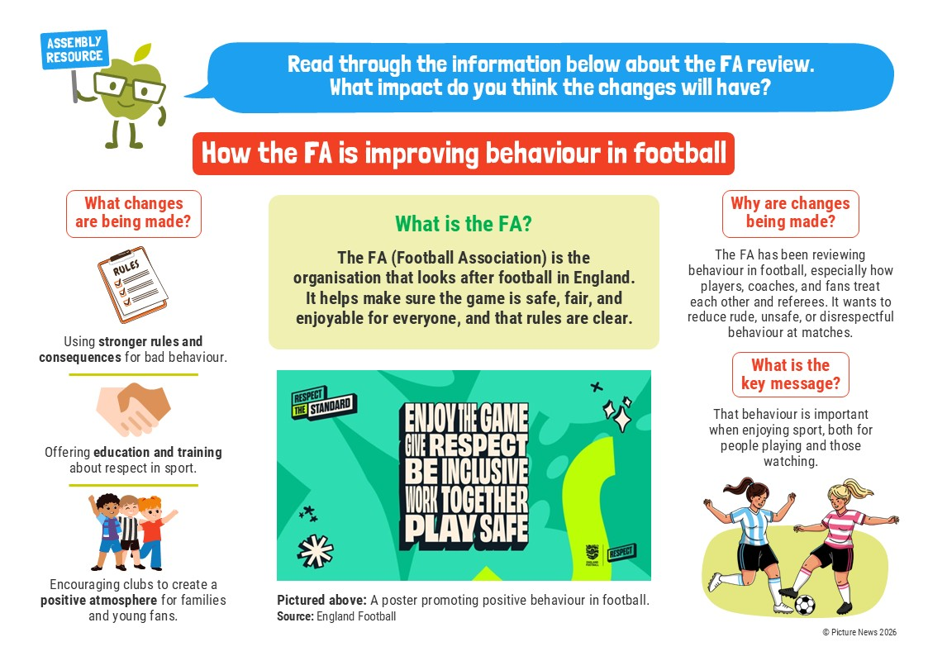

Slide 7


Slide 8
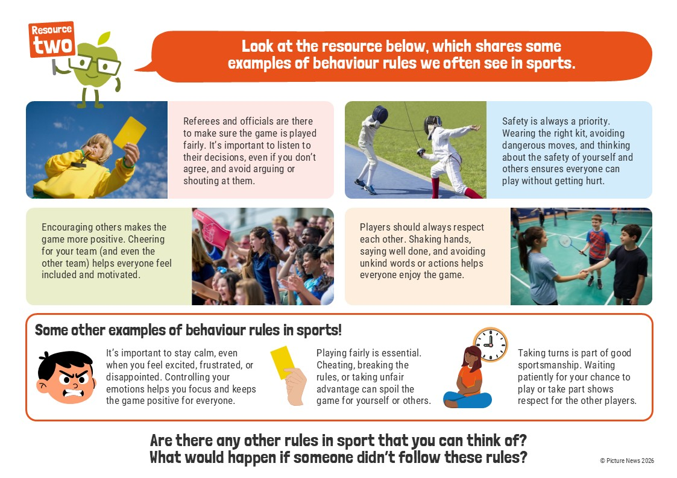

Slide 9
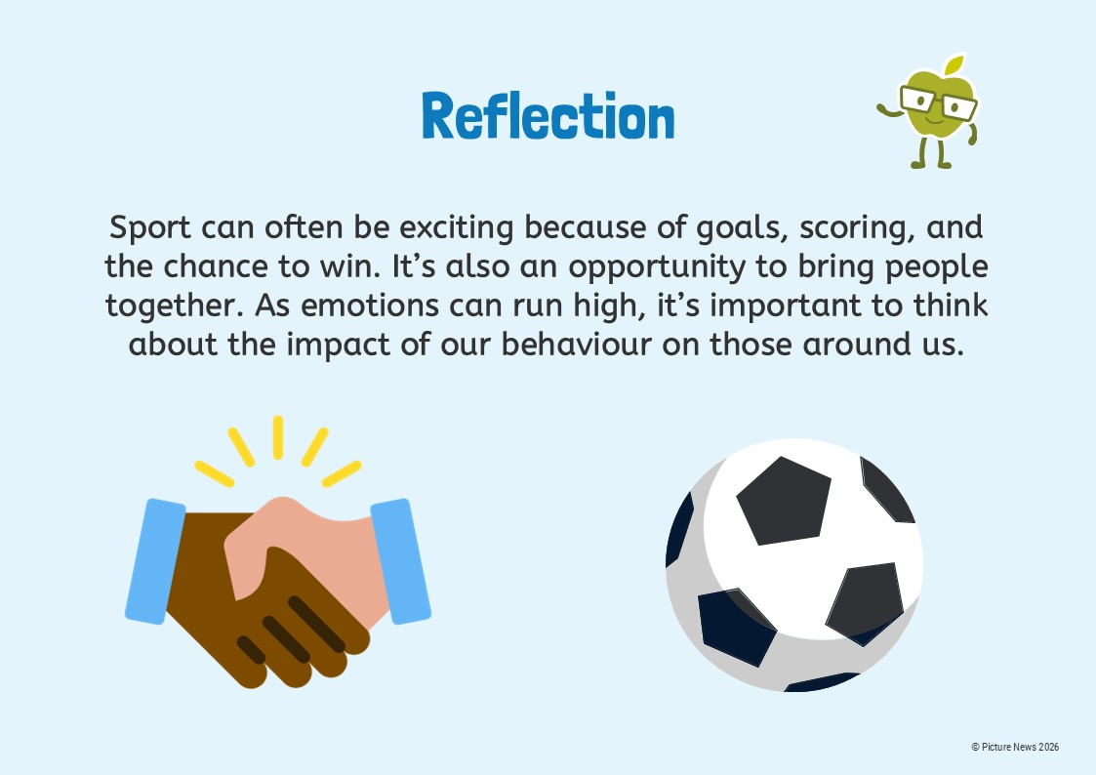

Slide 10


Slide 11


