Slide 1


A
Attendance assembly 23rd March 2026

Slide 2

95% and above Attendance weekly Reward.
Gain a star for each week your class achieves 95%+ How did your class do?

Slide 3

Attendance here is Monday- Thursday last week
Only 4 classes over 95%
One class- 100% Well done.

Slide 4

Ward End weekly attendance
YEAR | Wb 23rd Feb | Wb 2nd March | Wb 9th March | Wb 16th March | Wb | Wb
6.1 | 93% | 96% | 94% | 91%
6.2 | 96% | 99% | 99% | 90%
6.3 | 95% | 94% | 95% | 91%
6.4 | 98% | 94% | 92% | 93%
5.1 | 95% | 94% | 95% | 93%
5.2 | 95% | 97% | 96% | 89%
5.3 | 97% | 95% | 91% | 87%
5.4 | 98% | 98% | 97% | 95%

Slide 5

Ward End weekly attendance
 | Wb 23rd Feb | Wb 2nd March | Week 9th March | Wb 16th March | Wb | Wb
4.1 | 93% | 95% | 94% | 93%
4.2 | 98% | 96% | 96% | 93%
4.3 | 96% | 100% | 97% | 93%
4.4 | 92% | 93% | 97% | 92%
3.1 | 98% | 93% | 97% | 92%
3.2 | 95% | 93% | 96% | 91%
3.3 | 87% | 96% | 95% | 83%
3.4 | 95% | 95% | 96% | 94%

Slide 6

Ward End weekly attendance
YEAR | Wb 23rd Feb | Wb 2nd March | Wb 9th March | Wb 16th March | Wb | Wb
2.1 | 95% | 93% | 95% | 86%
2.2 | 97% | 95% | 98% | 94%
2.3 | 97% | 91% | 97% | 92%
2.4 | 92% | 89% | 98% | 94%
1.1 | 94% | 94% | 98% | 93%
1.2 | 92% | 95% | 93% | 98%
1.3 | 92% | 97% | 97% | 94%
1.4 | 96% | 94% | 96% | 83%

Slide 7

Ward End weekly attendance
YEAR | Wb 23rd Feb | Wb 2nd March | Wb 9th March | Wb 16th March | Wb | Wb
Rabbits | 98% | 91% | 98% | 95%
Squirrels | 96% | 90% | 88% | 84%
Hedgehogs | 92% | 98% | 92% | 89%
Owls | 87% | 98% | 99% | 100%
Doves | 86% | 76% | 90% | 93%
Swans | 96% | 97% | 93% | 90%

Slide 8


Well done Owls- 100%

Slide 9
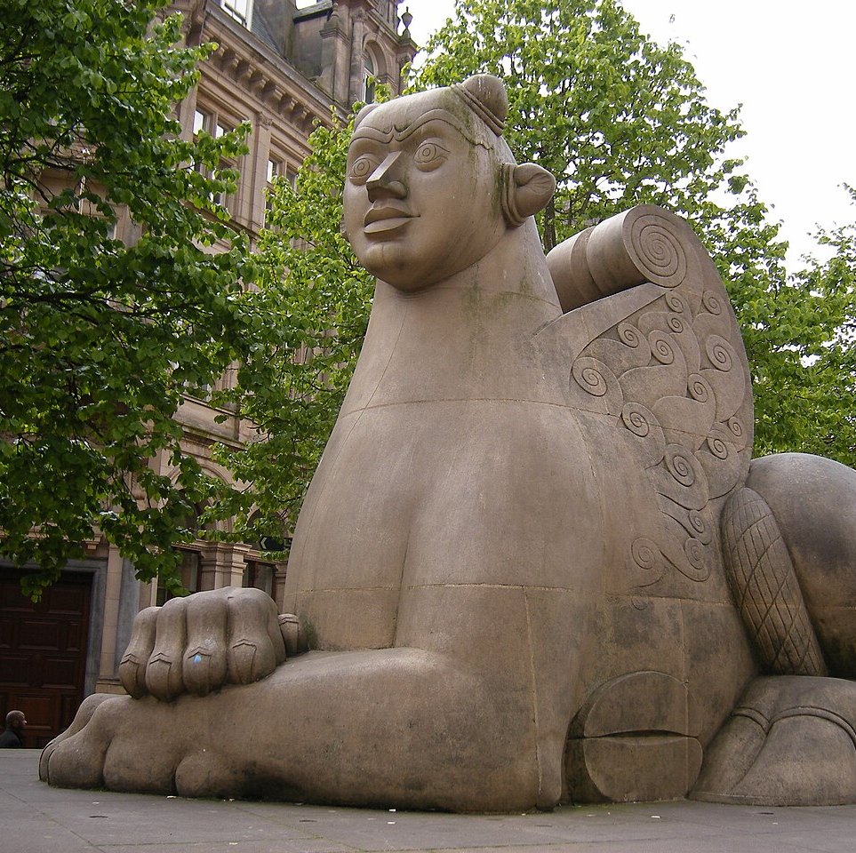
Exciting events this week
Story- Teller in Year One on Monday
Year 2 visit Birmingham city centre to do the Sculpture trail and visit Central Library
Y5/6 musician's workshop on Monday
Special Eid menu Wednesday 25th in the Canteen.
Friday, Eid/ Easter Party afternoon, with snacks. Wear your home/ party clothes all day.

Slide 10
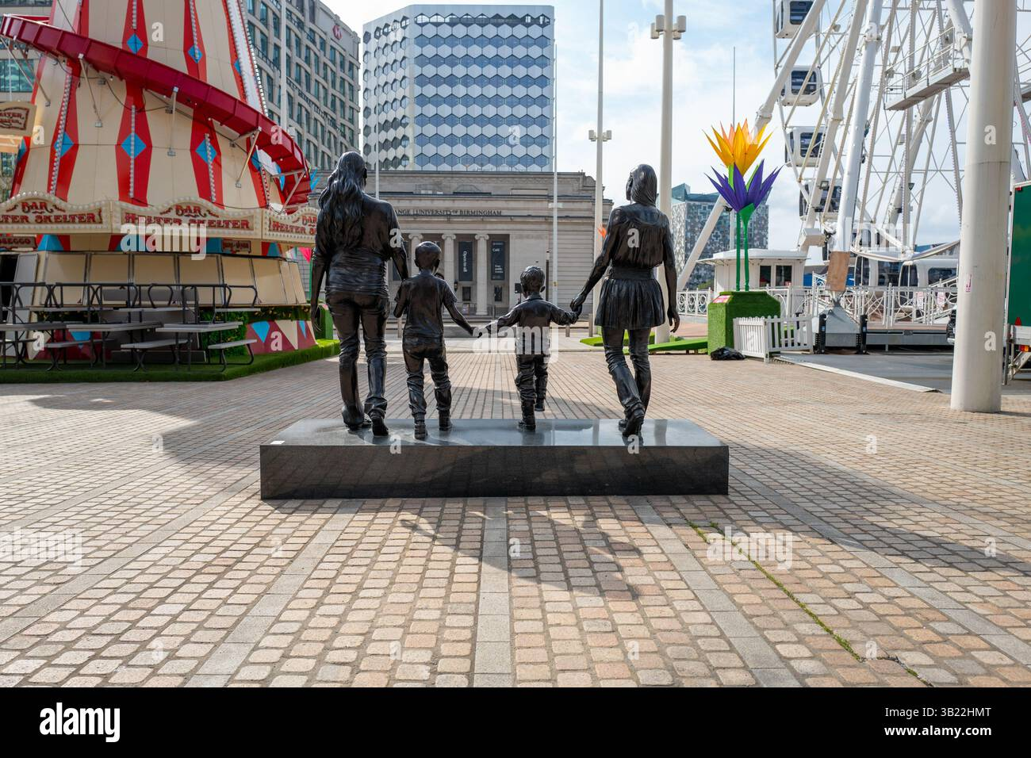
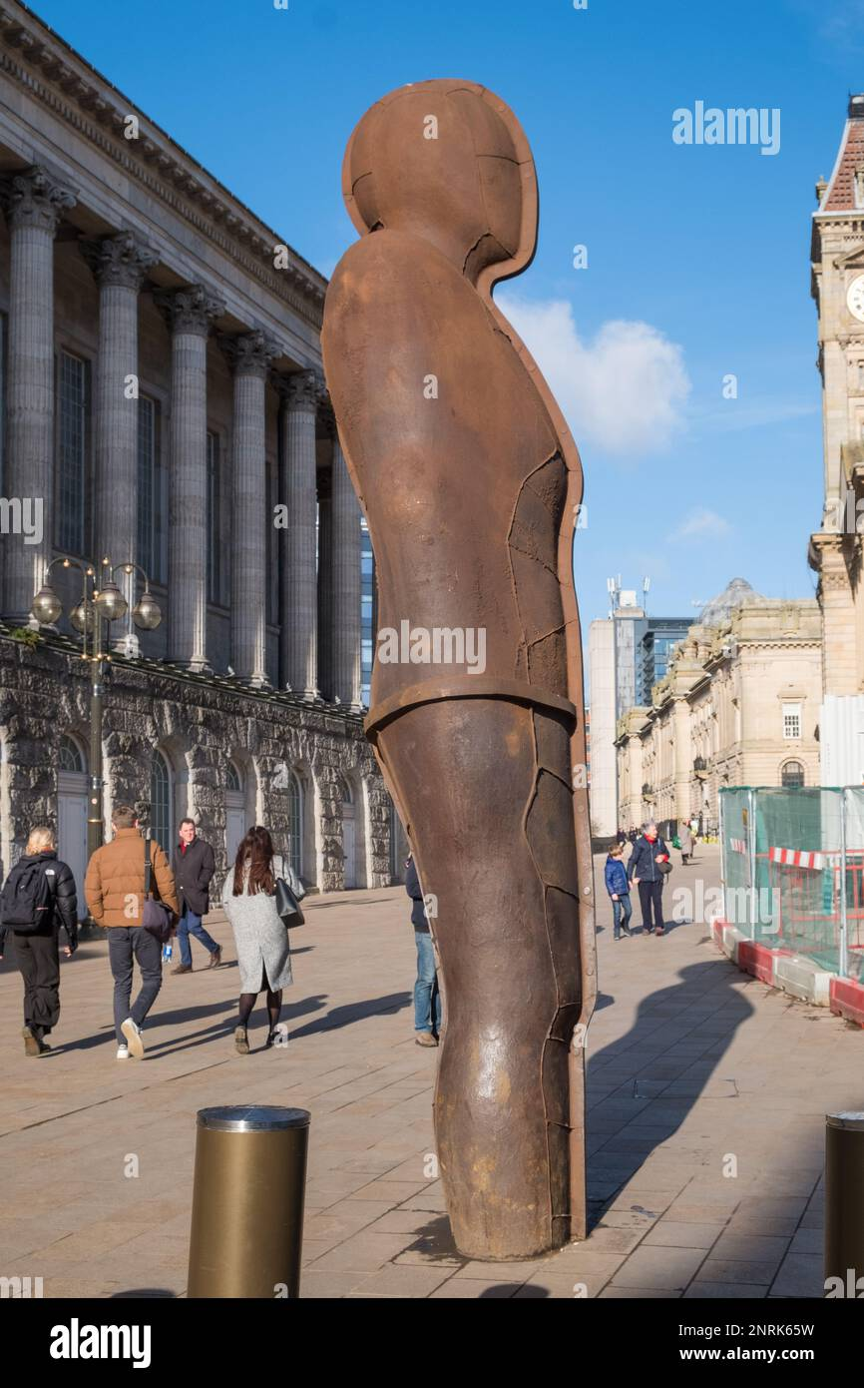
Here are some of the Sculptures that year 2 will be finding this week in Birmingham. Have you seen them? look up
The Birmingham Sculpture Trail on line.

Slide 11
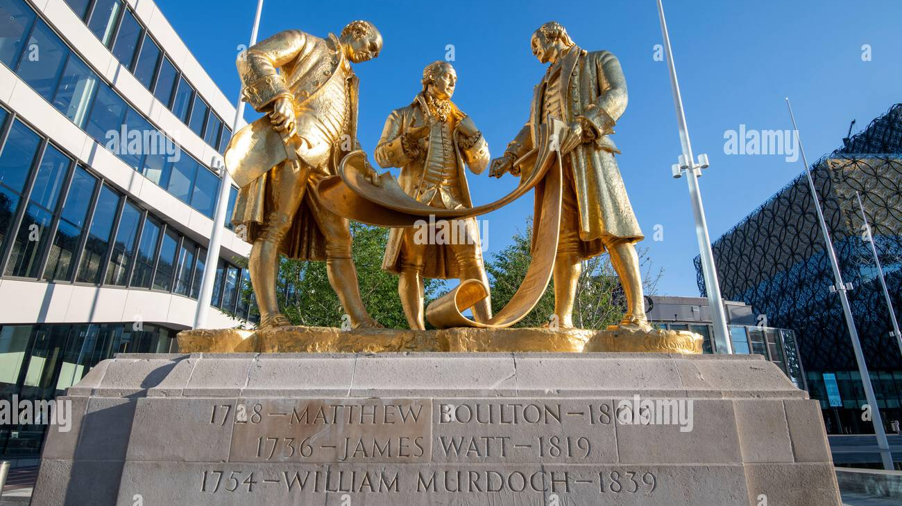

Slide 12
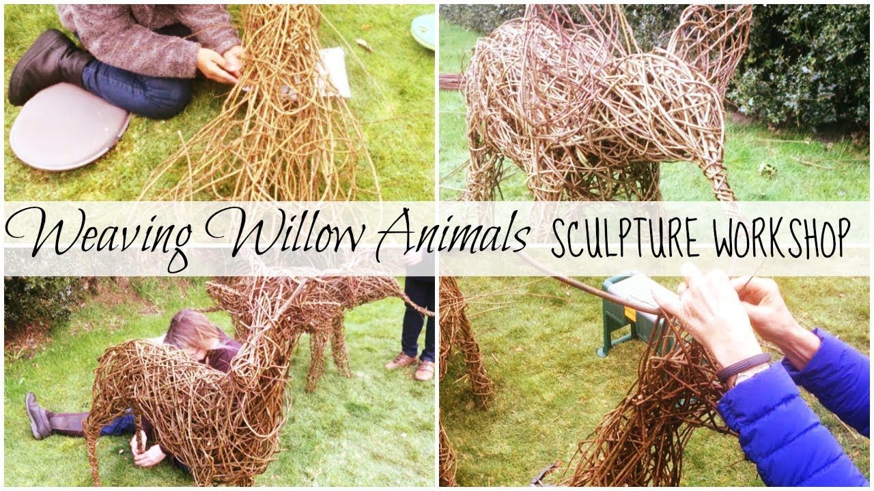
We enjoyed a fabulous art week- last week.
Classes are working on a sculpture together using exciting materials
We’ll be doing some willow weaving too

Slide 13
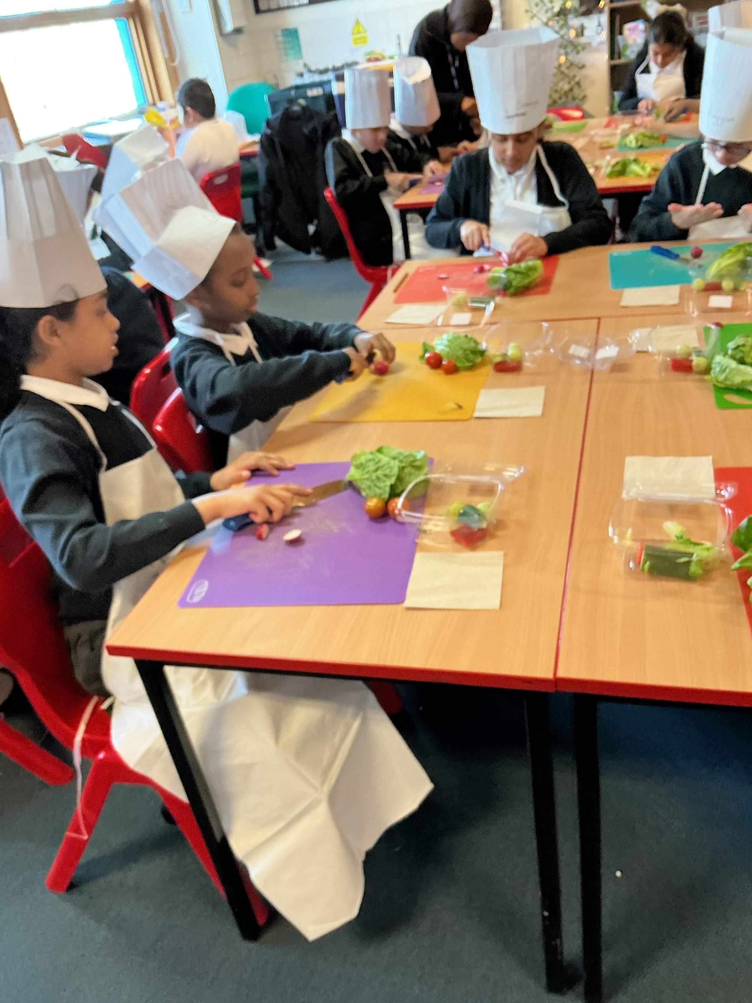
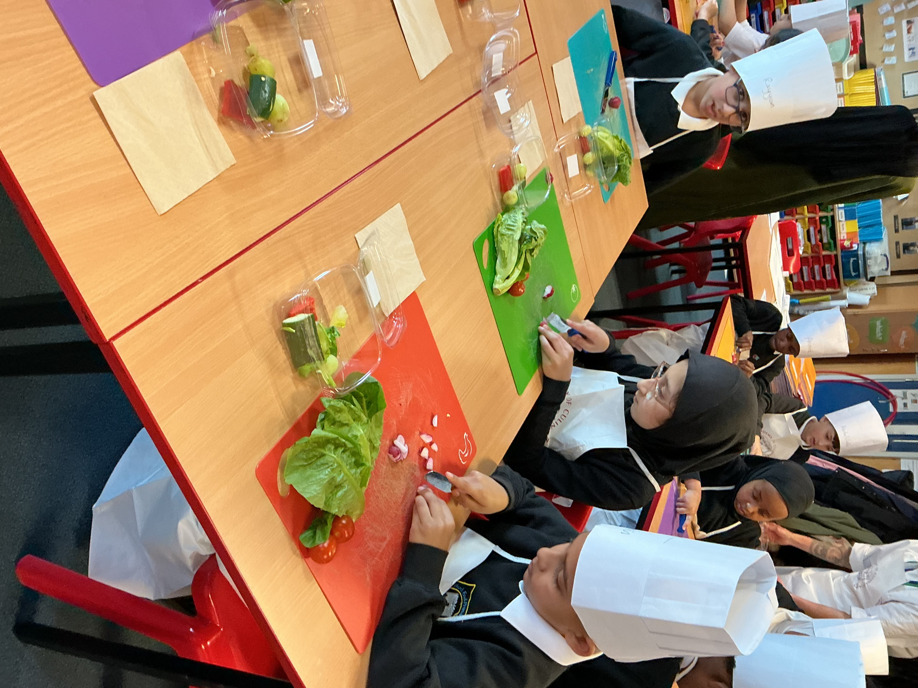
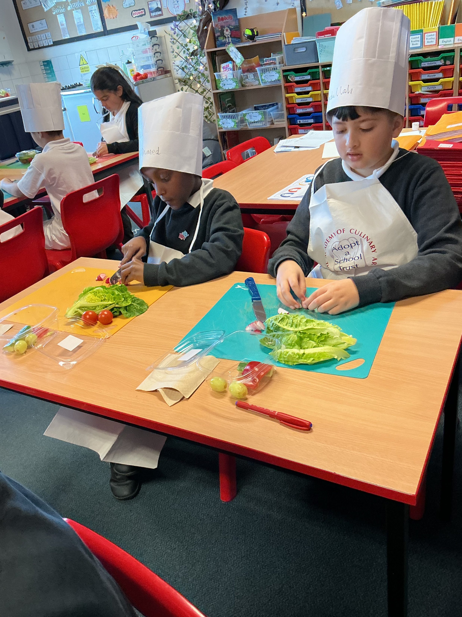
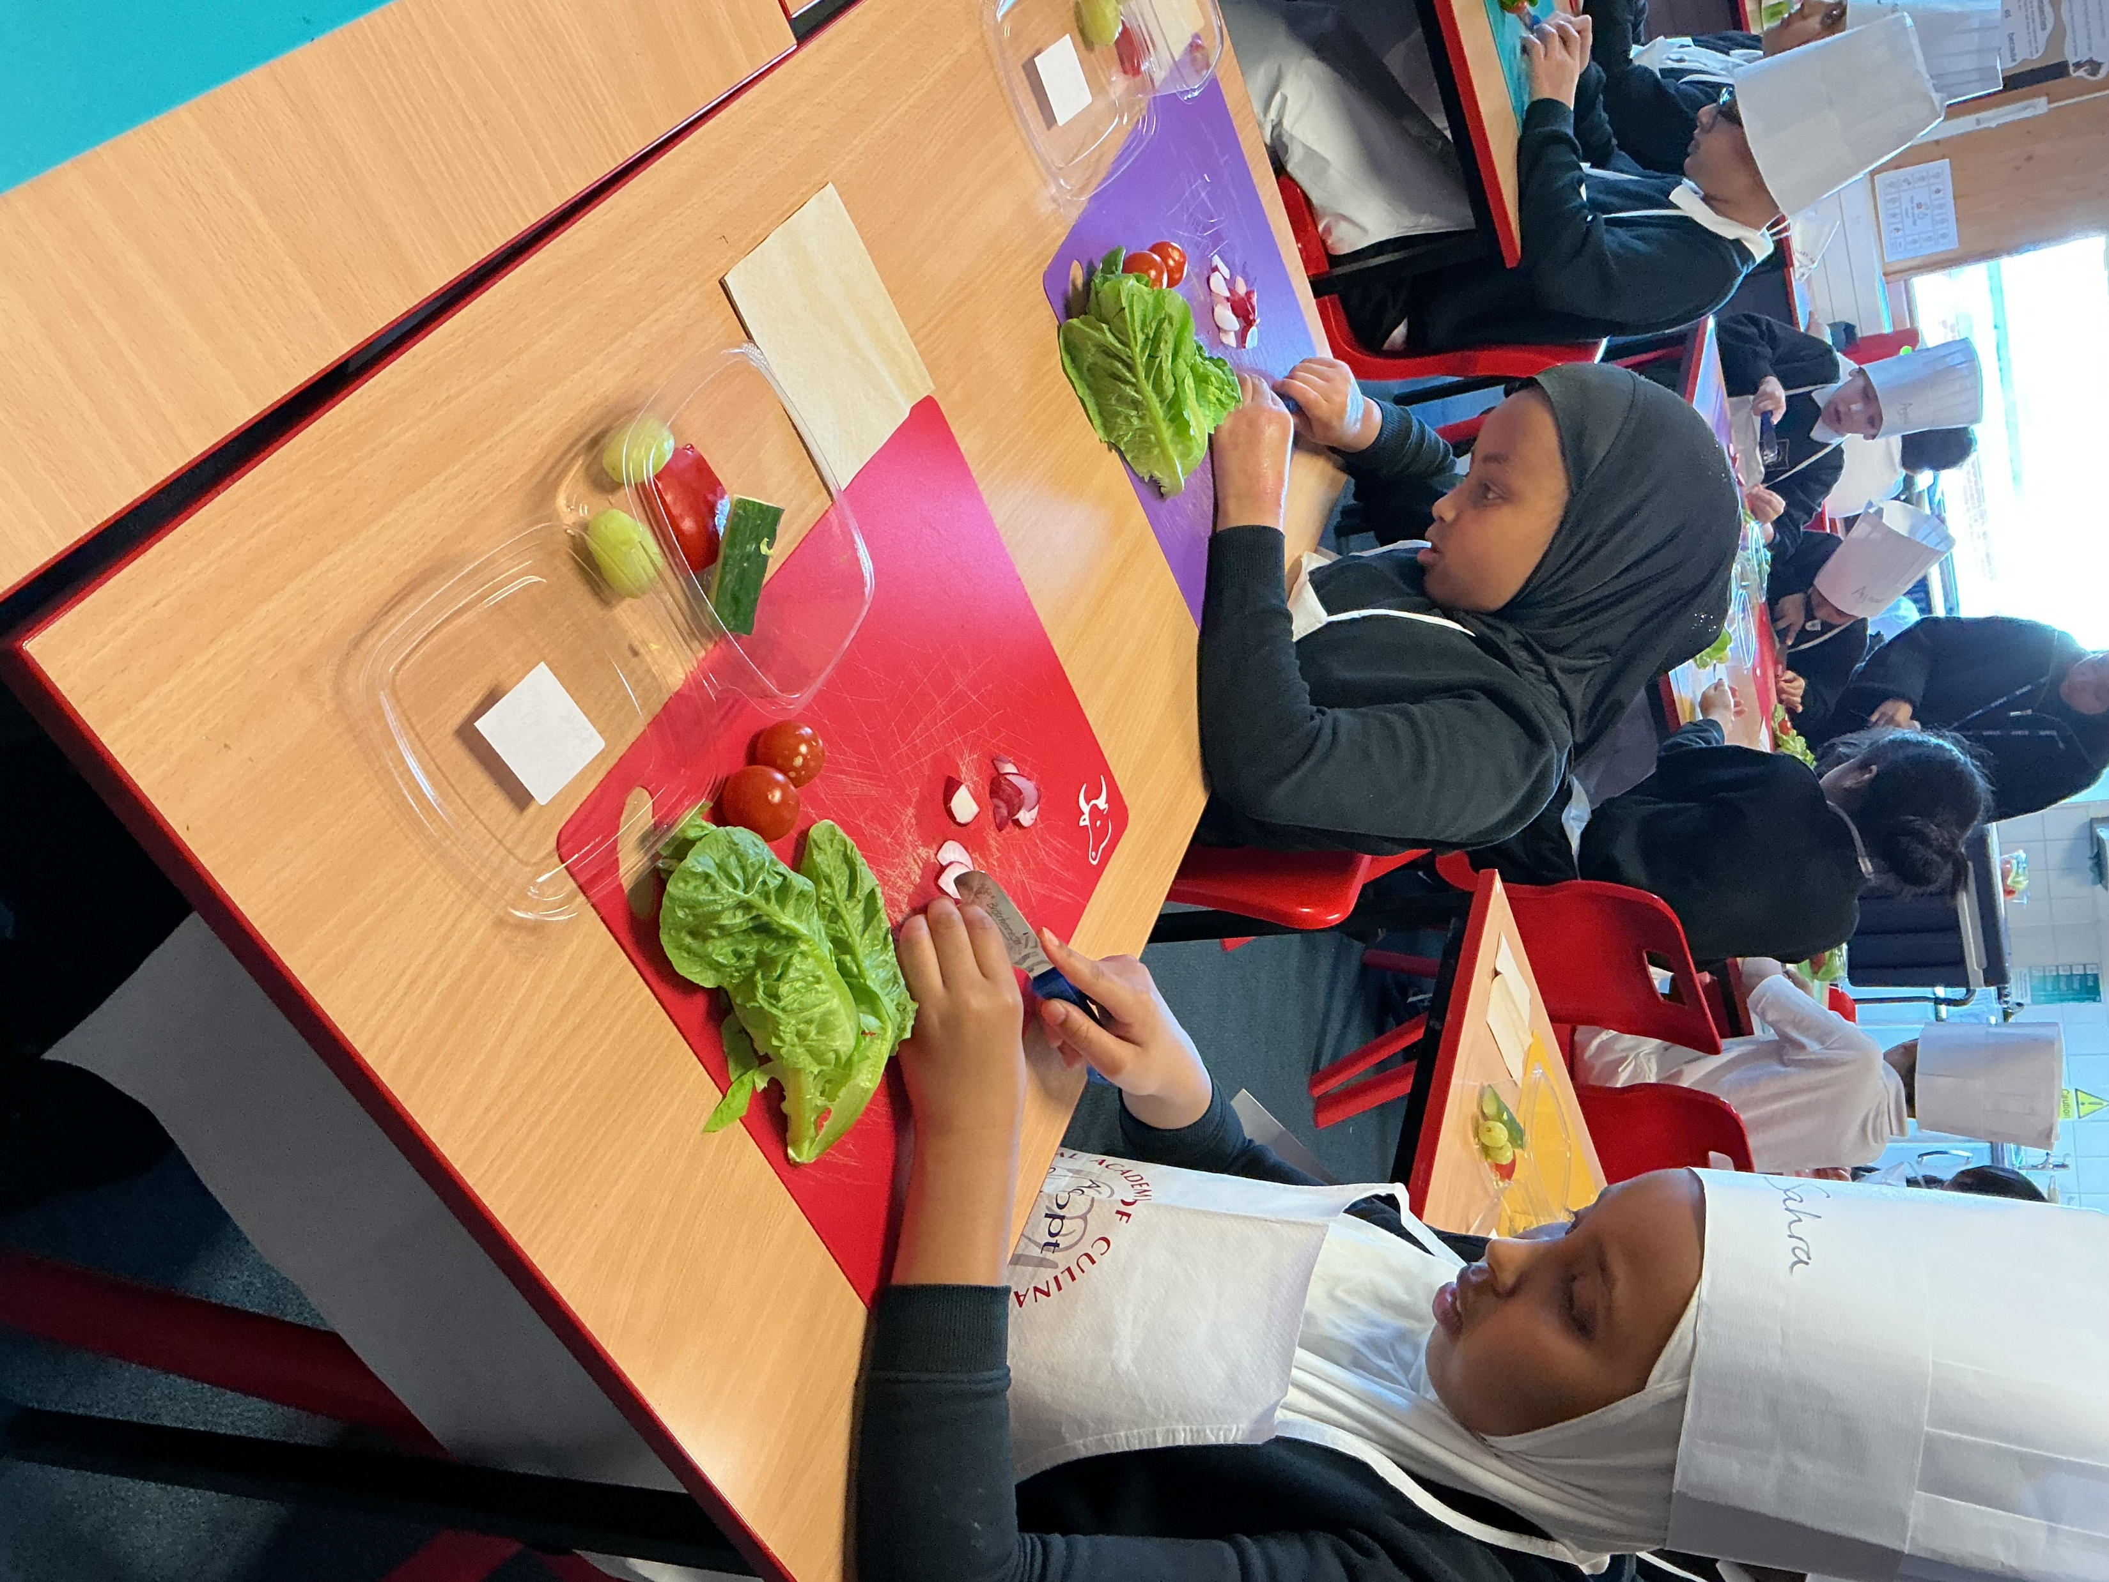
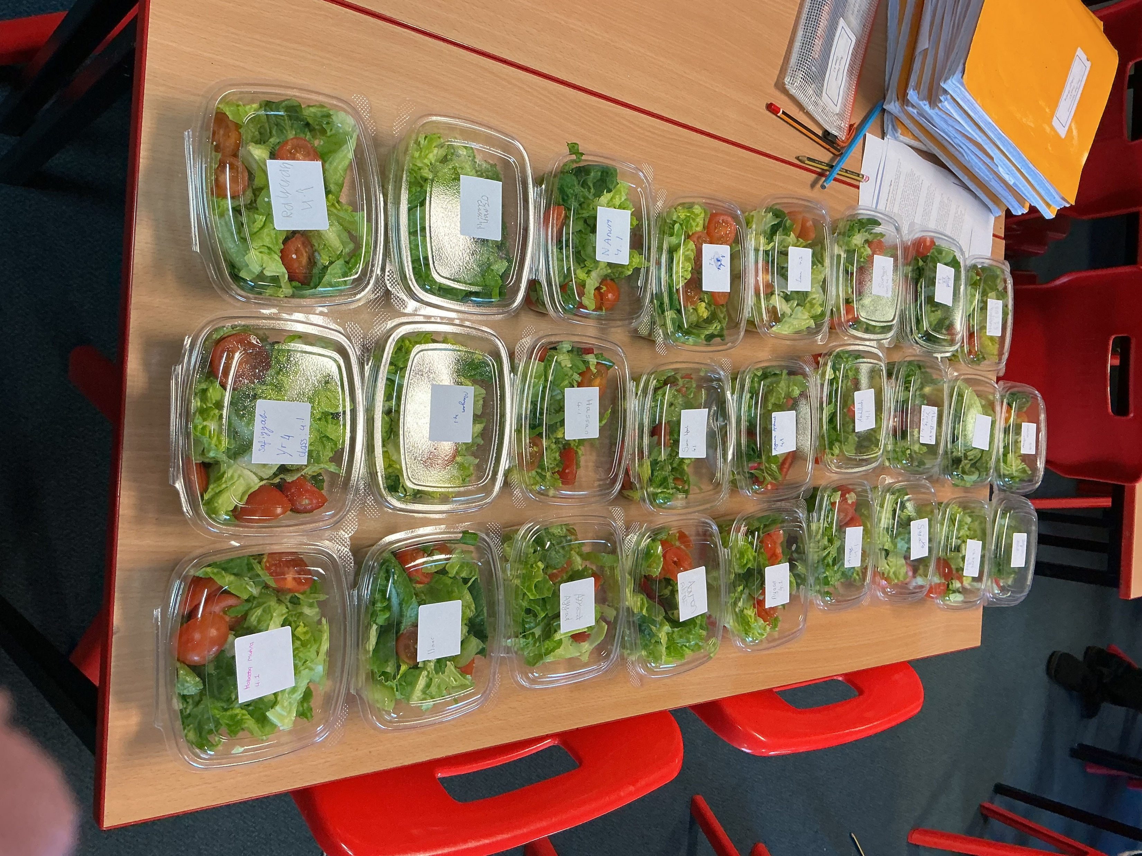
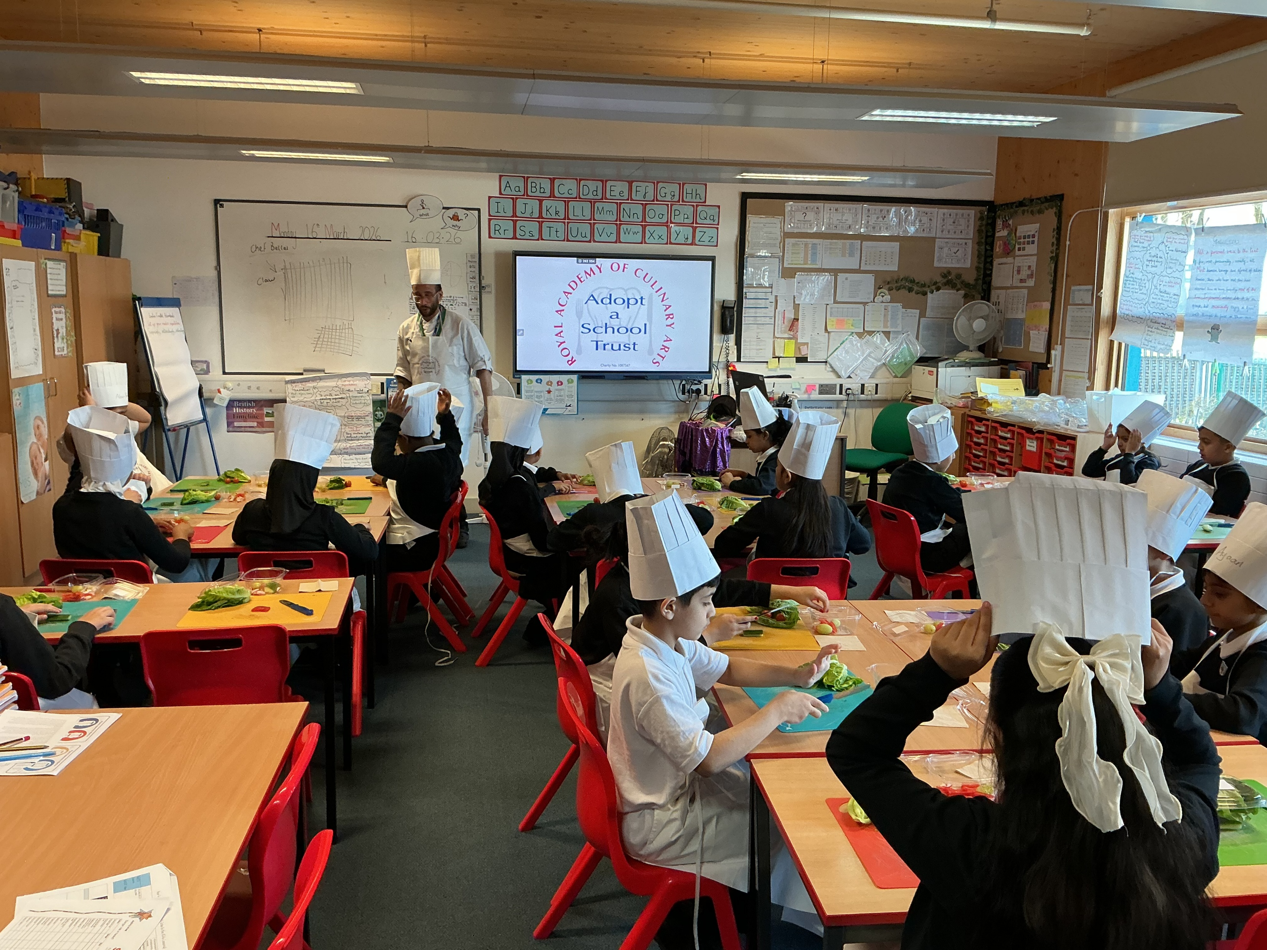
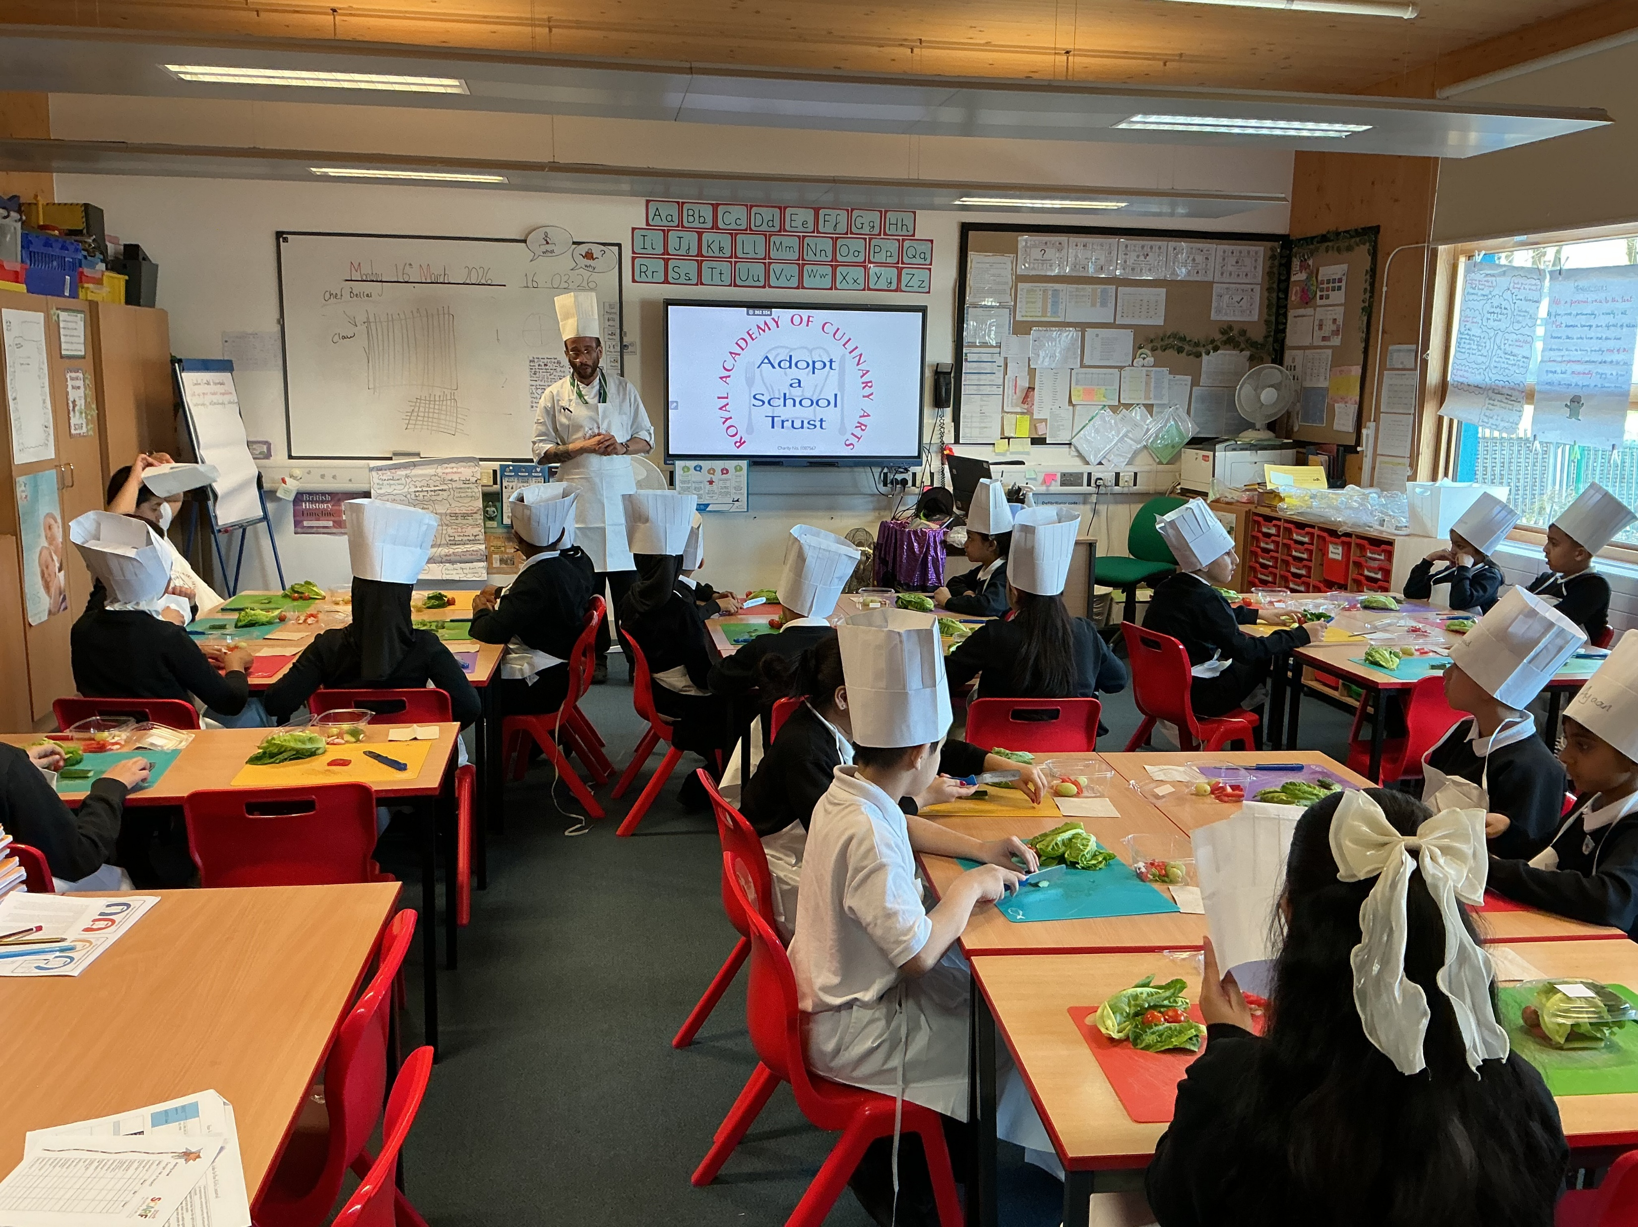
Cooking session in Year 4

Slide 14

Eid Parties Friday 27th March in the afternoon- wear your party clothes all day!

Slide 15

Ward End School News.
The Swimming Pool is here!
Year 3 and Year 4
Monday 23rd February – Friday 17th April
Year 1, Year 2 and Resource Base
Monday 20th April – Friday 22nd May
Year 5 and Year 6
Monday 1st June – Friday 17th July

Slide 16


Slide 17


Slide 18

Walk to School Competition weeks. Value: Resilience
From Monday 16th March, for the next two weeks, Ward End Primary School will be in competition with over 2000 schools around the country in the Big Walk and Wheel.
Each day, we will count the number of children walking to school and enter that number into the competition.
There will be a daily prize draw with prizes of equipment for the school.
We think with your help we are in with a good chance!
So now the weather is improving, why not ditch the car and walk at least once a week or even every day!

Slide 19
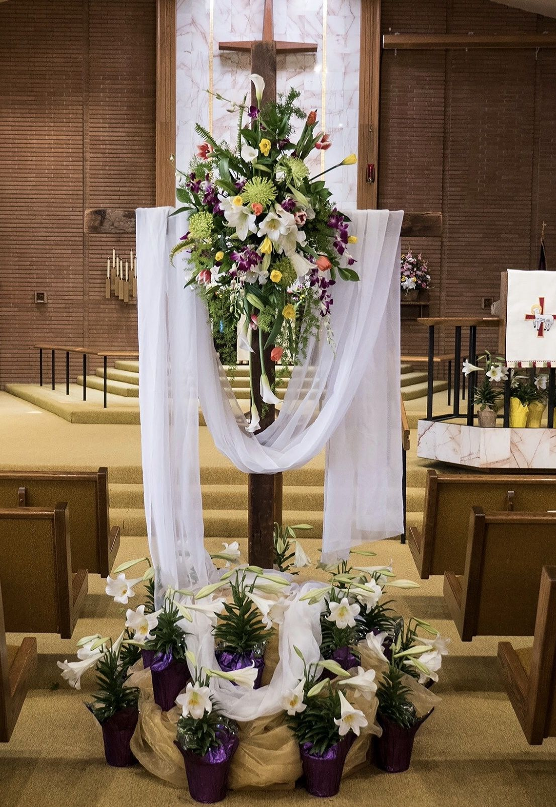
Easter is the most important festival in the Christian Calendar. Here a church is decorated- in white for the special service.

Slide 20

Easter bunny and eggs have become a symbol of this festival.

Slide 21
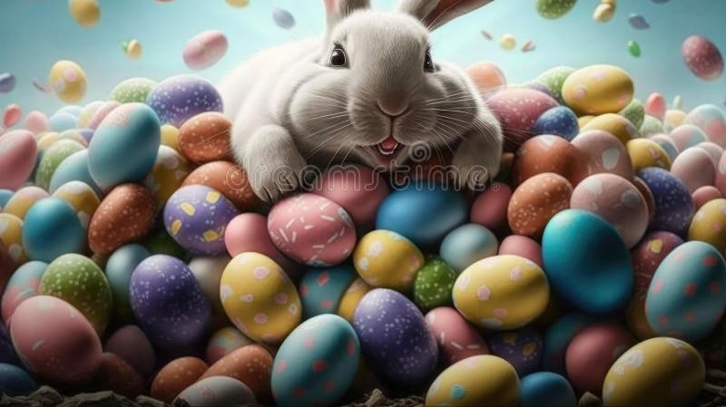
Happy Easter Holidays- we return on TUESDAY 14th April.

