Slide 1


Attendance assembly 2nd March 2026

Slide 2

95% and above Attendance weekly Reward.
Gain a star for each week your class achieves 95%+ How did your class do?

Slide 3

19 classes over 95%
A really strong start to Spring 2 half term
Well done!

Slide 4

Ward End weekly attendance
YEAR | Wb 23rd Feb | Wb | Wb | Wb | Wb | Wb
6.1 | 93%
6.2 | 96%
6.3 | 95%
6.4 | 98%
5.1 | 95%
5.2 | 95%
5.3 | 97%
5.4 | 98%

Slide 5

Ward End weekly attendance
 | Wb 23rd Feb | Wb | Week | Wb | Wb | Wb
4.1 | 93%
4.2 | 98%
4.3 | 96%
4.4 | 92%
3.1 | 98%
3.2 | 95%
3.3 | 87%
3.4 | 95%

Slide 6

Ward End weekly attendance
YEAR | Wb 23rd Feb | Wb | Wb | Wb | Wb | Wb
2.1 | 95%
2.2 | 97%
2.3 | 97%
2.4 | 92%
1.1 | 94%
1.2 | 92%
1.3 | 92%
1.4 | 96%

Slide 7

Ward End weekly attendance
YEAR | Wb 23rd Feb | Wb | Wb | Wb | Wb | Wb
Rabbits | 98%
Squirrels | 96%
Hedgehogs | 92%
Owls | 87%
Doves | 86%
Swans | 96%

Slide 8

Save the Date!
Ward End celebrates World Book Day with a week of live author visits and a book fair
On
Monday 2nd – Friday 6th March.
Your teacher has booked a LIVE author visit
you’ll learn secrets, ask questions, and get inspired!”

Slide 9
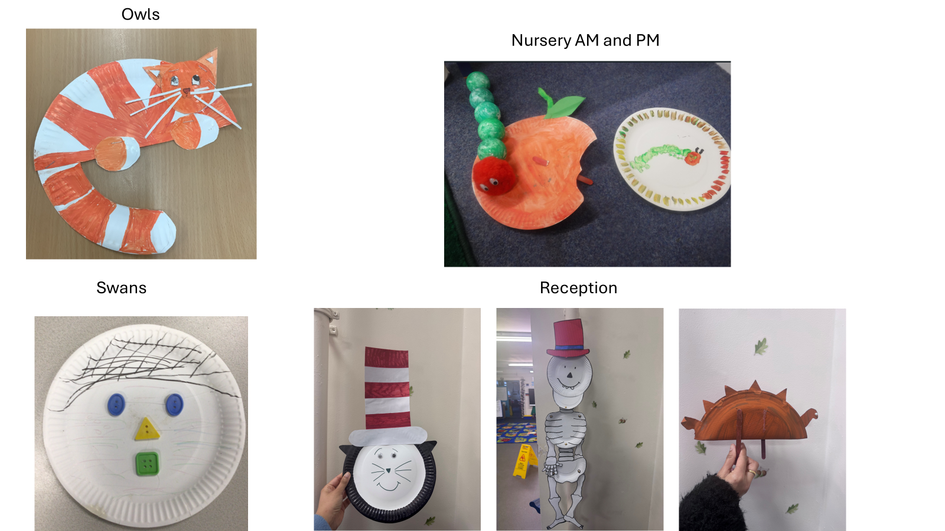
Paper plate design winners!!!

Slide 10
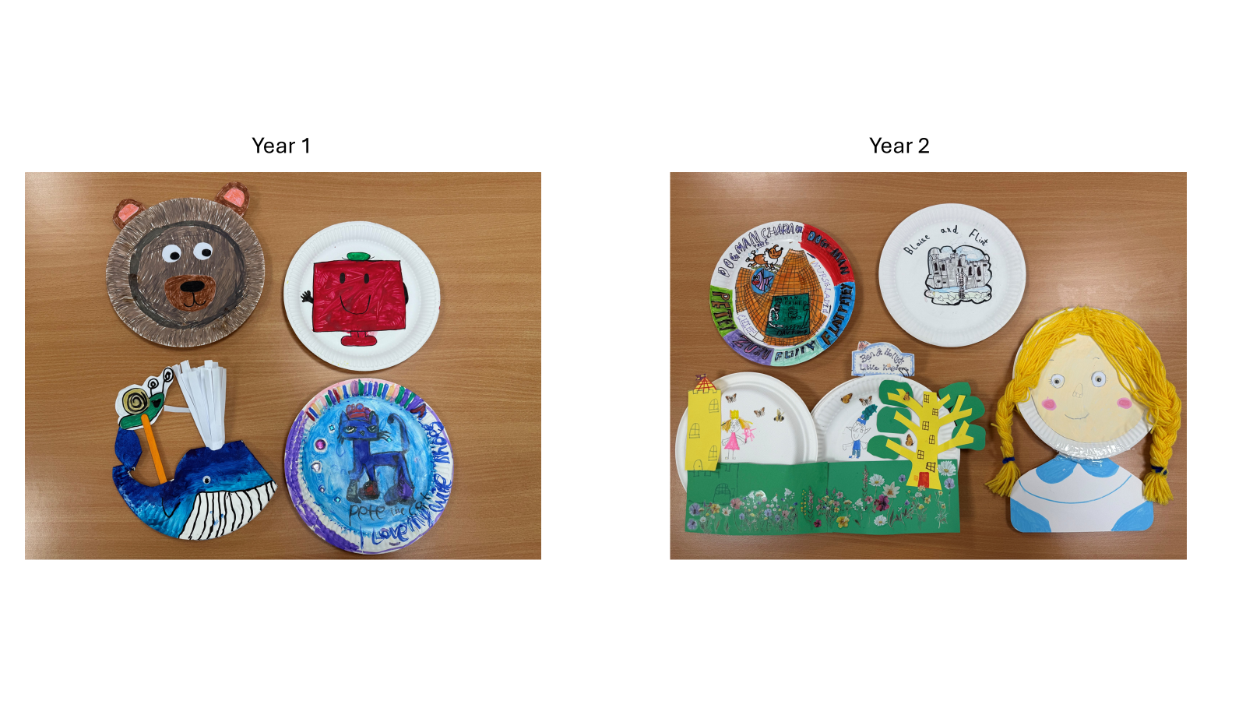
Can you guess the book?

Slide 11
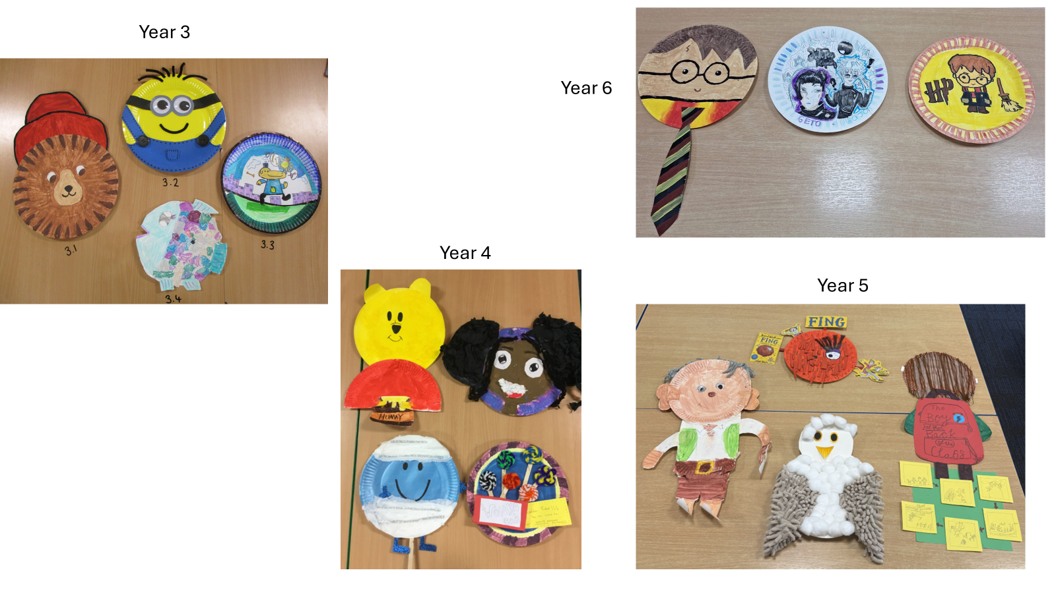
Some really great entries- well done to everyone who joined in. Value: Curiosity

Slide 12



World Book day visitors this week.
We have a Tom Palmer virtual event.
We also have Peter Bunzl in school on Monday morning in the hall (visiting year 5 and 6)
In addition, we have Matt Brown visiting year 3 and 4 on Friday.
Which virtual event would your class like to join? Register in advance- see next slide……

Slide 13


Which live author do YOU want to meet?
Book on now !

Slide 14

Book Fair in school this week
Monday: Year 1 & 2
Tuesday: Year 3 & 4
Wednesday: Year 5 & 6
Thursday: Reception & Nursery
Friday: Open to everyone

Slide 15

Ward End School News.
The Swimming Pool is here!
Year 3 and Year 4
Monday 23rd February – Friday 17th April
Year 1, Year 2 and Resource Base
Monday 20th April – Friday 22nd May
Year 5 and Year 6
Monday 1st June – Friday 17th July

Slide 16


Fabulous attendance celebration
Our next attendance celebration is planned very soon……
Watch this space!!!!
If you gained 95% + attendance in January and February you will be able to attend.
Value: Curiosity, perseverance

Slide 17

A Charter for playtime/lunchtime.
Please work with your class to come up with 4 positive rules for play time and lunchtime.
We want to avoid pupils having accidents by improving the way we play.
What do you think we should plan to do?
Send you 4 ideas to your UNICEF reps at the end of this week please?
Think about our school aims and rules (see next few slides to remind yourself)

Slide 18


Slide 19


Slide 20


Slide 21

Walk to School Initiative
PARK and STRIDE – can you do it? Ask your parents to read the letter sent by class dojo
Pupils who live too far away to walk- can park away from school and join the walking initiative too. Park and stride. Park 5 minutes walk away and walk the extra distance.
Log your journey to school every day- to earn badges each month.
How did you travel to school?
Value: perseverance

Slide 22
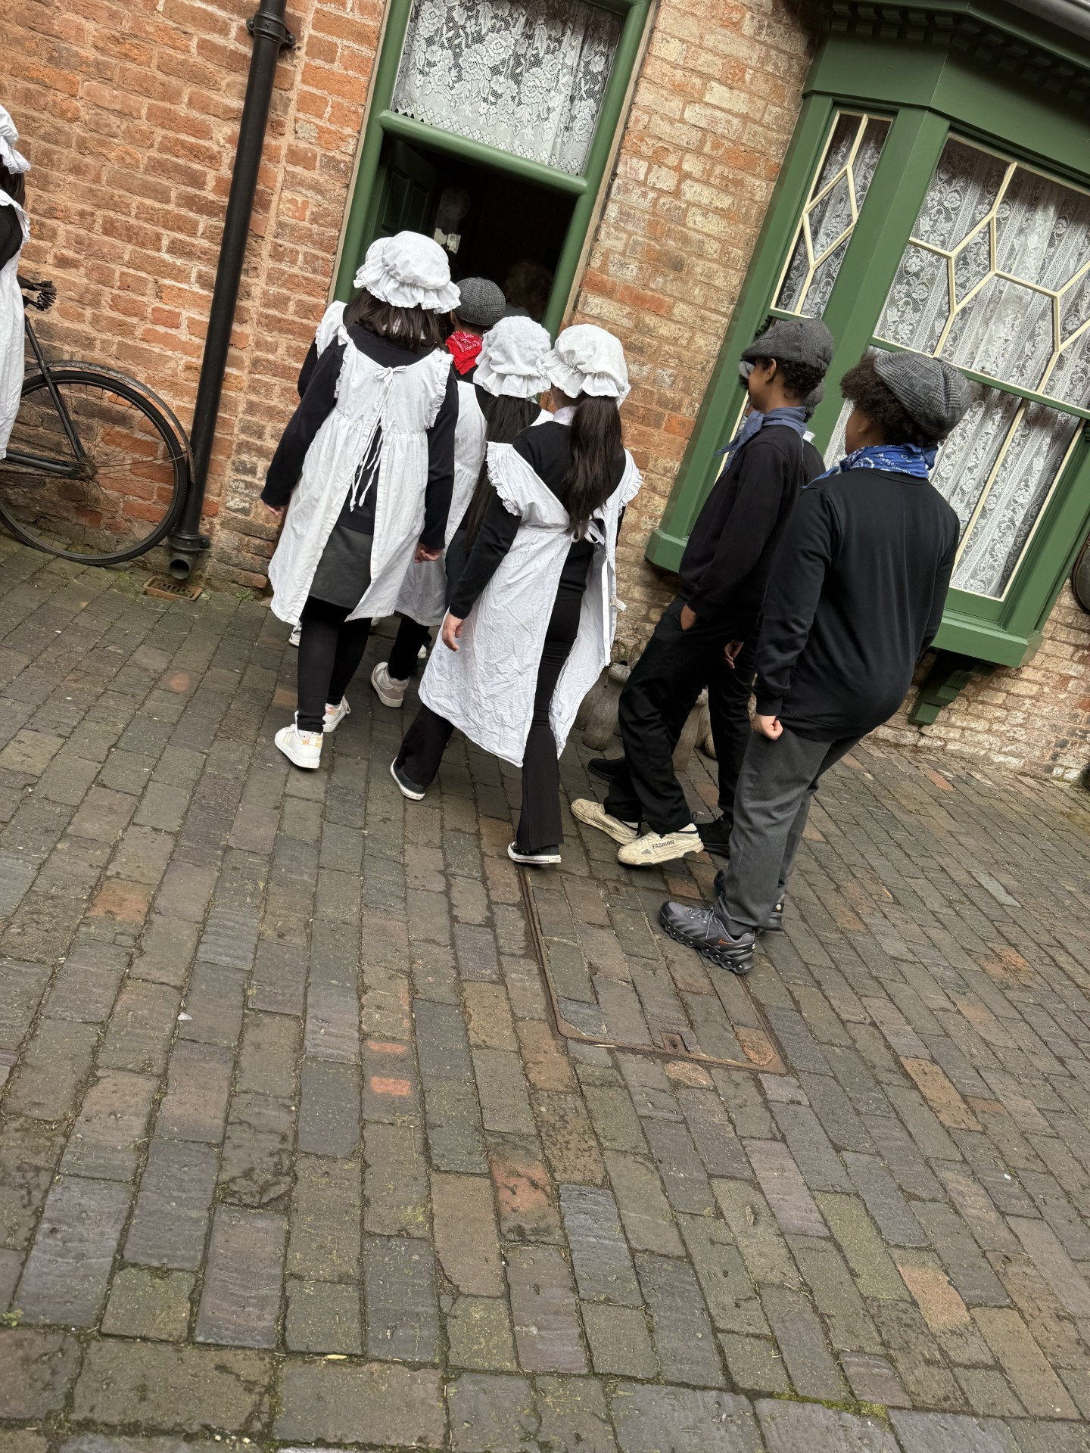
Well done Year 6 who were praised for their excellent school values when they visited the Back- to- Back houses in Birmingham last week

