Slide 1


Attendance assembly 9th March 2026

Slide 2

95% and above Attendance weekly Reward.
Gain a star for each week your class achieves 95%+ How did your class do?

Slide 3

16 classes over 95%
A really strong start to Spring 2 half term
One class 100% Well done.

Slide 4

Ward End weekly attendance
YEAR | Wb 23rd Feb | Wb 2nd March | Wb | Wb | Wb | Wb
6.1 | 93% | 96%
6.2 | 96% | 99%
6.3 | 95% | 94%
6.4 | 98% | 94%
5.1 | 95% | 94%
5.2 | 95% | 97%
5.3 | 97% | 95%
5.4 | 98% | 98%

Slide 5

Ward End weekly attendance
 | Wb 23rd Feb | Wb 2nd March | Week | Wb | Wb | Wb
4.1 | 93% | 95%
4.2 | 98% | 96%
4.3 | 96% | 100%
4.4 | 92% | 93%
3.1 | 98% | 93%
3.2 | 95% | 93%
3.3 | 87% | 96%
3.4 | 95% | 95%

Slide 6

Ward End weekly attendance
YEAR | Wb 23rd Feb | Wb 2nd March | Wb | Wb | Wb | Wb
2.1 | 95% | 93%
2.2 | 97% | 95%
2.3 | 97% | 91%
2.4 | 92% | 89%
1.1 | 94% | 94%
1.2 | 92% | 95%
1.3 | 92% | 97%
1.4 | 96% | 94%

Slide 7

Ward End weekly attendance
YEAR | Wb 23rd Feb | Wb 2nd March | Wb | Wb | Wb | Wb
Rabbits | 98% | 91%
Squirrels | 96% | 90%
Hedgehogs | 92% | 98%
Owls | 87% | 98%
Doves | 86% | 76%
Swans | 96% | 97%

Slide 8
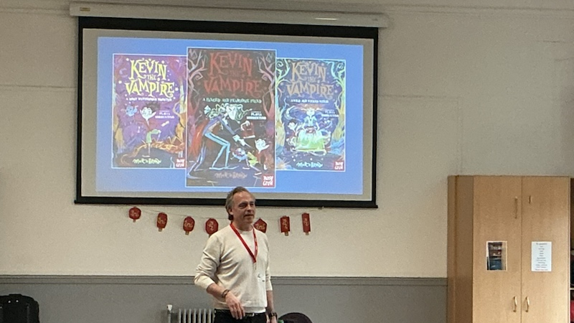
Author visit: Matt Brown

Slide 9
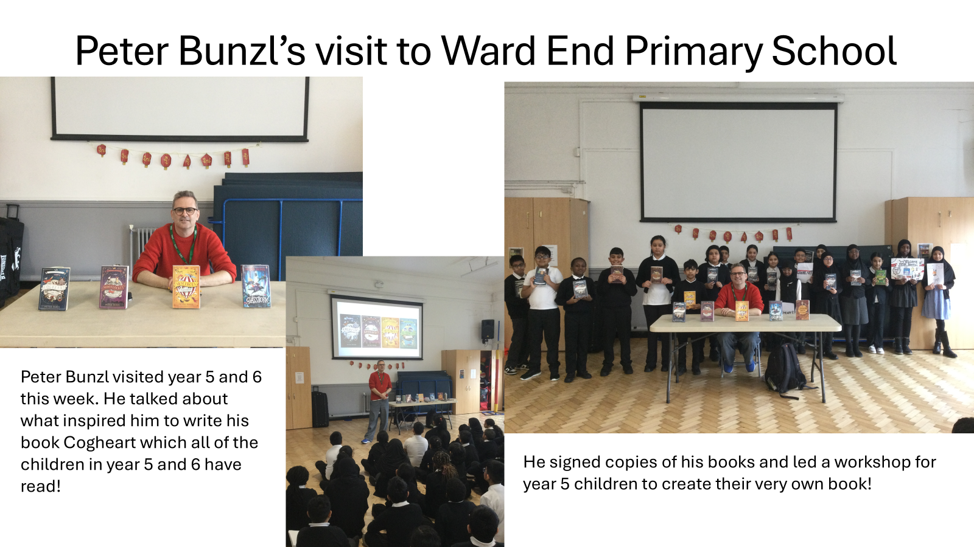

Slide 10


Slide 11


Slide 12
We would like every class from year 1 to year 6 to be part of the voting!
Next steps…
Your teacher will read all four books to you.
Your job will be to rank the books (write 1 beside your favourite book, 2 beside your next favourite, 3 beside the next, and 4 beside the book you like least)
We will collect the votes in and then send them off to The Federation of Children’s Book Groups who will count our votes along with votes from lots of other schools from around the country!
The award ceremony will take place on 13th June when we will find out the winner!
Extra: If you want to write a letter to the author or create some drawings inspired by the book, please do! Your work could be added to the special portfolio we’ll give the author at the award ceremony.

Slide 13

Exciting events WEPS
This week
Year 1 visit St Martin’s Church, going to Birmingham on the bus.
Value : Respect
Reception have a play- Jack and the Bean Stalk. Value Curiosity
Years 2 and 5 have visit from NSPCC Speak out and Stay Safe workshop. How to look after yourself in any situation.
Value: Courage, curiosity.

Slide 14

Exciting events next week
ARTS WEEK all week. Artist Mark Riley will be with us.
Year 3 have a Grafitti art workshop on Tuesday next week
The Fire Engine will visit us for Reception on Monday
A Chef will be working with year 4 pupils
Nursery will have a play: The Little Red Hen
And
It will be Eid too! Special Eid menu next Wednesday in the Canteen.

Slide 15


Slide 16

Ward End News: Years 1-6
End of the day (every day)
All classes will be outside by 3.30pm (3pm on Fridays) ready for gates to open to parents at 3.30pm.
This way there will be less congestion in the playground, and classes won’t have to walk through groups of parents. Make sure you are on time every day please. Mrs Chahal has promised parents that classes will be there on time.
Line up (not crowd)- decide on a line order and walk out in that order. Remain quiet and still until your teacher sees your parents and says you can go.
Do not go until dismissed by your teacher- for safety. You may have to wait politely for a few minutes.

Slide 17

End of the day: Value Respect.
Pupils cannot leave the line to go back into school until the last child is dismissed. Take everything with you.
Once everyone has been dismissed, if you need to go back inside for something you have forgotten- you can then go. Wait patiently.
Teachers cannot take messages whilst dismissing pupils. If you or your parents have messages, please wait until the end- or write a dojo message.
Mrs Chahal & Mrs Martin will be in the playground – they can take messages.
These steps are to keep everyone safe. Be Ready, Be Safe, Be Kind.

Slide 18

Ward End School News.
The Swimming Pool is here!
Year 3 and Year 4
Monday 23rd February – Friday 17th April
Year 1, Year 2 and Resource Base
Monday 20th April – Friday 22nd May
Year 5 and Year 6
Monday 1st June – Friday 17th July

Slide 19

A Charter for playtime/lunchtime.
Please work with your class to come up with 4 positive rules for play time and lunchtime.
We want to avoid pupils having accidents by improving the way we play.
What do you think we should plan to do?
Send you 4 ideas to your UNICEF reps at the end of this week please?
Think about our school aims and rules (see next few slides to remind yourself)

Slide 20


Slide 21


Slide 22


Slide 23

Walk to School Initiative
PARK and STRIDE – can you do it? Ask your parents to read the letter sent by class dojo
Pupils who live too far away to walk- can park away from school and join the walking initiative too. Park and stride. Park 5 minutes walk away and walk the extra distance.
Log your journey to school every day- to earn badges each month.
How did you travel to school?
Value: perseverance

