Slide 1



Slide 2


Slide 3


Slide 4
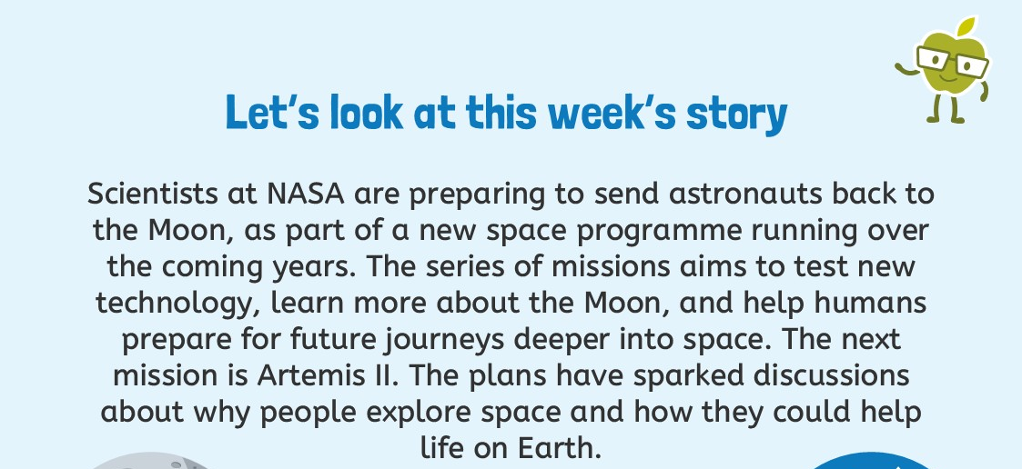
Artemis II: Meet the Astronauts Who will Fly Around the Moon (Official NASA Video)

Slide 5


Slide 6
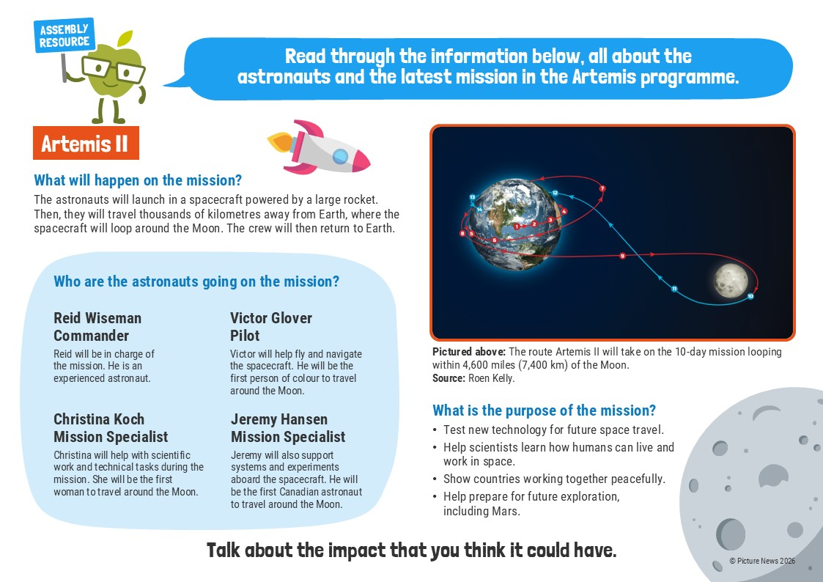

Slide 7
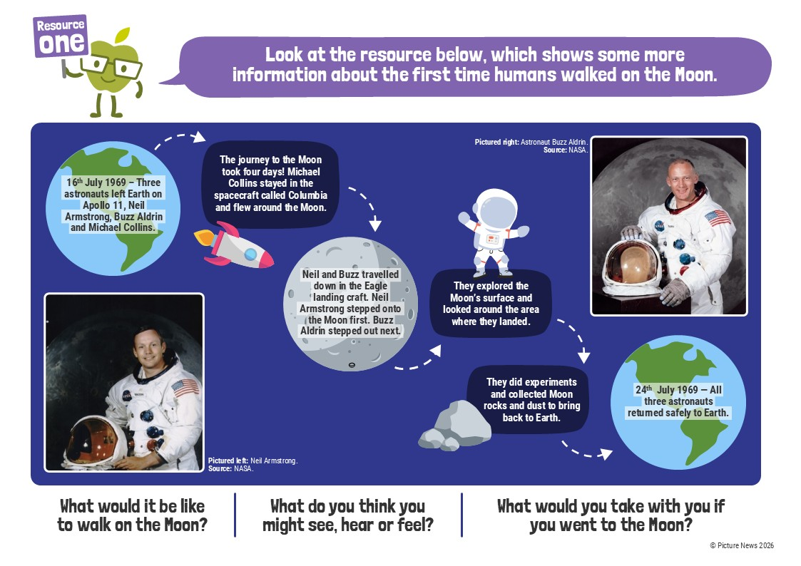

Slide 8
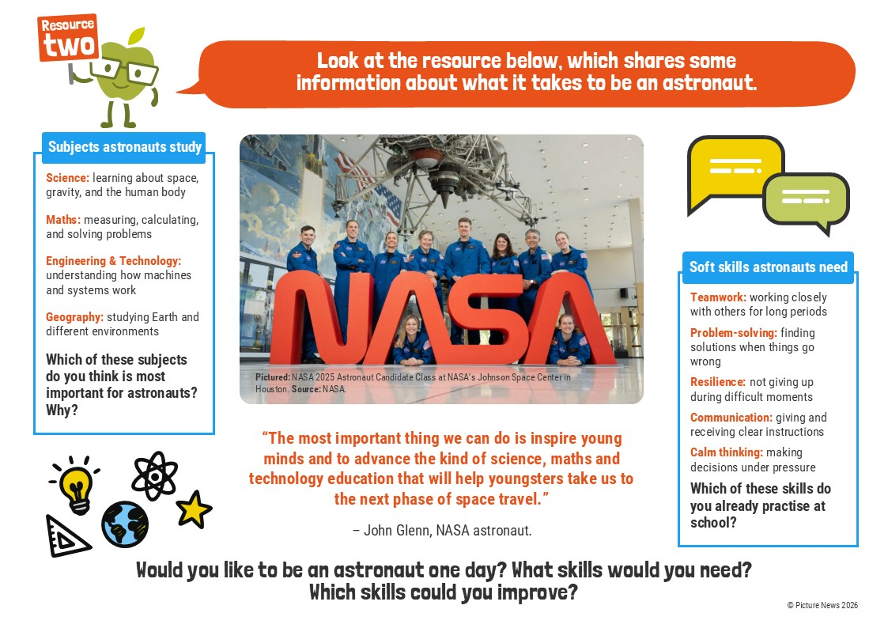

Slide 9
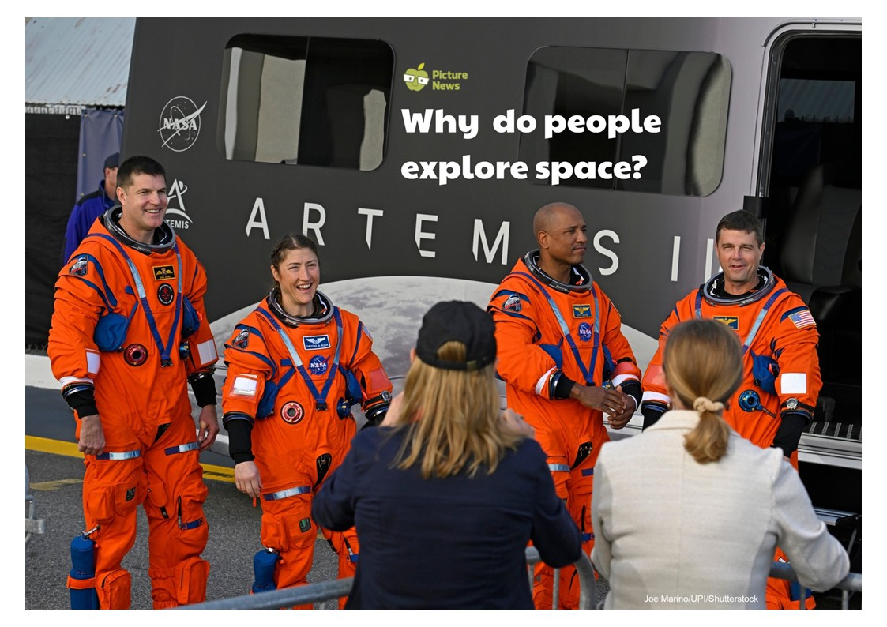

Slide 10
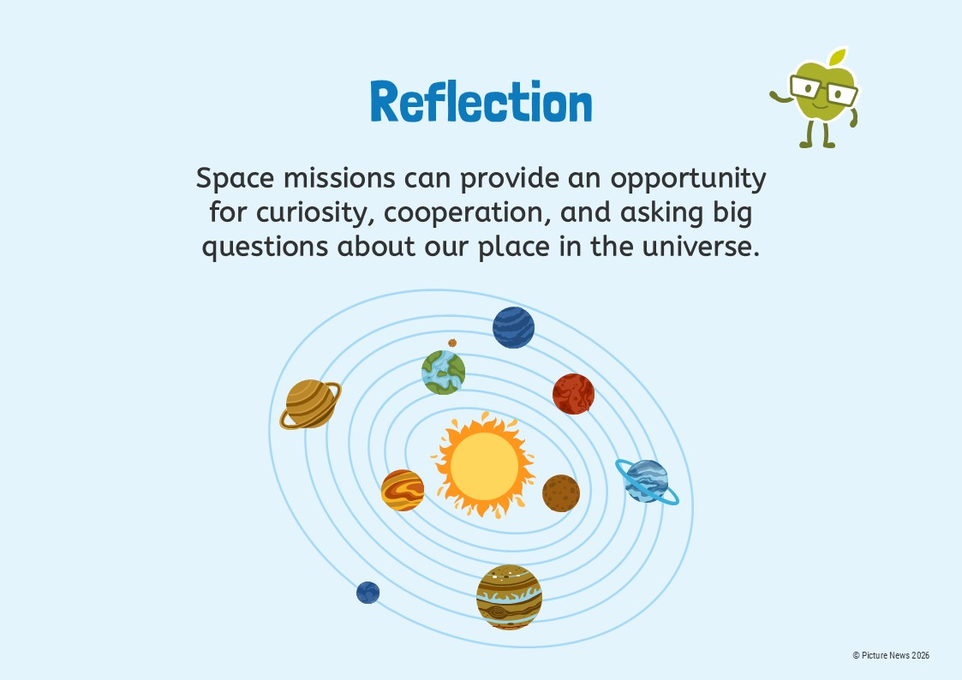

Slide 11


Slide 12


