Slide 1


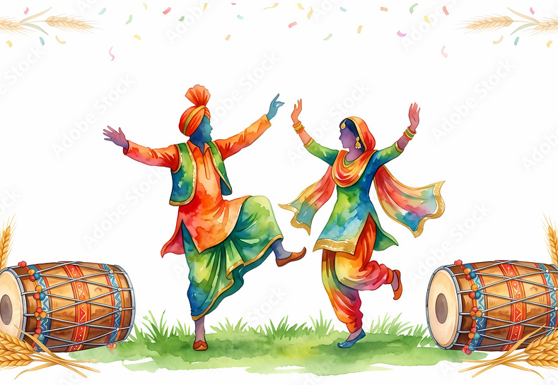
Attendance assembly 14th April 2026

Slide 2

95% and above Attendance weekly Reward.
Gain a star for each week your class achieves 95%+ How did your class do?

Slide 3

There are 9 classes over 95%
Well done! Keep working hard to be in school every day.

Slide 4

Ward End weekly attendance
YEAR | Wb 23rd Feb | Wb 2nd March | Wb 9th March | Wb 16th March | Wb 23rd March
6.1 | 93% | 96% | 94% | 91% | 95%
6.2 | 96% | 99% | 99% | 90% | 92%
6.3 | 95% | 94% | 95% | 91% | 94%
6.4 | 98% | 94% | 92% | 93% | 93%
5.1 | 95% | 94% | 95% | 93% | 88%
5.2 | 95% | 97% | 96% | 89% | 92%
5.3 | 97% | 95% | 91% | 87% | 89%
5.4 | 98% | 98% | 97% | 95% | 97%

Slide 5

Ward End weekly attendance
 | Wb 23rd Feb | Wb 2nd March | Week 9th March | Wb 16th March | Wb 23rd March
4.1 | 93% | 95% | 94% | 93% | 84%
4.2 | 98% | 96% | 96% | 93% | 89%
4.3 | 96% | 100% | 97% | 93% | 90%
4.4 | 92% | 93% | 97% | 92% | 92%
3.1 | 98% | 93% | 97% | 92% | 95%
3.2 | 95% | 93% | 96% | 91% | 97%
3.3 | 87% | 96% | 95% | 83% | 84%
3.4 | 95% | 95% | 96% | 94% | 84%

Slide 6

Ward End weekly attendance
YEAR | Wb 23rd Feb | Wb 2nd March | Wb 9th March | Wb 16th March | Wb 23rd March
2.1 | 95% | 93% | 95% | 86% | 93%
2.2 | 97% | 95% | 98% | 94% | 79%
2.3 | 97% | 91% | 97% | 92% | 97%
2.4 | 92% | 89% | 98% | 94% | 94%
1.1 | 94% | 94% | 98% | 93% | 92%
1.2 | 92% | 95% | 93% | 98% | 81%
1.3 | 92% | 97% | 97% | 94% | 97%
1.4 | 96% | 94% | 96% | 83% | 92%

Slide 7

Ward End weekly attendance
YEAR | Wb 23rd Feb | Wb 2nd March | Wb 9th March | Wb 16th March | Wb 23rd March | Wb
Rabbits | 98% | 91% | 98% | 95% | 94%
Squirrels | 96% | 90% | 88% | 84% | 80%
Hedgehogs | 92% | 98% | 92% | 89% | 97%
Owls | 87% | 98% | 99% | 100% | 98%
Doves | 86% | 76% | 90% | 93% | 95%
Swans | 96% | 97% | 93% | 90% | 91%

Slide 8
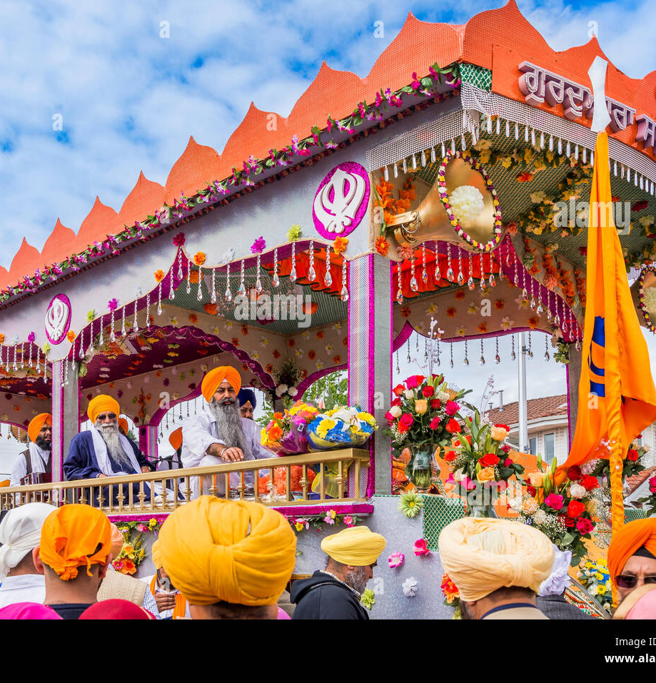
The Sikh festival-
Vaisaki
This is our Assembly Theme this week.
British Value: Respect and Tolerance for everyone’s faith and beliefs.
Use the language of
Vaisaki ( or Baisakhi) is a major Spring festival, it celebrates the
Sikh New Year and Harvest festival.
People in India celebrate with community parades, visits to
Gudwaras traditional music and happy gatherings.
This festival also commemorates the founding of the Khalsa- Sikh Community in 1699 – find that on your class time line. Sikhism is considered the world’s newest religion.
In Punjab (India) people of all religions gather and celebrate the Harvest festival together- being grateful for the crops which grow on their
farms to feed people and animals.

Slide 9
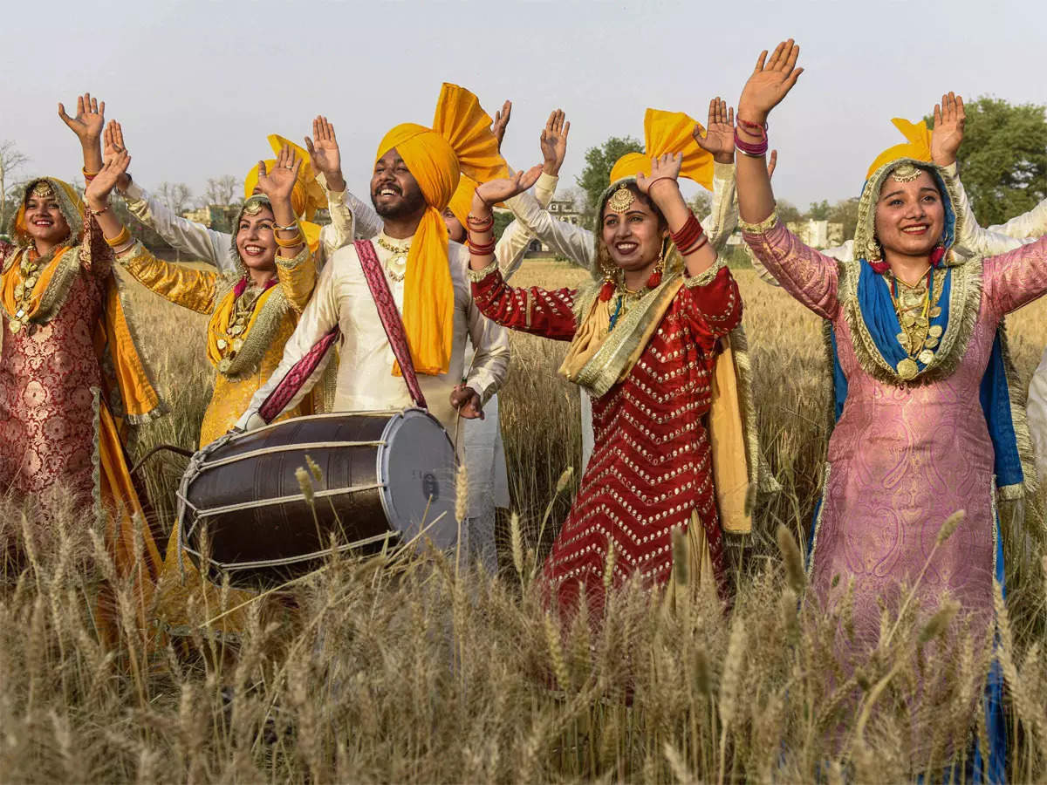
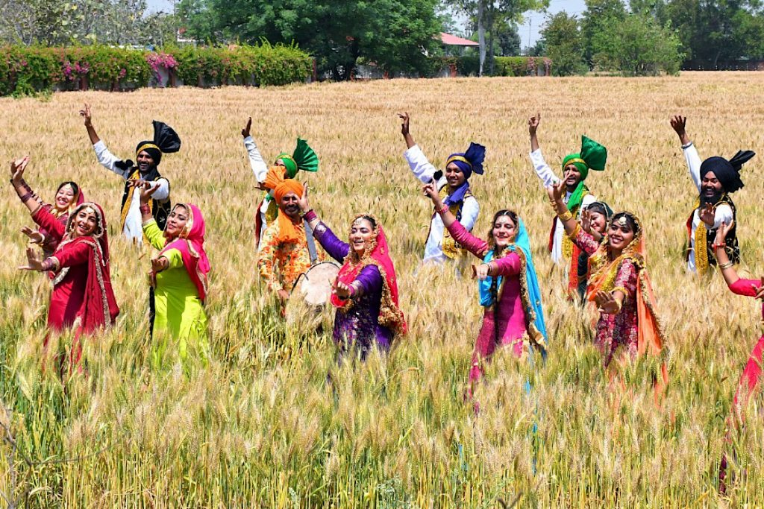
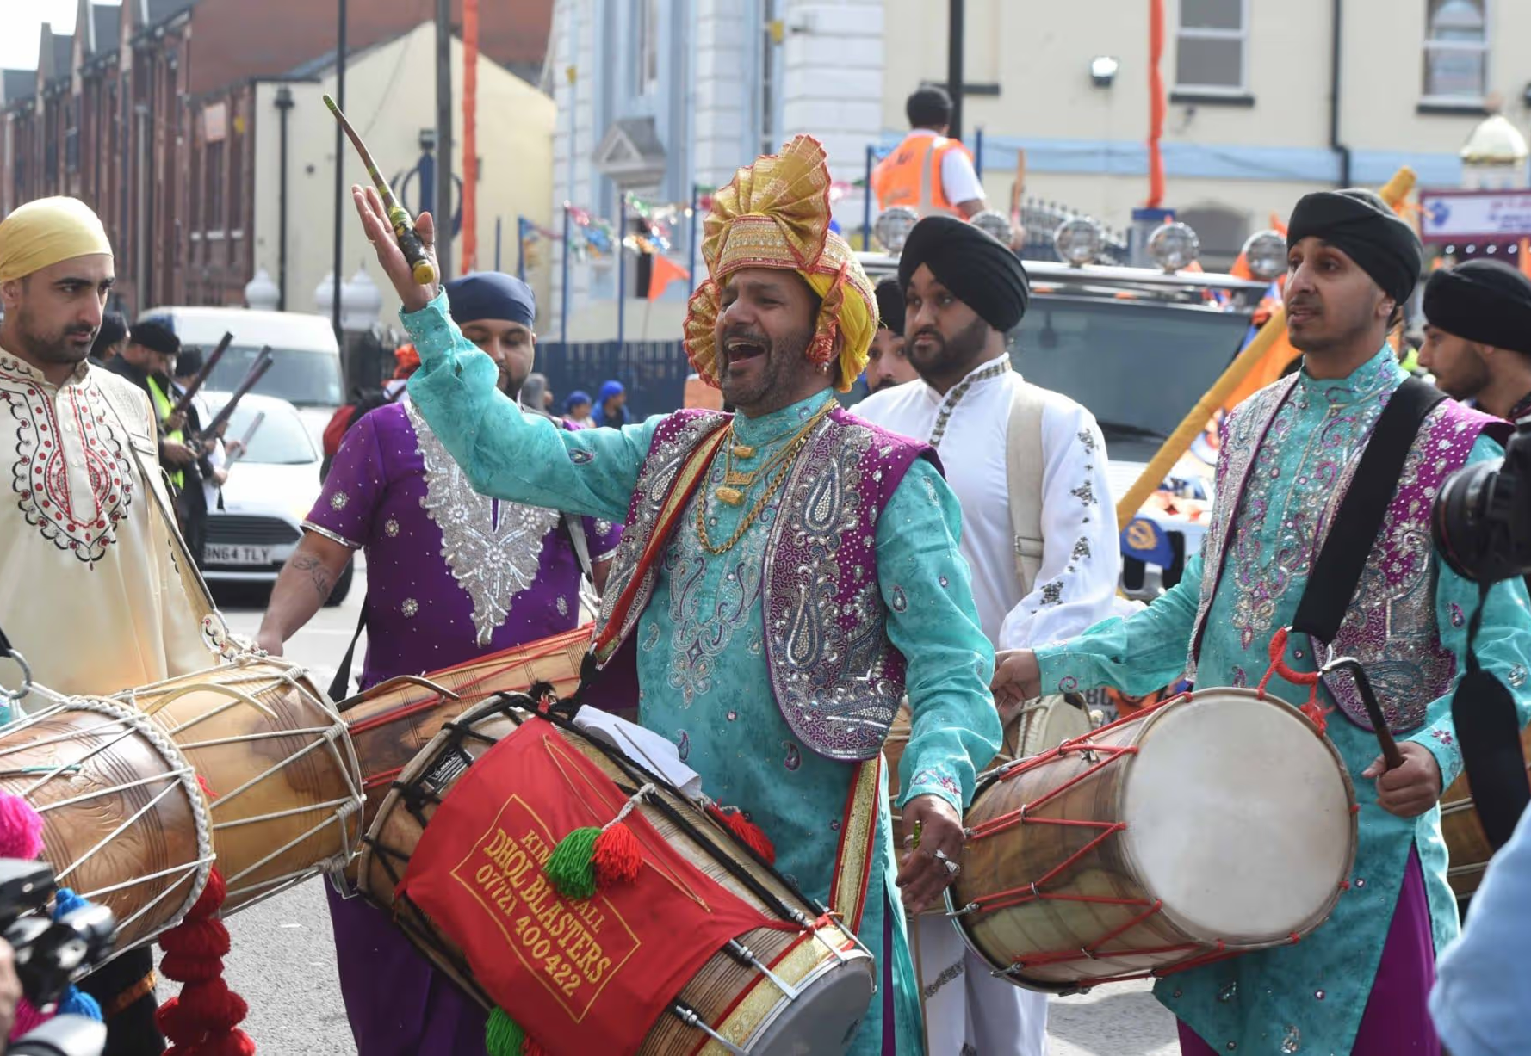
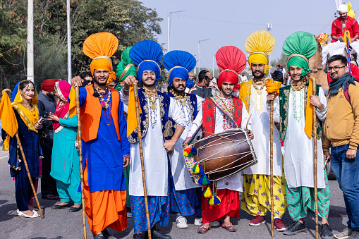
Celebrated in the UK and abroad
What questions do you have?
Use the language of discussion
I wonder what
I would like to know
Why….
Where….
How….
School Value: Respect

Slide 10
Perhaps you can find some more Vaisaki photos?
Https://www.bbc.co.uk/programmes/p011m4hh
You can watch this Clip to see the Bhangra dancing.

Slide 11
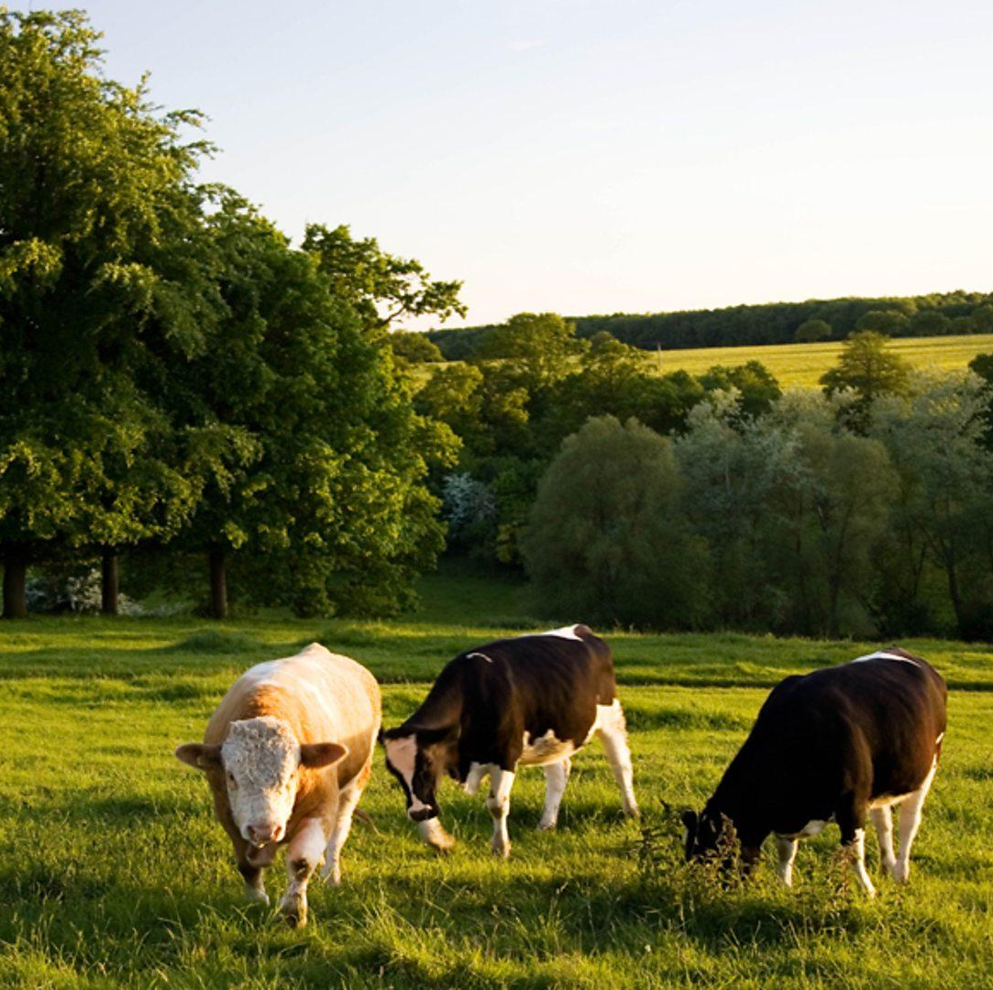
Exciting events this week
Year One visit Mount Pleasant Farm
EYFS have a play production of Jack and the Bean stalk
Next week:
Years 3 visit Lickey Hills Country Park
Sparrows are walking to Ward End Library
Chef visits year 4

Slide 12
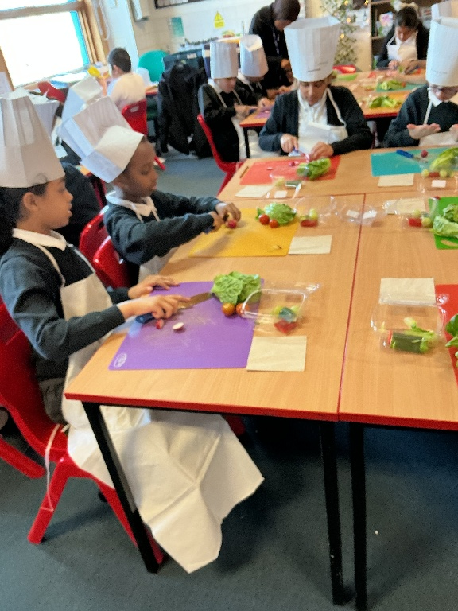
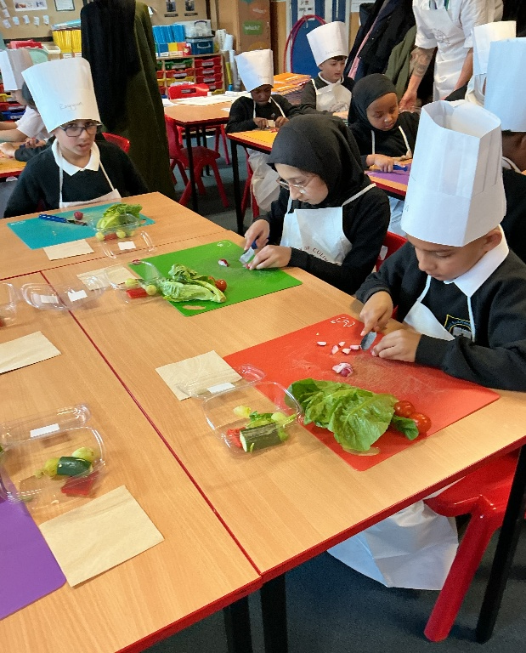
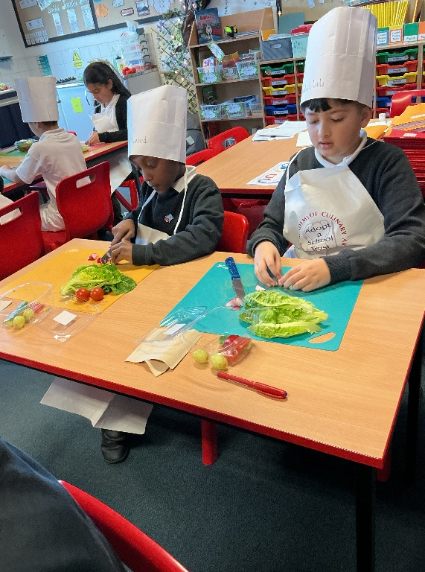
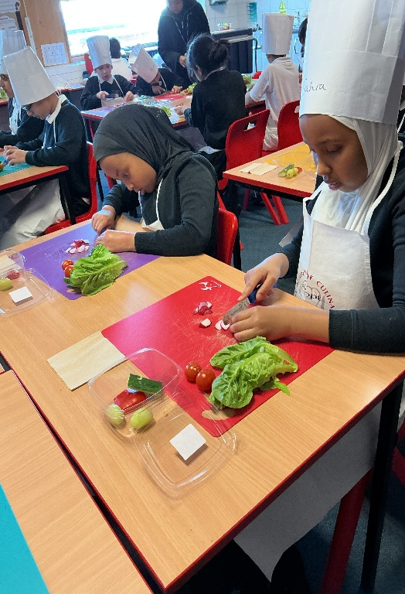
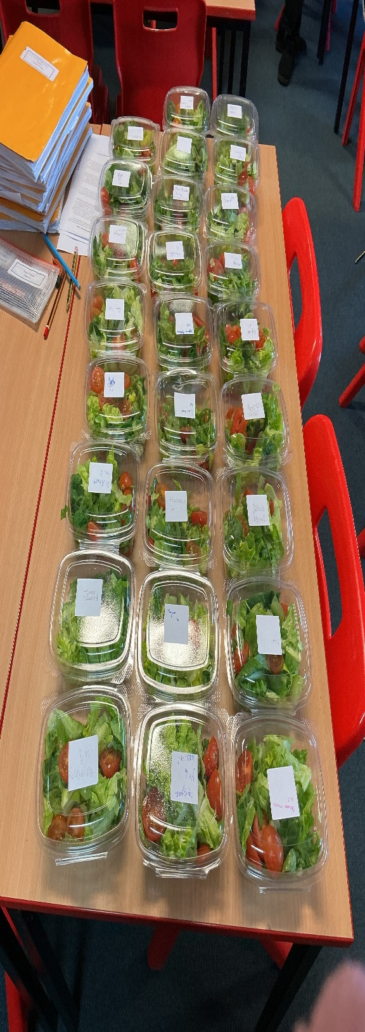
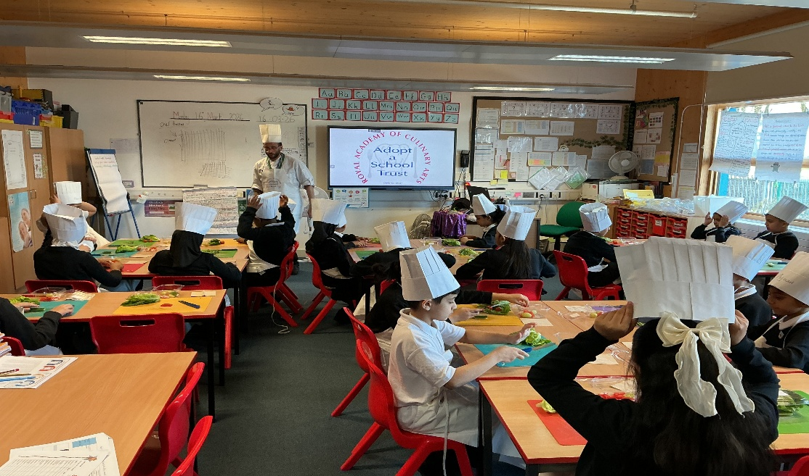
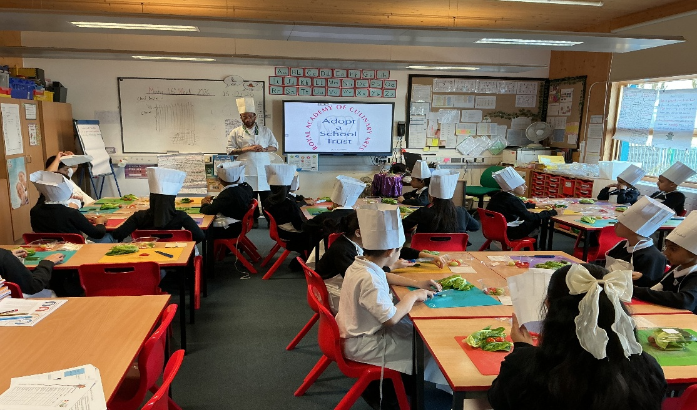
Cooking session in Year 4

Slide 13
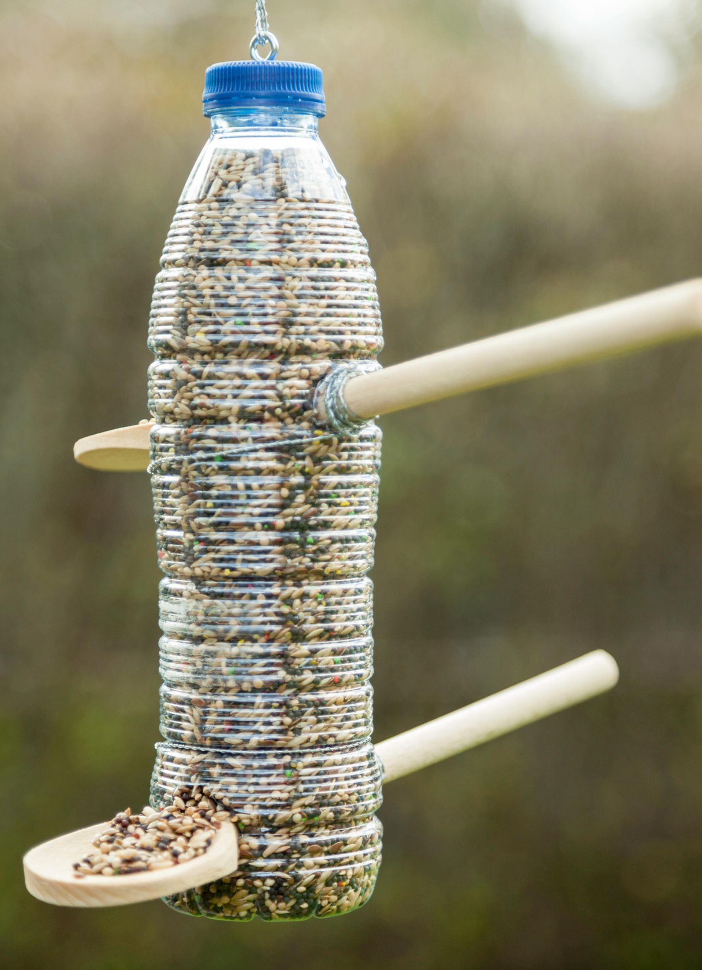
Earth Day – coming soon
(get ready!)
Everyone will be involved in DT projects during the afternoon
YR& Y1- Sowing seeds
Y2- Vegetable/ Herb Planting/Seed Sowing
Y3- Hanging Baskets
Y 4 - Bug Hotels
Y 5- Bird Feeders
Y 6 - Model- Eco Houses.

Slide 14

Ward End School News.
The Swimming Pool is here!
Year 3 and Year 4
Monday 23rd February – Friday 17th April
Year 1, Year 2 and Resource Base
Monday 20th April – Friday 22nd May
Year 5 and Year 6
Monday 1st June – Friday 17th July

Slide 15


Slide 16


Slide 17

Walk to School Competition weeks. Value: Resilience
Each day, walk to school
So now the weather is improving, why not ditch the car and walk at least once a week or even every day!

