Slide 1

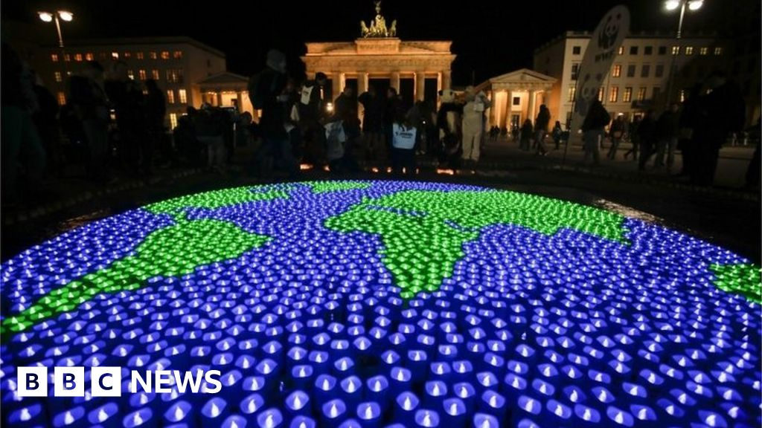
Attendance assembly 20th April 2026

Slide 2

95% and above Attendance weekly Reward.
Gain a star for each week your class achieves 95%+ How did your class do?

Slide 3
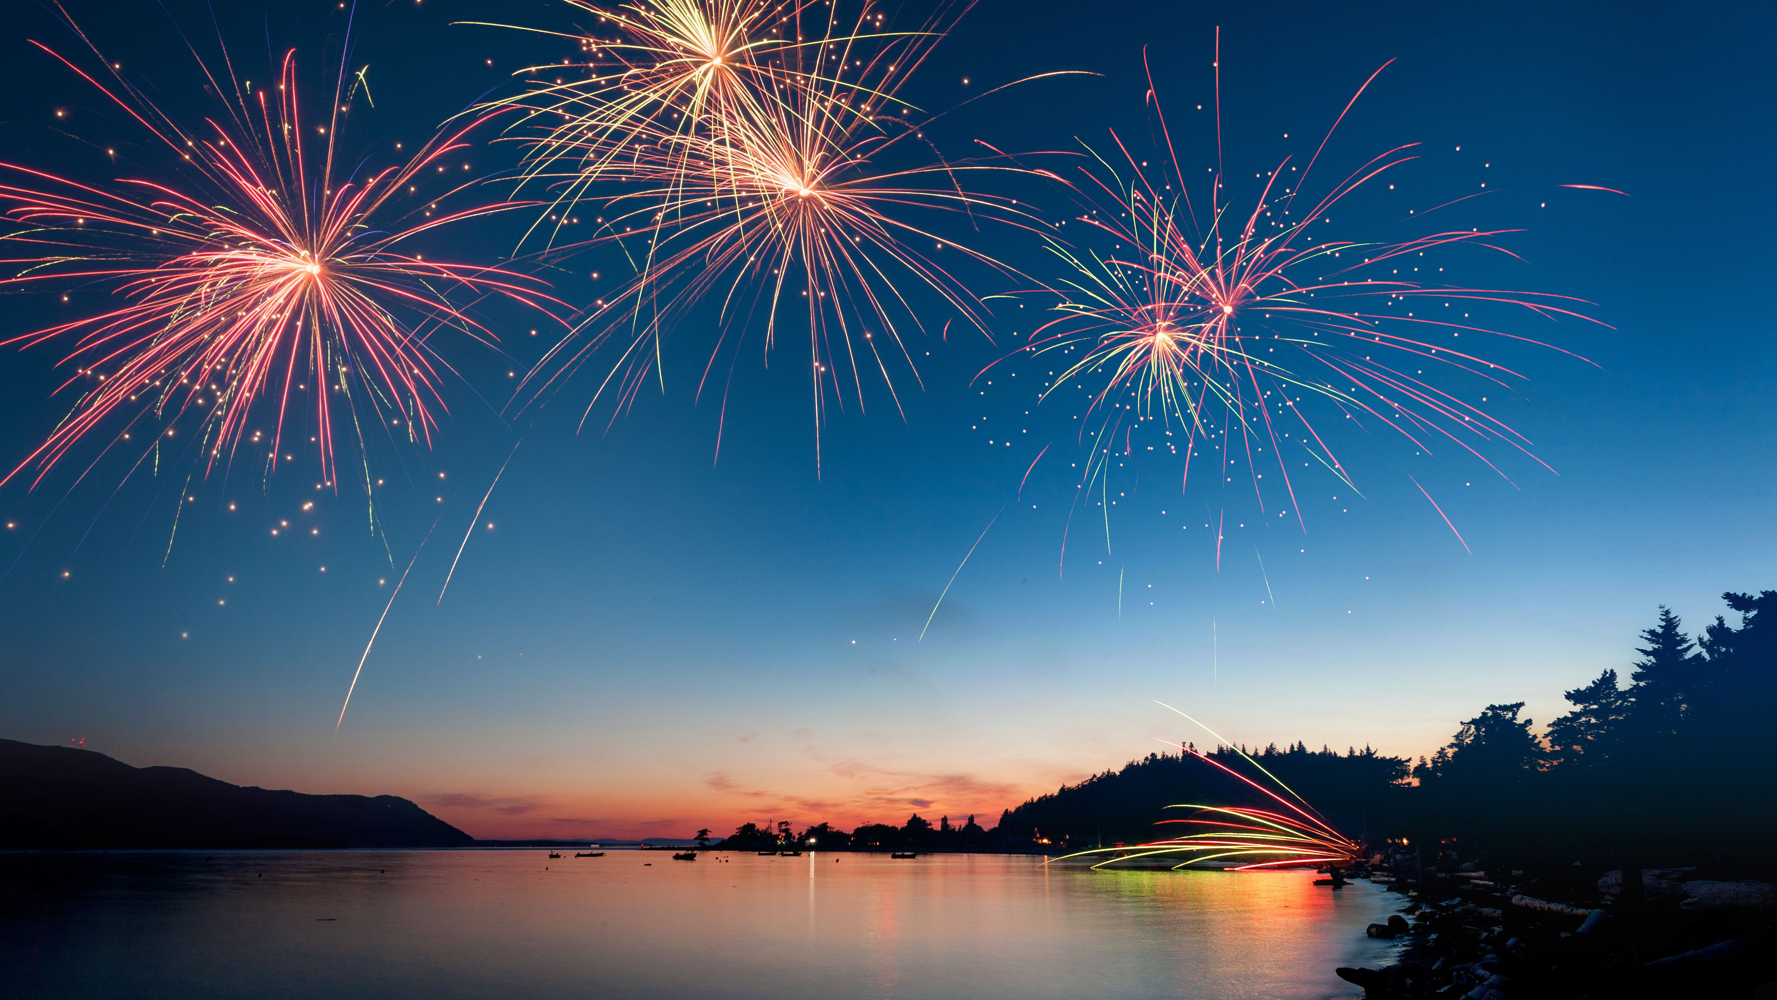
Only 8 classes over 95% this week
Keep working hard to be in school every day.

Slide 4

Ward End weekly attendance
YEAR | Wb 14th April | Wb | Wb | Wb | Wb
6.1 | 93%
6.2 | 97%
6.3 | 93%
6.4 | 91%
5.1 | 89%
5.2 | 84%
5.3 | 92%
5.4 | 94%

Slide 5

Ward End weekly attendance
 | Wb 14th April | Wb | Week | Wb | Wb
4.1 | 86%
4.2 | 94%
4.3 | 89%
4.4 | 86%
3.1 | 95%
3.2 | 95%
3.3 | 91%
3.4 | 87%

Slide 6

Ward End weekly attendance
YEAR | Wb 14th April | Wb | Wb | Wb | Wb
2.1 | 99%
2.2 | 92%
2.3 | 88%
2.4 | 97%
1.1 | 90%
1.2 | 90%
1.3 | 92%
1.4 | 89%

Slide 7

Ward End weekly attendance
YEAR | Wb 14th April | Wb | Wb | Wb | Wb | Wb
Rabbits | 89%
Squirrels | 77%
Hedgehogs | 97%
Owls | 97%
Doves | 87%
Swans | 96%

Slide 8
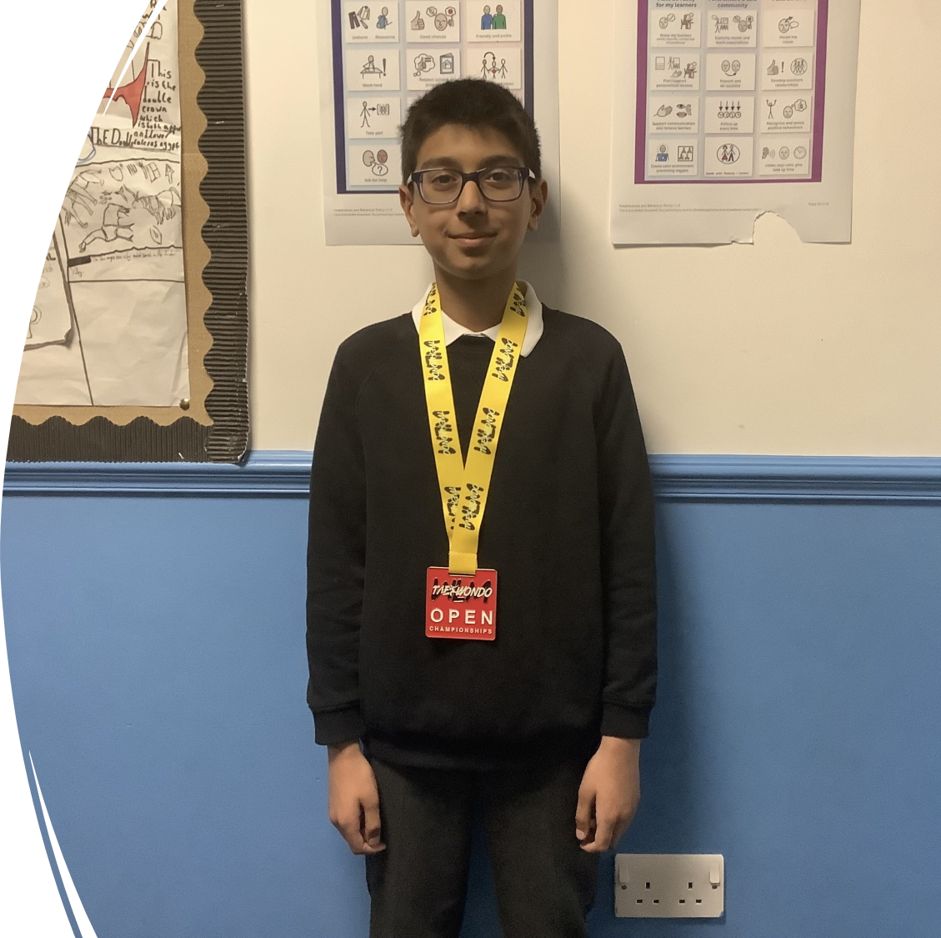
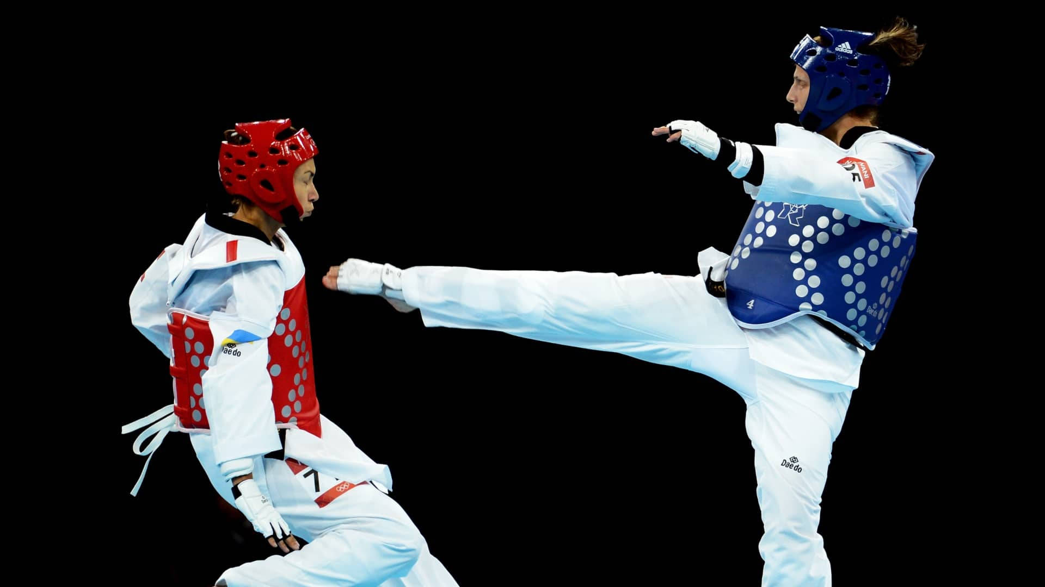
A Special Achievement!
Yousuf in 6.3 is now the European Champion at Taekwondo.
Taekwondo is a martial art from Korea, meaning the way of foot and hand.
It uses kicks, punches and blocks and teaches Respect, Focus and Confidence.

Slide 9
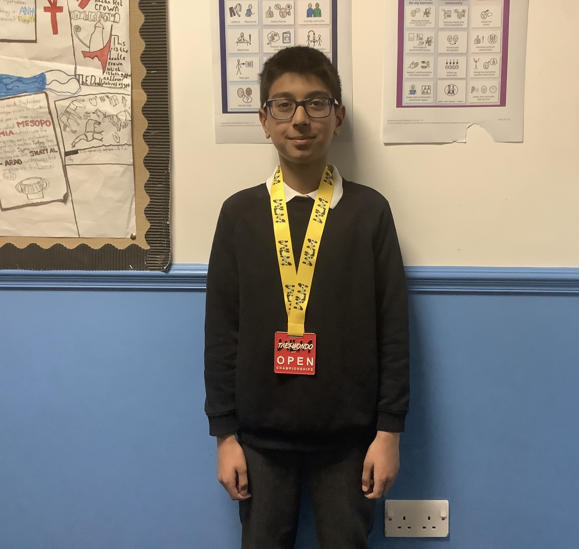
A Ward End Champion
Yousuf wears protective gear to fight his matches and score points against is opponent.
Last weekend at a competition in Liverpool he won a gold medal.
Yousuf aims to compete in the Olympics when he is older! Watch this space…
Well done Yousuf!!!

Slide 10
What Values has Yousuf demonstrated?
Can you say HOW each of the Values apply to Yousuf’s training and determination to be a champion?
Respect
Resilience
Courage
Creativity
Perseverance
Aspiration
Start your sentences with ‘I think that….’

Slide 11

Earth Day 2026
This is our Assembly Theme this week.
British Value: Democracy
Can you find a meaning for Democracy
and explain it to your talk partner?
Democracy is one of our 4 BRITISH VALUES
Democracy
Liberty
Tolerance and respect for other’s religions and beliefs
The rule of law

Slide 12
Watch Earth Hour official trailer here
https://youtu.be/xbg97CnFf8c
Watch lights switching off for Earth Hour here:
https://www.bbc.co.uk/news/av/world-56553545

Slide 13

Can you say why saving our planet is important?
Use the language of explanation or discussion.
You can look on NASA website for images of Earth taken from the latest Space expedition:-
Artemis II
4 astronauts spent 10 days in space flying around the moon and back to gather data and test systems.

Slide 14
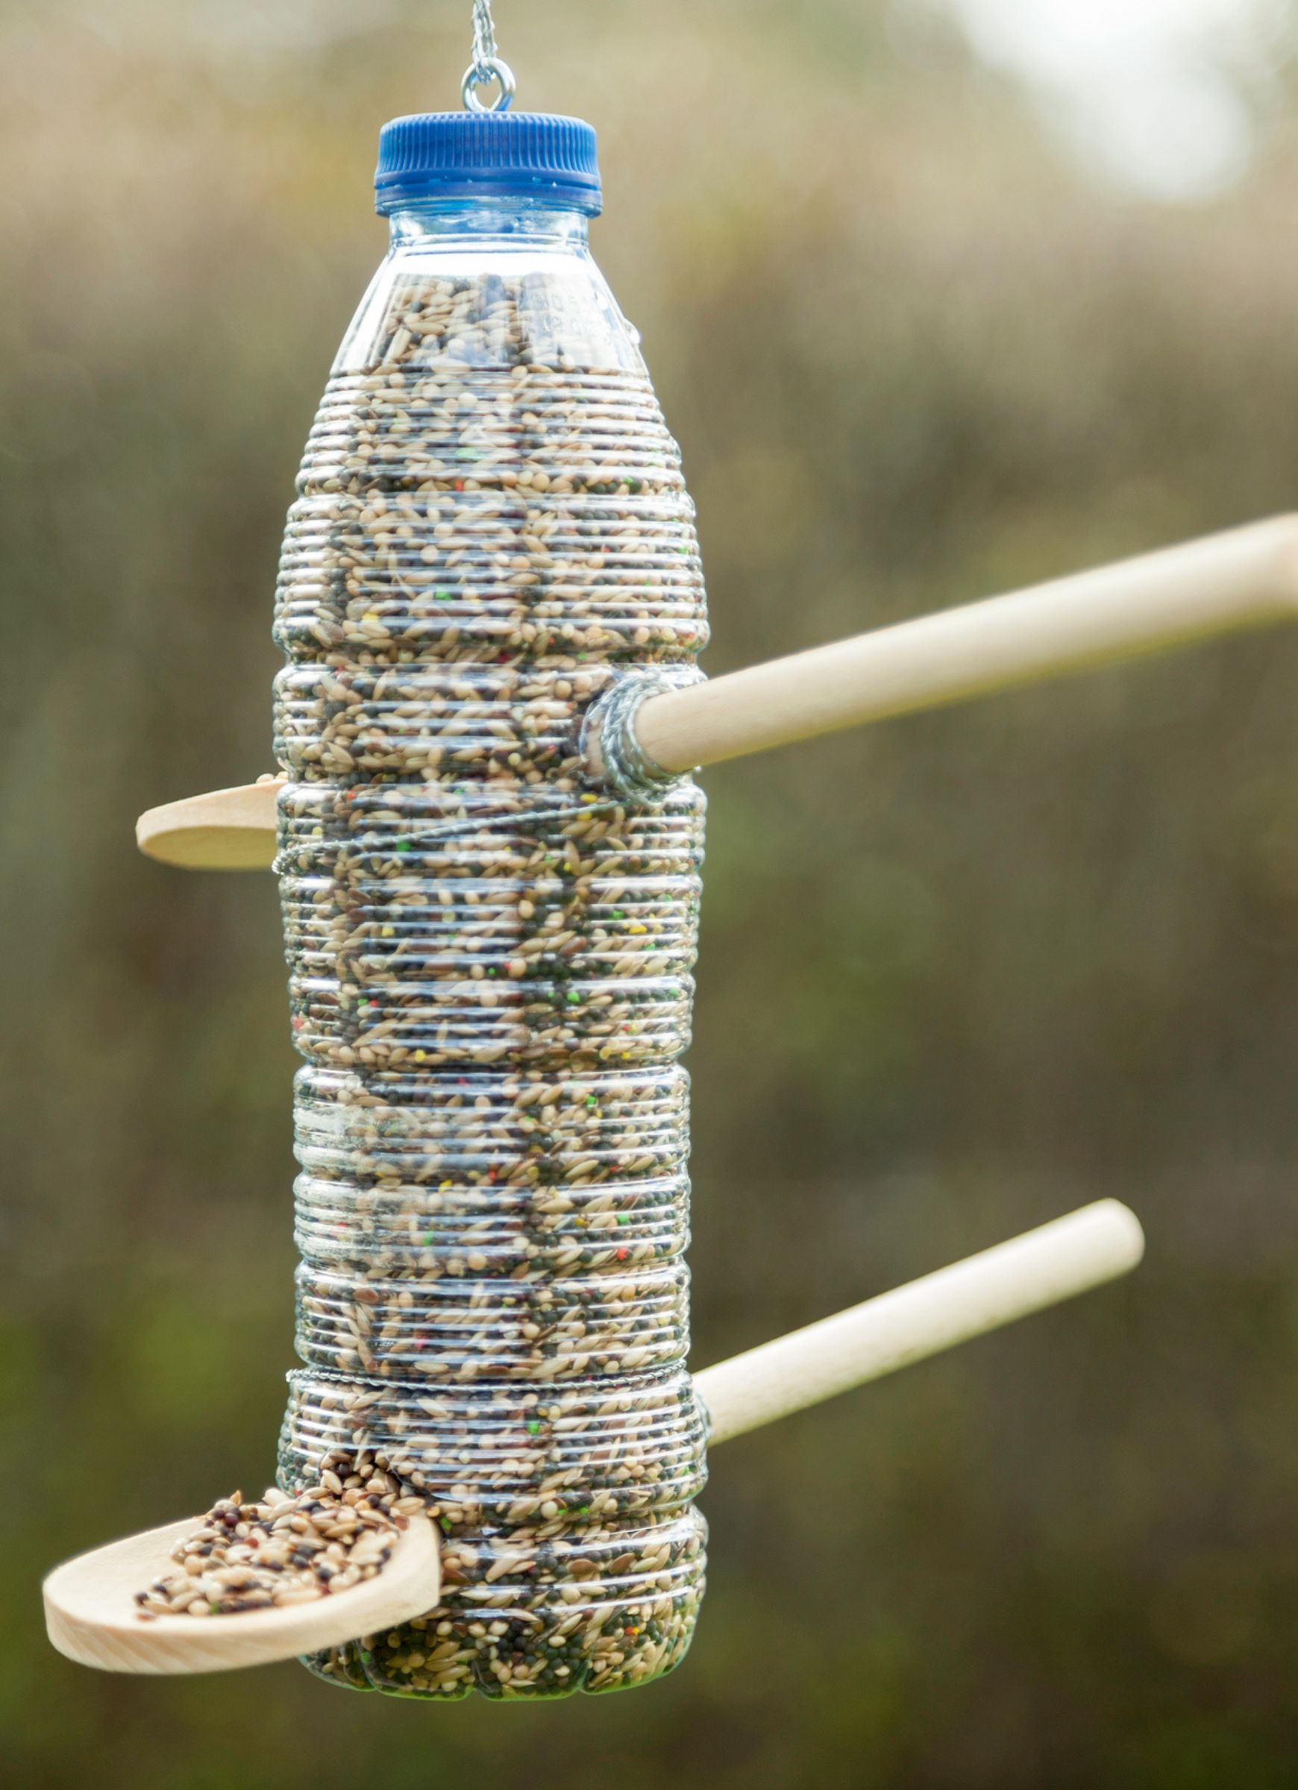

Earth Day – coming soon
(get ready!)
Everyone will be involved in DT projects during the afternoon
YR& Y1- Sowing seeds
Y2- Vegetable/ Herb Planting/Seed Sowing
Y3- Hanging Baskets
Y 4 - Bug Hotels
Y 5- Bird Feeders
Y 6 - Model- Eco Houses.

Slide 15
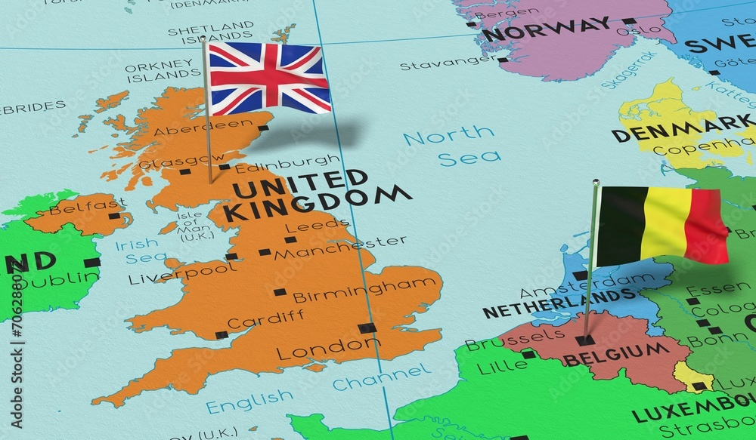
Exciting events this week
Year One visit Mount Pleasant Farm
Years 3 visit Lickey Hills Country Park
Sparrows are walking to Ward End Library
Chef visits year 4
On Thursday Headteachers from schools in Brussels (The capitol of Belgium) visit Ward End Primary

Slide 16

Ward End School News.
The Swimming Pool is here!
Year 1, Year 2 and Resource Base
Monday 20th April – Friday 22nd May
Year 5 and Year 6
Monday 1st June – Friday 17th July

Slide 17


Slide 18


Slide 19

Walk to School Competition weeks. Value: Resilience
Each day, walk to school
So now the weather is improving, why not ditch the car and walk at least once a week or even every day!

