Slide 1

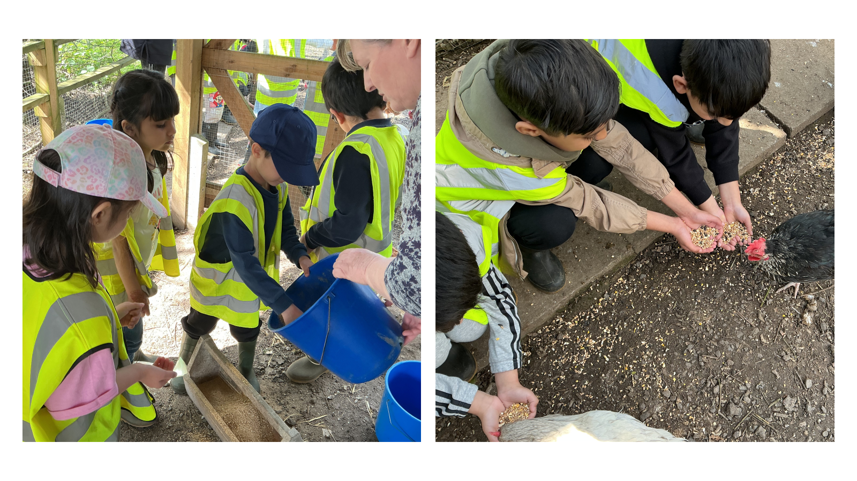
Attendance assembly 27th April 2026
This is year One at Mount Pleasant farm last week.

Slide 2

95% and above Attendance weekly Reward.
Gain a star for each week your class achieves 95%+ How did your class do?

Slide 3

10 classes over 95% this week
One year group – all classes over 95%
Keep working hard to be in school every day.

Slide 4

Ward End weekly attendance
YEAR | Wb 14th April | Wb 20th April | Wb | Wb | Wb
6.1 | 93% | 95%
6.2 | 97% | 97%
6.3 | 93% | 95%
6.4 | 91% | 97%
5.1 | 89% | 91%
5.2 | 84% | 88%
5.3 | 92% | 94%
5.4 | 94% | 99%

Slide 5

Ward End weekly attendance
 | Wb 14th April | Wb 20th April | Week | Wb | Wb
4.1 | 86% | 91%
4.2 | 94% | 94%
4.3 | 89% | 95%
4.4 | 86% | 87%
3.1 | 95% | 97%
3.2 | 95% | 95%
3.3 | 91% | 92%
3.4 | 87% | 94%

Slide 6

Ward End weekly attendance
YEAR | Wb 14th April | Wb 20th April | Wb | Wb | Wb
2.1 | 99% | 93%
2.2 | 92% | 94%
2.3 | 88% | 92%
2.4 | 97% | 98%
1.1 | 90% | 93%
1.2 | 90% | 90%
1.3 | 92% | 88%
1.4 | 89% | 92%

Slide 7

Ward End weekly attendance
YEAR | Wb 14th April | Wb 20th April | Wb | Wb | Wb | Wb
Rabbits | 89% | 92%
Squirrels | 77% | 85%
Hedgehogs | 97% | 93%
Owls | 97% | 96%
Doves | 87% | 91%
Swans | 96% | 92%

Slide 8


Slide 9
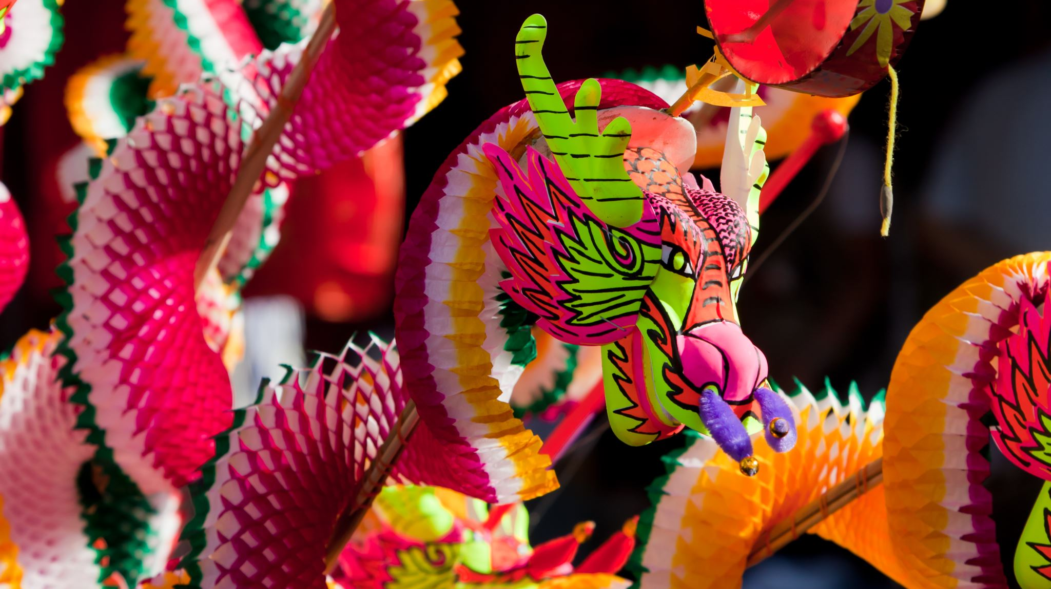
Assembly Theme this week
Vesak- a Buddhist festival
This festival offers a time to reflect on the importance of compassion, peace and kindness.

Slide 10
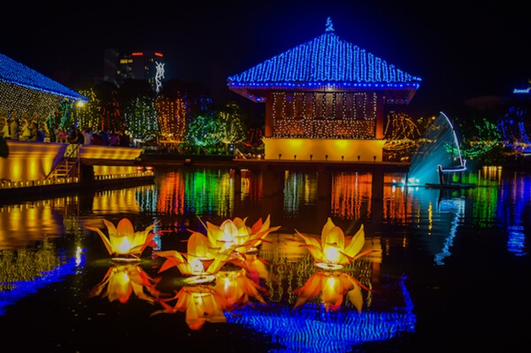
British Values are reflected in Compassion Peace and Kindness
-Respect and Tolerance for all faiths and beliefs.
You can learn about Vesak here
https://www.bbc.co.uk/bitesize/articles/zbsp92p#zy4yjfr

Slide 11


How is Vesak festival similar or different to your family’s festival?
Use the language of comparison to tell a friend
These thinks are the same because……………..
I think these things are different……………

Slide 12

Exciting events last week
On Thursday Headteachers from schools in Brussels (The capitol of Belgium) visited Ward End Primary
They were VERY impressed with all classes learning and behaviour for learning- well done to everyone!
They particularly liked our Oracy lessons, pop-up pool and the allotment.

Slide 13
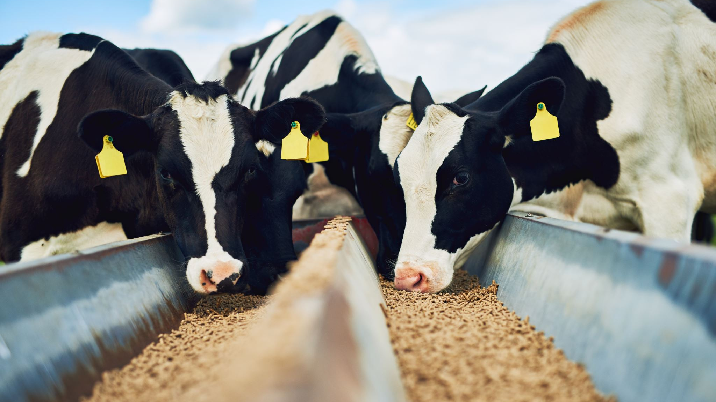
What’s been going on? Year One visited the farm. We saw self-milking cows!!

Slide 14
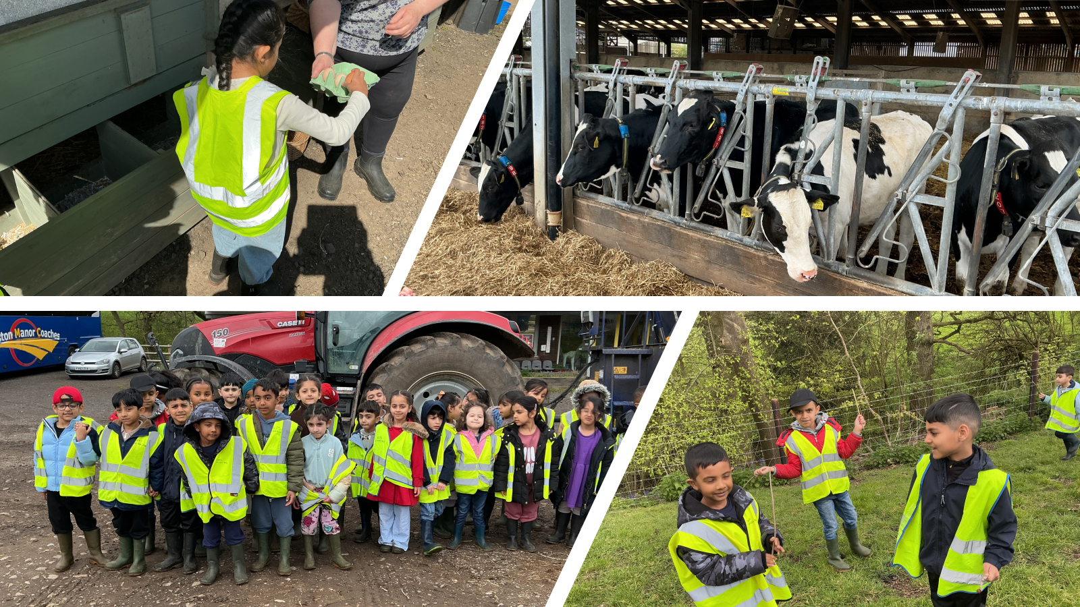

Slide 15
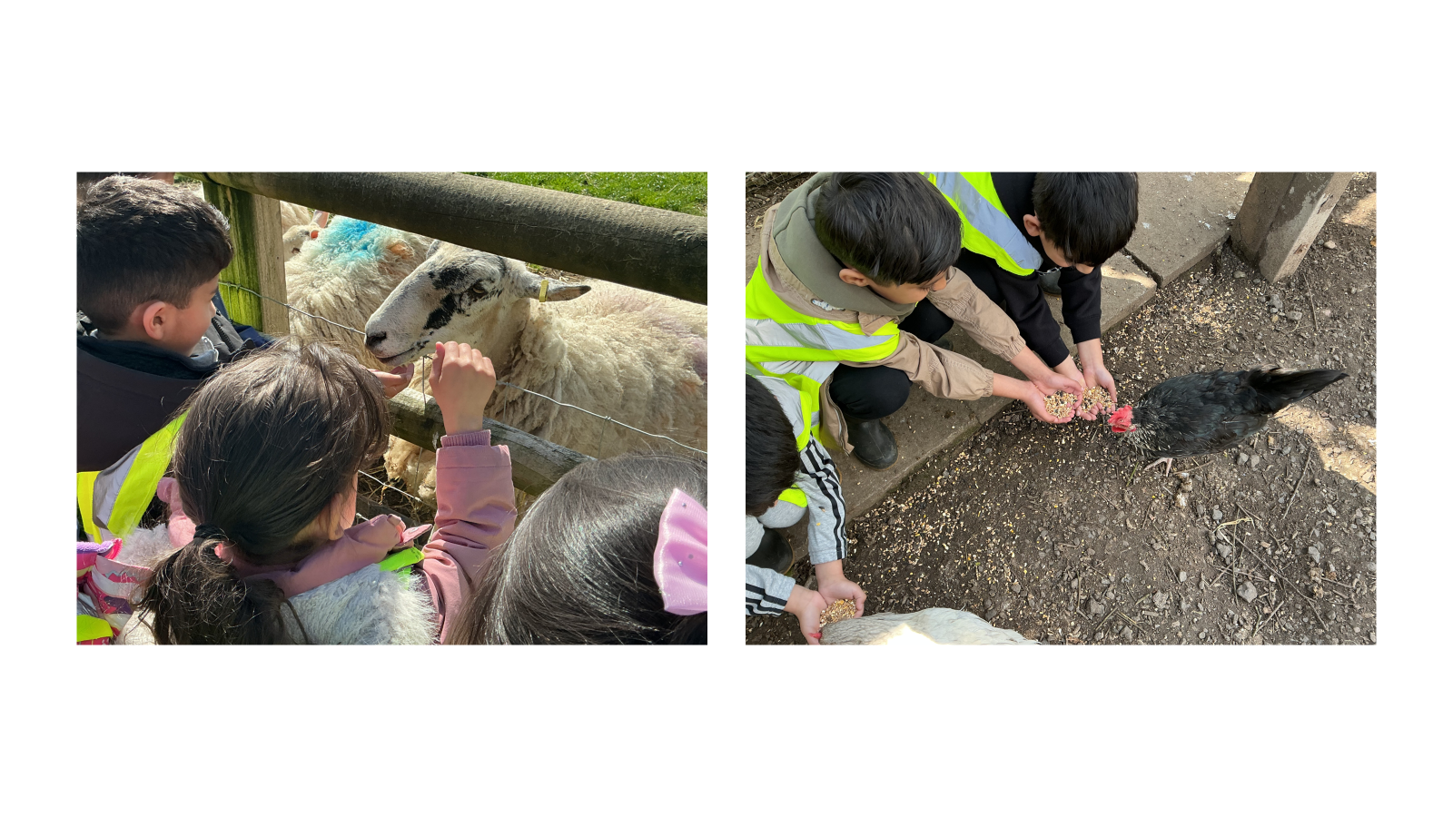

Slide 16
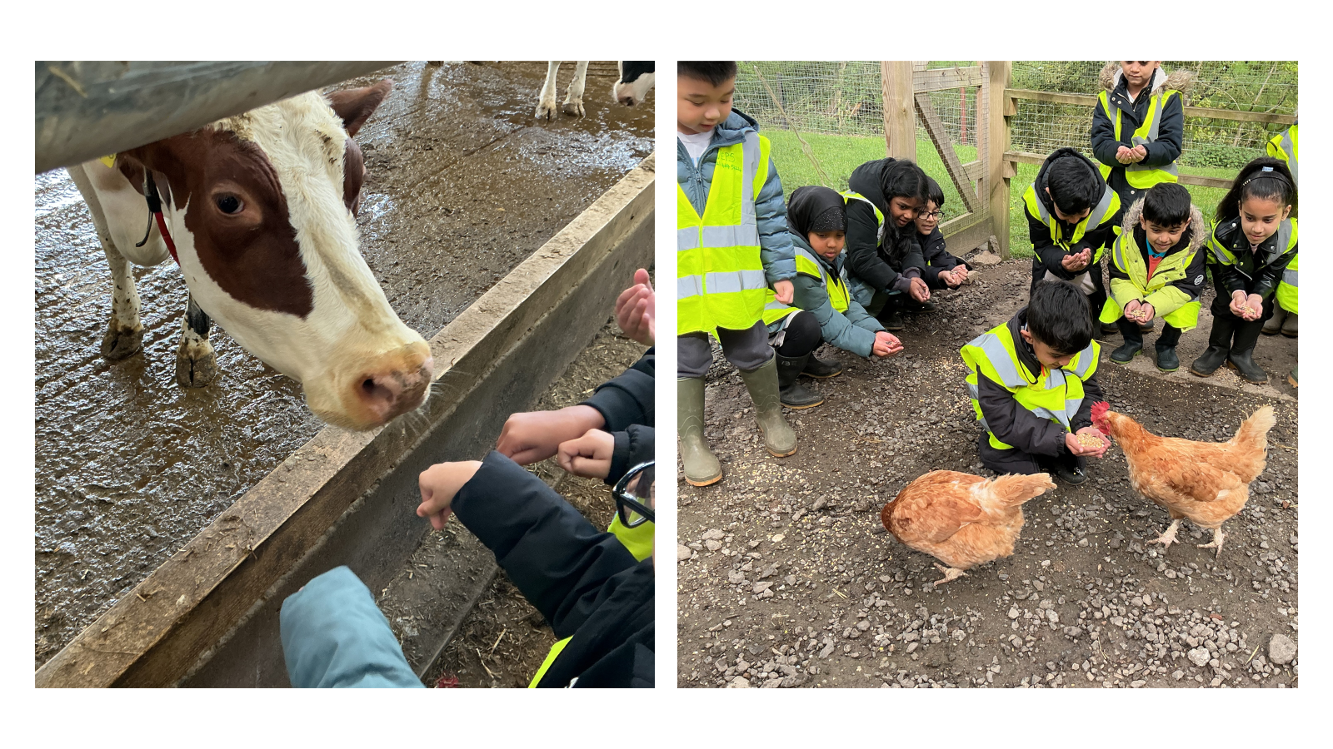

Slide 17
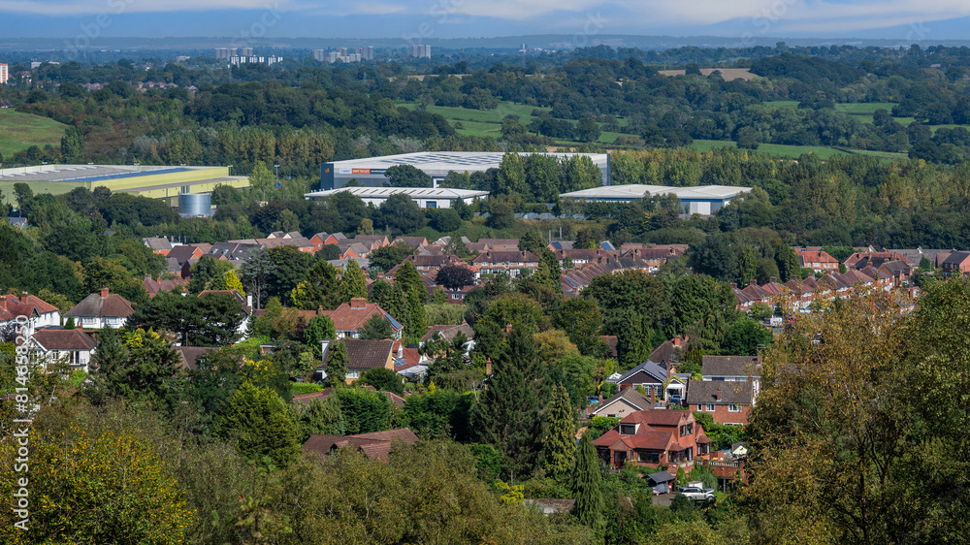
Year 3 had a day in the country-side, looking at Settlements. Can you spot Birmingham?

Slide 18
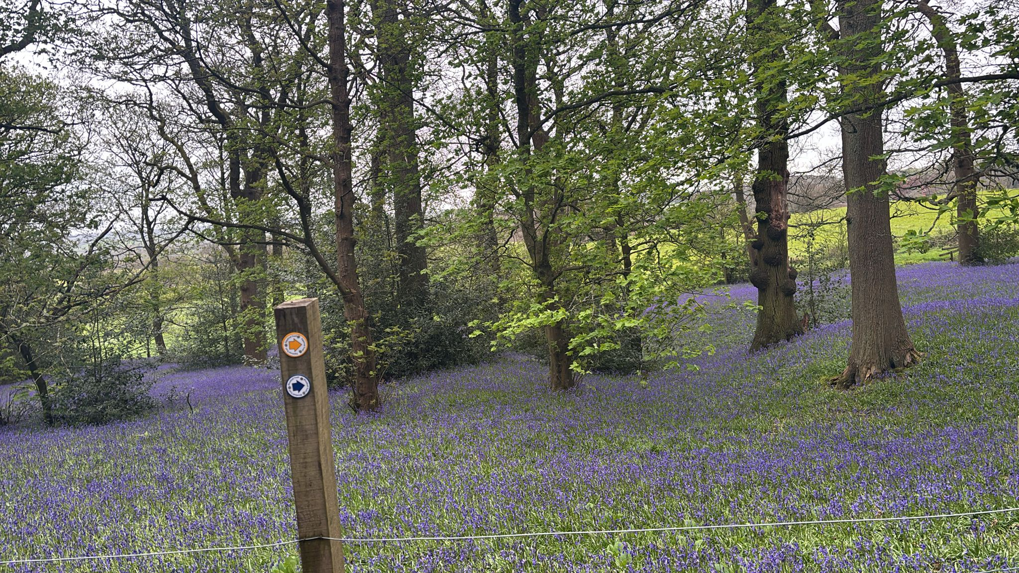
We did den building, nature study, art and the bluebell walk.

Slide 19

Ward End School News.
The Swimming Pool is here!
Year 1, Year 2 and Resource Base
Monday 20th April – Friday 22nd May
Year 5 and Year 6
Monday 1st June – Friday 17th July

Slide 20


Slide 21


Slide 22

Walk to School Competition weeks. Value: Resilience
Each day, walk to school
So now the weather is improving, why not ditch the car and walk at least once a week or even every day!

