Slide 1

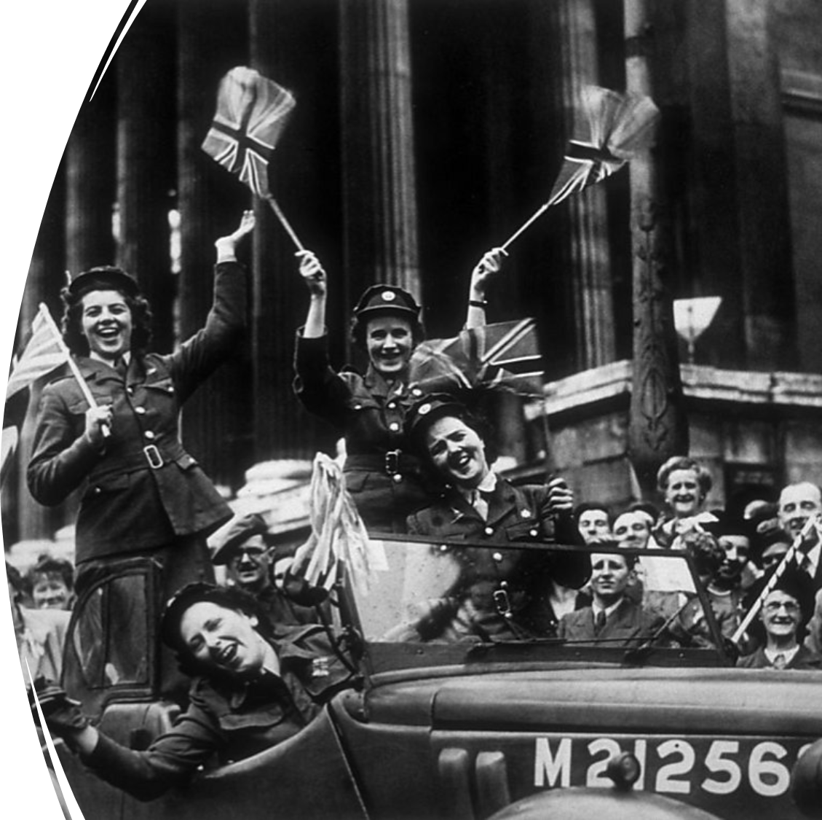

Attendance assembly 11th May 2026

Slide 2

95% and above Attendance weekly Reward.
Gain a star for each week your class achieves 95%+ How did your class do?

Slide 3

19 classes over 95% this week
Six classes 100% yeah!
Well done!
Keep working hard to be in school every day.

Slide 4

Ward End weekly attendance
YEAR | Wb 14th April | Wb 20th April | Wb 27th April | Wb 5th May | Wb
6.1 | 93% | 95% | 99% | 96%
6.2 | 97% | 97% | 95% | 95%
6.3 | 93% | 95% | 97% | 94%
6.4 | 91% | 97% | 97% | 98%
5.1 | 89% | 91% | 94% | 93%
5.2 | 84% | 88% | 88% | 88%
5.3 | 92% | 94% | 94% | 94%
5.4 | 94% | 99% | 98% | 100%

Slide 5

Ward End weekly attendance
 | Wb 14th April | Wb 20th April | Week 27th April | Wb 5th May | Wb
4.1 | 86% | 91% | 92% | 93%
4.2 | 94% | 94% | 96% | 95%
4.3 | 89% | 95% | 99% | 97%
4.4 | 86% | 87% | 94% | 95%
3.1 | 95% | 97% | 97% | 95%
3.2 | 95% | 95% | 98% | 95%
3.3 | 91% | 92% | 95% | 94%
3.4 | 87% | 94% | 91% | 96%

Slide 6


Ward End weekly attendance
YEAR | Wb 14th April | Wb 20th April | Wb 27th April | Wb 5th May | Wb
2.1 | 99% | 93% | 95% | 94%
2.2 | 92% | 94% | 99% | 96%
2.3 | 88% | 92% | 100% | 100%
2.4 | 97% | 98% | 99% | 96%
1.1 | 90% | 93% | 91% | 100%
1.2 | 90% | 90% | 88% | 90%
1.3 | 92% | 88% | 93% | 94%
1.4 | 89% | 92% | 96% | 96%

Slide 7

Ward End weekly attendance
YEAR | Wb 14th April | Wb 20th April | Wb 27th April | Wb 5th May | Wb | Wb
Rabbits | 89% | 92% | 92% | 98%
Squirrels | 77% | 85% | 83% | 84%
Hedgehogs | 97% | 93% | 93% | 100%
Owls | 97% | 96% | 96% | 100%
Doves | 87% | 91% | 92% | 87%
Swans | 96% | 92% | 91% | 100%

Slide 8
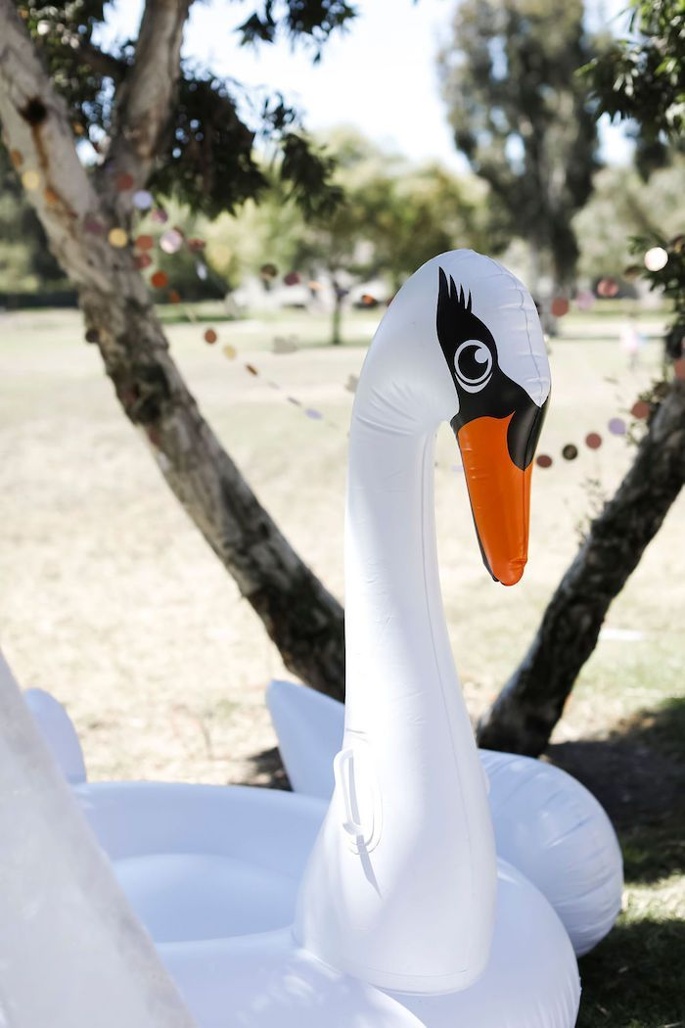



Well done
5.4, 2.3
100% and Hedgehogs, Owls and Swans!!

Slide 9

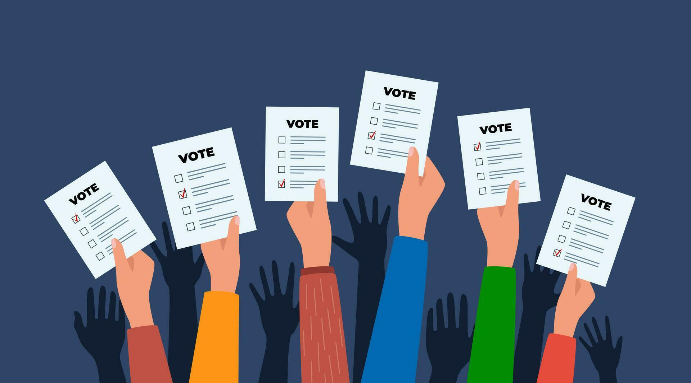
Assembly Theme this week
British Value:-
Liberty
VE Day 8th May
Liberty means to be free from controlling influences or restrictions on your way of life, or views.
Liberty gives people the power to act, speak and have choices without interference from others.

Slide 10
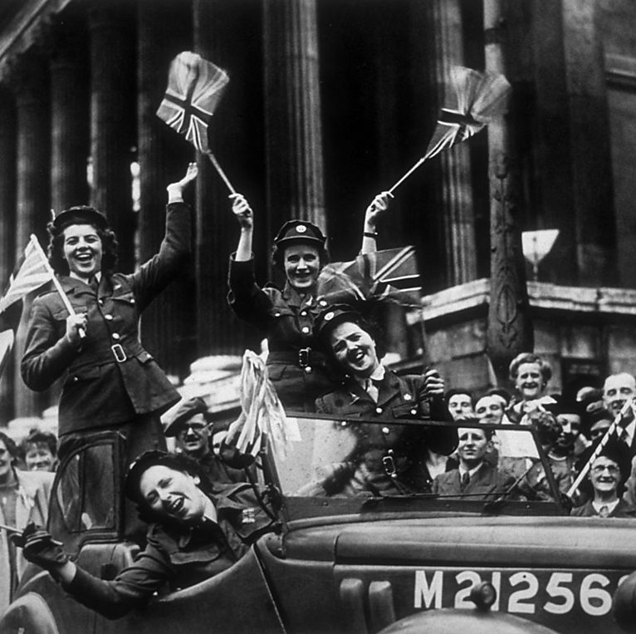
VE Day 8th May
What is VE Day?
VE Day - which stands for Victory in Europe Day - was the day near the end of World War Two when the surrender of Nazi Germany was announced and fighting in Europe stopped.
VE Day was on 8 May 1945.
VE Day was a time of huge celebration because it ended the Second World War in Europe.
British Prime Minister Winston Churchill made an announcement on the radio at 3pm that the war in Europe had ended, after Germany's surrender the day before.
People across the UK and Europe celebrated by putting up flags, having street parties and gathering outside of Buckingham Palace to cheer.

Slide 11
Assembly Theme this week
British Value:-
Liberty
VE Day 8th May
How did VE day give people across the would Liberty?
Use the language of explanation…
I think that after VE day people felt……

Slide 12

David Attenborough is 100 Years old
Here is his video made when he was 93 (7 years ago)
https://youtu.be/64R2MYUt394

Slide 13
David Attenborough is 100 Years old
How does David Attenborough’s work link with our assembly theme of Liberty?
How can you explain?

Slide 14


Slide 15


Slide 16

Walk to School Competition weeks. Value: Resilience
Each day, walk to school
So now the weather is improving, why not ditch the car and walk at least once a week or even every day!

