Slide 1
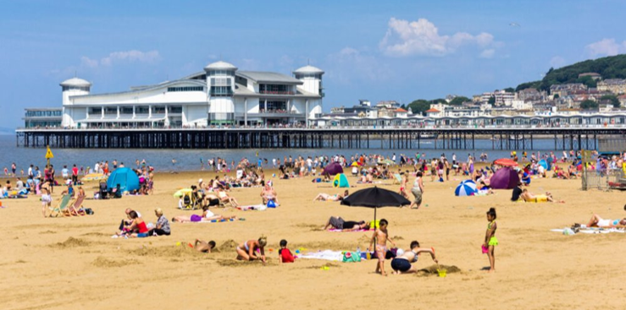


Attendance assembly 15th June 2026

Slide 2

95% and above Attendance weekly Reward.
Gain a star for each week your class achieves 95%+ How did your class do?

Slide 3

14 classes over 95% this week
1 class 100% yeah!
Well done!
Keep working hard to be in school every day.

Slide 4

Ward End weekly attendance
YEAR | Wb 1st June | Wb 8th June | Wb | Wb | Wb | Wb
6.1 | 96% | 98%
6.2 | 94% | 95%
6.3 | 96% | 92%
6.4 | 96% | 97%
5.1 | 94% | 93%
5.2 | 90% | 88%
5.3 | 94% | 92%
5.4 | 93% | 99%

Slide 5

Ward End weekly attendance
 | Wb 1st June | Wb 8th June | Week | Wb | Wb | Wb
4.1 | 93% | 91%
4.2 | 98% | 93%
4.3 | 100% | 98%
4.4 | 92% | 90%
3.1 | 99% | 98%
3.2 | 95% | 94%
3.3 | 90% | 94%
3.4 | 93% | 97%

Slide 6

Ward End weekly attendance
YEAR | Wb 1st June | Wb 8th June | Wb | Wb | Wb | Wb
2.1 | 94% | 95%
2.2 | 96% | 96%
2.3 | 99% | 96%
2.4 | 97% | 91%
1.1 | 94% | 98%
1.2 | 85% | 92%
1.3 | 99% | 94%
1.4 | 96% | 90%

Slide 7

Ward End weekly attendance
YEAR | Wb 1st June | Wb 8th June | Wb | Wb | Wb | Wb
Rabbits | 97% | 98%
Squirrels | 92% | 88%
Hedgehogs | 96% | 94%
Owls | 94% | 100%
Doves | 77% | 93%
Swans | 96% | 98%

Slide 8

Well done
Owls
100%

Slide 9

Attendance award certificates for last half term.
If your attendance was 95% or above for last half term ( April- May) you will have received a certificate.
Remember you have a chance to earn a certificate every half term- 6 half terms a year.
Attendance celebrations for April- May to follow.

Slide 10

Assembly Theme this week
Father’s Day
School Value: Respect for those who care for us.
Time to reflect about people in our families that care for us
Fathers, Grandfathers, Uncles, Cousins.
Sunday 21st June 2026, maybe you can make a card
- or do a good dead for a family member. What will you do?

Slide 11
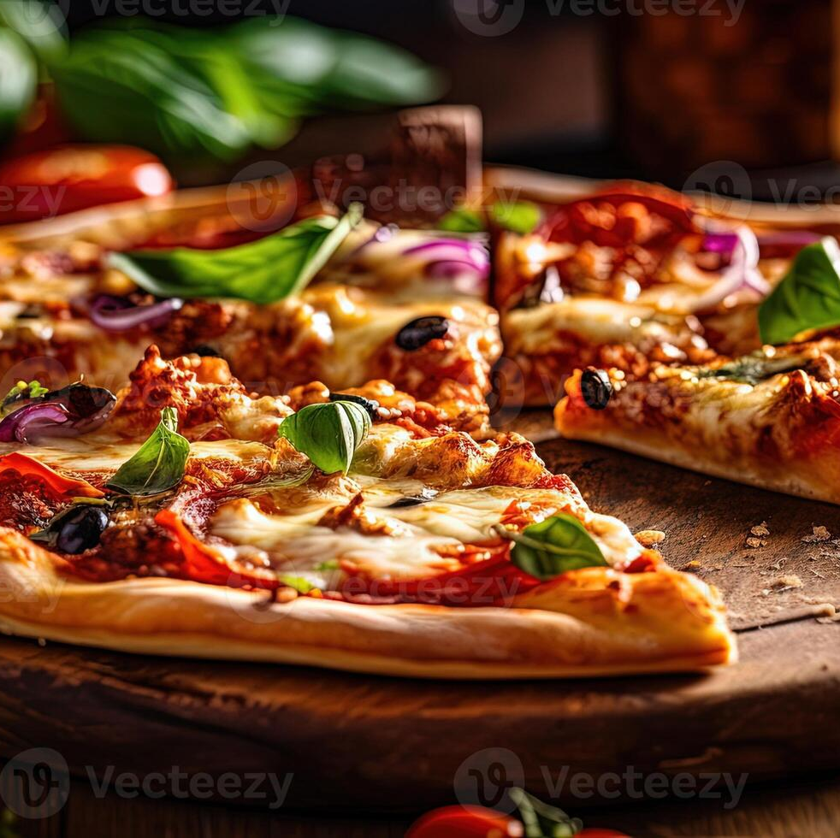
New School Dinner Menus started last week.
With 2 types of pizza
Taco Tuesday – this Tuesday!!!!!!
Chicken Tika curry
Lamb curry
New chicken wraps
Vegetarian Lasagne.
Have a look at the new menu. Thank you for the pupils who helped with new suggestions.

Slide 12
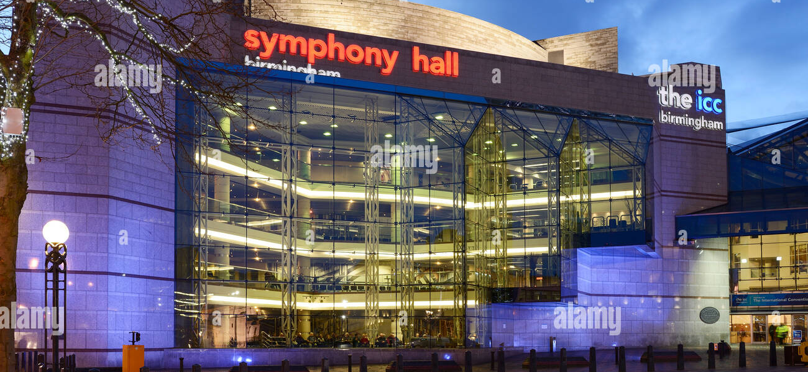
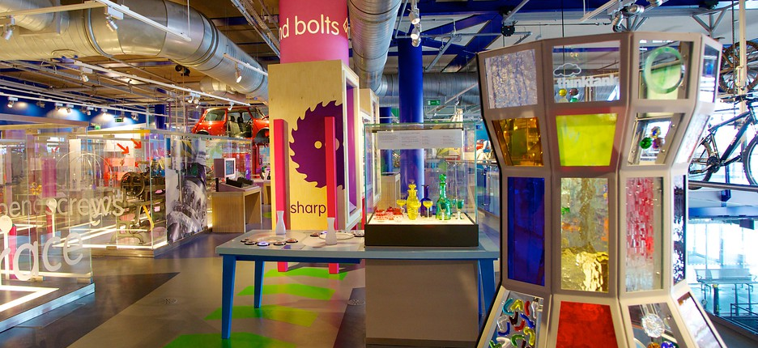
What’s happening this week?
Year 1 are visiting Think Tank science and discovery centre.
Our Musicians in year 5 and 6 are playing in a concert at Symphony Hall Birmingham.
What a fabulous week.

Slide 13
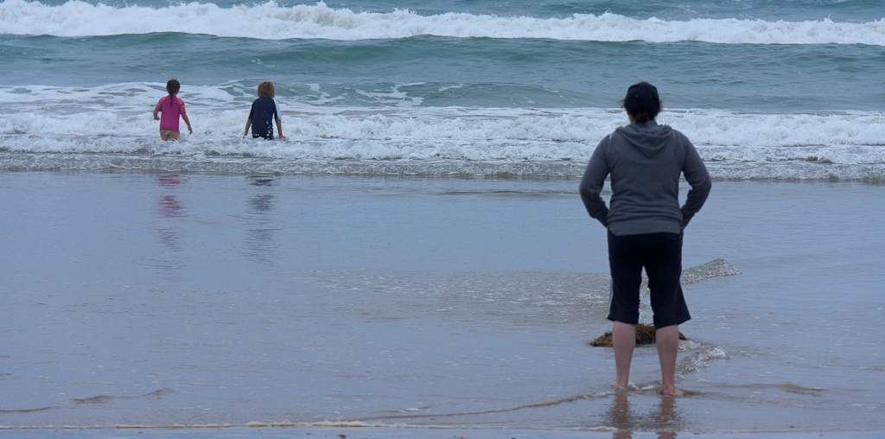
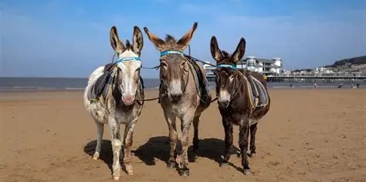
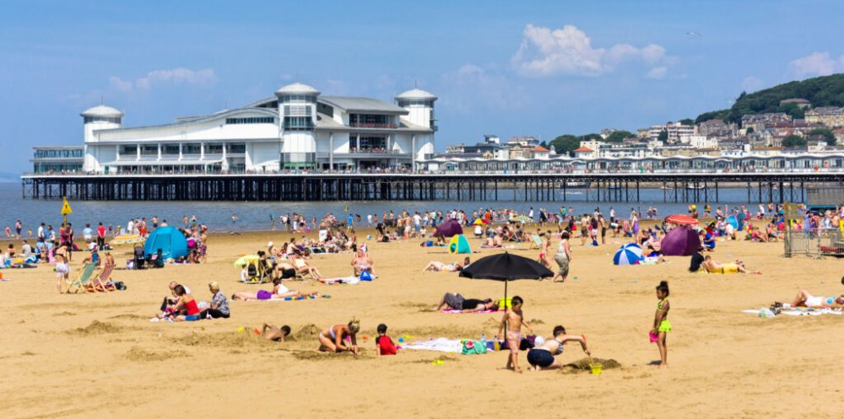
What’s happening this week?
Year 2 are visiting Weston Super Mare, to look at a coastal town.
What can you remember about your trip to Weston in year 2?

Slide 14

What are you reading?
To go with the seaside theme- see Jacqueline Wilson’s new book
The summer holidays have finally arrived, and Daisy is bored. She's glad she won’t have to see her worst enemy Chloe for the whole summer, but she's desperate for a proper holiday at the seaside, building sandcastles, eating lots of ice cream and maybe even spotting a mermaid in the sea!

Slide 15


Try these new titles too…
Second book in a series:
When she arrives in Nigeria, Mayowa quickly realises that her British relatives aren’t the only ones with secrets.
Her enigmatic great-aunt, Iya Ibeji, welcomes her to Alaafia, a peaceful haven just outside Lagos, and introduces her to esin l’oro — an ancient art that reveals the true power of spoken words.
Under her aunt’s guidance, Mayowa begins to understand how language can bend, shape, and even rewrite reality itself.
It’s magic!

Slide 16
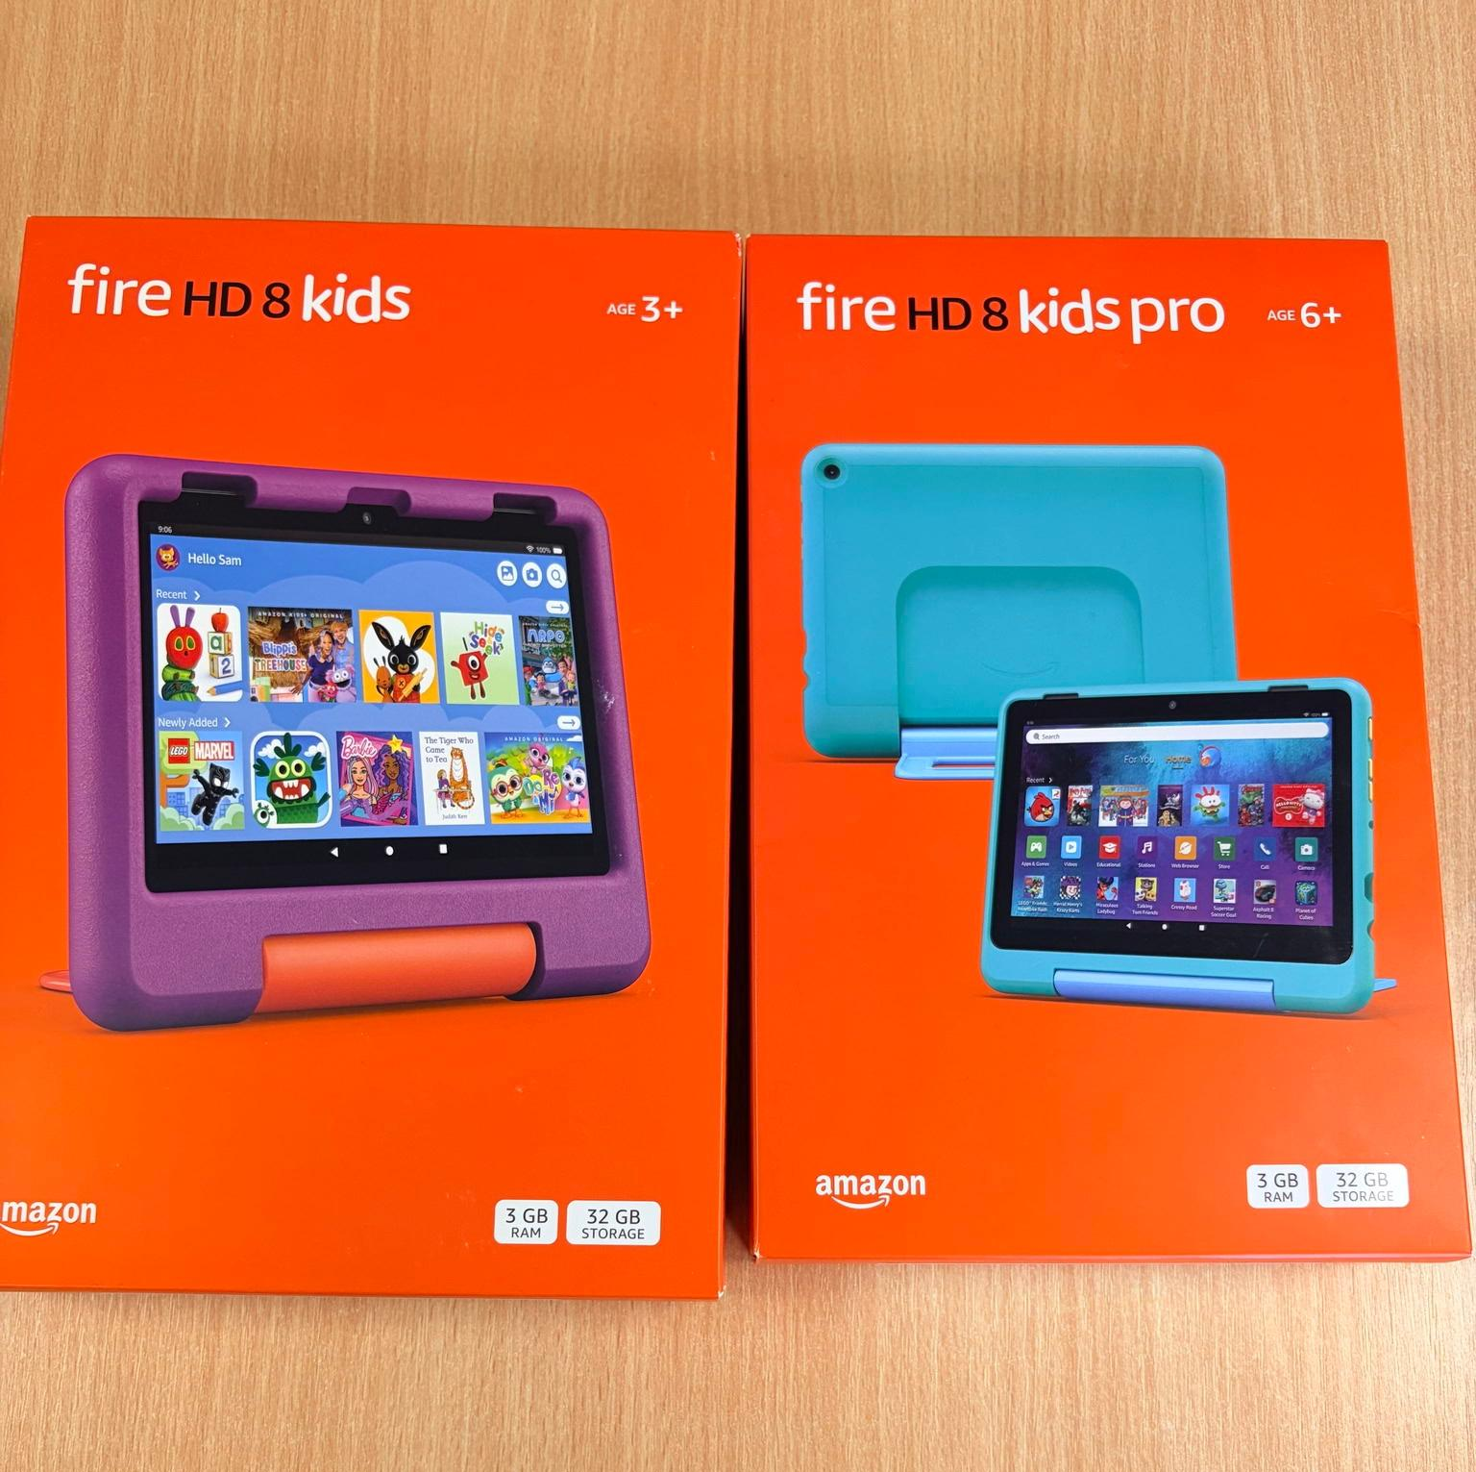
Raffle tickets summer fair
Reminder to buy your raffle tickets every morning in the school playground, raffle is drawn at the Summer Fair on 26th June.
£1 per strip of 5 tickets

Slide 17
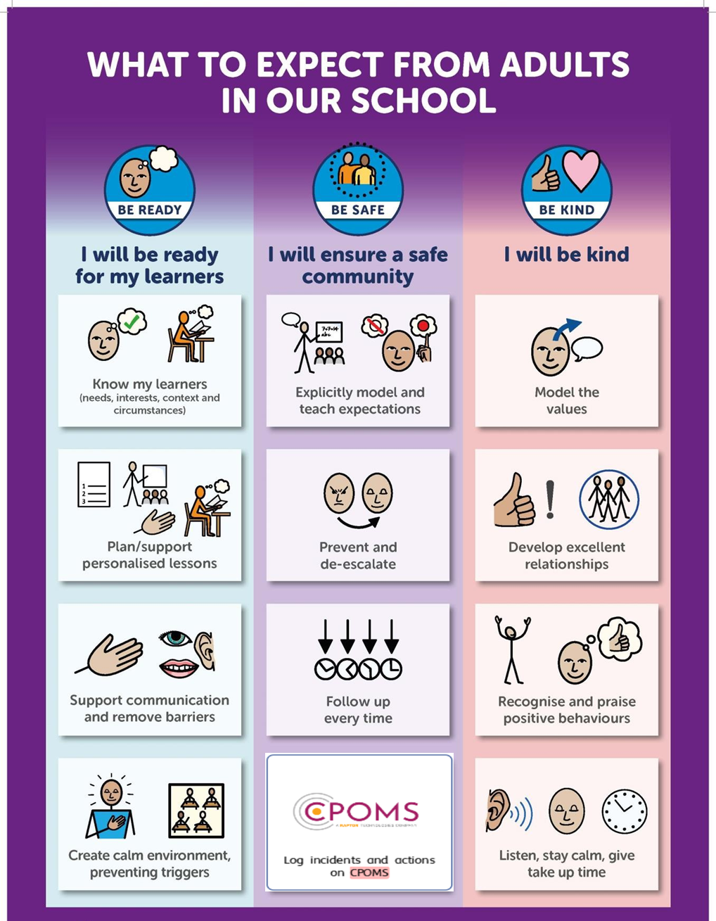

Slide 18
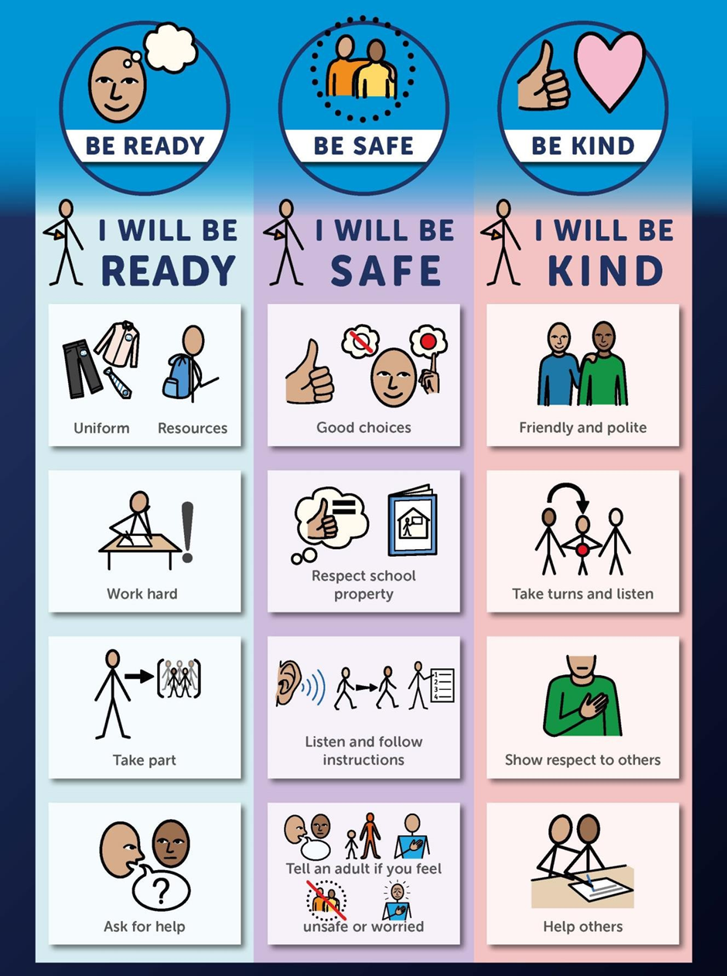

Slide 19

Walk to School Competition weeks. Value: Resilience
Each day, walk to school
So now the weather is improving, why not ditch the car and walk at least once a week or even every day!

Slide 20
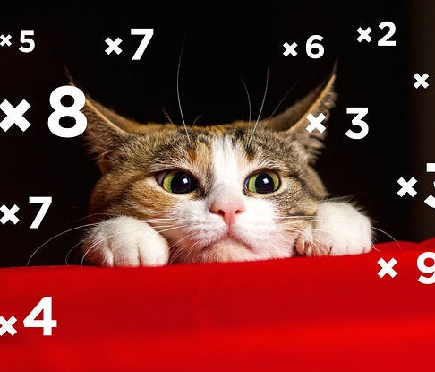

Well done Year 4
We all completed a times tables test last week
Lots of hard work, and everyone did really well!
X tables are a life skill, we use them everyday.
Value: Perseverance

