Slide 1
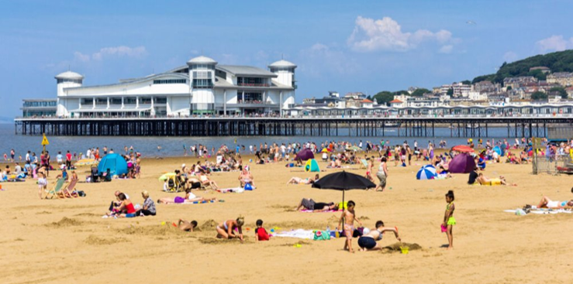

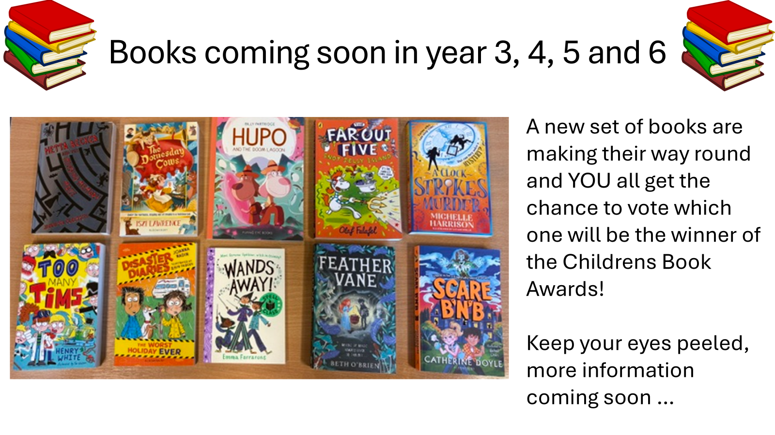
Attendance assembly 22nd June 2026

Slide 2

95% and above Attendance weekly Reward.
Gain a star for each week your class achieves 95%+ How did your class do?

Slide 3
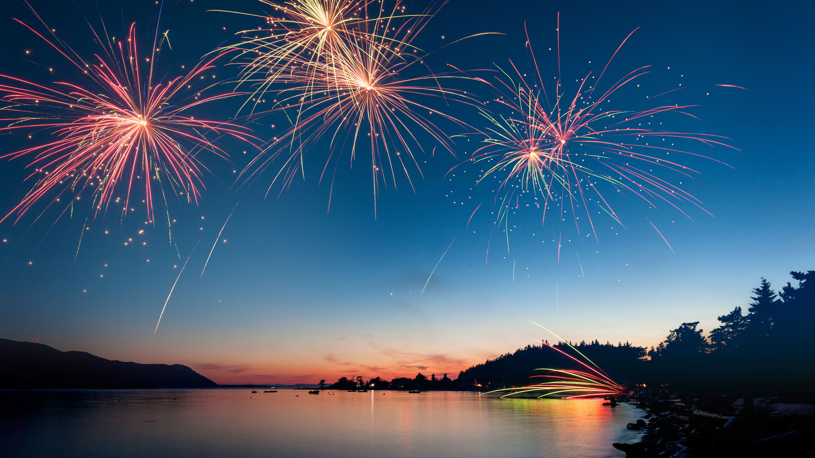
17 classes over 95% this week
2 classes 100% yeah!
Well done!
Keep working hard to be in school every day.

Slide 4

Ward End weekly attendance
YEAR | Wb 1st June | Wb 8th June | Wb 15th June | Wb | Wb | Wb
6.1 | 96% | 98% | 95%
6.2 | 94% | 95% | 97%
6.3 | 96% | 92% | 91%
6.4 | 96% | 97% | 95%
5.1 | 94% | 93% | 91%
5.2 | 90% | 88% | 86%
5.3 | 94% | 92% | 91%
5.4 | 93% | 99% | 96%

Slide 5

Ward End weekly attendance
 | Wb 1st June | Wb 8th June | Week 15th June | Wb | Wb | Wb
4.1 | 93% | 91% | 92%
4.2 | 98% | 93% | 93%
4.3 | 100% | 98% | 96%
4.4 | 92% | 90% | 89%
3.1 | 99% | 98% | 92%
3.2 | 95% | 94% | 95%
3.3 | 90% | 94% | 94%
3.4 | 93% | 97% | 97%

Slide 6

Ward End weekly attendance
YEAR | Wb 1st June | Wb 8th June | Wb 15th June | Wb | Wb | Wb
2.1 | 94% | 95% | 94%
2.2 | 96% | 96% | 93%
2.3 | 99% | 96% | 100%
2.4 | 97% | 91% | 99%
1.1 | 94% | 98% | 95%
1.2 | 85% | 92% | 91%
1.3 | 99% | 94% | 95%
1.4 | 96% | 90% | 98%

Slide 7

Ward End weekly attendance
YEAR | Wb 1st June | Wb 8th June | Wb 15th June | Wb | Wb | Wb
Rabbits | 97% | 98% | 95%
Squirrels | 92% | 88% | 88%
Hedgehogs | 96% | 94% | 97%
Owls | 94% | 100% | 99%
Doves | 77% | 93% | 95%
Swans | 96% | 98% | 100%

Slide 8
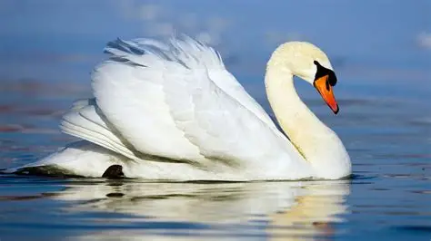
Well done
2.3 & Swans
100%

Slide 9

Assembly Theme this week
Wellbeing- looking after yourself
Thinking about Moving On or Moving Up!
Share your thoughts about moving to the next class.
- or for year 6 – Secondary School.
It’s natural to be nervous or worried about a change. What can you do to help each other through a change or transition?
Can you practice your good ideas this week and next week- for dojo rewards.
Look out for someone who may be feeling anxious- and try to help. School Value: Resilience, Courage.

Slide 10
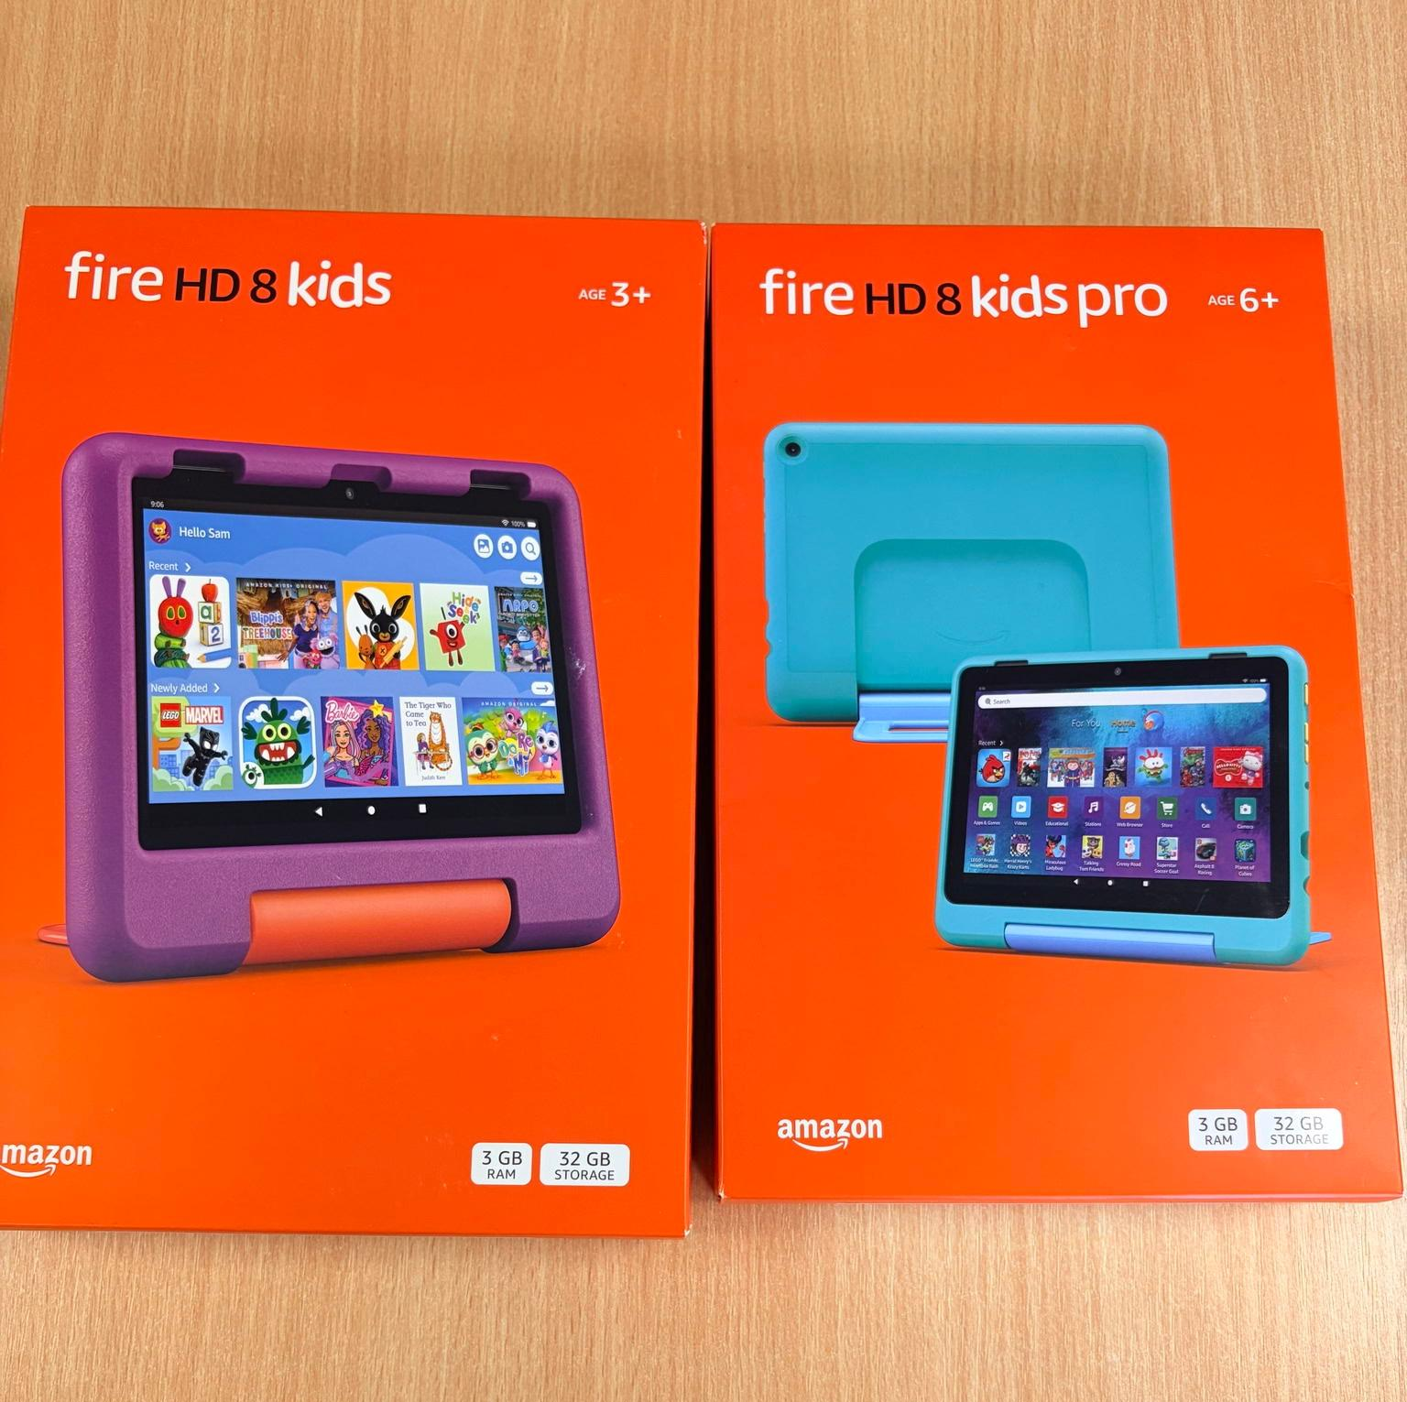
Raffle tickets summer fair
Reminder to buy your raffle tickets every morning in the school playground, raffle is drawn at the Summer Fair on 26th June.
£1 per strip of 5 tickets

Slide 11
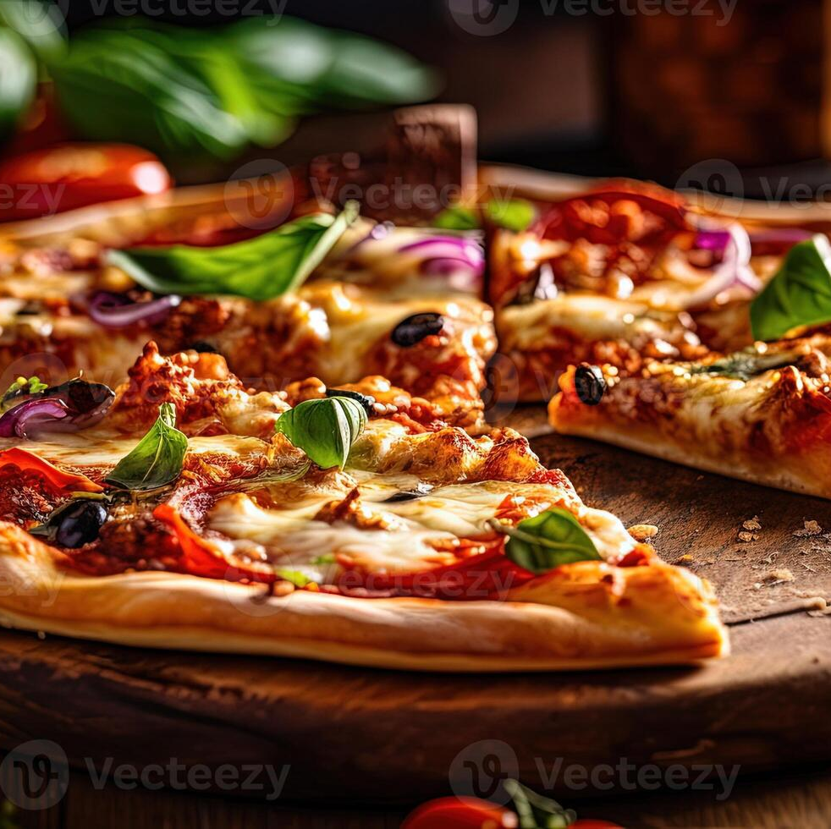
New School Dinner Menus started last week.
With 2 types of pizza
Taco Tuesday – this Tuesday (YES, we are doing it again with real TACOS this time)
Chicken Tika curry
Lamb curry
New chicken wraps
Vegetarian Lasagne.
Have a look at the new menu. Thank you for the pupils who helped with new suggestions.

Slide 12
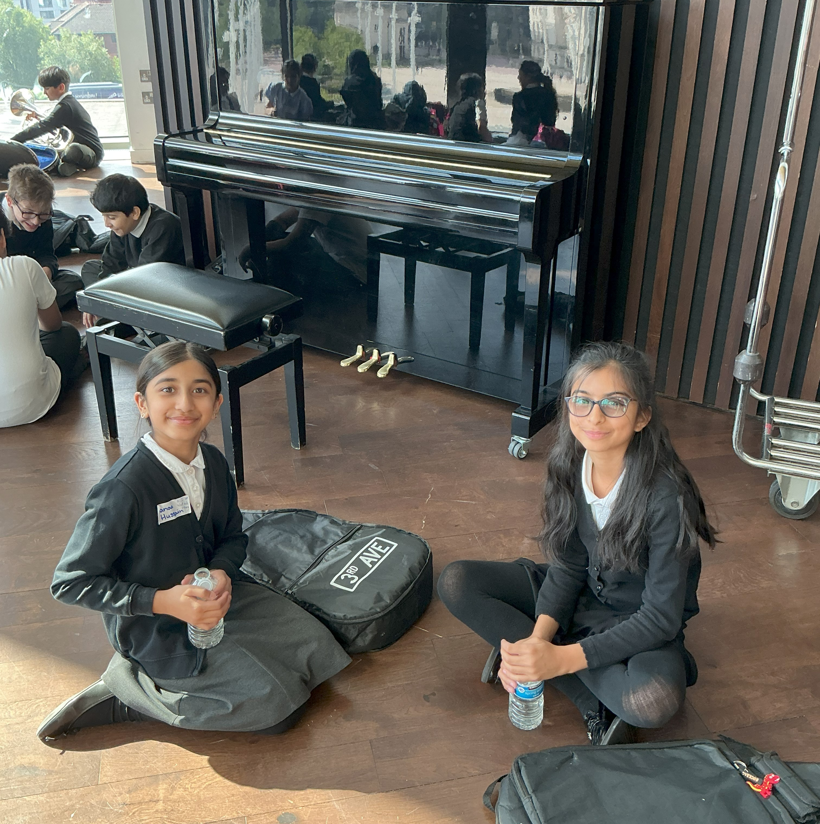
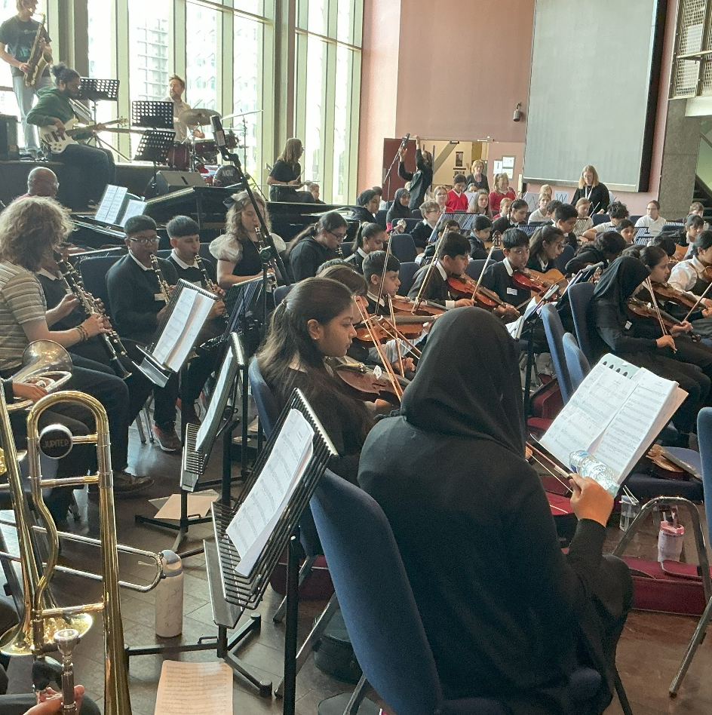
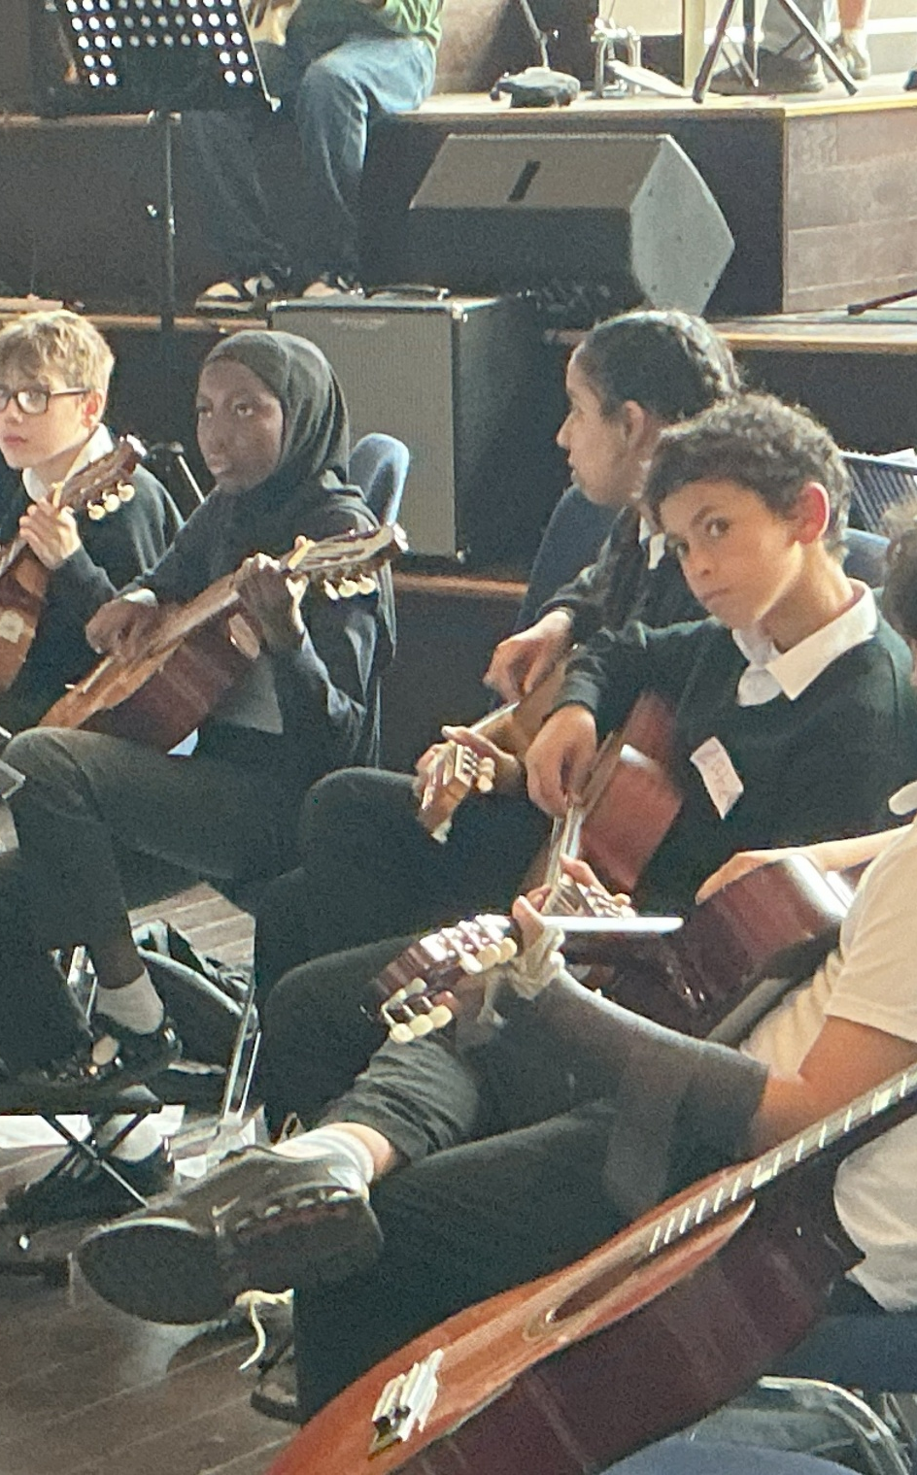
Symphony Hall visit?
Ward End Orchestra had a fantastic time, behaved beautifully
and truly made us proud

Slide 13
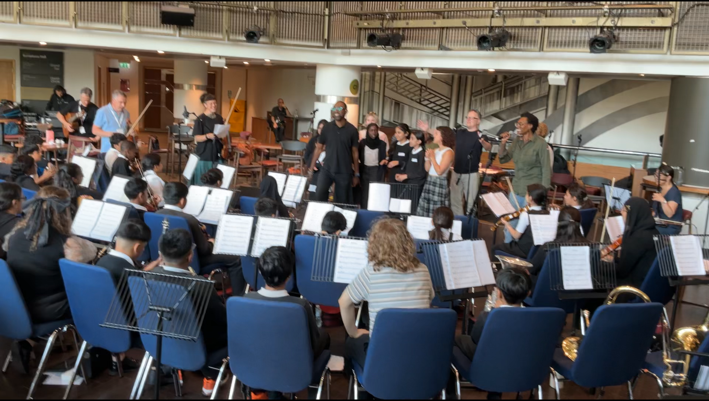
Click link to watch and listen

Slide 14
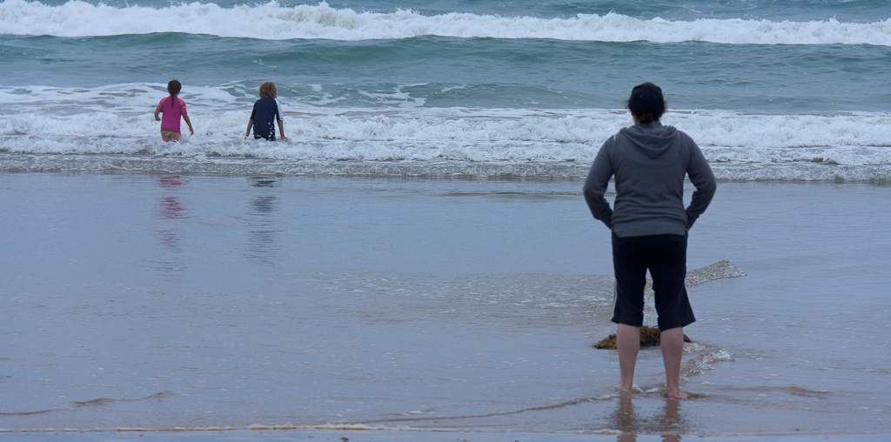
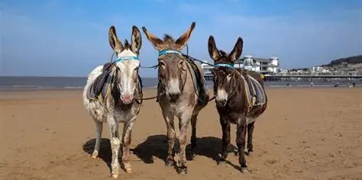
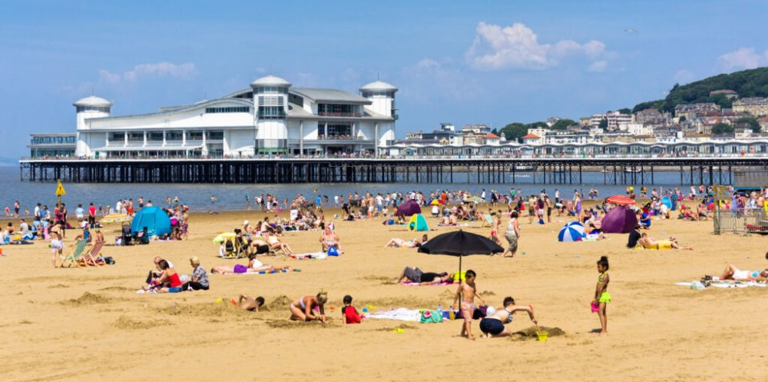
What’s happening this week?
Year 2 are visiting Weston Super Mare, to look at a coastal town.
What can you remember about your trip to Weston in year 2?
Robins and Sparrows are going to the Nature Centre.
Year 1 are going to the Think Tank Birmingham.

Slide 15


Slide 16
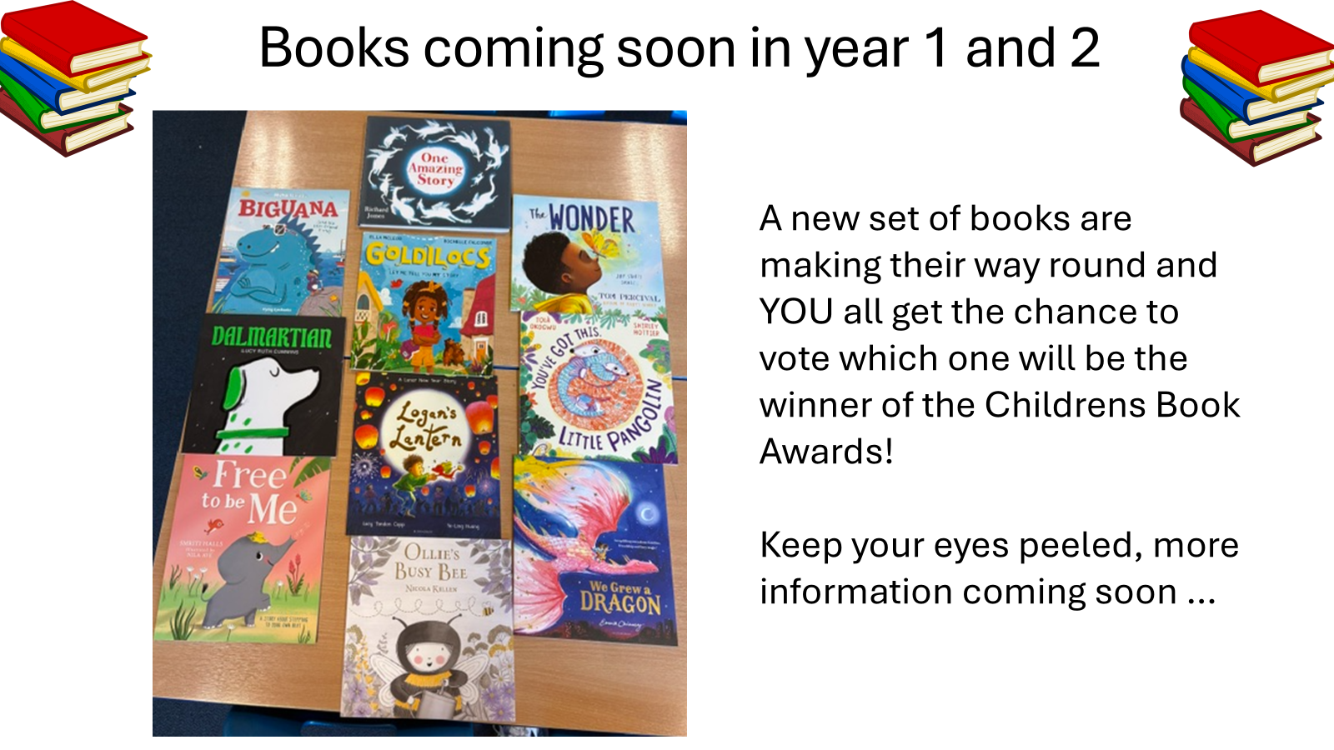

Slide 18


Try these new titles too…
Second book in a series:
When she arrives in Nigeria, Mayowa quickly realises that her British relatives aren’t the only ones with secrets.
Her enigmatic great-aunt, Iya Ibeji, welcomes her to Alaafia, a peaceful haven just outside Lagos, and introduces her to esin l’oro — an ancient art that reveals the true power of spoken words.
Under her aunt’s guidance, Mayowa begins to understand how language can bend, shape, and even rewrite reality itself.
It’s magic!

Slide 19
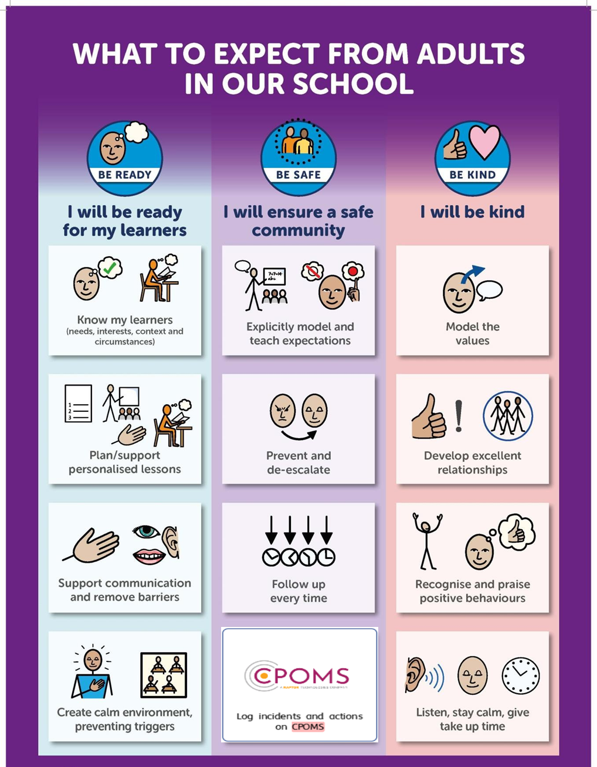

Slide 20


Slide 21

Walk to School Competition weeks. Value: Resilience
Each day, walk to school
So now the weather is improving, why not ditch the car and walk at least once a week or even every day!

Slide 22
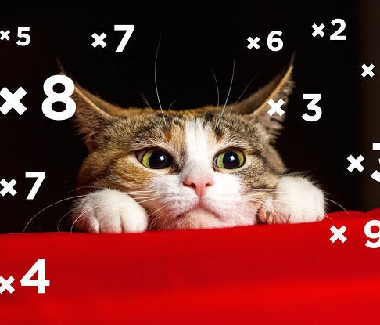

Well done Year 4
We all completed a times tables test last week
Lots of hard work, and everyone did really well!
X tables are a life skill, we use them everyday.
Value: Perseverance

