Slide 1
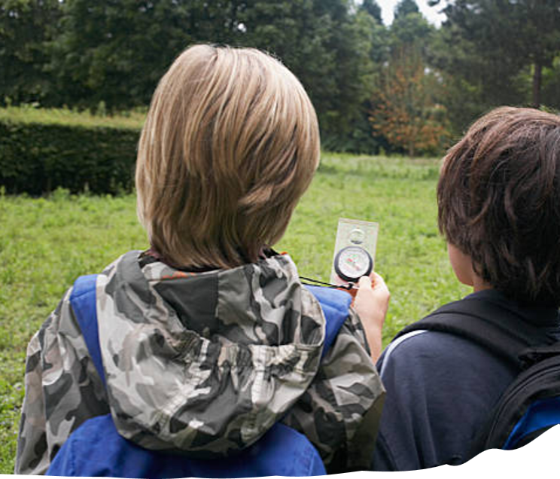


Attendance assembly 28th June 2026

Slide 2

95% and above Attendance weekly Reward.
Gain a star for each week your class achieves 95%+ How did your class do?

Slide 3

Attendance was low last week due to us being closed for 2 days
No attendance charts to share this week.
Discuss -How many more stars on your door, do you need for a class reward for over 95%
Could you gain your prize in the next 3 weeks?

Slide 4

Assembly Theme this week
School Values: Resilience, Courage & Curiosity
Thinking about Moving On or Moving Up!
This Wednesday we will all visit our new classroom and spend the morning with next year’s class teacher
Think about…..
What questions can you Orally rehearse for Wednesday- or write some down.
It’s natural to be nervous or worried about a change. What can you do to help each other through a change or transition?
Can you practice your good ideas this week and next week- for dojo rewards. Tell your new teacher about it.
Look out for someone who may be feeling anxious- and try to help. School Value: Resilience, Courage.

Slide 5
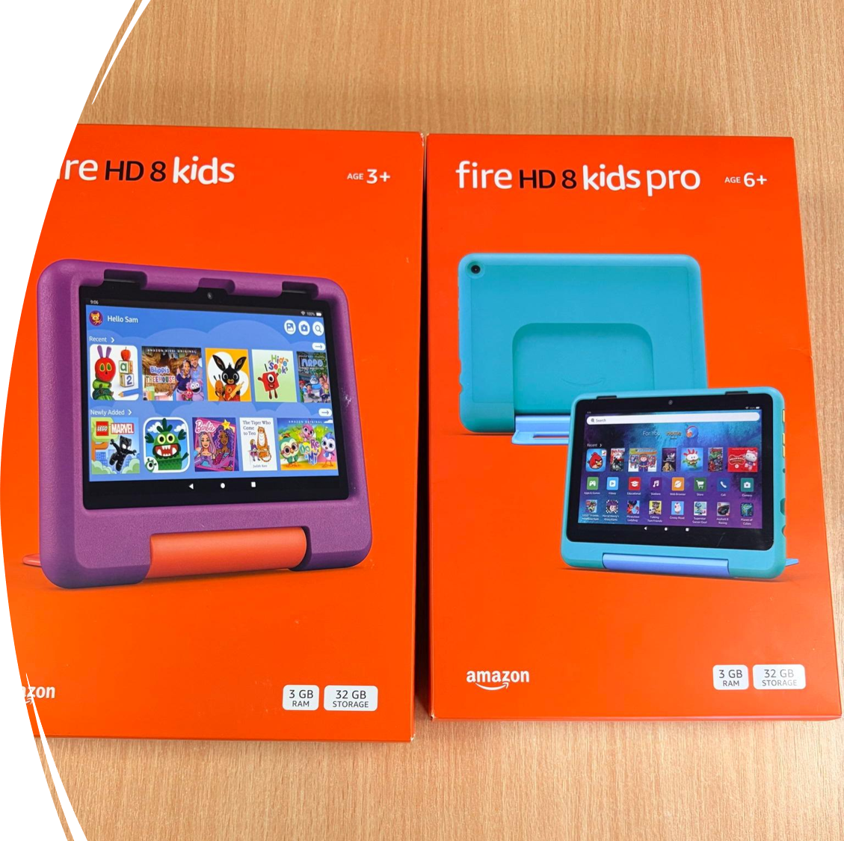
What’s happening at Ward End this week?
Cannock Chase trip -Year 5
Drum Group performance for parents on Tuesday
Reception, Y1, Y2 and Owls Sports Day on Wednesday
Transition Day for everyone on Wednesday
Summer Fair on Thursday.
Y1 Think Tank visit on Friday
Guitars performance on Friday
Year 3 & 4 – your Sports Day is being re arranged…. News to follow.
Reminder to buy your raffle tickets every morning in the school playground, raffle is drawn at the Summer Fair this Thursday!
£1 per strip of 5 tickets

Slide 6


Slide 7
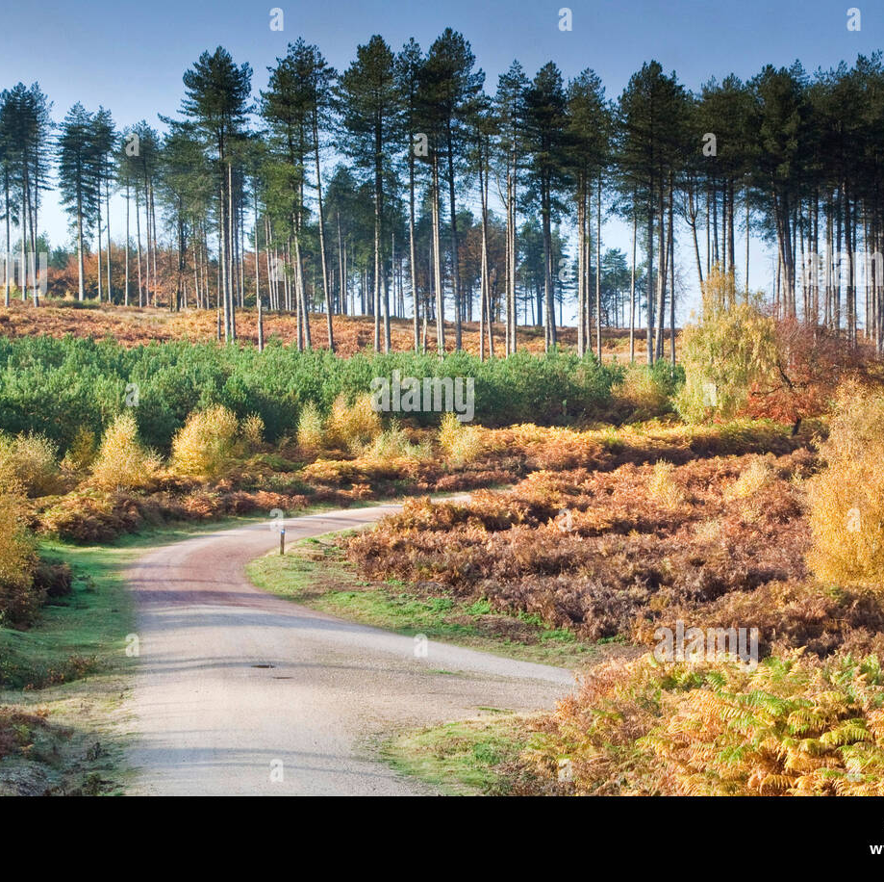
What’s happening this week?
Year 5 are visiting Cannock Chase to go Orienteering
(this photo is Cannock Chase)
Can you find out what Orienteering is?

Slide 8
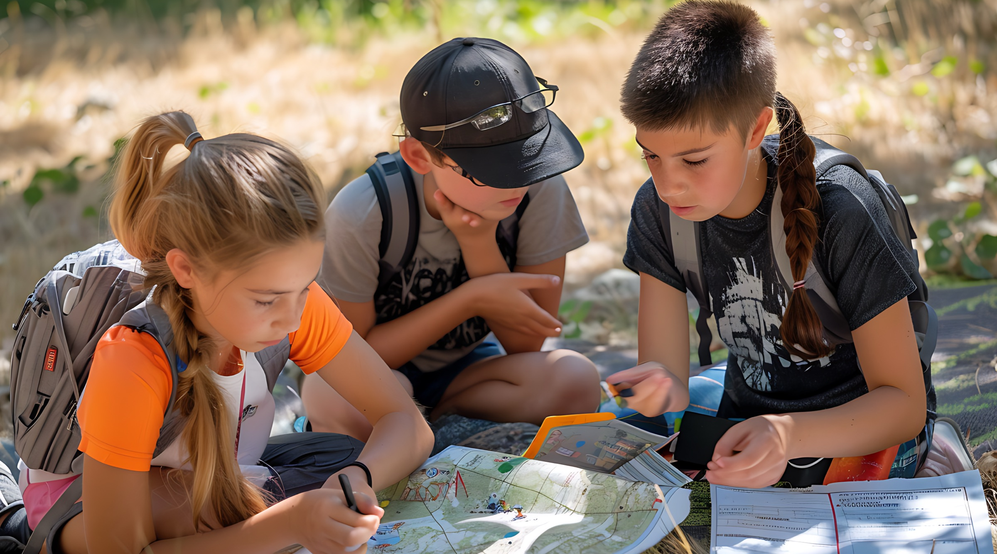
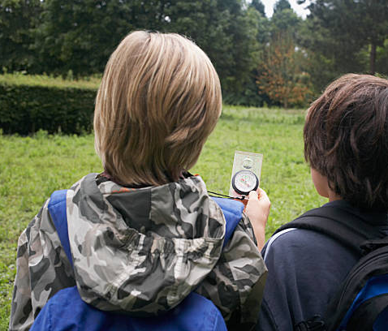
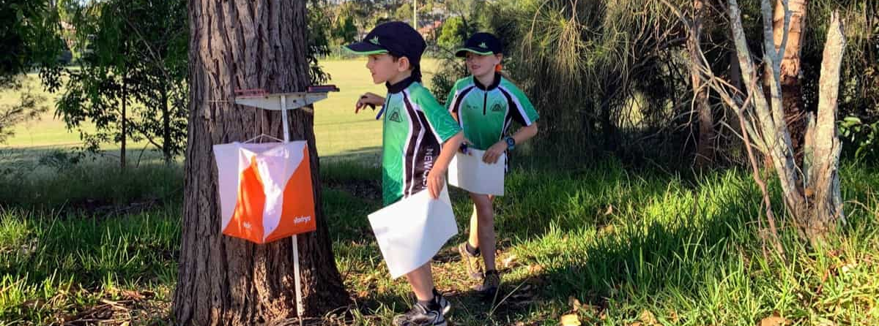
Here are some clues. Try to explain your thoughts in a sentence to a friend.

Slide 9



Try these new titles. Click link to watch the children’s book awards clip
https://youtu.be/46lCRcpFfX8?si=E_2AdQqKDuIbMnYq

Slide 10
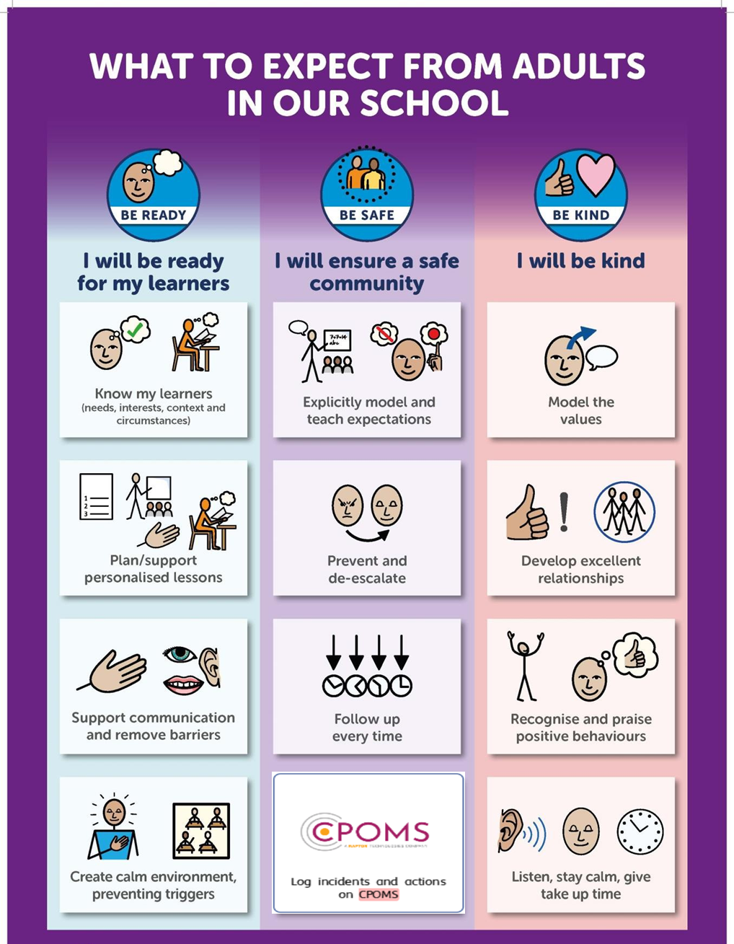

Slide 11
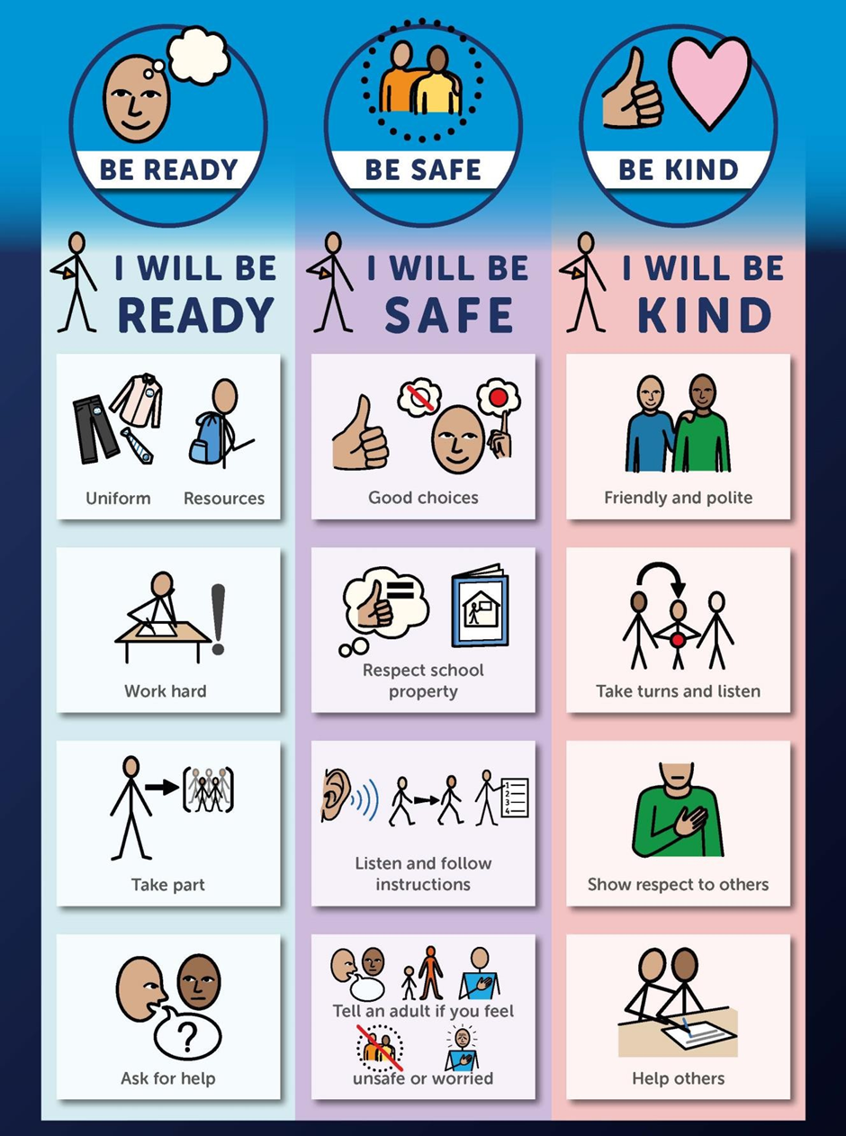

Slide 12

Walk to School Competition weeks. Value: Resilience
Each day, walk to school (it’s good for you)
So now the weather is hot, hot, hot!
Why not ditch the car and walk at least once a week or even every day!

Slide 13
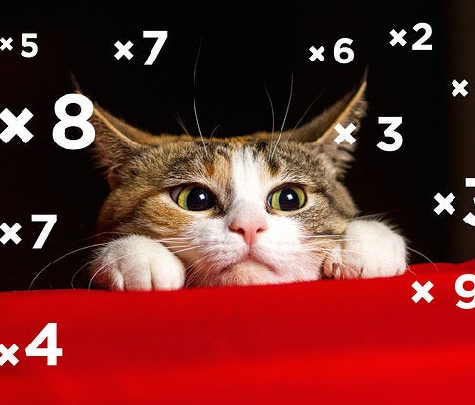

Well done Year 4
We all completed a times tables test last week
Lots of hard work, and everyone did really well!
X tables are a life skill, we use them everyday.
Value: Perseverance

