Slide 1
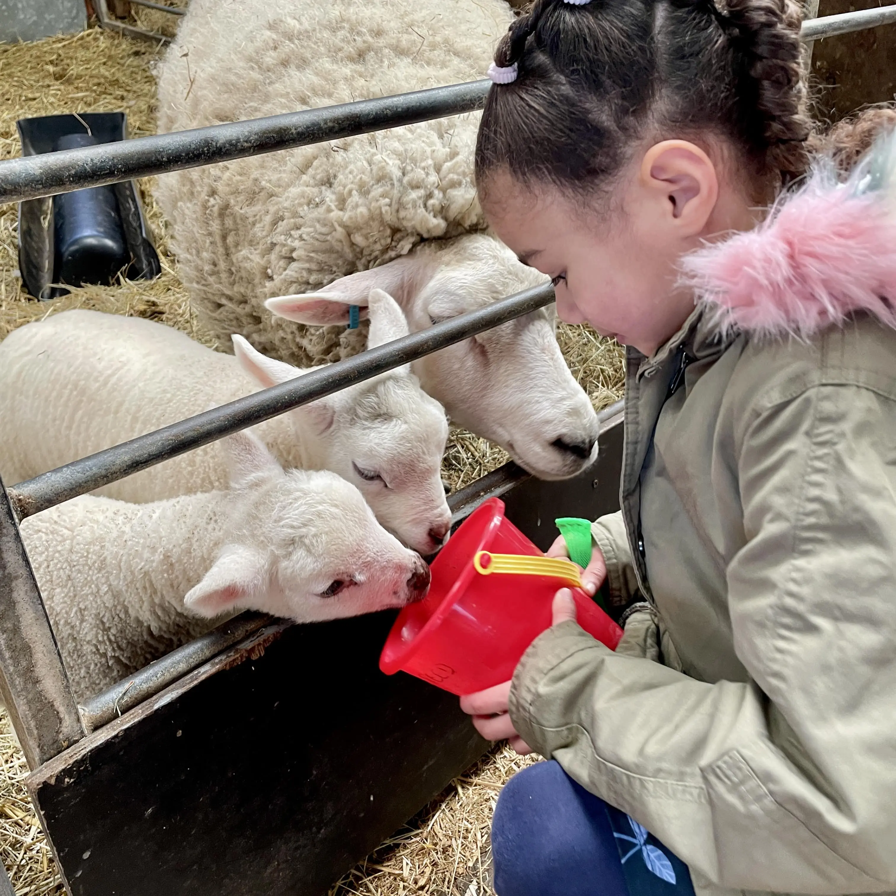


Attendance assembly 8th June 2026

Slide 2

95% and above Attendance weekly Reward.
Gain a star for each week your class achieves 95%+ How did your class do?

Slide 3

15 classes over 95% this week
1 class 100% yeah!
Well done!
Keep working hard to be in school every day.

Slide 4

Ward End weekly attendance
YEAR | Wb 1st June | Wb | Wb | Wb | Wb | Wb
6.1 | 96%
6.2 | 94%
6.3 | 96%
6.4 | 96%
5.1 | 94%
5.2 | 90%
5.3 | 94%
5.4 | 93%

Slide 5

Ward End weekly attendance
 | Wb 1st June | Wb | Week | Wb | Wb | Wb
4.1 | 93%
4.2 | 98%
4.3 | 100%
4.4 | 92%
3.1 | 99%
3.2 | 95%
3.3 | 90%
3.4 | 93%

Slide 6

Ward End weekly attendance
YEAR | Wb 1st June | Wb | Wb | Wb | Wb | Wb
2.1 | 94%
2.2 | 96%
2.3 | 99%
2.4 | 97%
1.1 | 94%
1.2 | 85%
1.3 | 99%
1.4 | 96%

Slide 7

Ward End weekly attendance
YEAR | Wb 1st June | Wb | Wb | Wb | Wb | Wb
Rabbits | 97%
Squirrels | 92%
Hedgehogs | 96%
Owls | 94%
Doves | 77%
Swans | 96%

Slide 8

Well done
4.3
100%

Slide 9

Attendance award certificates this week
If your attendance was 95% or above for last half term ( April- May) you will receive a certificate this week.
Remember you have a chance to earn a certificate every half term- 6 half terms a year.
Attendance celebrations for April- May to follow.
Do you have any ideas for our attendance celebrations please?

Slide 10

Assembly Theme this week
British Value:-
Rule of Law ( our Rights)
Discuss with a friend….
What are your Rights?
Which UNICEF rights can you remember? Which do you feel are most important?
School Aims: Be Ready, Be Safe, Be Kind.

Slide 11

New School Dinner Menus start on Friday
With 2 types of pizza
Taco Tuesday
Chicken Tika curry
Lamb curry
New chicken wraps
Vegetarian Lasagne.
Have a look at the new menu. Thank you for the pupils who helped with new suggestions.

Slide 12
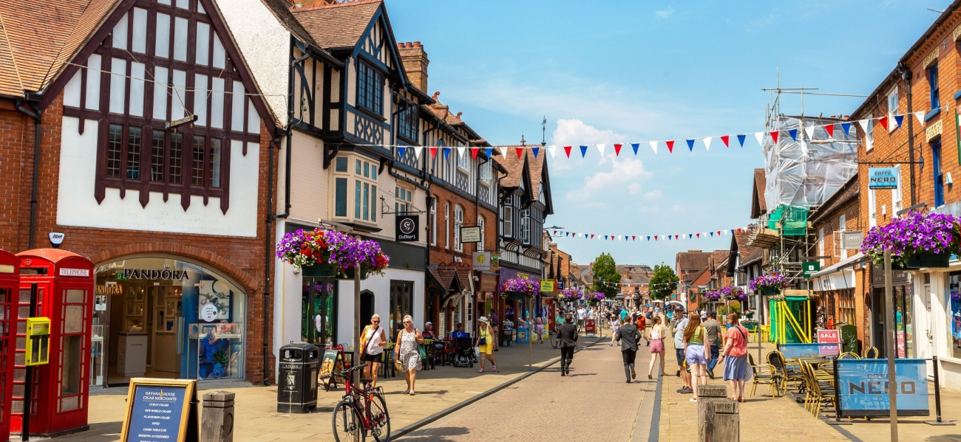
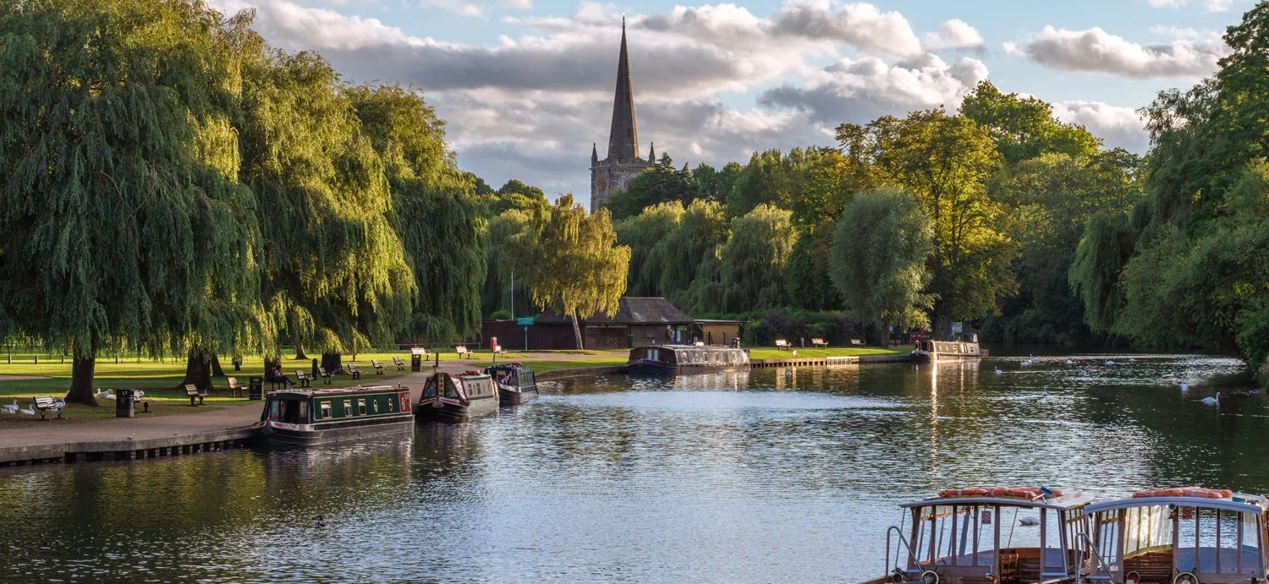
What’s happening this week?
Year 6 are visiting Stratford on Avon to explore History and the Geography of the town- Rivers and canals.
Year 4 are visiting The Islamic presentation Centre in Birmingham.
Reception are visiting Ash End Farm

Slide 13
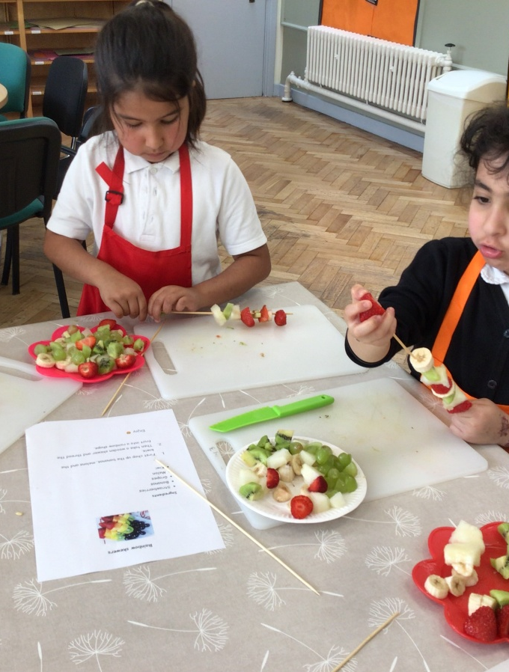
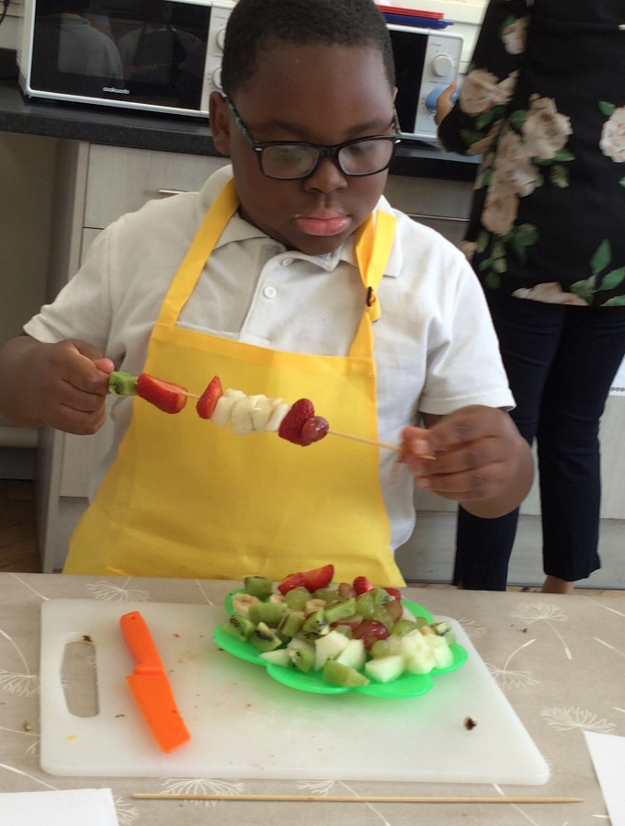
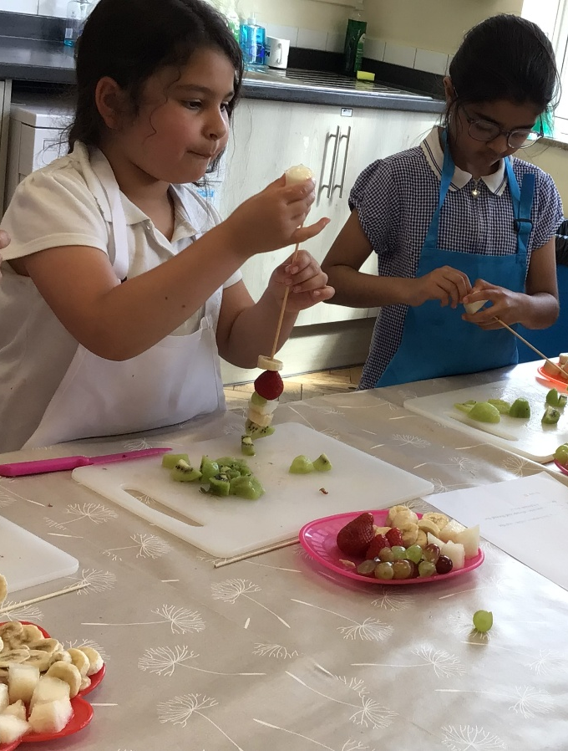
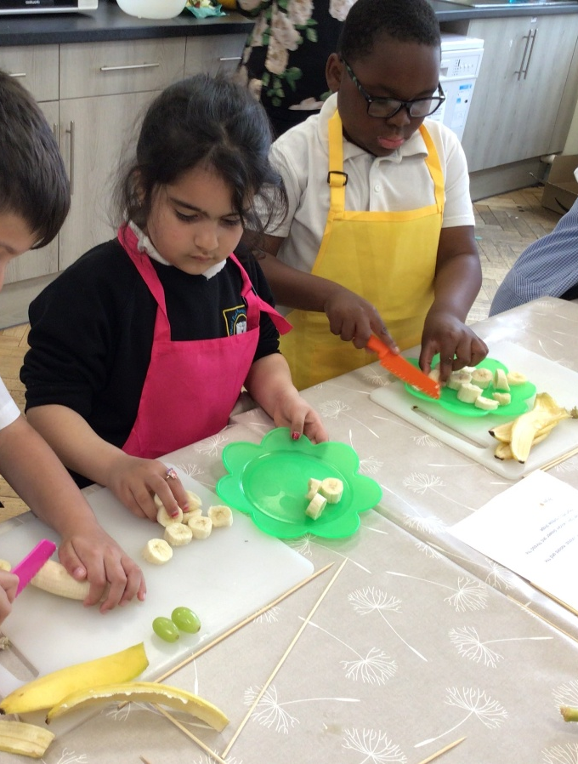
Great fun at cooking club!

Slide 14


Slide 15


Slide 16

Walk to School Competition weeks. Value: Resilience
Each day, walk to school
So now the weather is improving, why not ditch the car and walk at least once a week or even every day!

Slide 17
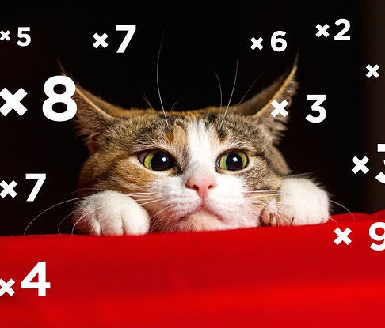

Well done Year 4
We all completed a times tables test last week
Lots of hard work, and everyone did really well!
X tables are a life skill, we use them everyday.
Value: Perseverance

