Slide 1
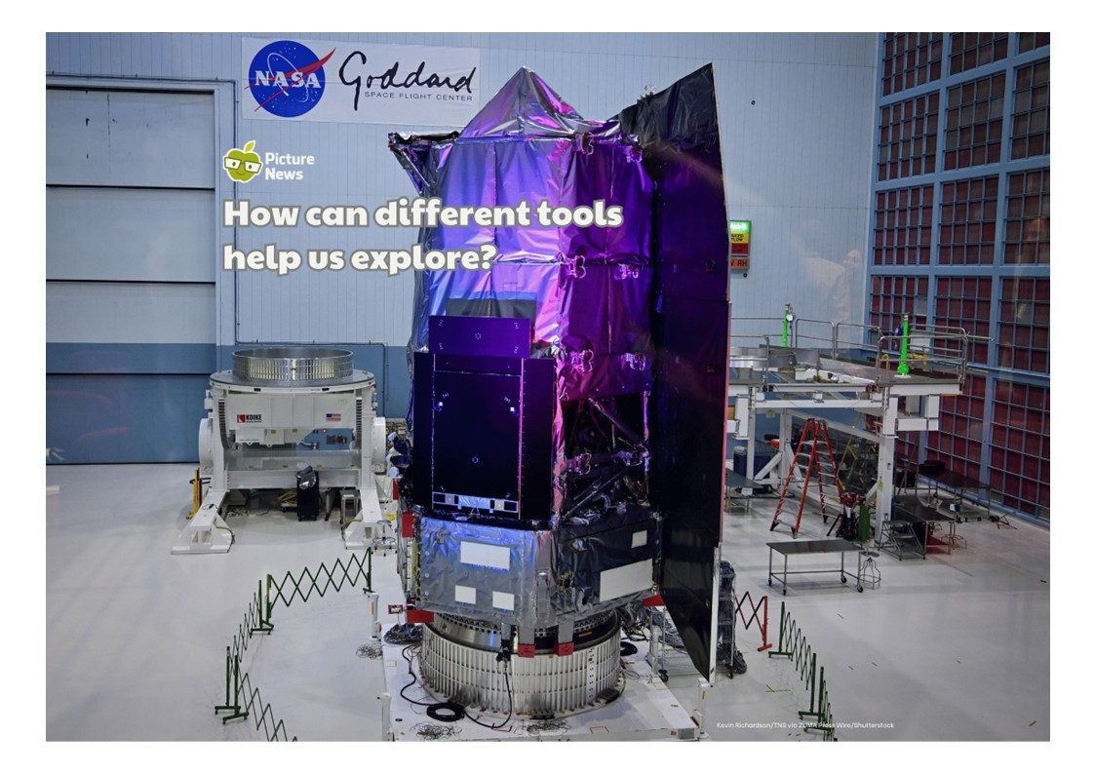

Slide 2


Slide 3


Slide 4
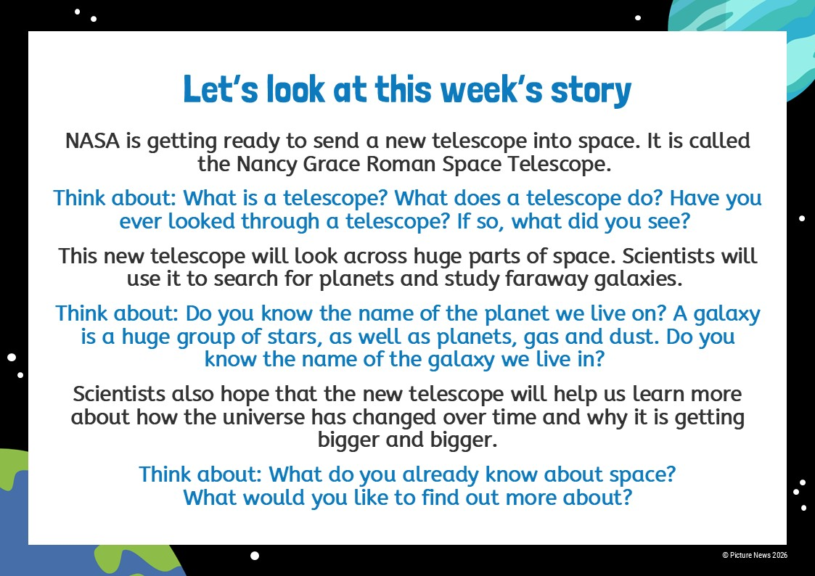
NASA's Roman Telescope Is Ready for Launch

Slide 5


Slide 6


Slide 7


Slide 8
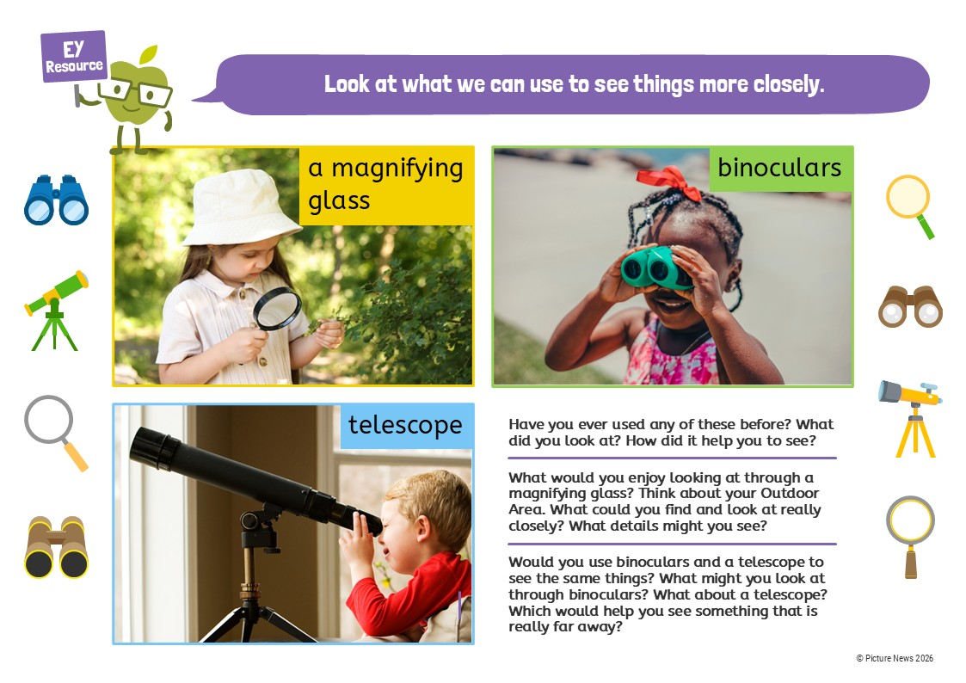

Slide 9
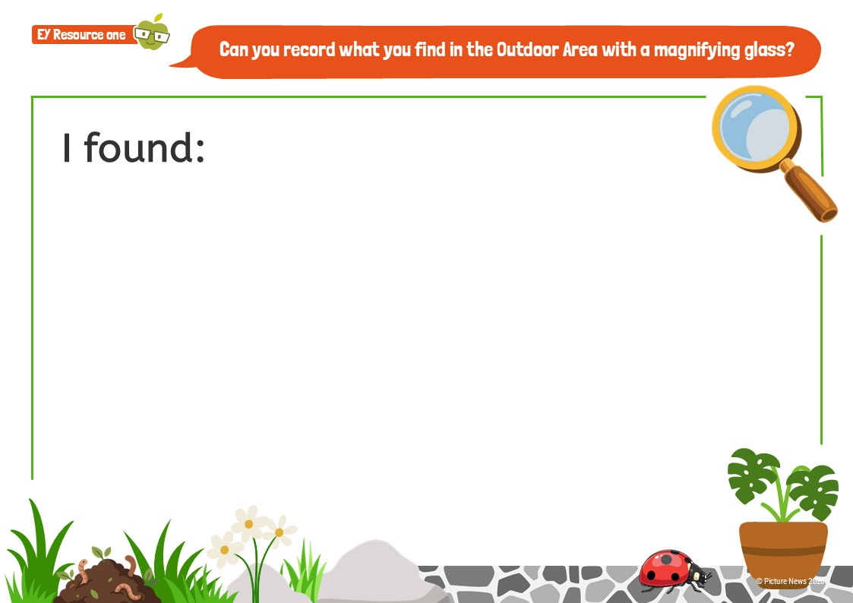

Slide 10
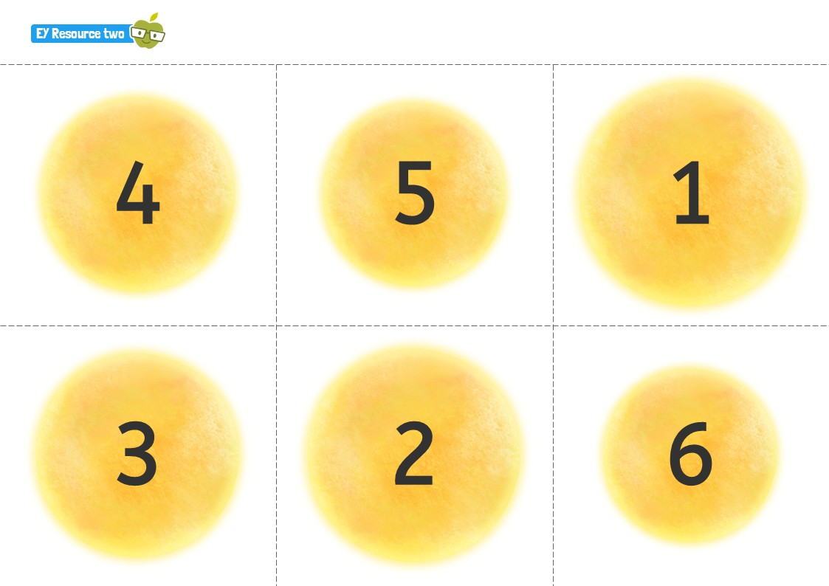

Slide 11
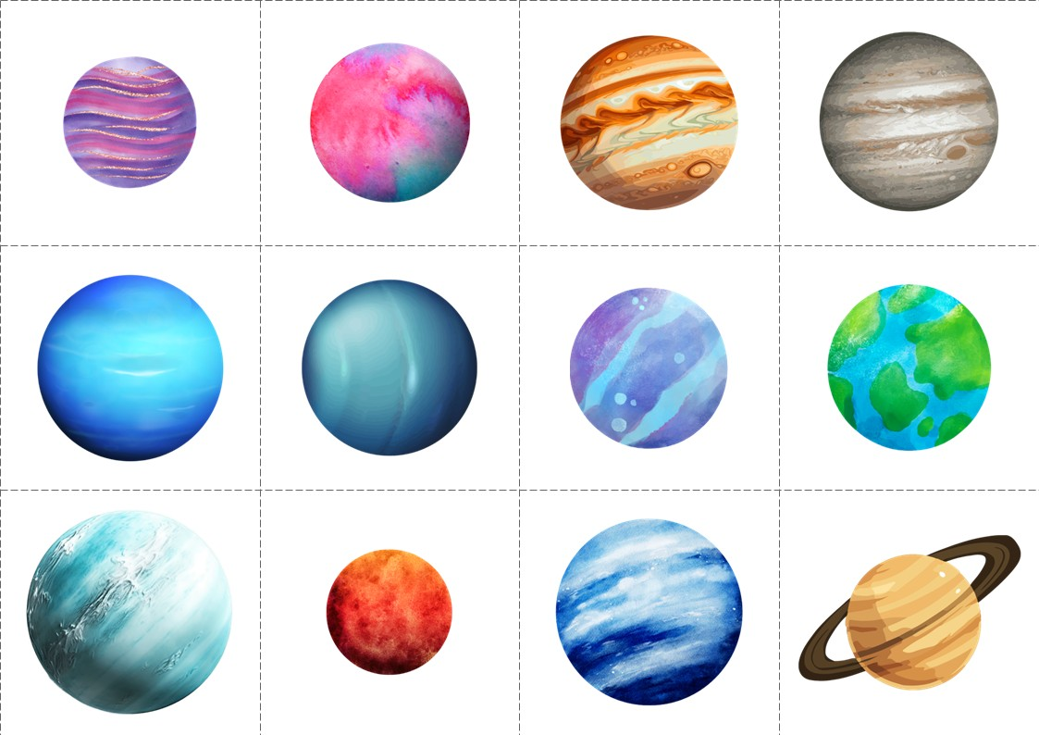

Slide 12
