Slide 1



Attendance assembly 14th September 2026

Slide 2

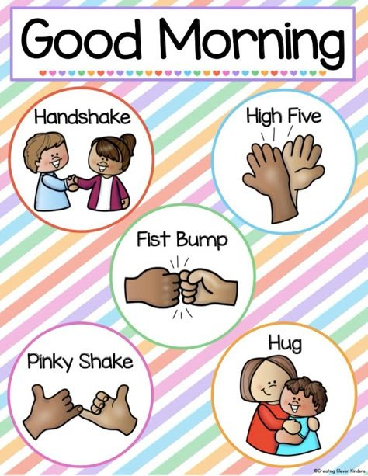
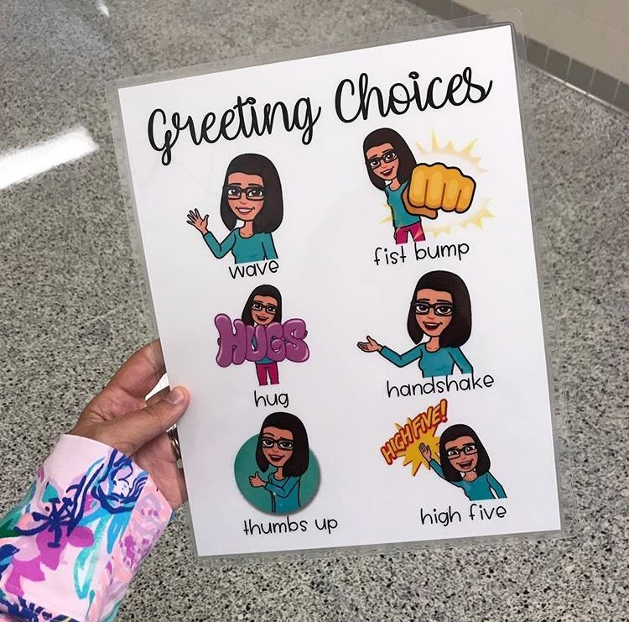
Ward End Welcomes- are yours ready!

Slide 3

Assembly focus: All the ways we can help each other to learn
It’s a good time to set some goals for the new term/ new year. Values: Courage
Have a think about what you would like to achive this term in your-
Handwriting
Spelling
Reading
Your attendance
Use talk- tactics to explain this to a friend. They should ask you some exploratory questions too. Look at clarify & summaries in the yellow pillar.

Slide 4
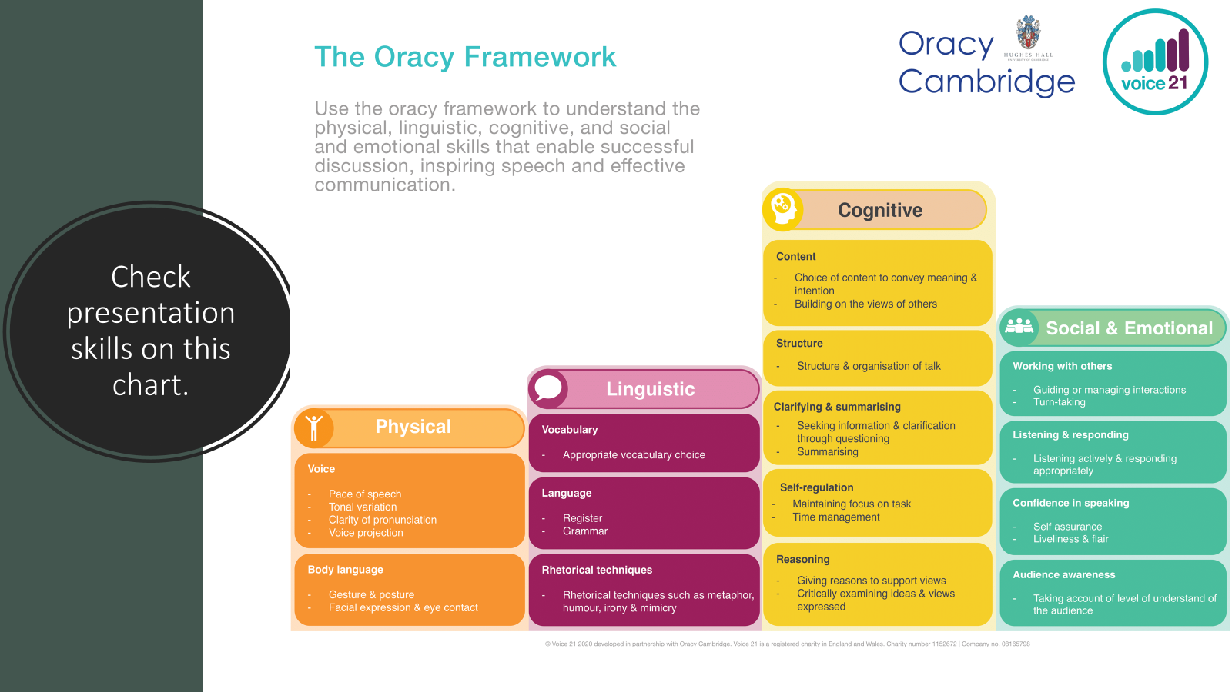

Slide 5
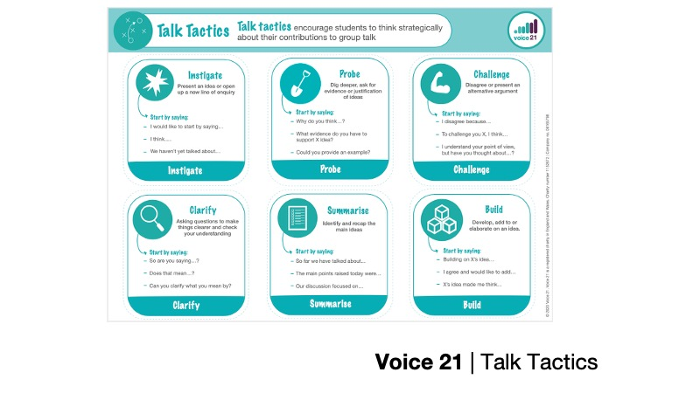

Slide 6

Please have a look at our attendance poster
How is your class doing?
What ways can you think of to make sure everyone comes to school every day?
Can you say WHY this is important? Use the language of discussion.
I think………because…..

Slide 7
95% and above Attendance weekly Reward.
Gain a star for each week your class achieves 95%+ How did your class do?

Slide 8

I8 classes have 95% and above- they have a star on their door chart
1/6 towards a class reward Well Done!
Two classes with 100%
Fantastic

Slide 9

Ward End weekly attendance
YEAR | Wb 7th Sept | Wb 14th Sept | Wb 21st Sept | Wb 28th Sept | Wb 5th Oct | Wb 12th Oct
6.1 | 98%
6.2 | 89%
6.3 | 96%
6.4 | 94%
5.1 | 96%
5.2 | 98%
5.3 | 94%
5.4 | 91%

Slide 10

Ward End weekly attendance
 | Wb 7th Sept | Wb 14th Sept | Week 21st Sept | Wb 28th Sept | Wb 5th Oct | Wb 12th Oct
4.1 | 97%
4.2 | 97%
4.3 | 83%
4.4 | 92%
3.1 | 91%
3.2 | 100%
3.3 | 97%
3.4 | 96%

Slide 11

Ward End weekly attendance
YEAR | Wb 7th Sept | Wb 14th Sept | Wb 21st Sept | Wb 28th Sept | Wb 5th Oct | Wb 12th Oct
2.1 | 97%
2.2 | 94%
2.3 | 95%
2.4 | 92%
1.1 | 91%
1.2 | 96%
1.3 | 97%

Slide 12

Ward End weekly attendance
YEAR | Wb 7th Sept | Wb 14th Sept | Wb 21st Sept | Wb 28th Sept | Wb 5th Oct | Wb 12th Oct
Squirrels | 96%
Foxes | 97%
Hedgehogs | 89%
Owls | 97%
Doves | 96%
Swans | 100%

Slide 13

Well done Swans & 3.2
100% attendance!

Slide 14


Slide 15
Coming soon
European Day of Languages 25th September:
Special Spanish Lunch
Voted for by pupils – enjoy!!

Slide 16


What fabulous books are you reading? These are my next 2 reads. Read your book every night!

Slide 17

Uniform expectations-
Remember
Black school shoes- not trainers.
Headscarves- fastened and short ends ( for your health and safety)
PE kit- white T shirt, black shorts or leggings, Or tracksuit –trousers, with no logo's.
No jewellery. No smart watches.
Long hair tied up please. Every day.
Dojo's this week for complete correct uniform.

